Slide 1



Guidelines for making poster presentations
Dr. Sofia Mastrokoukou
Department of Psychology, University of Turin
April 19, 2024

Slide 2
POSTER format
Title
Introduction
Methods
Results
Discussion
Limitations
Implications
Conclusion

Slide 3
WRITE A “TELL ALL” poster IN IMRAD FORMAT
Intro (background and objective) statement
Methods (participants, exposures, outcomes)
Results in past tense
Discussion (conclusion) of what the results mean in present tense

Slide 4
More in depth (I)
Title: Title should be in large fonts (e.g. Arial >80 points) and attract potential viewers. If possible, institute logos or affiliations should be minimised in size and put in the lower corner of the poster, or, alternatively, next to the title.
Introduction: Get your viewer interested about the issue or question while using the absolute minimum of background information and definitions. Put the objectives of your study at the end of your introduction.
Methods: Be short, but precise. State what study design you used and define your study population. Provide a case definition, if applicable. Mention statistical, laboratory and other methods that were used.

Slide 5
More in depth (II)
Results: Briefly provide descriptive results (response rate, age and sex distribution). Present data that more specifically addresses the hypothesis and refer to supporting charts or images. Tables and graphs should stand on their own.
– A minimal amount of text materials should supplement the graphic materials.
– Use regions of empty space between poster elements to differentiate and accentuate these elements.
– Graphic materials should be readable at a distance of 1.5-2.0 metres. The font size should be at least 1 cm high. Lines in illustrations should be larger than normal.
– Use colours for emphasis, but do not overuse (2-3 colours are usually enough). Avoid using patterns or open bars in histograms.
– Remove all non-essential information from graphs and tables (data curves not discussed by the poster; excess grid lines in tables).
– Graphics and tables should have a complete title and legend.
Conclusion and recommendations: Comment on main results and discuss why they are conclusive and interesting. Discuss potential biases. What are your recommendations?

Slide 6
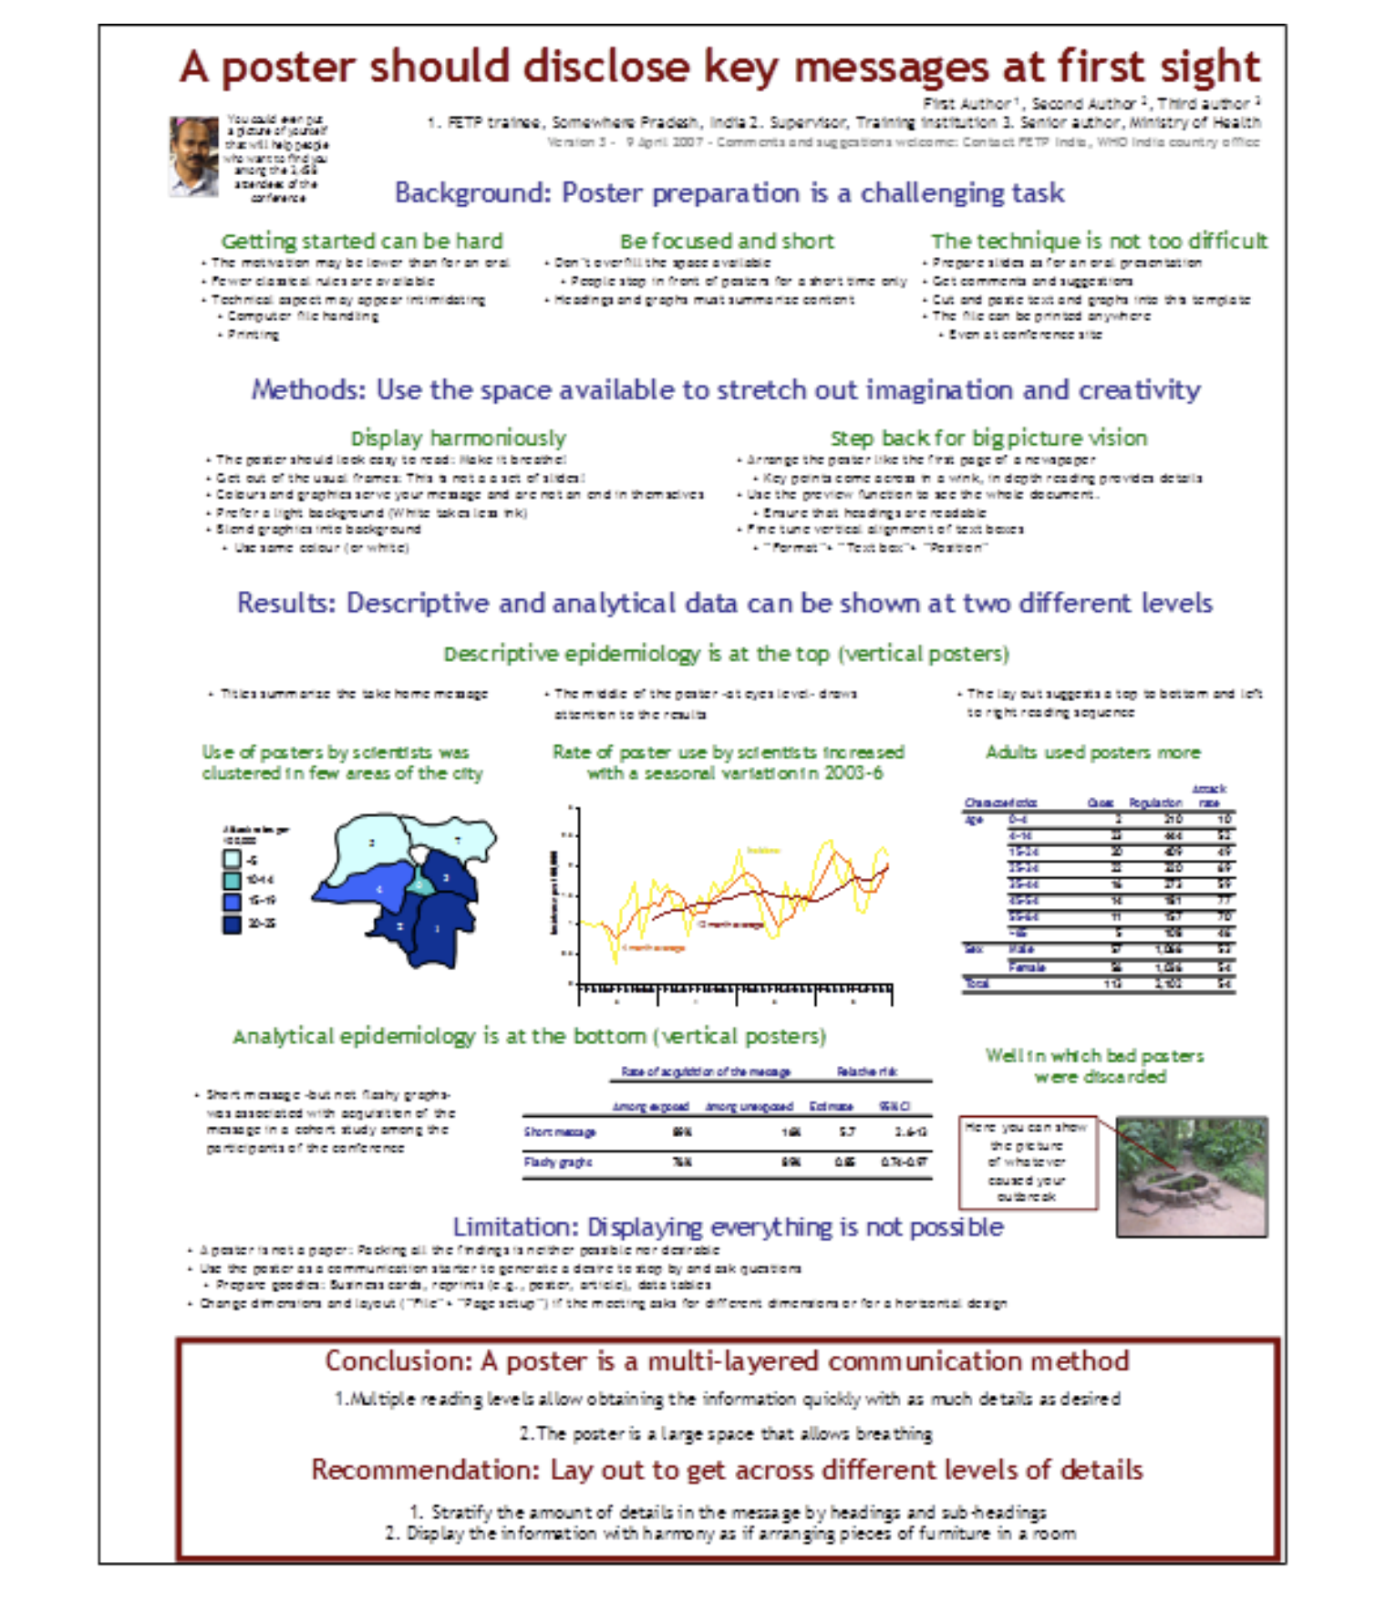
Example

Slide 7
scoping review on entrepreneurial ethics (Introduction)
Introduction- Briefly introduce the importance of ethics in entrepreneurship and the rationale behind conducting a scoping review in this area.
Objective: Clearly state the aim of your scoping review on entrepreneurial ethics. What key questions were you addressing? What gaps did you aim to fill?

Slide 8
scoping review on entrepreneurial ethics (methodology-Databases)
The databases included PubMed, Scopus, Web of Science, and Google Scholar, to ensure a wide coverage of both health sciences and business ethics literature. Our search strategy utilized a combination of keywords and Boolean operators, tailored to the nuances of each database. The keywords included "entrepreneurial ethics," "business ethics," "startup ethics," "entrepreneurial decision-making," and "ethical challenges in entrepreneurship." We refined our search by using filters such as publication date (from January 2000 to December 2023) and language (English only).
We screened titles and abstracts according to pre-defined inclusion and exclusion criteria, followed by full-text screening of selected studies. The criteria were developed to focus on studies that discuss ethical considerations, challenges, frameworks, or education specifically within the context of entrepreneurship.

Slide 9
scoping review on entrepreneurial ethics (methodology-criteria)
Criteria | Inclusion | Exclusion
Subject Focus | Studies focusing on ethical issues, frameworks, or education in entrepreneurship. | Studies focusing on general business ethics without specific relevance to entrepreneurship.
Document Type | Peer-reviewed articles, conference papers, and grey literature such as reports and white papers. | Non-peer-reviewed articles, opinion pieces, and editorials.
Publication Date | Published between January 2000 and December 2023. | Published before January 2000.
Language | English | Non-English
Study Design | Quantitative, qualitative, and mixed-methods studies. | Reviews, meta-analyses, and theoretical papers without primary data.
Geographical Focus | Studies conducted worldwide. | Studies with a geographical focus not clearly stated or irrelevant.
Entrepreneurial Sector | All sectors including tech startups, social enterprises, and traditional businesses. | Studies focusing exclusively on large corporations or non-entrepreneurial entities.
Methodology: Summarize how you conducted the review, including databases searched, keywords used, and inclusion/exclusion criteria.

Slide 10
scoping review on entrepreneurial ethics (results)
Author(s) | Country | Method | Sample Size | Key Results
Smith & Johnson (2022) | USA | Qualitative | 30 SMEs | Identified the predominance of ad-hoc ethical decision-making processes in early-stage startups.
Lee, et al. (2021) | South Korea | Quantitative | 200 Entrepreneurs | Highlighted ethical challenges related to competitive pressures and the need for ethical leadership training.
Fernandez (2023) | Spain | Qualitative | 5 Case Studies | Showed how ethical business models can lead to sustainable competitive advantages in tech startups.
Patel & Kumar (2020) | India | Mixed-Methods | 100 Entrepreneurs, 20 Experts | Found a significant correlation between ethical practices and investor trust in new ventures.
O'Connor & Davis (2022) | Ireland | Qualitative | 12 Startups | Explored the role of cultural values in shaping the ethical frameworks of entrepreneurs.
Wang & Zhang (2023) | China | Quantitative | 500 Entrepreneurs | Demonstrated the impact of regulatory environments on ethical behavior in the e-commerce sector.
Mbeki & Sithole (2021) | South Africa | Focus Groups | 40 Entrepreneurs | Uncovered ethical dilemmas related to social responsibility and community engagement.
Rivera & Gomez (2022) | Mexico | Quantitative | 300 Entrepreneurs | Reported a lack of formal ethics training among entrepreneurs, suggesting a need for structured programs.

Slide 11
scoping review on entrepreneurial ethics (discussion I)
When drafting the discussion section of your scoping review on entrepreneurial ethics, you're synthesizing your findings, interpreting what they mean in the broader context, and suggesting directions for future research.
1. Start with Key Findings
Summarize the Core Insights: Begin by highlighting the most significant findings from your review. This includes any surprising trends, major themes in the literature, or gaps in the research.
2. Contextualize Your Findings
Compare with Existing Literature: Discuss how your findings align with or differ from existing studies on entrepreneurial ethics. Are there any new trends or contradictions?
Theoretical Implications: Consider the implications of your findings for theoretical frameworks related to entrepreneurial ethics. How do they expand, challenge, or refine existing theories?
3. Address the Gaps
Identify Research Gaps: Clearly outline the gaps and limitations in the current research landscape that your scoping review has uncovered.
Explain the Significance: Discuss why these gaps matter. How do they limit our understanding of entrepreneurial ethics? What risks do they pose for practitioners?

Slide 12
scoping review on entrepreneurial ethics (discussion II)
4. Highlight Practical Implications
For Entrepreneurs: Discuss how entrepreneurs can apply the ethical frameworks or insights from your review in their decision-making processes.
For Policy and Education: Suggest how your findings could inform the development of policies or educational programs aimed at fostering ethical entrepreneurship.
5. Suggest Directions for Future Research
Specific Questions: Based on the gaps you've identified, propose specific research questions that future studies could address.
Methodological Recommendations: If you've noticed a lack of diversity in research methods, suggest alternative approaches that could provide new insights.
6. Reflect on Methodology
Strengths and Limitations: Briefly discuss the strengths and limitations of your scoping review methodology. How might these affect the interpretation of your findings?
Scope of Review: Consider the scope of your review in the discussion. Were there any areas of entrepreneurial ethics that were particularly well-covered or neglected?
7. End with a Conclusion
Sum Up the Big Picture: Conclude with a summary of the most critical insights from your discussion, emphasizing the contribution of your scoping review to the field of entrepreneurial ethics.

Slide 13

extra tip

Slide 14

extra tip

Slide 15

Shyness is not your thing

Slide 16

Thank you!
Contact details:
sofia.mastrokoukou@unito.it

