Slide 1
Global warming, carbon dioxide emissions and windfall profits
Eustathios Chiotis
Windfall profits
Ex Ante Regulated Producer prices by RAE
Lignite profits in Greece in 2022
Key parameters for Regulated Prices after RAE
The carbon cycle
Cumulative carbon dioxide emissions
Global warming and climate change
Negative emissions

Slide 2
Figure 1. Regulated Producer Revenue Prices (RPRP) depending on the fuel and type of power station.

Slide 3
Figure 2. Monthly contribution to cumulative profit from lignite compared to CC-natural gas, in €-millions.

Slide 4
Power station type | Power station efficiency | Specific emissions tCO2/MWh | Required lignite, t/MWh
Lignite, old | 0.285 | 1.38 | 2.2
Lignite, modern Ptolemaida 5 | 0.415 | 1.05 | 1.5
Natural gas, open cycle | 0.35 | 0.54 | -
Natural gas, combined cycle | 0.5 | 0.38 | -
Natural gas, modern combined cycle | 0.63 | 0.33
Key parameters for RPRP after RAE

Slide 5
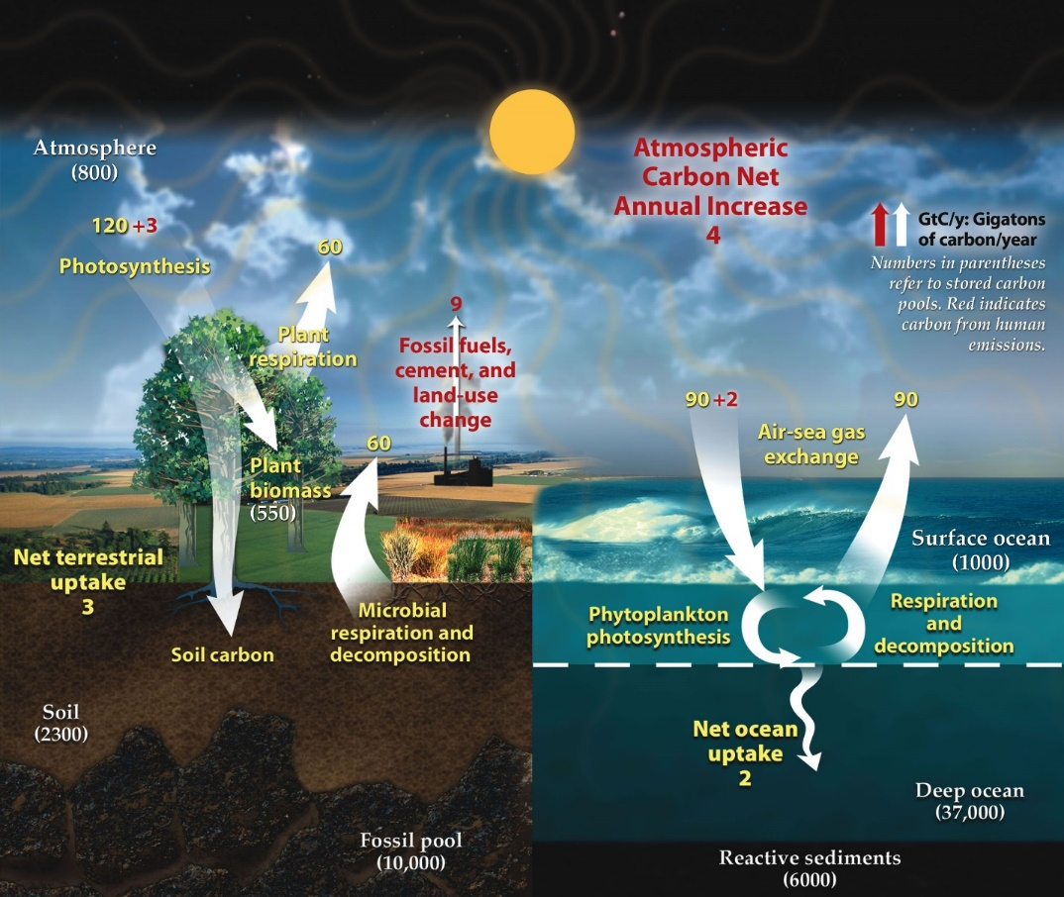

Slide 6
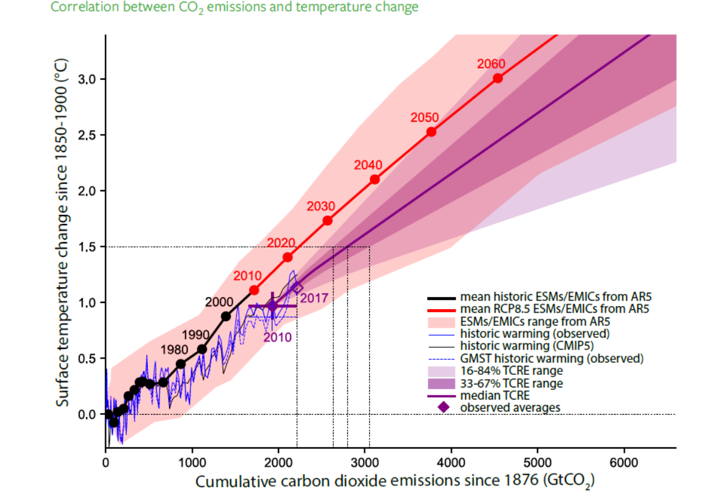

Slide 7
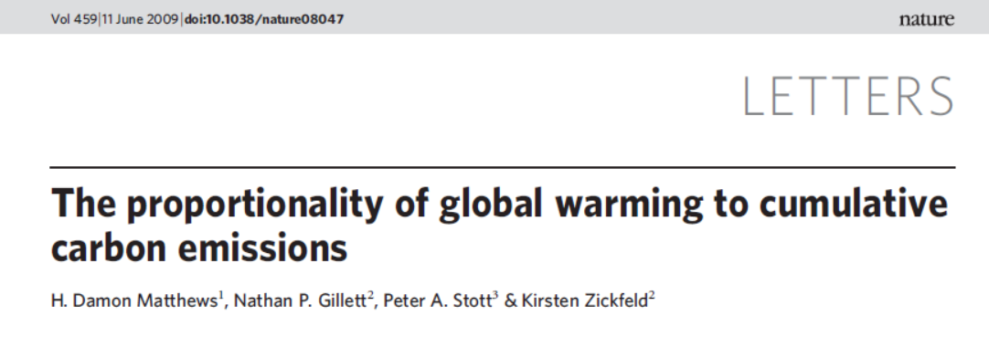
Vol 459|11 June 2009| doi:10.1038/nature08047, Nature LETTERS
We show that the carbon–climate response (CCR), defined as the ratio of temperature change to cumulative carbon emissions, is approximately independent of both the atmospheric CO2 concentration and its rate of change.
CCR = ΔT/E_{T}

Slide 8
LITTLE ICE AGE
The Little Ice Age was a period of wide-spread cooling from around 1300 to around 1850 AD when average global temperatures dropped by as much as 2°C (3.6°F), particularly in Europe and North America.
‘Little Ice Age’ was a global phenomenon, not merely a European one. Evidence of cooling can be found in ice cores, tree rings, and other proxy paleoclimatic indicators. Additionally, there are written records and direct meteorological measurements in Europe beginning in 1659.

Slide 9
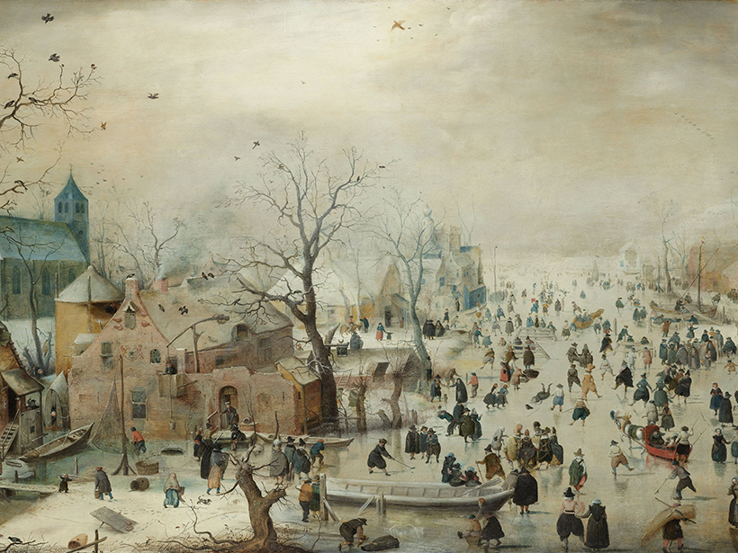
Hendrick Avercamp (1585-1634), Rijksmuseum

Slide 10
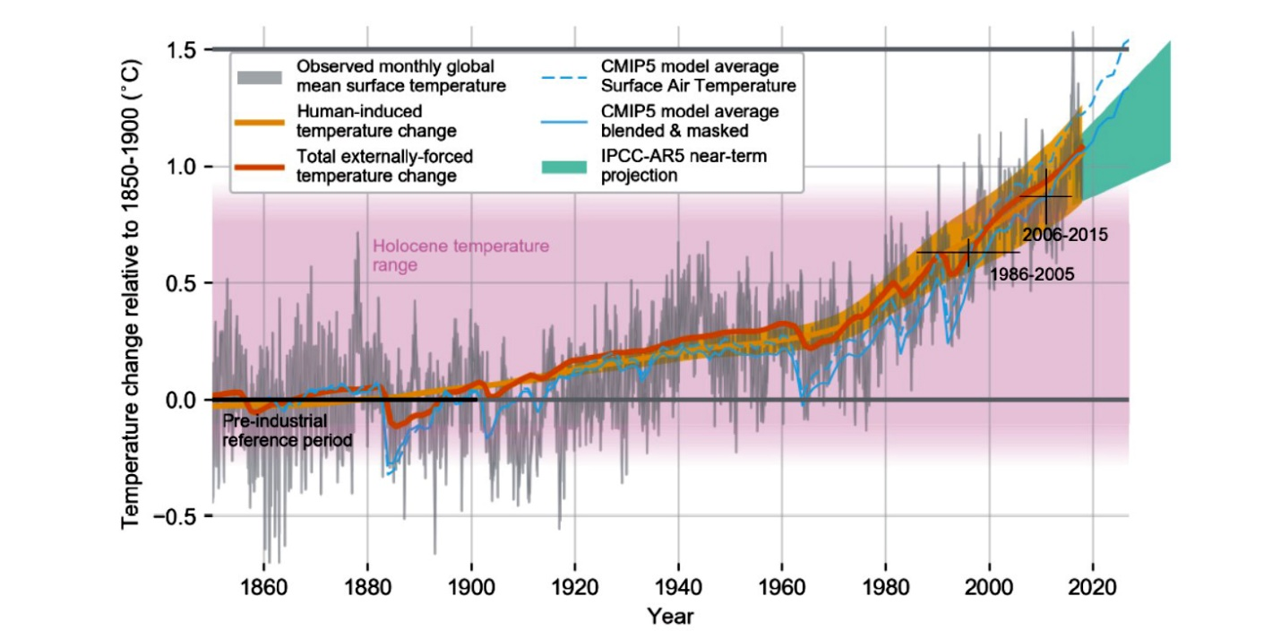
Evolution of the global mean temperature over the period of instrumental observations. Source: IPCC.

Slide 11
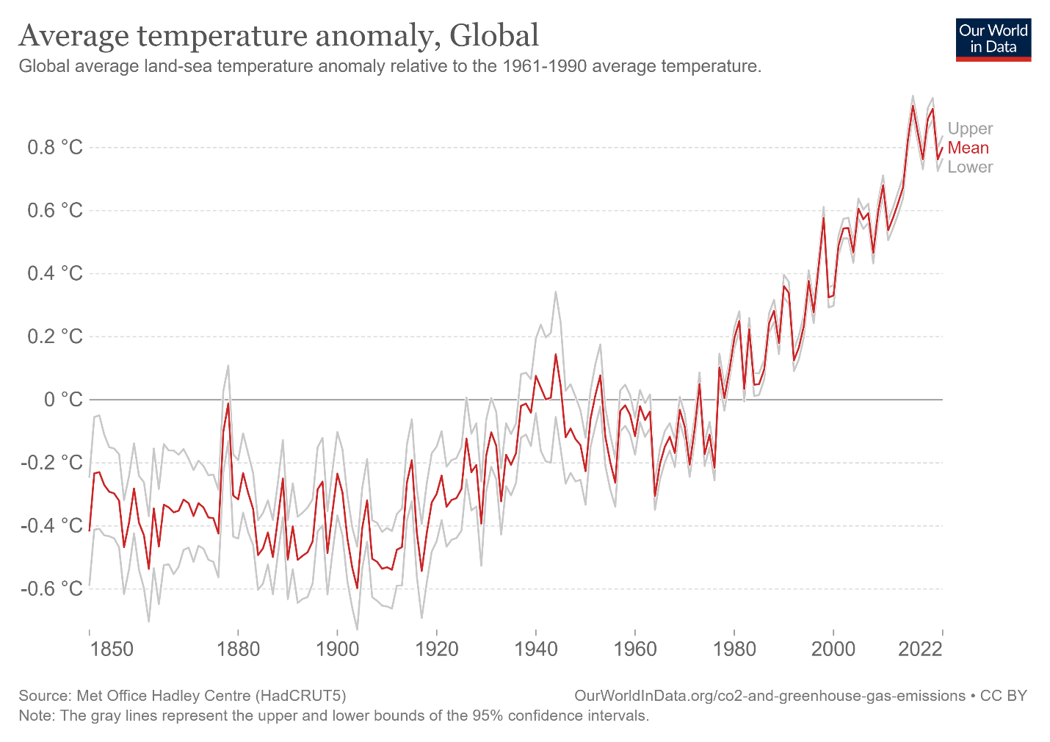
Global average temperature anomaly seems to start in 1980, which corresponds to zero anomaly in this Figure.

Slide 12
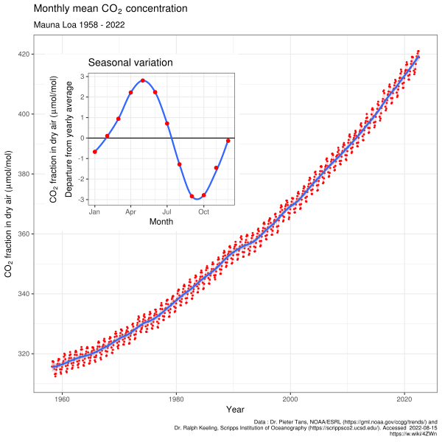
The increasing trend of the Keeling curve and the monthly seasonal changes.

Slide 13
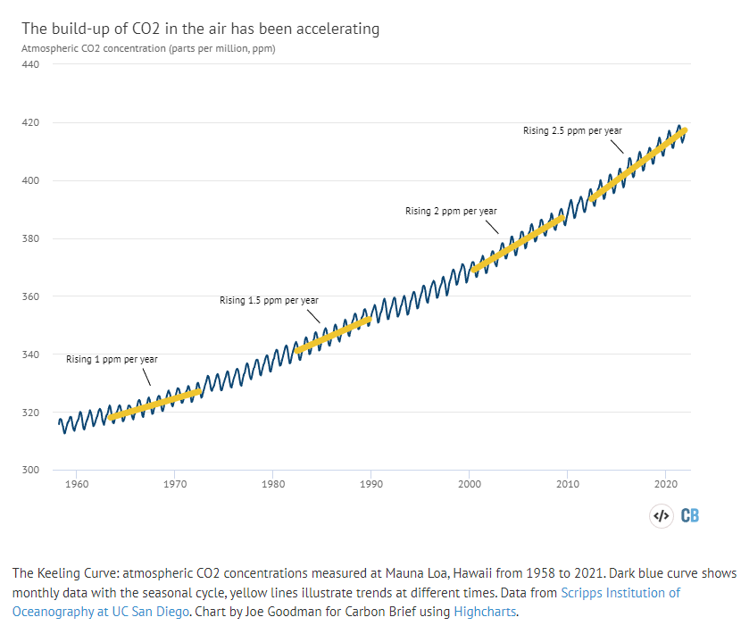

Slide 14
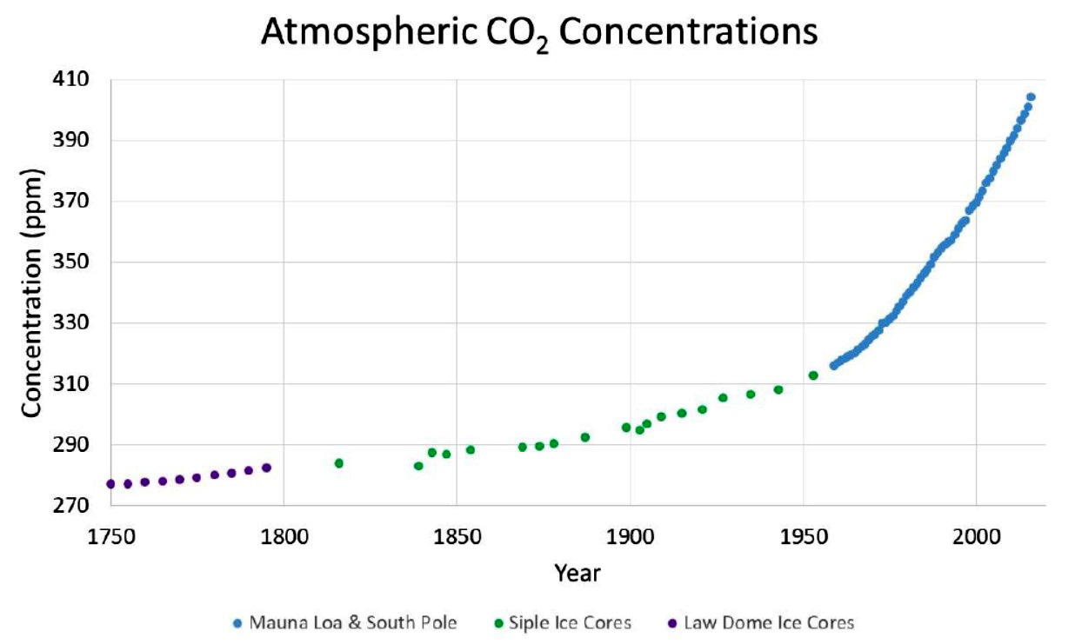
Compiled observations of atmospheric CO2 concentrations (ppm) (O’Connor 2020)

Slide 15
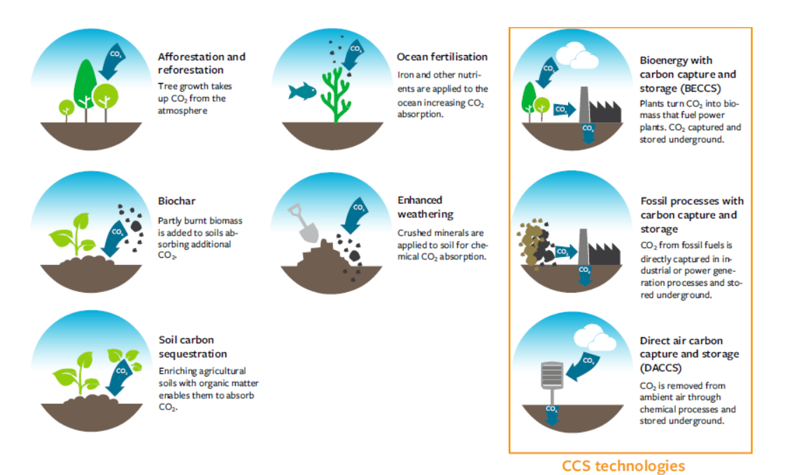
Practices for generating negative emissions

Slide 16
Thank you

Slide 17
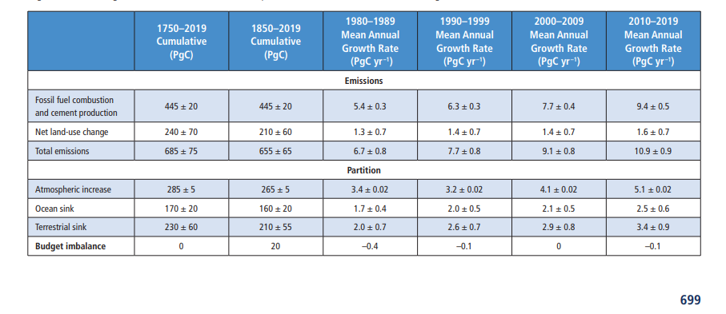
The global CO2 budget
Sixth Assessment Report of the Intergovernmental Panel on Climate Change, 2021

Slide 18
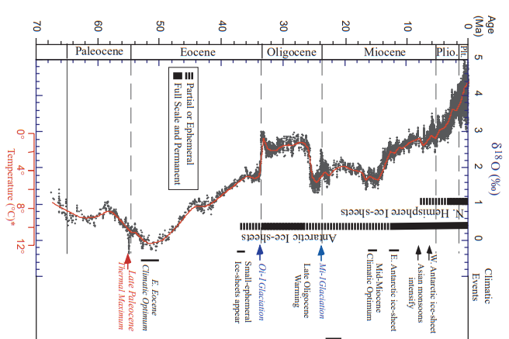

Slide 19
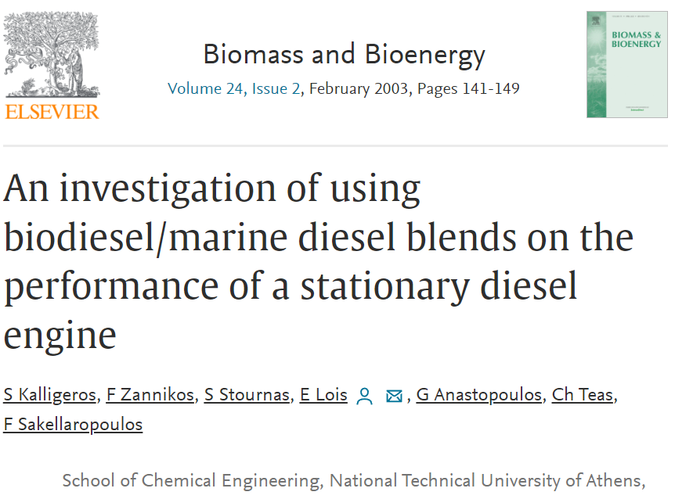
….. their addition to the marine diesel fuel improved the particulate matter, unburned hydrocarbons, nitrogen oxide and carbon monoxide emissions.

Slide 20
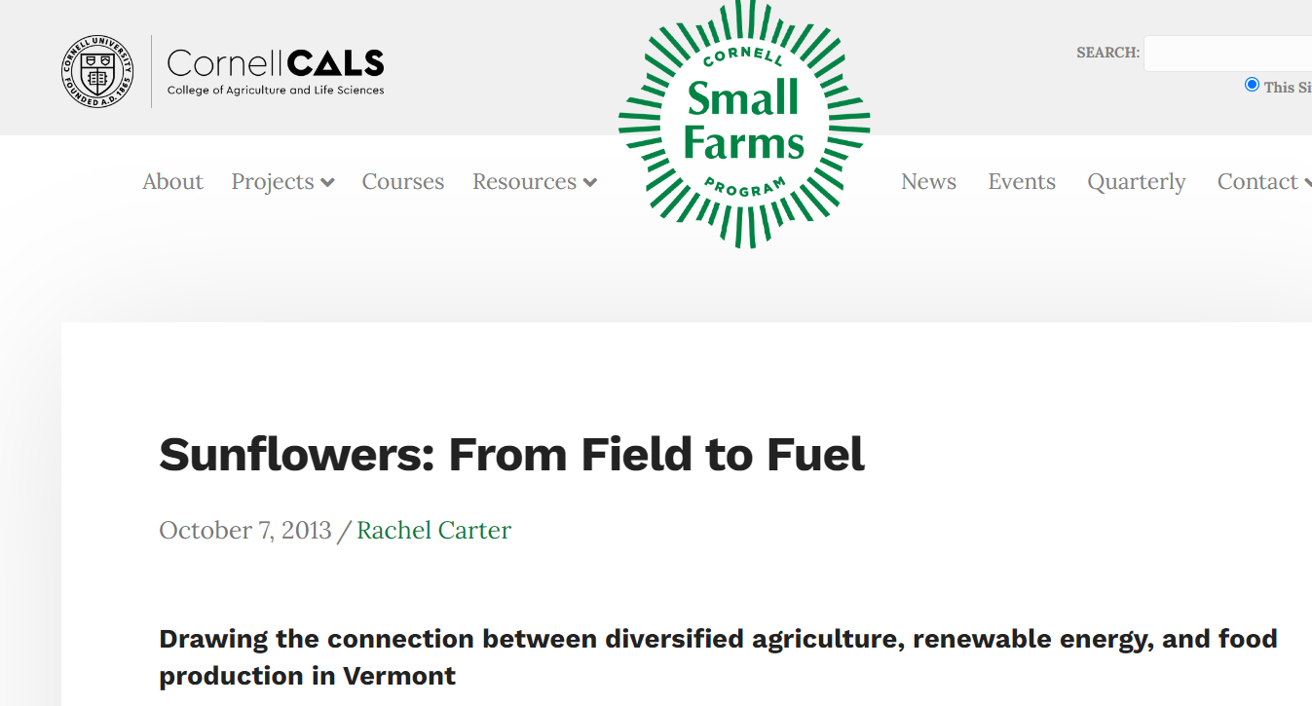

Slide 21
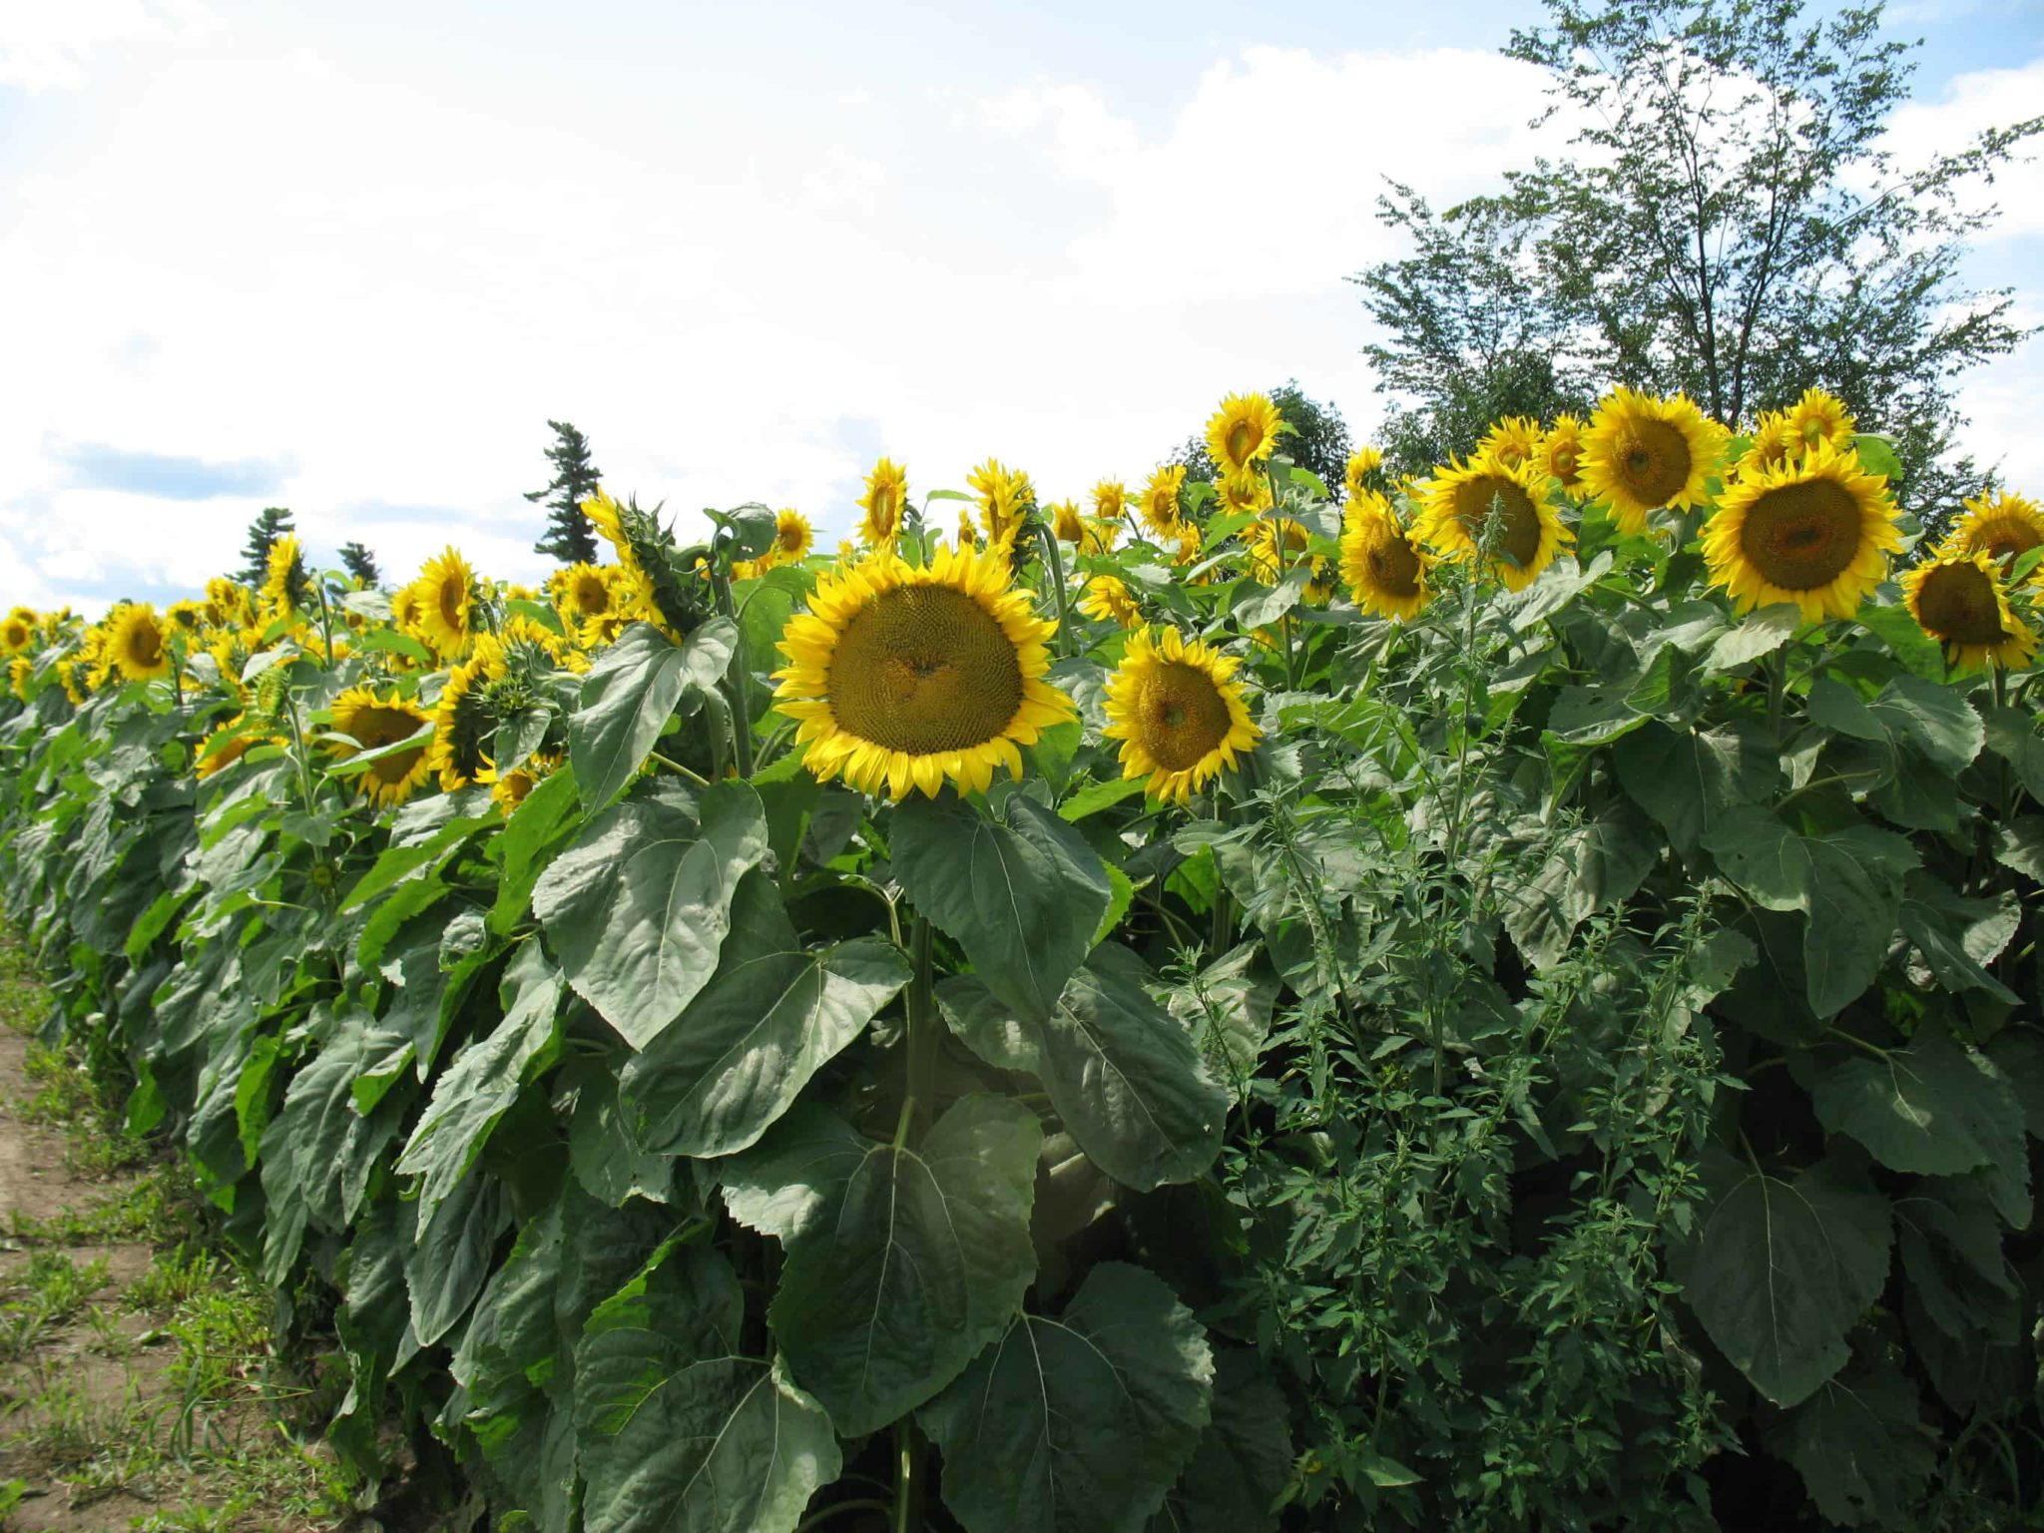
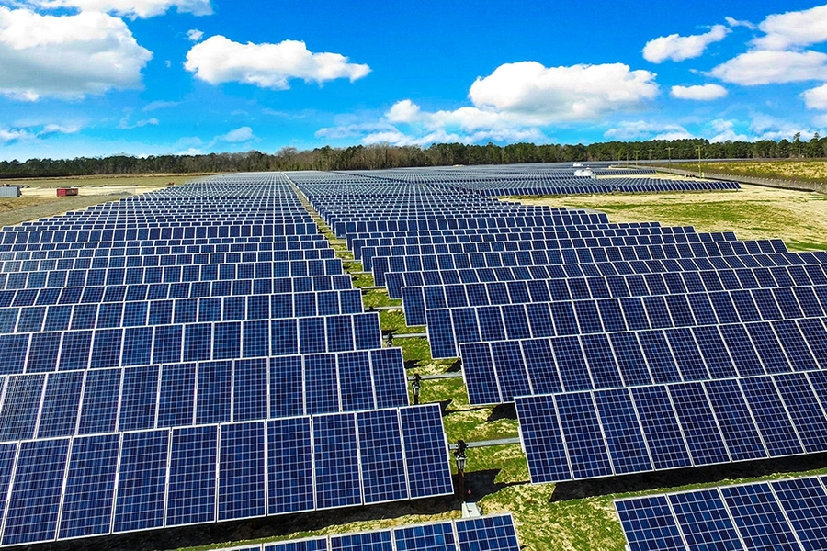
The average solar panels maintain peak performance for about 25-30 years. Despite cost decreases, installation still requires significant investment. Proper disposal of panels is critical and recycling options remain limited.
Electricity storage is expensive.

Slide 22
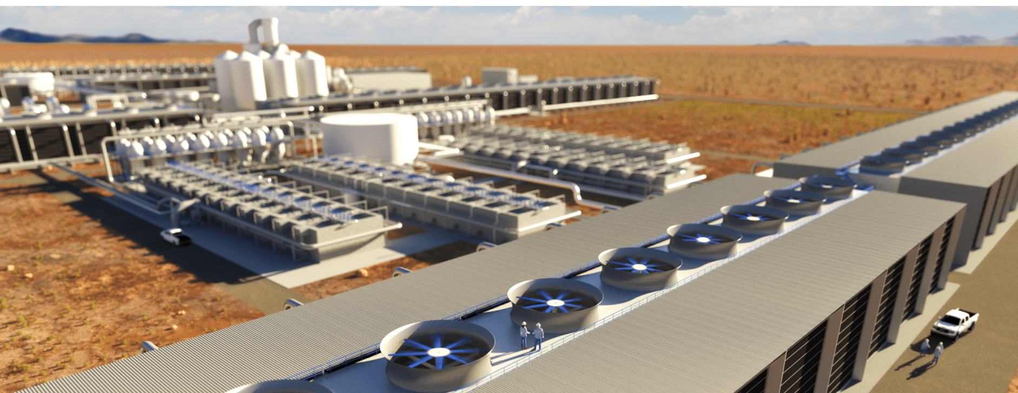
This Texan landscape was made famous for the billions of barrels of oil pulled out of its depths during the 20th Century. Now the legacy of those fossil fuels – the CO2 in our air – is being pumped back into the emptied reservoirs. Global warming, carbon dioxide emissions and windfall profits

Slide 23
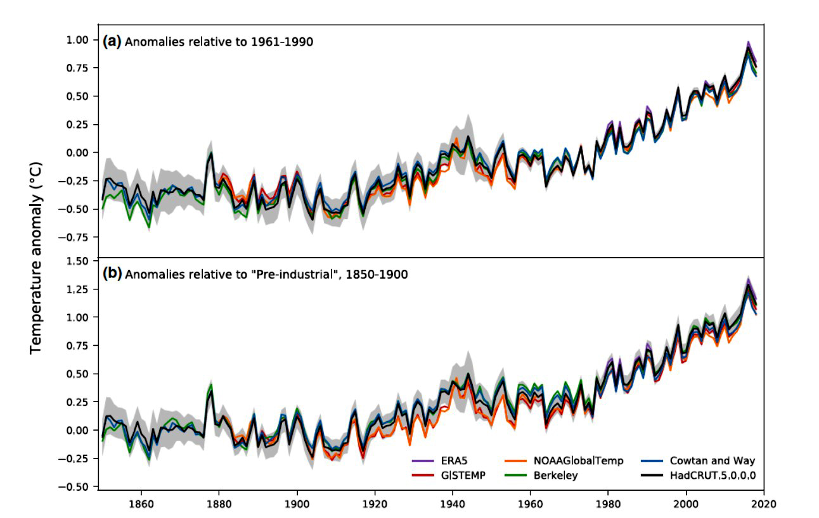
Global annual mean temperature difference from the pre-industrial conditions (1850-1900) for five data sets (2020)

