Slide 1

Life Cycle Analysis & Ecological Footprint Assessment for ORCHYD Project
Vasileios Papakostas, PhD Candidate
March, 2023

Slide 2
Presentation Outline
ORCHYD Project
Life Cycle Assessment (LCA)
Setup of the LCA
Analysis of scenarios
Simplified LCA
Ecological Footprint Assessment (EFA)

Slide 3

Project
Target: Increase hard rock drilling rates from the current range of 1-2m/h to up 4-10m/h.
Novelty: Combine 2 (previously separate) mature technologies High Pressure Water Jetting (HPWJ) and and Percussive Drilling in a system customised for hard rock geothermal reservoirs to depths of 6 km.
Ambition: Cut by 65% the drilling cost in hard rock sections.
This will result in 30% reduction of the total cost of deep geothermal well construction.
https://www.orchyd.eu/project/

Slide 4
Project
Consortium: 7 organizations from 5 different countries
France: Association pour la Recherche et le Développement des Méthodes et Processus Industriels (ARMINES)
France: MINES ParisTech (MINES PARISTECH)
United Kingdom: Imperial College of Science Technology and Medicine (ICL)
Norway: SINTEF AS (SINTEF)
France: Drillstar Industries (DRILLSTAR)
Greece: University of Piraeus Research Center (UPRC)
China: University of Petroleum – East China (UPC)

Slide 5
What is a Life Cycle Assessment (LCA)?
A life cycle assessment (LCA) is a methodology used to evaluate the environmental impacts of a product, process, or activity over its entire life cycle, from the extraction of raw materials to its disposal. It is a comprehensive approach that takes into account all stages of a product's life cycle, including material production, manufacturing, distribution, use, and disposal.
Factors such as resource depletion, energy consumption, greenhouse gas emissions, water and air pollution, and waste generation are considered. The results of an LCA can be used to identify areas for improvement, reduce environmental impacts, and inform product design and development.

Slide 6
What is a Life Cycle Inventory (LCI)?
LCI stands for Life Cycle Inventory, which is a database of all the inputs and outputs associated with a product or process over its entire life cycle. It provides the data used to quantify environmental impacts in a life cycle assessment (LCA). The LCI data is usually collected from manufacturers, suppliers, and other sources, and organized into different stages of the product life cycle. LCI databases are constantly evolving and are a valuable resource for understanding the environmental impacts of different products and processes.

Slide 7
Setup of the LCA
Comparison between conventional techniques and the novel drilling technique ORCHYD develops.
Apart from carbon emissions, the LCA will also covered additionally categories such as:
Ozone depletion
Smog
Acidification
Eutrophication
Fossil fuel depletion

Slide 8
Setup of the LCA
The developed scenarios examined the drilling of a single geothermal well.
In the case of doublet or triplet configurations, the results may be doubled or tripled accordingly.
A target depth is 5100m and full casing throughout the length of the well was assumed.
It is based on the well documented GPK-3 geothermal well at Soultz-sous-Forêts, France.
Given that ORCHYD aims to increase ROP in hard rock formations, the developed scenarios accounted for alterations of ROP for the deeper part of the well, which ranges from 1420 to 5100 m.

Slide 9
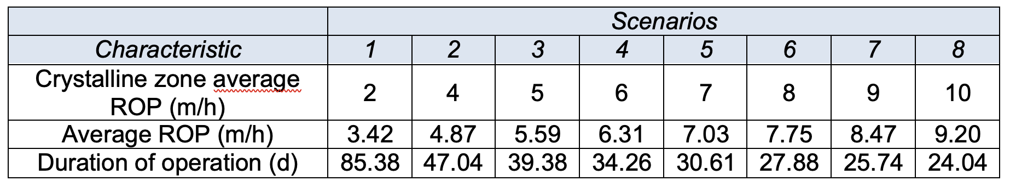
Setup of the LCA
Values of LCA characteristics for different scenarios (h: hours, d: days)

Slide 10
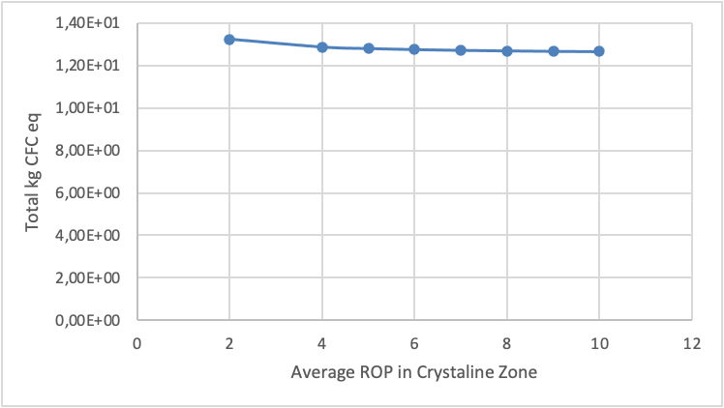
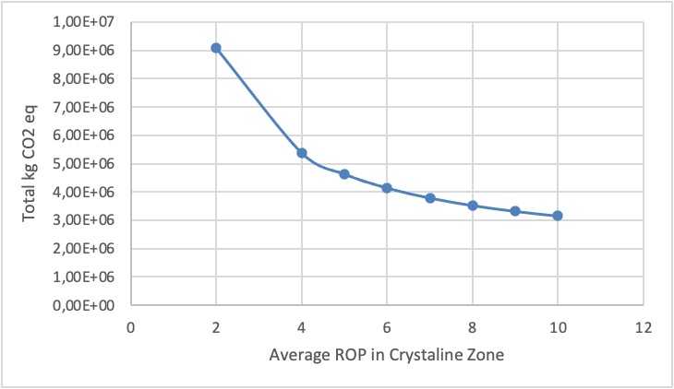
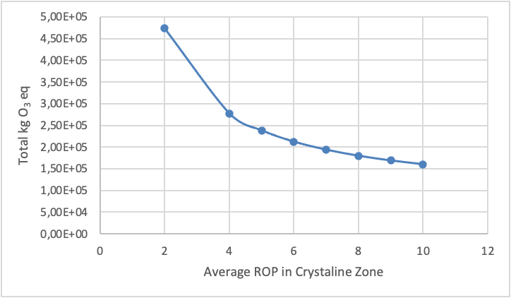
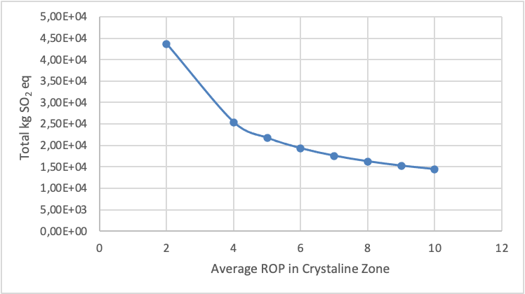
ROP effect on ozone depletion emissions
ROP effect on carbon footprint emissions
ROP effect on smog related emissions
ROP effect on acidification potential

Slide 11
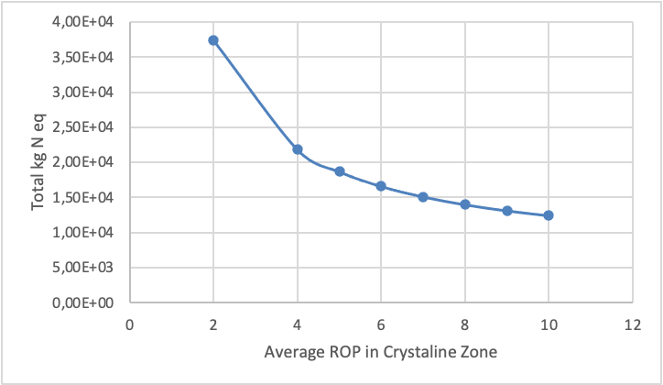
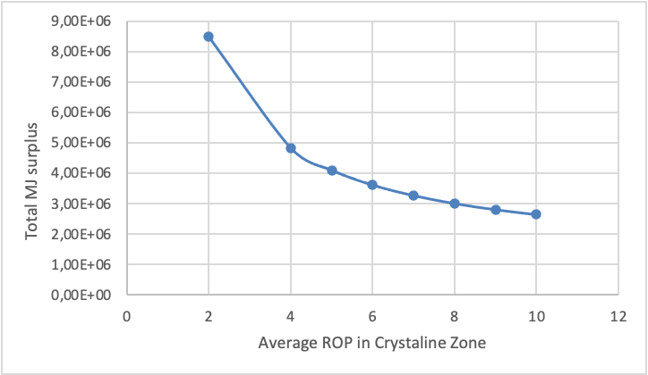
ROP effect on eutrophication potential
Energy consumption vs ROP in crystalline zone

Slide 12
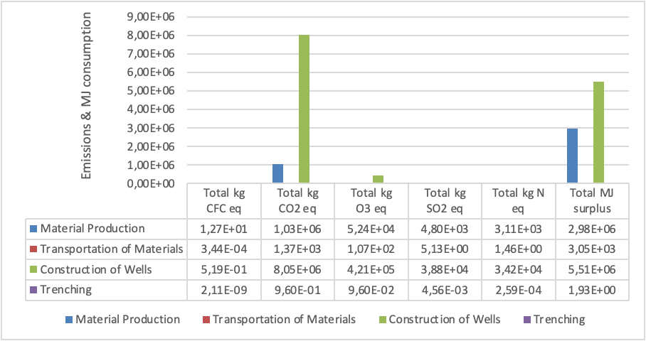
Life cycle stages comparison, Scenario 1

Slide 13
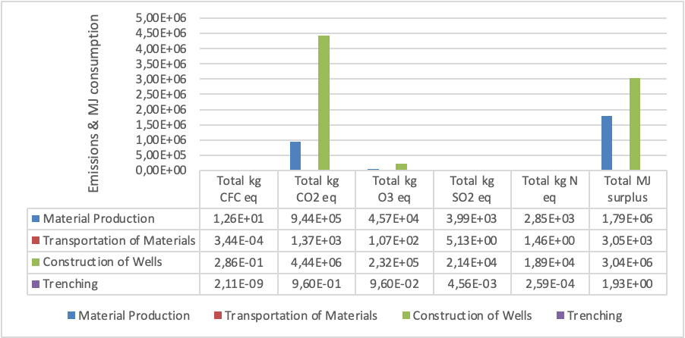
Life cycle stages comparison, Scenario 2

Slide 14
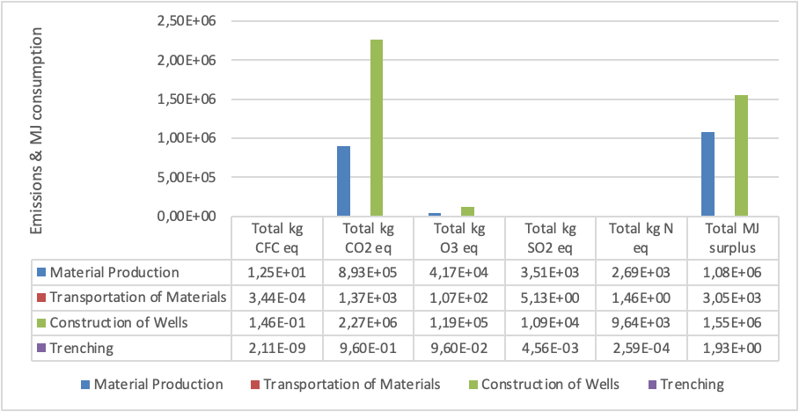
Life cycle stages comparison, Scenario 8

Slide 15
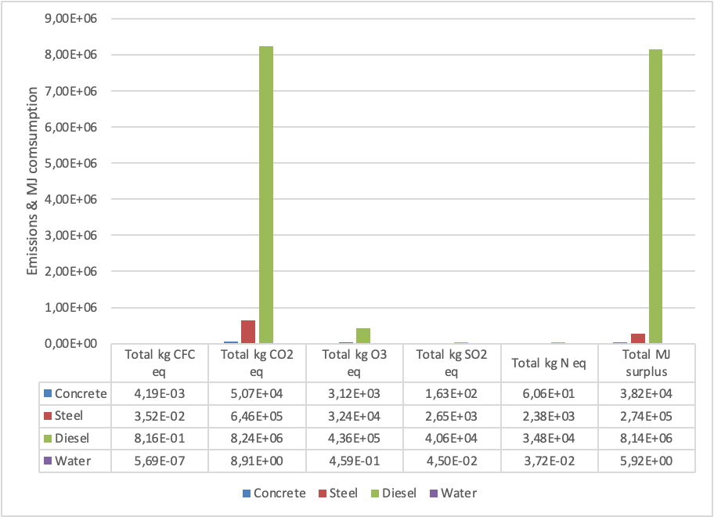
Material use impacts, Scenario 1

Slide 16
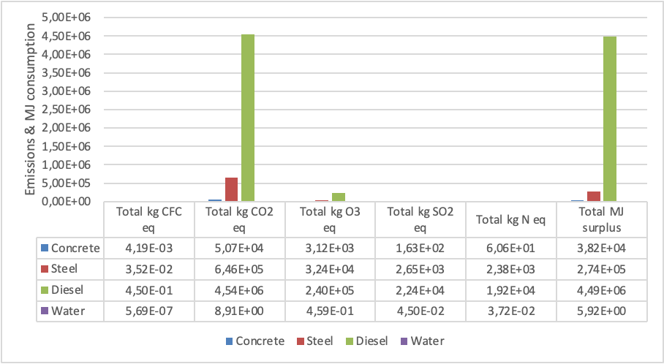
Material use impacts, Scenario 2

Slide 17
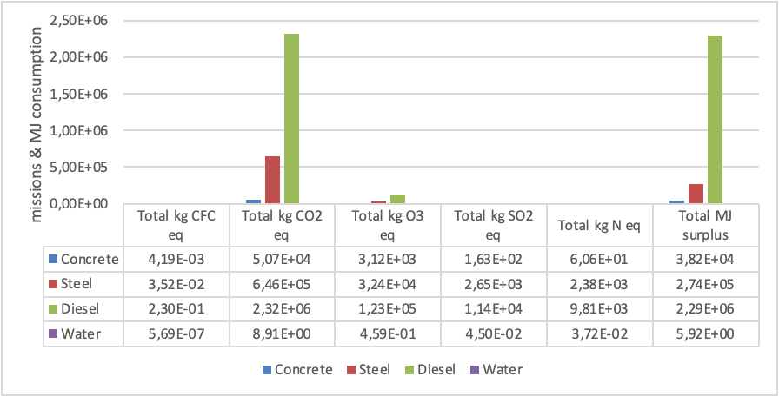
Material use impacts, Scenario 8

Slide 18
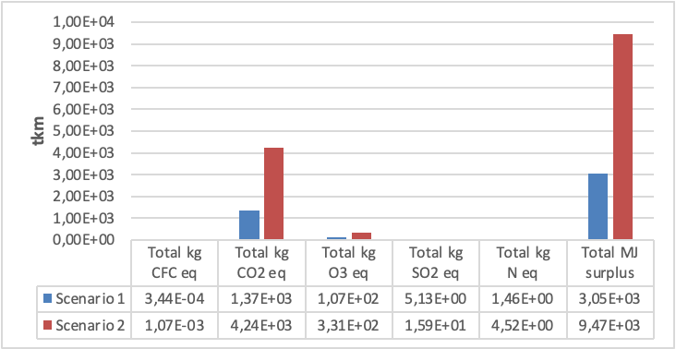
Distance impact on LCA

Slide 19
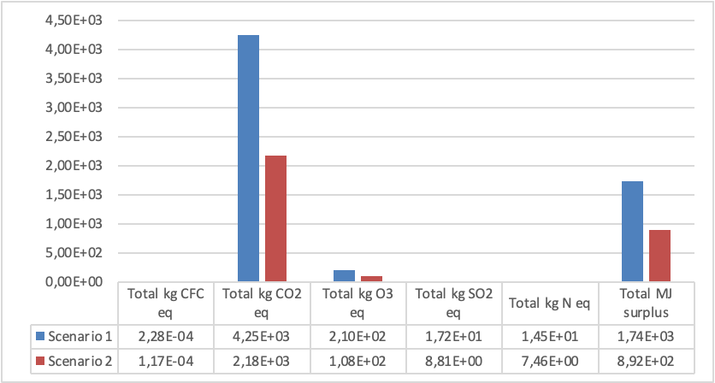
Life cycle emission equivalent and energy surplus vs rotary and percussive/HPWJ of drill bit usage

Slide 20
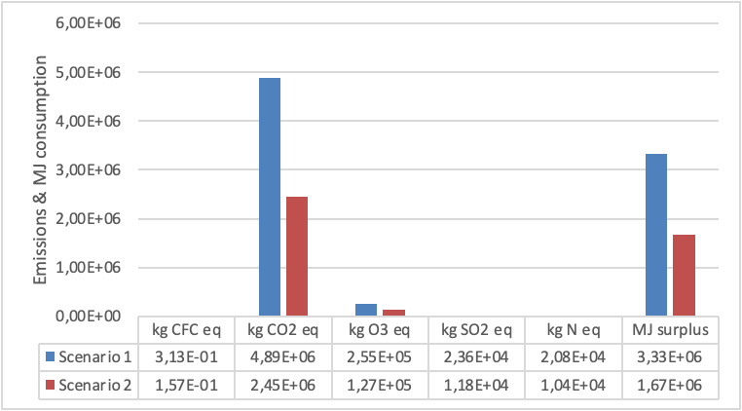
Life cycle emission equivalent and energy surplus vs rotary and percussive/HPWJ of drill bit replacement

Slide 21
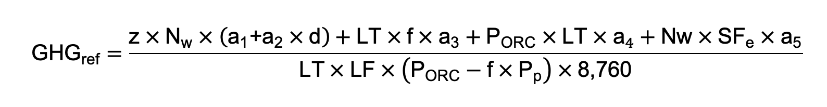
Simplified LCA for ORCHYD
The reference model provided the estimation of GHG emissions for EGS plants with the following equation:

Slide 22
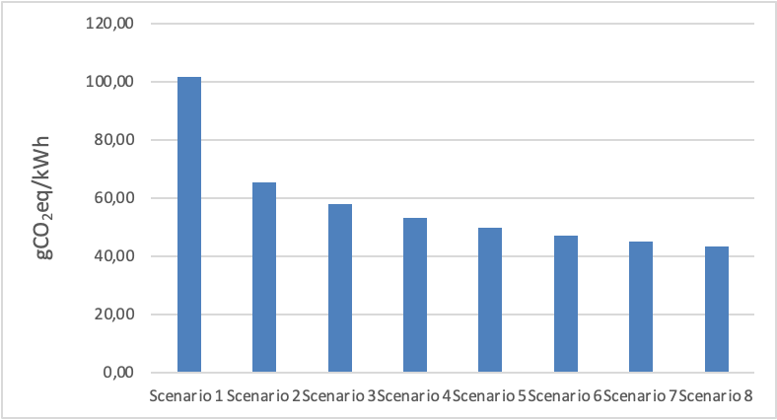
Simplified LCA of the whole life cycle of a geothermal plant, for the different scenarios developed within section 4.5.1.

Slide 23
LCA Results
Eight drilling scenarios were examined.
The baseline scenario considered an average ROP of 3.4 m/h, which progressively led to an average ROP of 9.2 m/h in scenario 8.
Compared to an ROP of 2 m/h in hard rock formations, scenarios with ROP rates between 4-10 m/h can lead to reductions of:
Carbon dioxide equivalent by 65.2%
Energy consumption (as MJ surplus) by 68.9%
CFC equivalent by 3.8%
Ozone equivalent by 66.2%
Sulfur dioxide equivalent by 66.7%
Nitrogen equivalent by 67.1%.
Drill bit usage and drill bit replacement times were also significantly reduced.

Slide 24
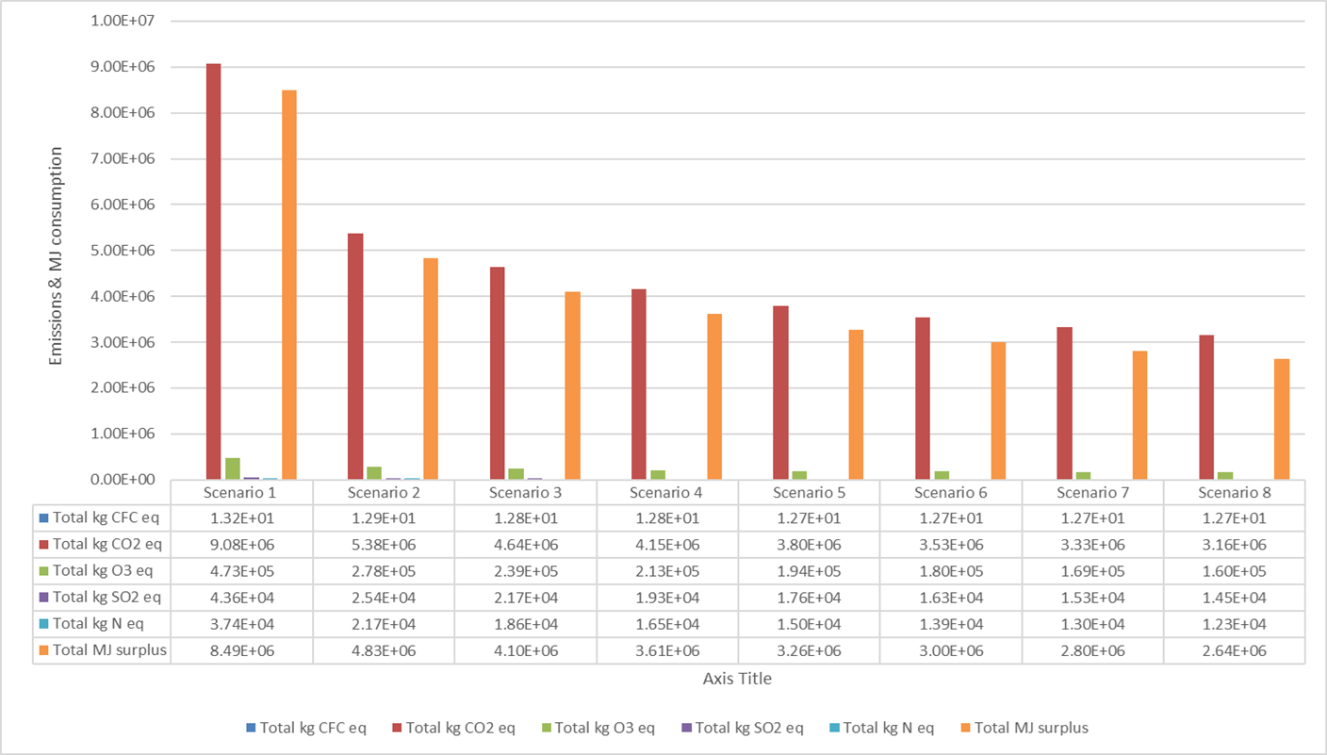
Total impacts of all scenarios for the six examined categories

Slide 25
Ecological Footprint Assessment (EFA)
Is a scalable accounting system with a wide range of applications regarding resource consumption.
It can be applied to individuals, cities, regions, countries or the global population.
Complements the LCA study from a biocapacity perspective expressed in global hectares.
It is a tool that aims to quantify in ecological terms the human activity in the biosphere.
It determines the extent of land required for the production of all raw materials that are needed for human activities, including waste production and treatment.
The metric unit used for calculations is the global hectare (gha) which equals to a hectare of land with the average biocapacity factor.

Slide 26
Six assumptions of EFA
It is possible to keep track of most of the resources humanity consumes and the wastes humanity generates.
Most of these resource and waste flows can be measured in terms of the biologically productive area necessary to maintain these flows (those resource and waste flows that cannot are excluded from the assessment).
By weighting each area in proportion to its usable biomass productivity (that is, its potential production of biomass that is of economic interest to people), the different areas can be expressed in standardized hectares. These standardized hectares, which we call ‘‘global hectares,’’ represent hectares with biomass productivity equal to the world average productivity that year.

Slide 27
Six assumptions of EFA
Because these areas stand for mutually exclusive uses, and each global hectare represents the same amount of usable biomass production for a given year, they can be added up to a total representing the aggregate human demand.
Nature’s supply of ecological services can also be expressed in global hectares of biologically productive space.
Area demand can exceed area supply
(e.g., a forest harvested at twice its regeneration rate appears in our accounts at twice its area). This phenomenon is called ‘‘ecological overshoot’’.

Slide 28
Implementation of EFA
For the implementation of EFA in a geothermal drilling operation, metrics and methodology of quantification are required.
The carbon footprint results of the LCA were used for the determination of the ecological footprint of drilling operations using the proposed technique by ORCHYD.
All calculations were based on carbon sequestration of forest areas. Different forest areas present different carbon absorption values.
A weighted average world carbon absorption value has been calculated to be 1.3 tons of carbon per hectare.
The percentage of carbon absorbed by the oceans is considered 30.8%. The footprint of 1 ton of CO2 in global hectares is 3.737929 tCO2/gha/yr.

Slide 29
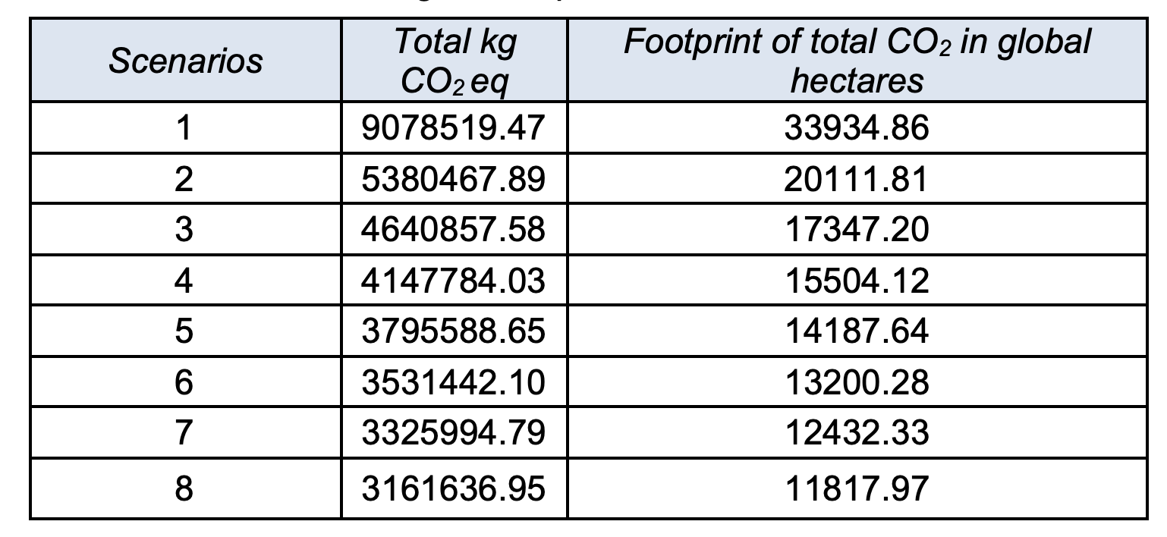
Total ecological footprint of the examined LCA scenarios

Slide 30
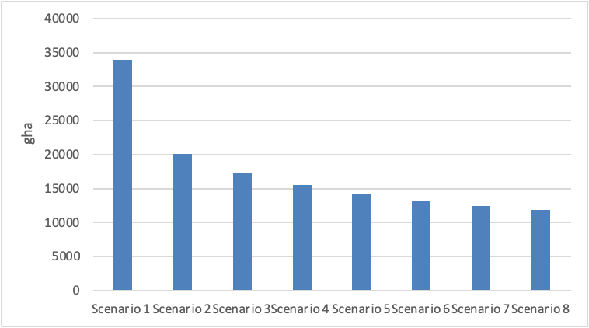
Footprint of total CO2 eq emission in global hectares for all 8 scenarios examined in LCA

Slide 31
Thank you for your attention
va.papakostas@gmail.com

