Slide 1


ORCHYD General Assembly December 2022
WP3, Task 3.2 (Social Impact Assessment) D3.2 (Report on Social Impacts)
J. A. Paravantis, N. Kontoulis & V. Papakostas
University of Piraeus
This project has received funding from the European Union’s Horizon 2020 research and innovation programme under grant agreement No 101006752

Slide 2
Zooming on Task 3.2, WP3
Task 3.2: Social impact assessment (M13 - M22)
Task 3.3 (M23 - M28)
Milestone 3.3
Complete online social survey (M19)
Deliverable 3.2
Report on social impacts (M22)
Energy security implications
Literature review
Structure of questionnaire
Survey distribution
Analysis of survey
Principal Component
Analysis (PCA)
Cluster Analysis
Results (CA)
M3.4 - Complete geothermal energy security index (M26)
D3.3 - Report on energy security (M28)

Slide 3
Report of Social Impact Assessment (Task 3.2)
Task 3.2 considered the social impacts identified in Task 3.1 and related them to sociocultural issues and project acceptance.
Literature review (D3.2)
Construction of questionnaire in three stages (M3.3)
Analysis of survey data with multivariate statistical techniques
Principal Component Analysis (PCA) and Cluster Analysis (CA)
Results
Recommendations

Slide 4
Literature review on social acceptance (1/4)
Review of 82 journal publications and conference proceedings
Studies of social acceptance of renewable and geothermal energy
Online surveys on social acceptance
Geothermal energy | 54
Public acceptance | 27
Induced seismicity | 13
Case studies | 31
Questionnaire-based surveys | 11

Slide 5
Literature review of social acceptance (2/4)
The concept of social acceptance is central to the literature, but there is no agreement on how acceptance should be defined.
Because it is a process, it is both complex and dynamic.
Its importance is often underestimated in discussions about technology transfer and the adoption of renewable energy.
Building trust with local communities is becoming an unavoidable objective for renewable energy transitions.

Slide 6
Literature review of social acceptance (3/4)
The definition of social acceptance has shifted from a market-oriented to a socio-political perspective.
Social acceptance
Has been identified as one of the most powerful barriers to new technology implementation in the global renewable energy sector.
Is an important consideration in the development of any energy project.
The evolution of energy policy and the operation of the energy market will be influenced by public acceptance.

Slide 7
Literature review of social acceptance (4/4)
There are three major dimensions of social acceptance: sociopolitical, community, and market (“triangle of social acceptance”).
These dimensions form the base for the questionnaire design.
The intent of this definition was conceptual distinction rather than factual separation.
It was created to aid empirical research by understanding and framing research questions about the nature and meaning of various paths in overlapping sectors of society where acceptance processes occur.

Slide 8
Online survey and data collection
Structure of questionnaire
Section 1: Background information (20 questions)
Section 2: Environmental concerns (6 questions)
Section 3: Socio-political issues (15 questions)
Section 4: Community acceptance (15 questions)
Section 5: Market acceptance (4 questions)

Slide 9
Data collection
Focus group
Pilot phase
Full-scale data collection
Colleagues and acquaintances
Partners
Translation into French
Creation in Microsoft Forms
Society at large (cross-national sample)
100 responses from 14 countries
Albania, Australia, China, Finland, France, Greece, India, Lithuania, Montenegro, Norway, Poland, UK, Ukraine, USA

Slide 10
Methodology (1/2)
Graphic and descriptive analysis (Appendices A & B)
Highest and lowest ranking items
Seismicity risk
Internal consistency of questionnaire
Too many variables
Principal Component Analysis
Conceptually related ranking variable groups (subjective, Appendix C)
Multimodal ranking variables (best)

Slide 11
Methodology (2/2)
Identify geothermal energy “tribes”
Cluster Analysis
2 cluster solution (Appendix D)
3 cluster solution (best)
Focus on NIMBY attitudes
Focus on skeptical attitudes
Relate to energy tribes

Slide 12
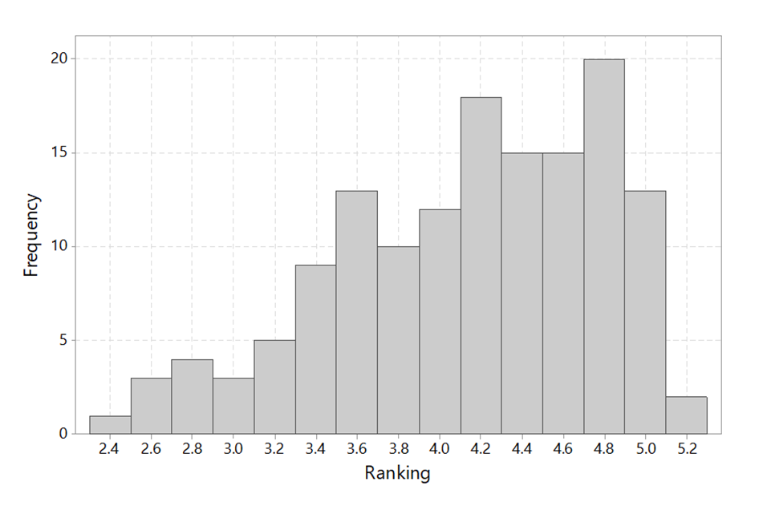

Slide 13
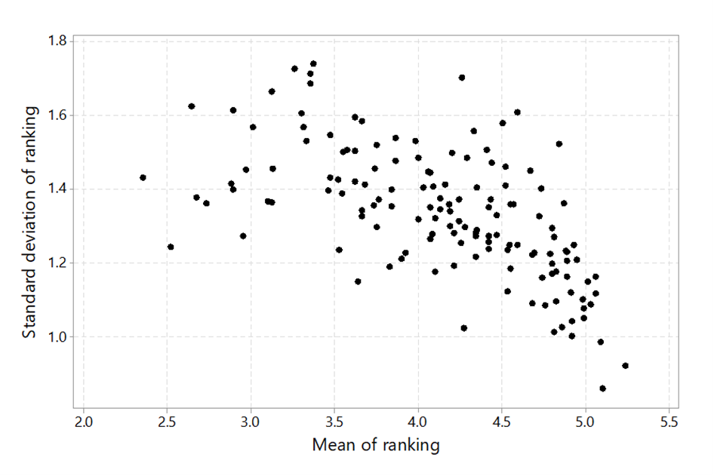

Slide 14
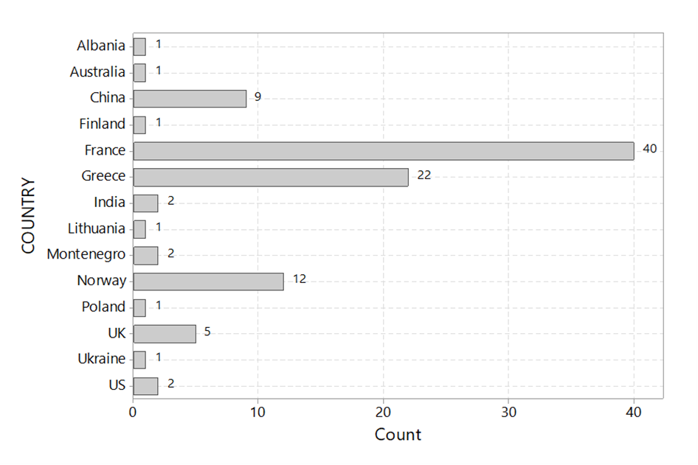

Slide 15
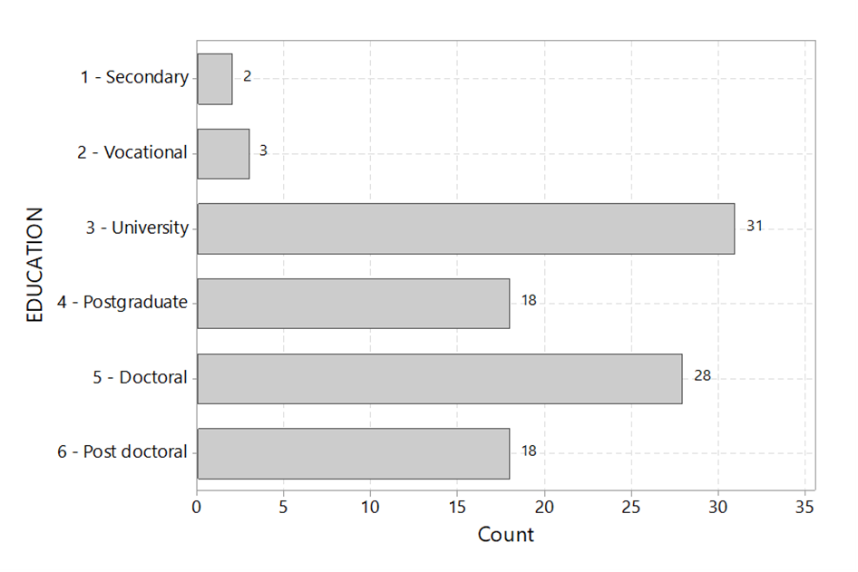

Slide 16
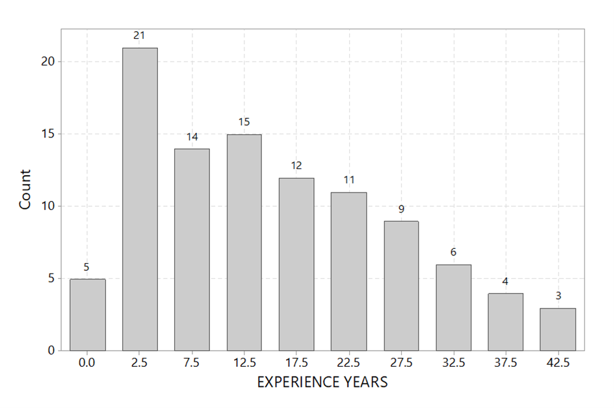

Slide 17
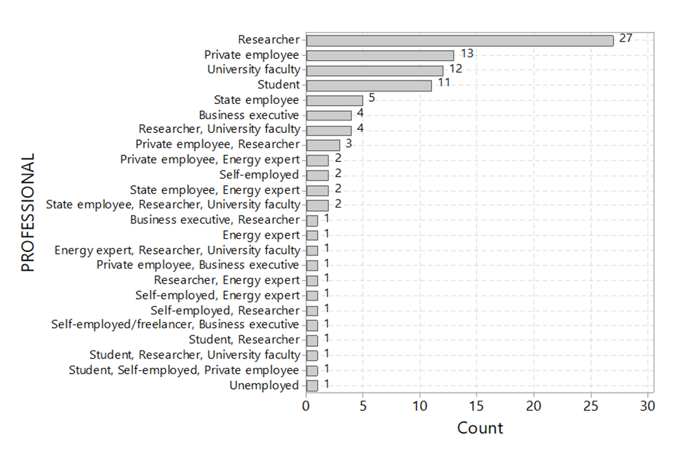

Slide 18
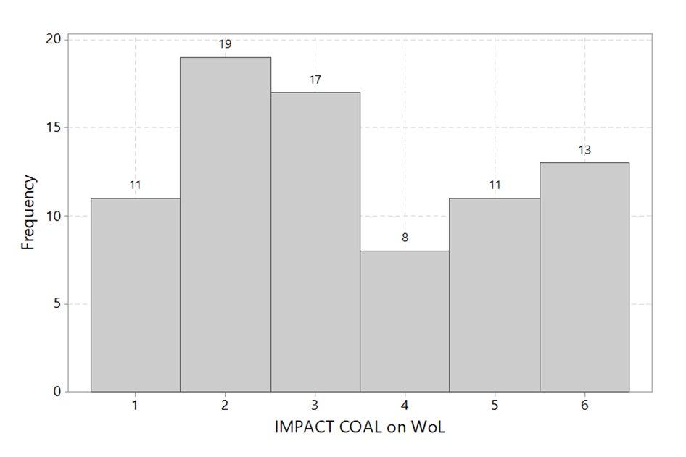

Slide 19
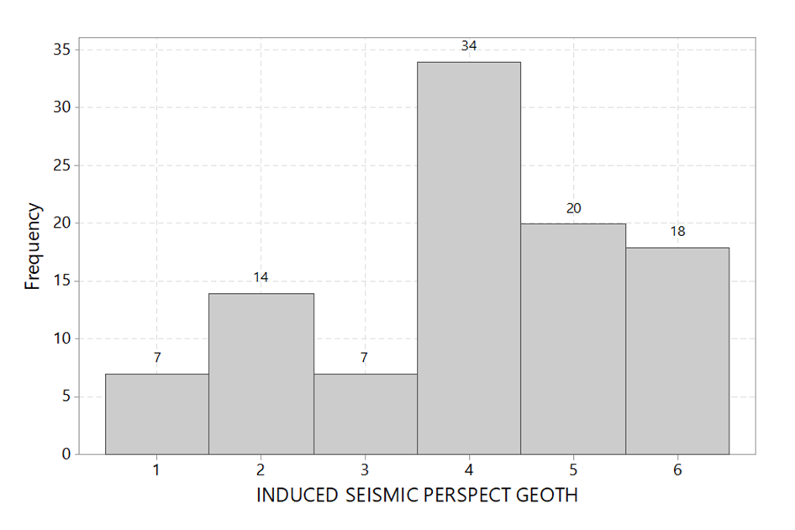

Slide 20
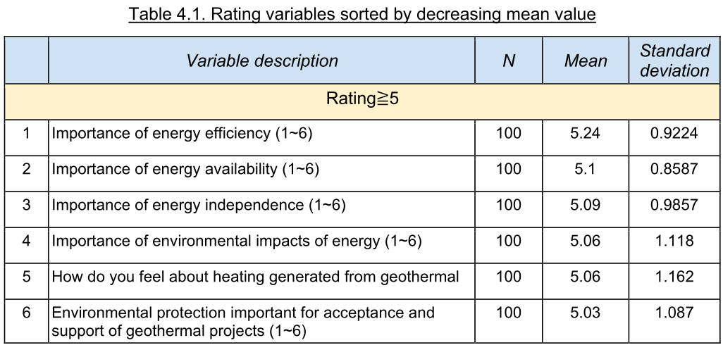

Slide 21
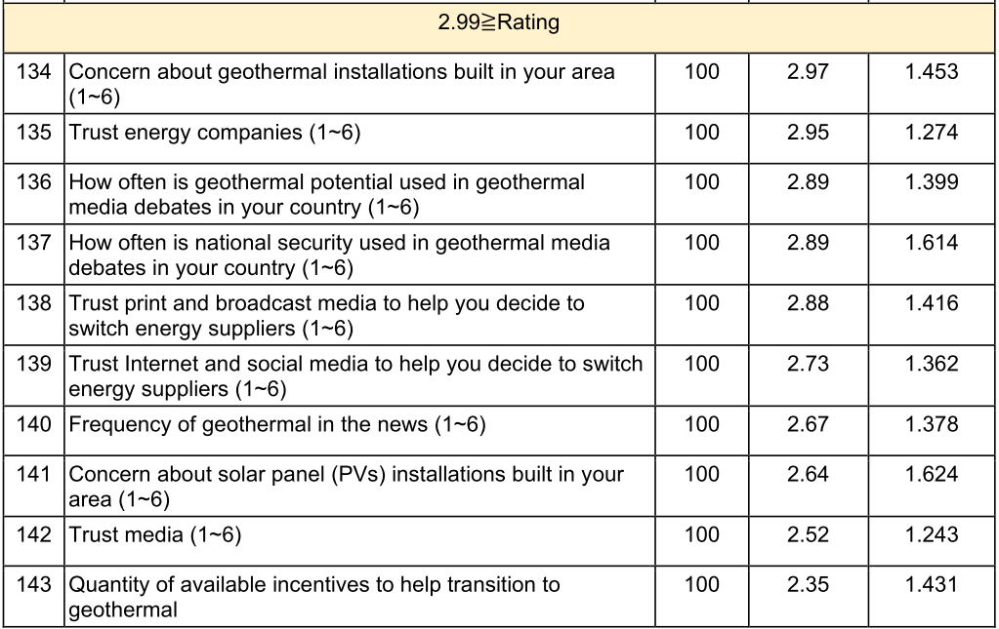

Slide 22
Principal Component Analysis (PCA)
PCA was performed to extract a small number of Principal Components (PCs), which would subsequently be used for Cluster Analysis.
The purpose of PCA was to obtain a few linear combinations of the ranking variables, which account for most of the variability in the data.
Two PCAs were run on:
(1) Selected variables that exhibited multimodality in their distribution.
(2) Subjectively selected groups of conceptually related ranking variables.
Missing cases were excluded listwise in both cases.

Slide 23
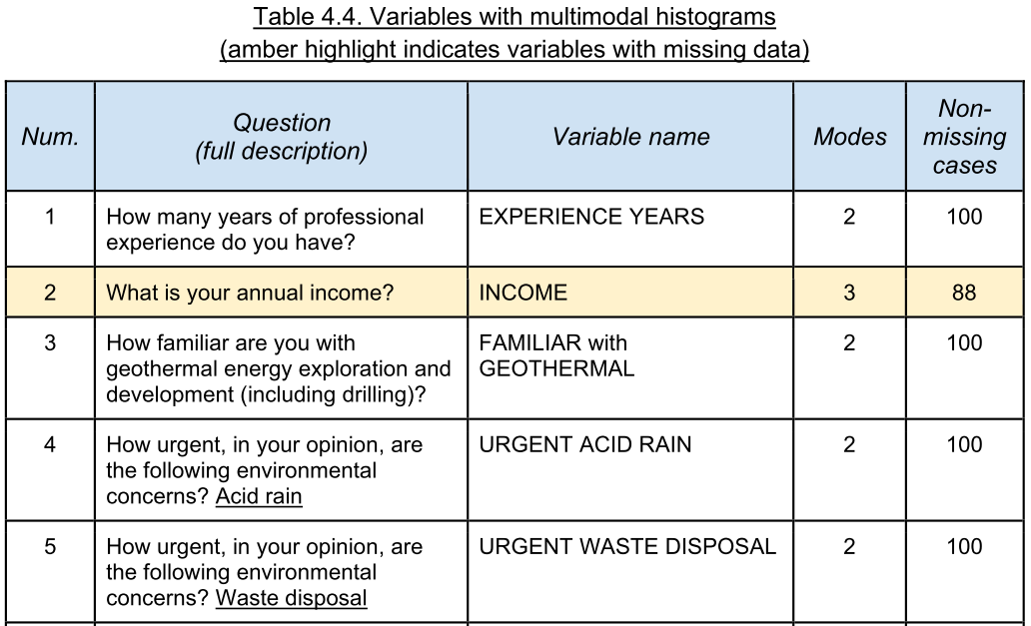

Slide 24
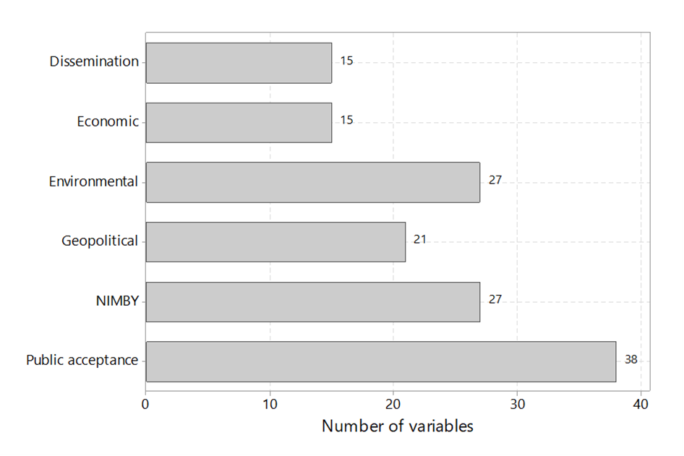

Slide 25
Cluster Analysis (CA)
Cluster analysis was run on the 10 PCs extracted from the variables (with multimodal histograms) that did not have any missing data.
Three cluster solution on PCs on selected variables.
88 out of 146 variables (60.3%) had a significant ANOVA F-test, supporting the presence of three clusters in the sample of responses.

Slide 26
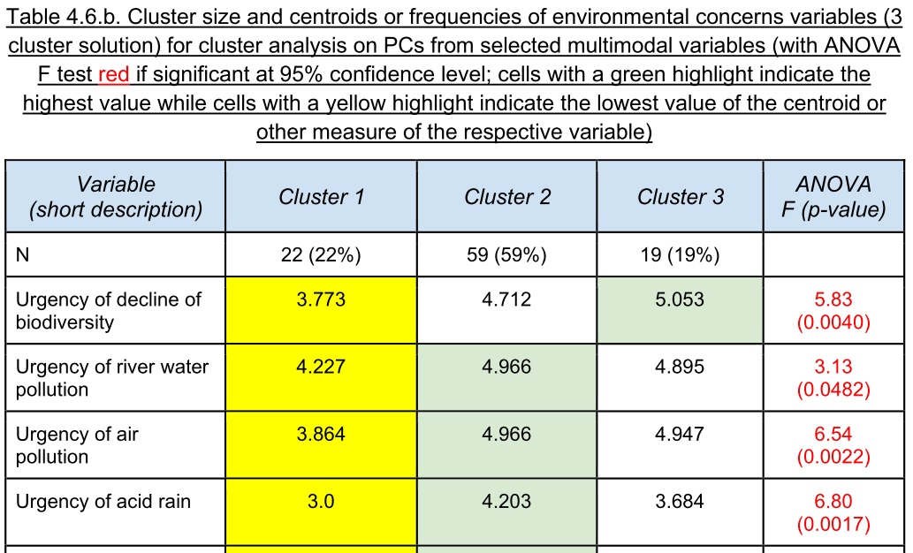

Slide 27
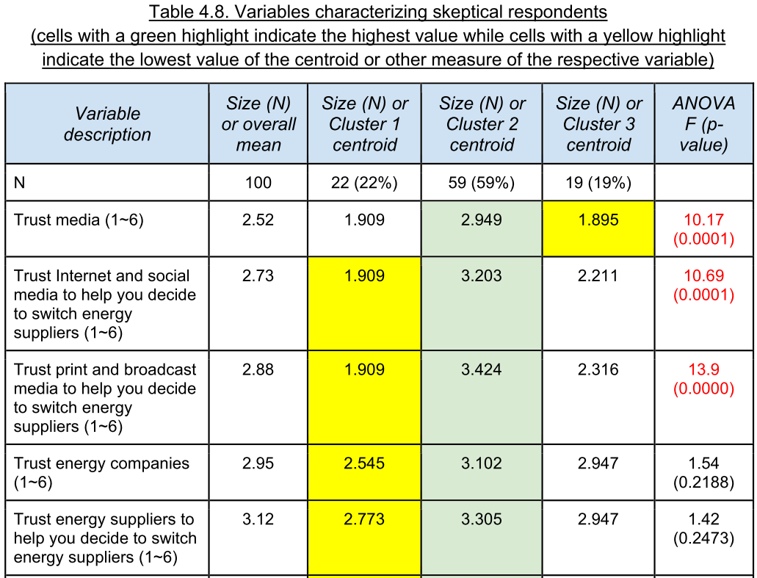

Slide 28
Skeptical attitudes
Respondents with the lowest rankings in almost all categories were in Cluster 1, which may be considered to contain most skeptical respondents.
A skeptical attitude is perhaps flagged by a negative impression of the media, followed by a reduced trust in various energy authorities and actors (e.g. energy companies, the EU, national governments, and regional authorities).
Interestingly, these skeptical respondents still had a relatively high impression of academic researchers and experts!

Slide 29
Cluster 1 (1/2)
“lower income, most familiar with geothermal, skeptical, distrustful”
Intermediate size (22 respondents)
Lowest average income
Respondents mostly from other urban and suburban areas
Most familiar with geothermal; best understanding of geothermal and how it works
Least concerned about urgency of GHG emissions, environmental issues, environmental impacts of geothermal, and environmental regulations
Preferring national and regional authorities to the EU

Slide 30
Cluster 1 (2/2)
“lower income, most familiar with geothermal, skeptical, distrustful”
Consistent (via 2 questions) lowest rating of the necessity to produce renewable energy
Considering solar, wind and geothermal to be the least impactful on the way of life
Least concerned about economic and community issues
Least exposed to geothermal in the news
Least trustful of various authorities (media etc.), with research journals and expert publications being relative more trusted
No active opposition to geothermal drilling

Slide 31
Cluster 2 (1/2)
“concerned, trustful, community oriented”
Largest (59 respondents)
Most male respondents
Most concerned about environmental issues and aesthetics, socioeconomic, institutional, and community issues
Preferring national, EU and local authorities to producers and suppliers
Consistent (via 2 questions) intermediate rating regarding the necessity of producing renewable energy
Considering solar, wind geothermal and biomass to be the most impactful on the way of life

Slide 32
Cluster 2 (2/2)
“concerned, trustful, community oriented”
Considering the role of scientists and researchers in energy selection less important
Underestimating the importance of energy independence
Most concerned about nearby nuclear energy installations
Least concerned about induced seismicity changing people’s perspective about geothermal energy
Most trustful of the media, NGOs, environmental associations, colleagues, and friends

Slide 33
Cluster 3 (1/3)
“upper income, least familiar with geothermal, focused concern, science-minded”
Smallest (22 respondents)
Most female respondents
Highest average income
Least familiar with geothermal
Highest concern for climate change effects and biodiversity, moderate concern about other environmental issues
Preferring national, EU and regional authorities to producers and suppliers

Slide 34
Cluster 3 (2/3)
“upper income, least familiar with geothermal, focused concern, science-minded”
Consistent (via 2 questions) highest rating regarding the necessity of producing renewable energy, and considering oil most impactful of the way of life
Considering scientists and researchers in energy selection very important
Trusting the EU and national governments, but not the media
Most concerned about nearby geothermal installations

Slide 35
Cluster 3 (3/3)
“upper income, least familiar with geothermal, focused concern, science-minded”
Most concerned about groundwater/soil contamination, water use, air pollution, noise, and geothermal induced seismicity
Prioritize academic/research/expert publications
Highest active opposition to geothermal drilling

Slide 36
Tabulated recommendations
Grouped recommendations
(a) Research literature
(b) Empirical findings (our survey)

Slide 37
Recommendations from empirical findings (1/4)
1. Some people will be more receptive to geothermal energy, even with hydraulic stimulation. Seek them out and help them take on the role of geothermal energy champion.
2. Some people are more familiar with geothermal energy and worry less about geothermal activities in their region. Seek them and recruit them as NIMBY warriors.
3. Some people know little of geothermal energy and worry the most about geothermal activities in their region. Nonetheless, these people agree on the need to develop renewable energy, and consider the role of scientists and researchers very important. Therefore, scientists, researchers and experts should be involved in approaching them.

Slide 38
Recommendations from empirical findings (2/4)
4. On geothermal issues, almost everyone trusts their national governments more than any other institution or organization. Also, national government policies and communication campaigns are most likely to influence public understanding of geothermal energy. Therefore, prioritize the role of the national government in fostering geothermal exploration.
5. Nearly everyone trusts scientists and researchers, but distrusts NGOs, environmental groups, and grassroots movements. In particular, dissemination activities involving academics and scientists are likely to have a more significant influence on public perceptions than activism and other types of communication used by NGOs, environmental groups, and grassroots movements. Therefore, involve scientists, researchers and experts, and avoid involving parties perceived negatively in promoting geothermal energy.

Slide 39
Recommendations from empirical findings (3/4)
6. Nearly everyone values energy independence, efficiency, affordability, availability, and source diversification. It is recommended that these ideas be used to drive the promotion of the (general) concept of geothermal energy.
7. Nearly everyone values environmental protection, community awareness and consultation, public health, and economic gains. It is recommended that these concepts be used to spearhead the (specific) concept of geothermal exploration.
8. In communities with established weak knowledge of geothermal energy and comprehension of how it works, dissemination activities should draw on their faith in the European Union and scientists and researchers.

Slide 40
Recommendations from empirical findings (4/4)
9. Dissemination activities among reactionary communities should draw dispassionately on scientific and research sources papers. Therefore, utilize news developments, polls, and surveys to identify such populations, and adopt such sources to calm their anxieties and persuade them of the merits of geothermal energy and the importance of geothermal exploration.
10. Although there are better ways to promote geothermal energy, help increase its presence in the media in order to communicate novel drilling technologies to the public – more knowledge is likely to lead to more acceptance.
11. Leverage economic incentives as a major component of public acceptance, particularly after the conflict in Ukraine (2022).

Slide 41
Update on the plan for the next 4 months
Task 3.3: Energy security implications [UPRC, ARMINES, ICL, SINTEF, DLS]
M25 (January 2023) to M28 (April 2023)
M3.4: Complete geothermal energy security index, due by end of M26 (February 2023)
D3.3: Report on energy security, due by end of M28 (April 2023)
Draft of D3.2 ready for review by end of M27 (March 2023)

Slide 42
Task 3.3: Energy security implications
Task 3.3 target: The impact of ORCHYD technology on energy security.
Extensive literature review ⇒ custom-made quantitative index
Selection of appropriate dimensions, components, and metrics that accurately reflect the role of geothermal energy and deep geothermal drilling.
The index will be formulated to incorporate the effect of the salient characteristics of the deep drilling technologies developed in ORCHYD.

Slide 43
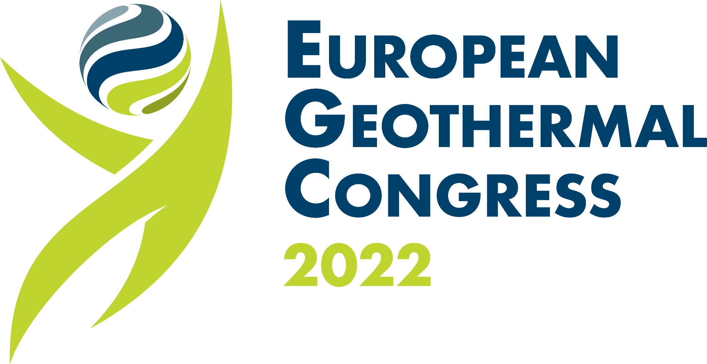
Publications
Oral Presentation in “S5-1 LECTURE & POSTER Speech: Drilling” of European Geothermal Congress 2022
Papakostas, V., Paravantis, J. A., Kontoulis, N., Cazenave, F., Gerbaud, L., and Velmurugan, N. (2022). Environmental Impacts of Water-Based Fluids in Geothermal Drilling. European Geothermal Congress 2022, 17-21 October 2022, Berlin, Germany.

Slide 44

Expected Publications
Full papers to be submitted by 31 December 2022
Paravantis, J. A., Kontoulis, N., Papakostas, V., Velmurugan, N., and Cazenave, F. (2023). Social Aspects of Deep Geothermal Drilling in the ORCHYD Project. World Geothermal Congress 2023, 7-11 October 2023, Beijing, China.
Paravantis, J. A., Papakostas, V., Kontoulis, N., Velmurugan, N., and Cazenave, F. (2023). Assessing the Environmental Impacts of Deep Geothermal Drilling in the ORCHYD Project. World Geothermal Congress 2023, 7-11 October 2023, Beijing, China.

Slide 45
All done, thank you

