Slide 1


ORCHYD WP3 Discussions
WP3 – Deliverable 3.1
Quantification of Environmental Impacts
University of Piraeus
This project has received funding from the European Union’s Horizon 2020 research and innovation programme under grant agreement No 101006752

Slide 2
Life Cycle Analysis (LCA)
    Carbon footprint is expressed in terms of CO2 equivalent.
    The ozone depletion potential is calculated in terms of chlorofluorocarbons (CFCs).
    Smog, which is a reaction of nitrogen oxides (NOx), and volatile organic compounds (VOCs) is expressed in ozone (O3) equivalent.
    The acidification potential is expressed in terms of sulfur dioxide (SO2).
    Eutrophication potential is expressed in terms of nitrogen (N).
    Fossil fuel depletion is measured in terms of energy (MJ) surplus.

Slide 3
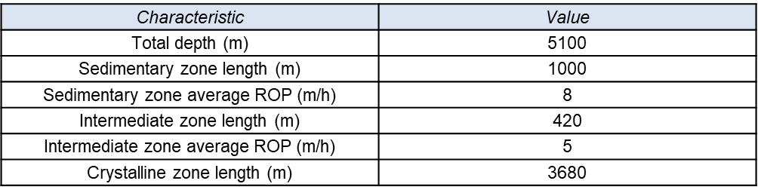
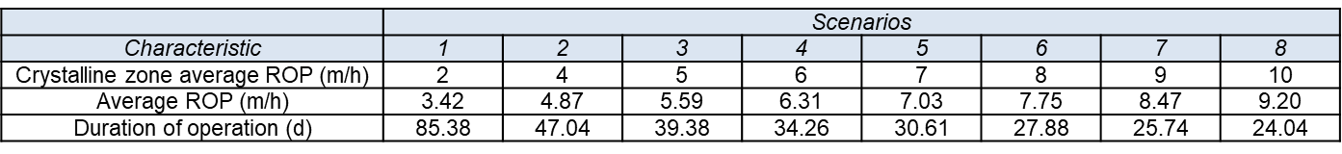
Baseline Scenario for LCA
Values of LCA characteristics common among scenarios (h: hours, d: days)
Values of LCA characteristics for different scenarios (h: hours, d: days)

Slide 4
LCA assumptions
    The following were considered:
    The usage of diesel for the production of materials; transport of materials and equipment; and usage of equipment during the various construction phases of the well
    Materials use for the submersible pump, chiller, and surface components
    Trenching
    Other material categories
    It was assumed that operations run on a 24/7 basis and no accidents were encountered.

Slide 5
LCA assumptions
    Calculations on the size and diameter of the wellbore for concrete and steel used as well as water and diesel consumption yielded typical values for these materials in all scenarios.
    It was estimated that a total of:
    357,550.13 kg of steel
    226.29 m³ of concrete (approximately equal to 543 tons, but intentionally computed as volume)
    29,030.78 kg of water were used
    Extra analysis was conducted concerning the usage of drilling bits made of steel, which slightly alters the steel consumption between scenario 1 and the rest of the scenarios.
    The reference value for diesel consumption was 157.7 L/h (or 49 gallons per hour).

Slide 6
LCA assumptions
    The drilling depth is 5100 m, and it is divided into four sections, two in sedimentary rock and two in fractured granite formation.
    The 1st section from the surface to 574 m was drilled at a 24-inch diameter.
    The 2nd section between 574 m and 1447 m was drilled at a 17½ inch diameter.
    The 3rd section between 1447 m and 4580 m was reopened (initially drilled in an 8½ inch diameter) at a 12¼ inch diameter.
    The 4th section was drilled at an 8½ inch diameter down to 5100 m.

Slide 7
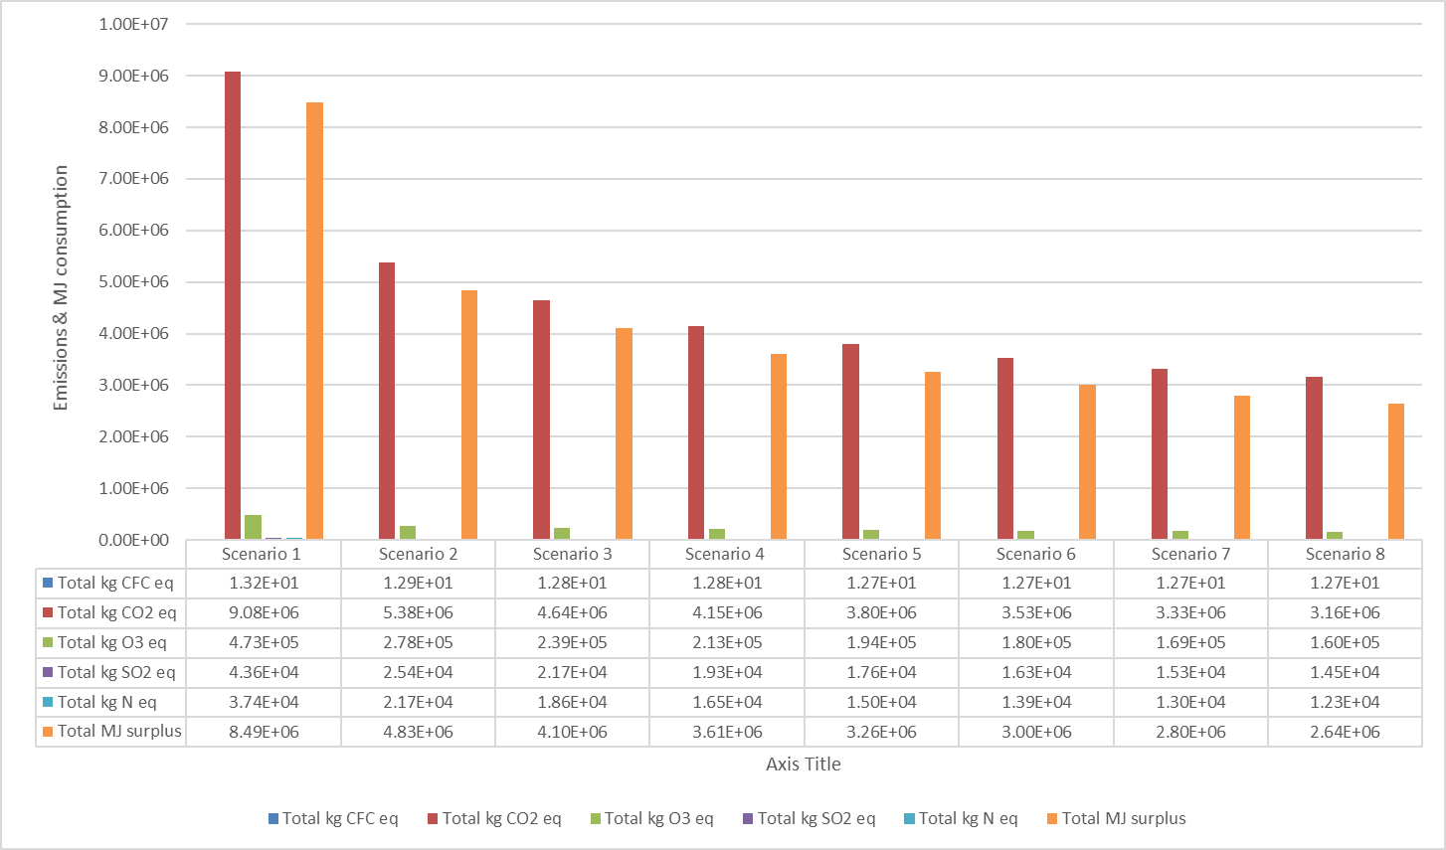
Total impacts of all scenarios for the six examined categories
Figure 4.11. of D3.1

Slide 8
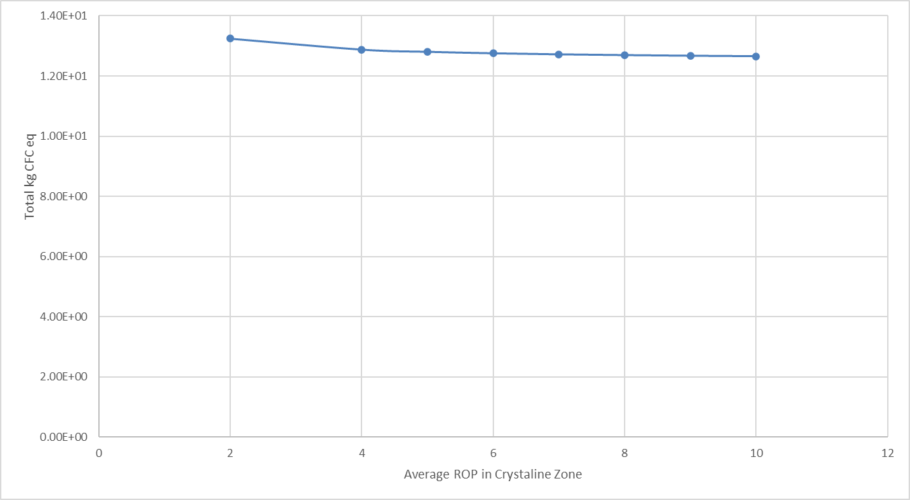
ROP effect on ozone depletion emissions
Ozone depletion is reduced in a range between 2.27% (Scenario 2) and 3.79% (Scenario 8) in comparison to baseline scenario (Scenario 1)
Figure 4.12. of D3.1

Slide 9
ROP effect on carbon footprint emissions
Carbon Footprint is reduced in a range between 40.75% (Scenario 2) and 65.2% (Scenario 8) in comparison to baseline scenario (Scenario 1)
Figure 4.13. of D3.1

Slide 10
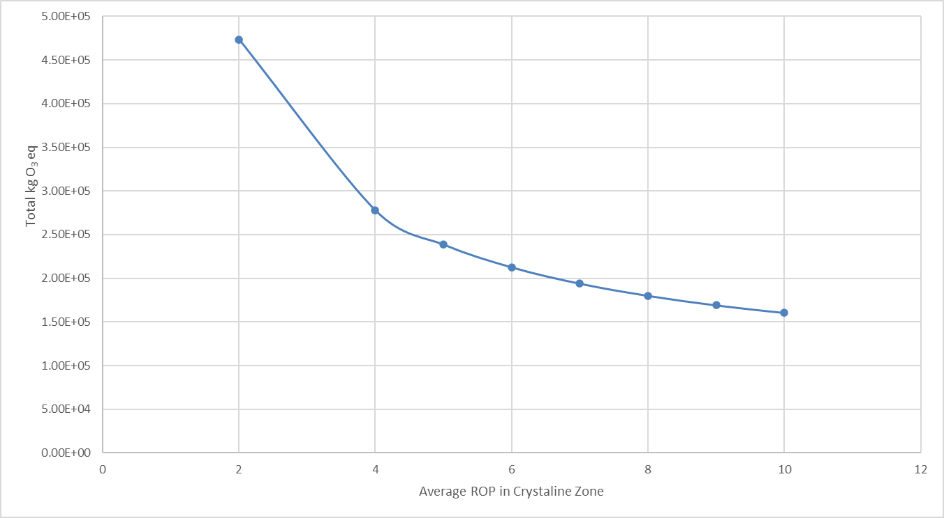
ROP effect on smog related emissions
Smog is reduced in a range between 41.23% (Scenario 2) and 66.17% (Scenario 8) in comparison to baseline scenario (Scenario 1)
Figure 4.14. of D3.1

Slide 11
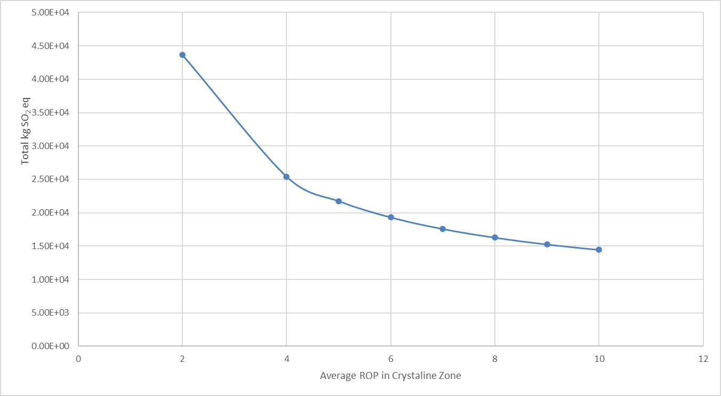
ROP effect on acidification potential
Acidification potential is reduced in a range between 41.74% (Scenario 2) and 66.74% (Scenario 8) in comparison to baseline scenario (Scenario 1)
Figure 4.15. of D3.1

Slide 12
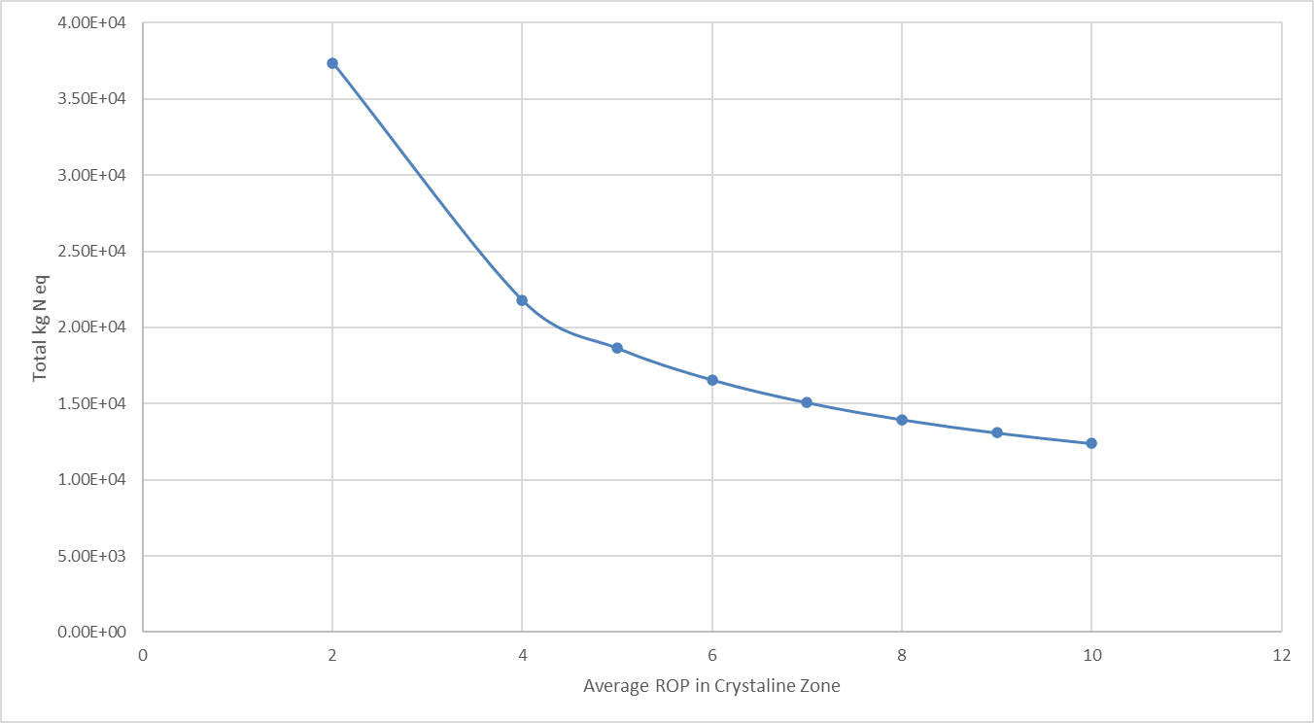
ROP effect on eutrophication potential
Eutrophication potential is reduced in a range between 41.98% (Scenario 2) and 67.11% (Scenario 8) in comparison to baseline scenario (Scenario 1)
Figure 4.16. of D3.1

Slide 13
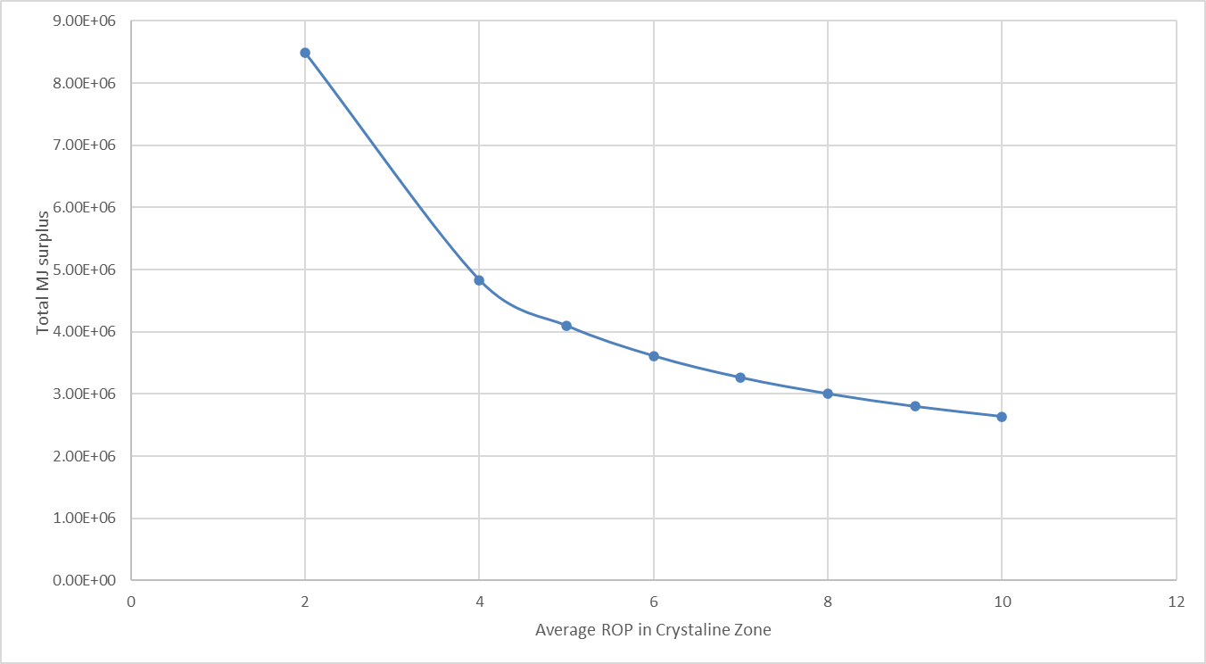
Fossil fuel depletion vs ROP in crystalline zone
Fossil fuel depletion is reduced in a range between 43.11% (Scenario 2) and 68.9% (Scenario 8) in comparison to baseline scenario (Scenario 1)
Figure 4.17. of D3.1

Slide 14
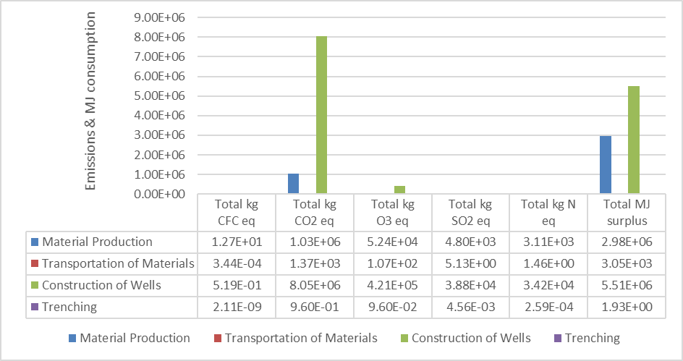
Life cycle stages comparison, Scenario 1
Figure 4.18. of D3.1

Slide 15
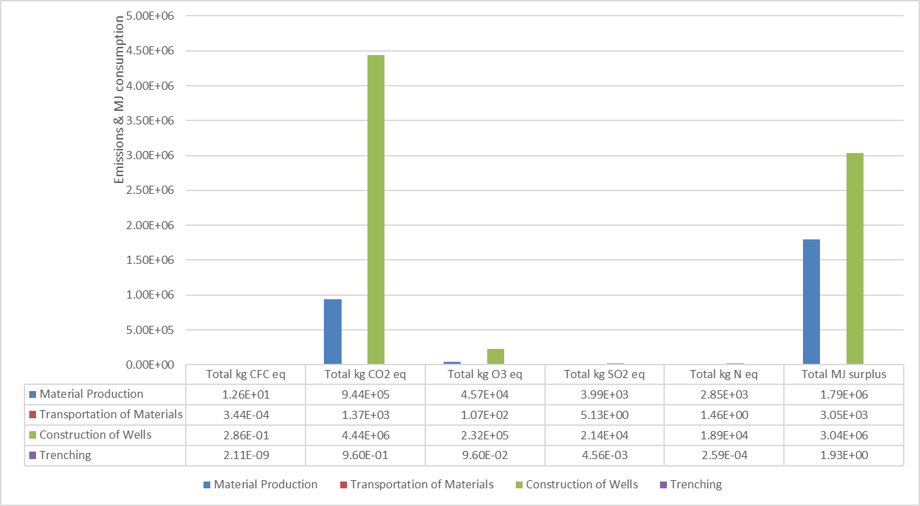
Life cycle stages comparison, Scenario 2
Figure 4.19. of D3.1

Slide 16
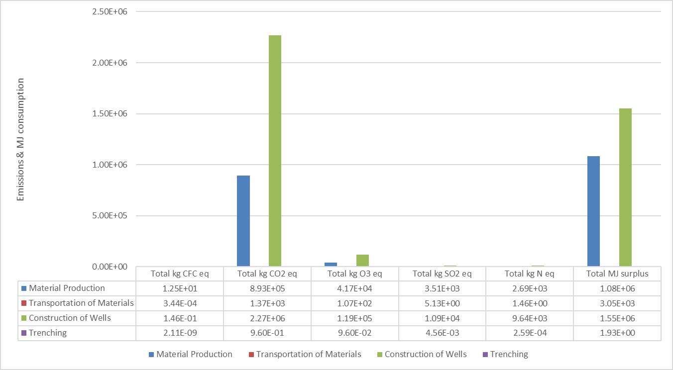
Life cycle stages comparison, Scenario 8
Figure 4.20. of D3.1

Slide 17
Life Cycle Stages Comparison (scenarios 1,2 & 8)
Construction of wells stage | Total kg CFC eq | Total kg CO2 eq | Total kg O3 eq | Total kg SO2 eq | Total kg N eq | Total MJ surplus
Scenario 1 | 3.91% | 88.67% | 88.90% | 88.99% | 88.90% | 64.89%
Scenario 2 | 2.21% | 82.43% | 83.49% | 88.90% | 86.87% | 62.82%
Scenario 8 | 1.15% | 71.69% | 73.91% | 75.66% | 78.18% | 58.80%

Slide 18
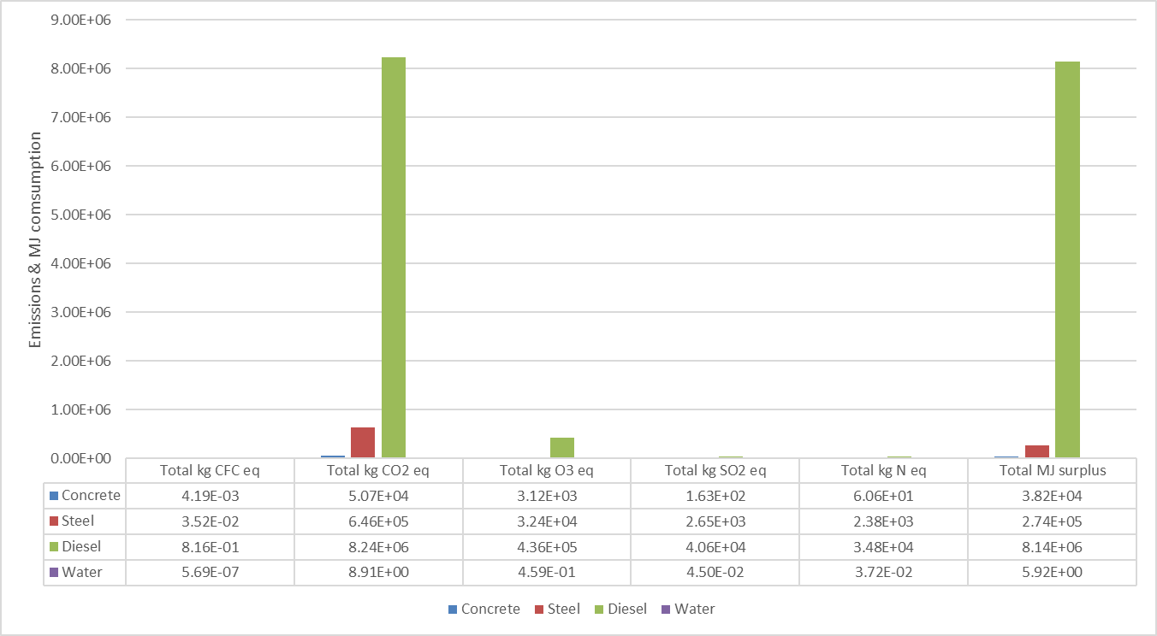
Material use impacts, Scenario 1
Figure 4.21. of D3.1

Slide 19
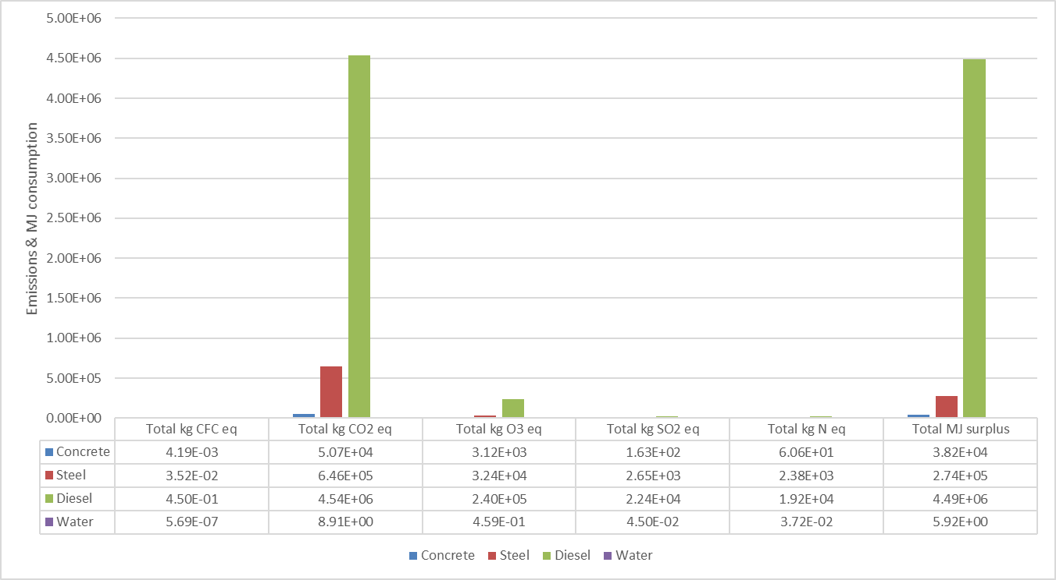
Material use impacts, Scenario 2
Figure 4.22. of D3.1

Slide 20
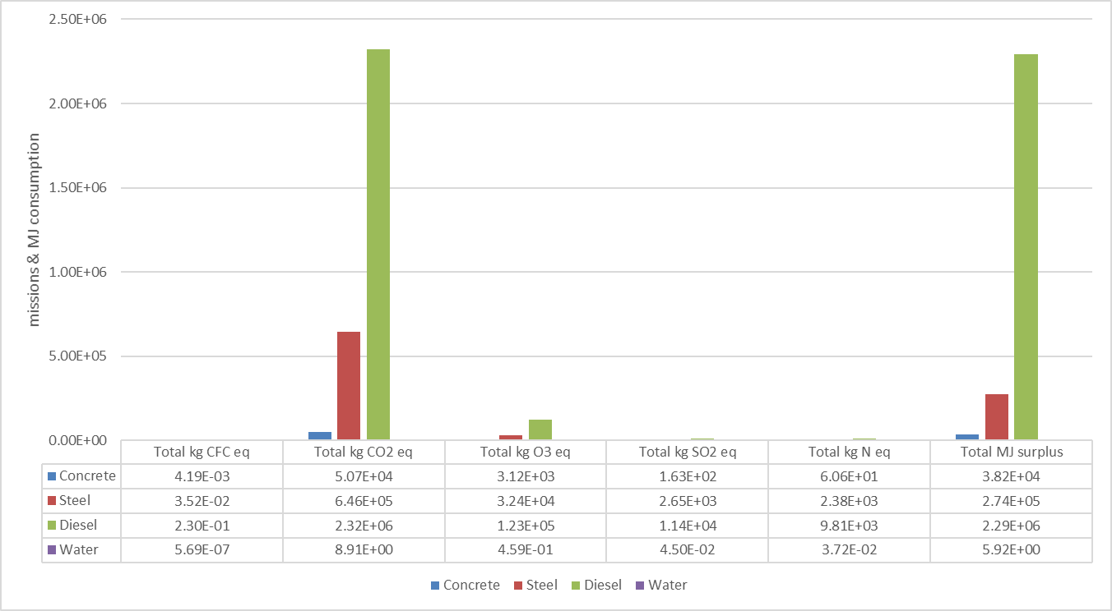
Material use impacts, Scenario 8
Figure 4.23. D3.1

Slide 21
Material use (scenarios 1,2 & 8)
Diesel consumption | Total kg CFC eq | Total kg CO2 eq | Total kg O3 eq | Total kg SO2 eq | Total kg N eq | Total MJ surplus
Scenario 1 | 95% | 92% | 92% | 94% | 93% | 96%
Scenario 2 | 92% | 87% | 87% | 89% | 89% | 94%
Scenario 8 | 85% | 77% | 78% | 80% | 80% | 88%

Slide 22
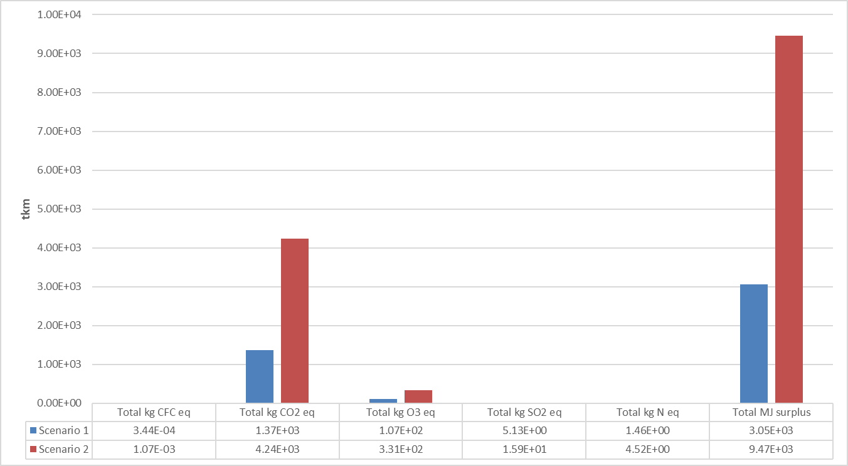
Distance impact on LCA
Emissions and MJ surplus are increased proportionally by 210 %
Figure 4.24. of D3.1

Slide 23
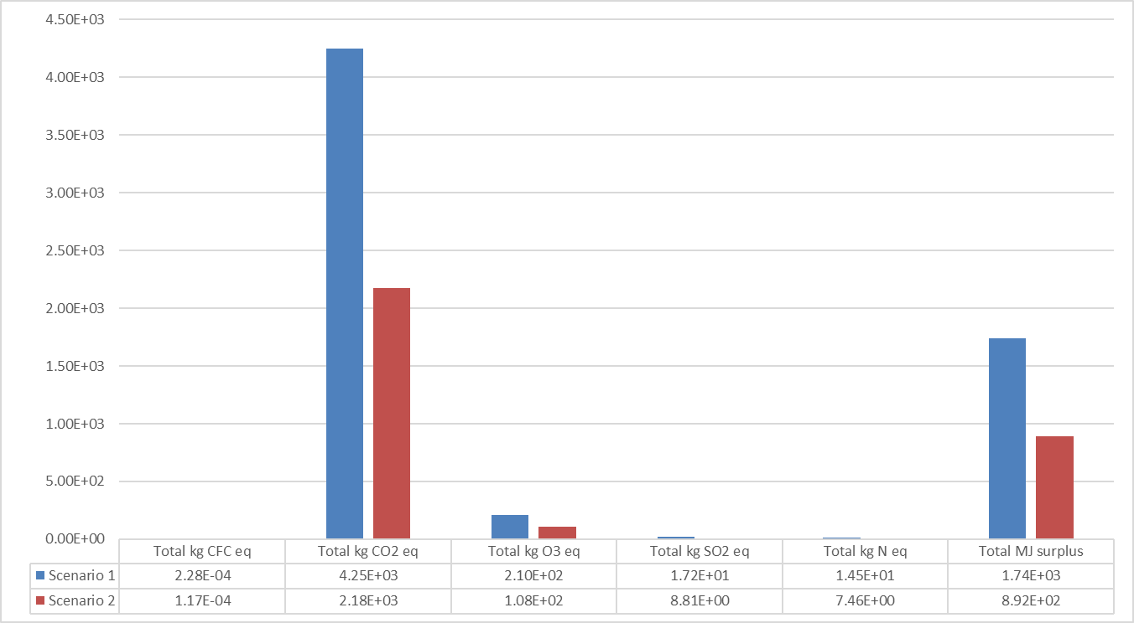
Life cycle emission equivalent and energy surplus vs rotary and percussive/HPWJ of drill bit usage
Emissions and MJ surplus are reduced proportionally by 48.74 %
Figure 4.25. of D3.1

Slide 24
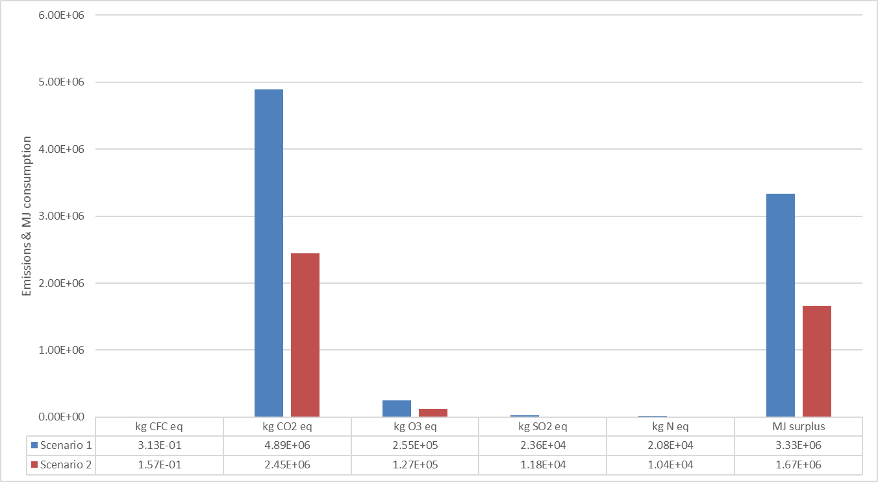
Life cycle emission equivalent and energy surplus vs rotary and percussive/HPWJ of drill bit replacement
Emissions and MJ surplus are reduced proportionally by 50.1 %
Figure 4.26. of D3.1

Slide 25
Summary of LCA
The conducted LCA on the different scenarios gave important results concerning the impact of ROP on the emissions and energy consumption of drilling operations.
There was an inversely proportional relation between ROP and the categories examined. ROP rates over the 3.5 m/h value of ROP (which was considered in Scenario1), yielded significantly lower carbon footprint and energy consumption during drilling operations (Scenarios 2 to 8).
Smog was reduced significantly, while minor reductions occurred in the rest of the examined categories, as well.
It may be concluded that the techniques developed by ORCHYD will lower emissions, reduce energy consumption, and make geothermal drilling operations more sustainable.

Slide 26
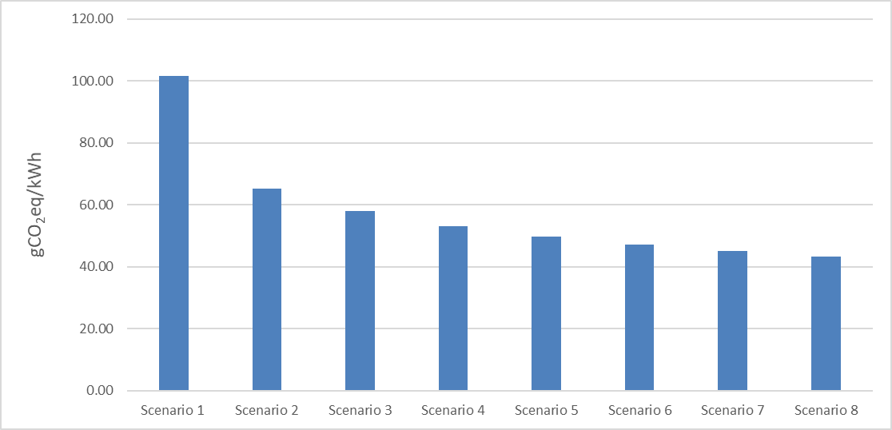
Simplified LCA of the whole life cycle of a geothermal plant, for the different scenarios
Carbon footprint is reduced in a range between 35.17 % (Scenario 2) and 56.66 % (Scenario 8) in comparison to baseline scenario (Scenario 1)
Figure 4.27. of D3.1

Slide 27
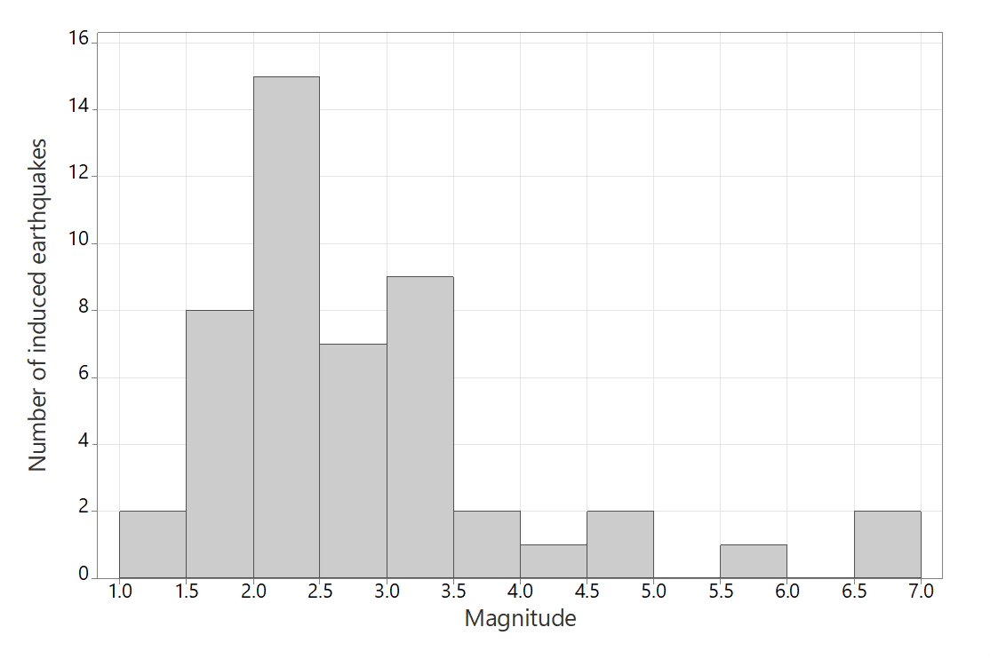
Induced seismicity
Figure 4.30. Number of induced earthquakes and their magnitude

Slide 28
Characterization of risk of induced seismicity
The ground motion of any target location needs to be characterized.
Adversely impacted categories need to be identified. This includes physical damage to residential housing, facilities of any kind, human activity interference, and socioeconomic impact.
The damage potential on any of these categories needs to be characterized to assess their vulnerability.
Risk estimation and its public presentation should take place.

Slide 29
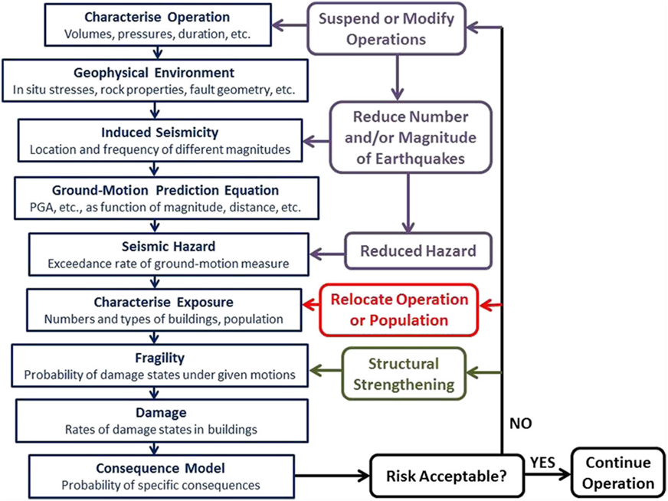
Risk calculation

Slide 30
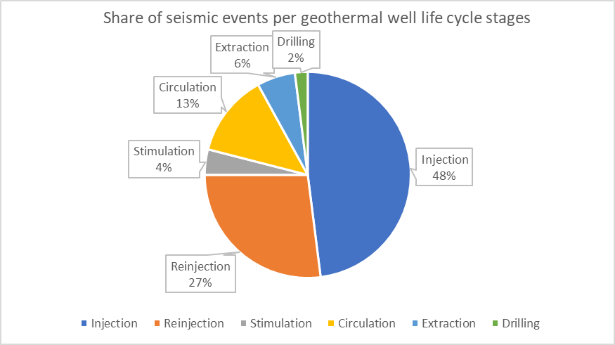
Induced seismicity risk calculation
The risk of induced seismicity has been calculated R = 0.04. This is a low-risk value. Examining qualitatively the recorded events, insight on induced seismicity in certain lithologies and depths was acquired.
Out of 49 recorded induced seismicity events, there is only 1 case in Iceland (Hellisheiði, Well HE-8) where a seismic event of 2.4 ML was recorded. Implementing the given equation, the risk of induced seismicity during drilling operations is calculated as R = 0.00075

Slide 31
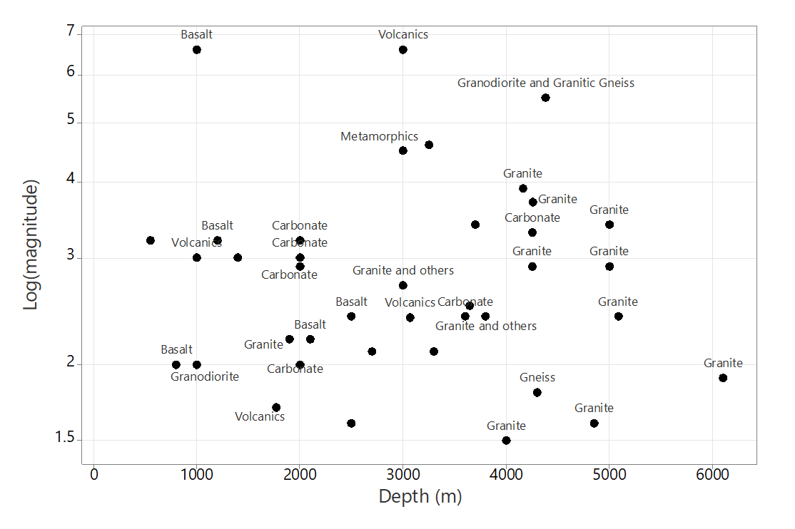
Log magnitude of an event of induced seismicity against depth of geothermal well with labels indicating lithology
Figure 4.35. of D3.1

Slide 32
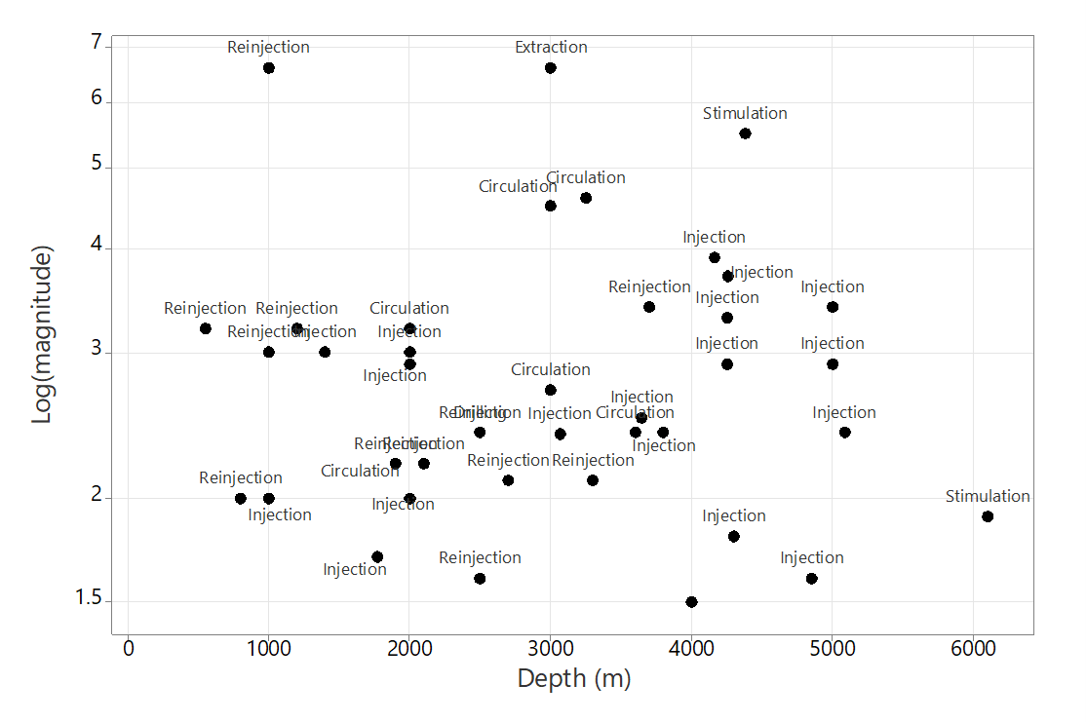
Log magnitude of an event of induced seismicity against depth of geothermal well with labels indicating process stage
Figure 4.36. of D3.1

Slide 33
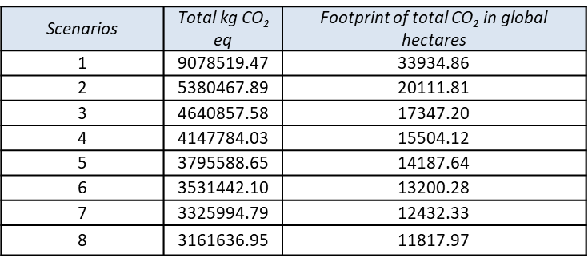
Ecological Footprint Assessment
For this assessment, values proposed by EPA Victoria (2005) are used. In the developed scenario, a similar to GPK-3 well examined in LCA is developed in Australia. A weighted average world carbon absorption value has been calculated to be 1.3 tons of carbon per hectare. The footprint of 1 ton of CO2 in global hectares is 3.737929 tCO2/gha/yr.

Slide 34
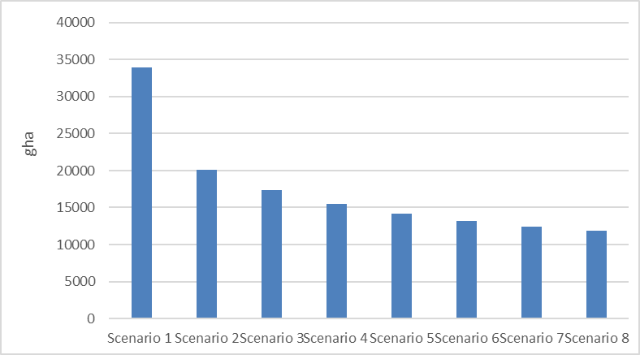
Footprint of total CO2 eq emission in global hectares for all 8 scenarios examined in LCA
Carbon footprint in global hectares is reduced in a range between 40.73 % (Scenario 2) and 65.17 % (Scenario 8) in comparison to baseline scenario (Scenario 1)
Figure 4.41. of D3.1

Slide 35
Publication efforts
    European Geothermal Congress 2022
      https://europeangeothermalcongress.eu
      Abstract has been accepted (January 19, 2022)
        “Environmental Impacts of Water-Based Fluids in Geothermal Drilling”
      Final paper to be submitted by April 26, 2022
      Energy and Climate Transformations - 3rd International Conference on
      Energy Research & Social Science
      https://www.elsevier.com/events/conferences/international-conference-on-energy-research-and-social-science/submit-abstract
      Abstract to be submitted by February 4, 2022

