Slide 1


ORCHYD WP3 Discussions
WP3 – Deliverable 3.1
Progress
University of Piraeus
This project has received funding from the European Union’s Horizon 2020 research and innovation programme under grant agreement No 101006752

Slide 2
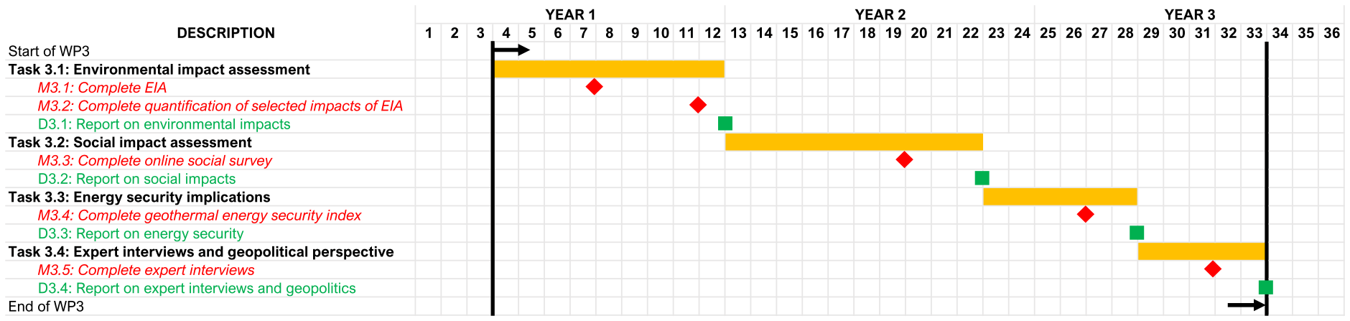
Overview of WP3

Slide 3
Overview of work towards D3.1
    Scope of presentation
      Overview of work towards D3.1
        Compared scenarios:
          (0) Baseline (ROP = 1~4)
          (1) Improved geothermal drilling (ROP = 4~10)
      Draft D3.1 at M7 to final D3.1 at M12: guided by scoping survey
      Next 3 to 6 months
      Input required of partners

Slide 4
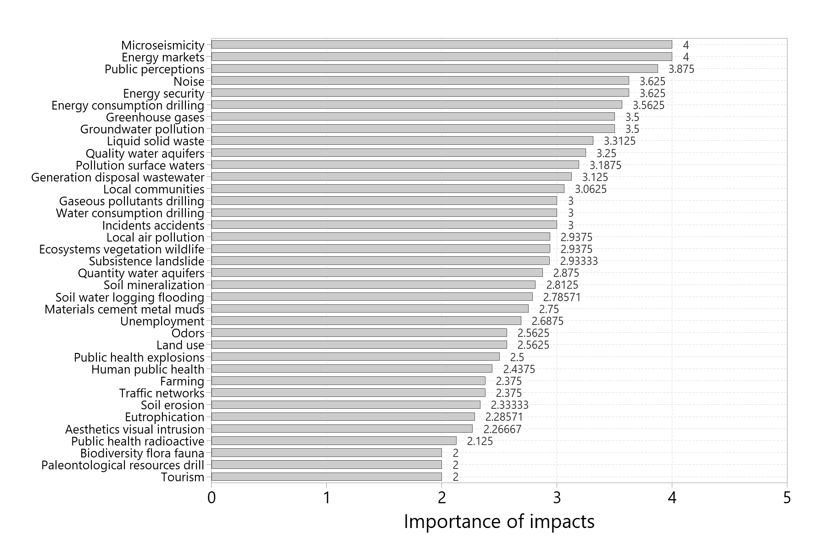

Slide 5
Lithosphere
    Affected geothermal drilling area is between 200 and 2500 m².
    Drilling, reinjection, and induced seismicity have all been linked to subsidence.
      Subsidence may be facilitated by the pressure drop caused by fluid withdrawal and the permeability of the formation.
      Annual subsidence rates of up to 40 cm have been reported.
    Groundwater pollution potentially related to geothermal drilling: ions (chloride, sodium, lithium, chromium, boron), heavy metals, etc.
      Crops and animal products near drilling sites may be affected (by groundwater pollution).
    In terms of (liquid and solid) waste, ORCHYD technologies are estimated to require 63% less drilling and tripping time, but 50% more drill bits.
    Drilling sites disrupt the landscape and produce aesthetic impacts and visual disturbances (drill towers, other infrastructure, roads, etc.).

Slide 6
Hydrosphere
    The problem is preserving the quality of potable water in shallow groundwater aquifers (with casings, liners, etc.).
    Water generated during testing and drilling should be contained, treated, and disposed of in a manner that is environmentally acceptable.
    Wastewater typically discharged from geothermal drilling operations may contain salts, carbonates, sulfates, and (heavy) metals (such as arsenic and boron).

Slide 7
Atmosphere
    Greenhouse gas emissions were assessed with (simplified and full) Life Cycle Assessment focusing on carbon footprint.
    Local air pollution includes carbon dioxide, hydrogen sulfide, ammonia, carbonates, sulfides/sulfates.
      Local air pollution is also generated by road traffic.
    Odors may be due to hydrogen sulfide.

Slide 8
Biosphere 1/2
    Vegetation and topsoil clearance will have an adverse effect on ecosystem services and wildlife.
    Compared to fossil fuel plants, geothermal exploitation is characterized by few health impacts.
      Such health impacts are related to noise; seismicity; emission of particulates and (toxic) gasses (sulfur dioxide, hydrogen sulfide); pollution with heavy metals; and use of hazardous chemicals (e.g. caustic soda).
      Respiratory and cardiovascular diseases have been reported near geothermal plants.
      The (potential) natural radioactivity of rocks (thus filter residues) is also a concern.
    Economic benefits include decreasing the (total) cost of drilling in hard rock (by two thirds); saving water, muds, and materials; opening new jobs and decreasing unemployment.

Slide 9
Biosphere 2/2
    Other socioeconomic impacts relate to incidents and accidents (e.g. blowout); and tourism.
    Public acceptance (especially for local communities) is an important issue that is being investigated in the context of Task 3.2 (Social impact assessment).
    Energy security and ORCHYD will be investigated in the context of Tasks 3.3 (Energy security implications) and 3.4 (Expert interviews and geopolitical perspective).
    Energy and material consumption, as well as their relationship to the rate of penetration (ROP), are discussed in the context of LCA.
    Most diesel consumption throughout the lifecycle of a geothermal project occurs during drilling.

Slide 10
Geothermal drilling fluids
    Has been presented and discussed in previous meetings.

Slide 11
Life Cycle Assessment (LCA) and
Ecological Footprint Analysis (EFA) 1/2
    Categories covered by the LCA: (1) carbon emissions; (2) ozone depletion by CFCs; (3) smog caused by NO_{x}, VOCs and expressed as O₃ equivalent; (4) acidification expressed as SO₂ equivalent; (5) eutrophication expressed as nitrogen equivalent; and (6) fossil fuel depletion expressed as future energy surplus.
    A drilling well of 5100 m (Soultz-sous-Forêts) was assumed.
    Average ROPs of 3.4 m/h (Scenario 1) to 9.2 m/h (Scenario 8) were considered.
    Diesel consumption, and material and equipment transport were considered. Steel, concrete, and water use was calculated.
    Life Cycle Inventory (LCI) to be discussed in another presentation.

Slide 12
Life Cycle Assessment (LCA) and
Ecological Footprint Analysis (EFA) 2/2
    From Scenario 1 to Scenario 8:
      CO₂ equiv. −65.2%
      MJ surplus −68.9%
      CFC equiv. −3.8%
      O₃ equiv. −66.2%
      SO₂ equiv. −66.7%
      N equiv. −67.1%
    Ecological Footprint (in gha) −65.2%
    Effect of ROP on each impact category discussed in another presentation.
    Life Cycle stages (production of materials, transportation of materials, construction of well, and trenching) and material impact per scenario compared in another presentation.

Slide 13
Seismicity
    Deep geothermal drilling is different from fracking.
    Induced seismicity in geothermal fields: maximum local magnitude (ML) ranges from 2 to 5.5.
    Public perceptions differ from country to country.
    Granites appear to give seismic events with magnitudes less than 3.5.
    Induced seismicity linked to reinjection flow rate: 35 to 40 l/s = low risk of seismicity; 70 l/s = high risk of seismicity; 140 l/s = extreme case, significantly increased risk of seismicity.
    Risk of seismicity (during the drilling phase) appears to be (very) low, as discussed in another presentation.

Slide 14
Noise modeling 1/3
    Expected traffic volumes too low for estimation of noise levels.
    Basic noise level at 10 meters away from the road was predicted to be equal to 65 dBA (UK Department of Transportation's methodology).
    A legally loaded truck was assumed to emit a sound pressure level of 95 dB.
    Without buildings or noise barriers, a noise level of about 60 dBA was estimated at a distance of about 1 km from a typical drilling well (~ normal daytime noise levels).
      A typical building would dampen noise levels behind it to around 60 dBA at approximately 300 m. A level comparable to the noise expected at night (below 50 dBA) would be observed at a distance of more than 2 km from the geothermal well.
      Adding a typical noise barrier behind a typical building would reduce noise levels significantly, reaching levels below 55 dBA at a distance beyond 500 m.

Slide 15
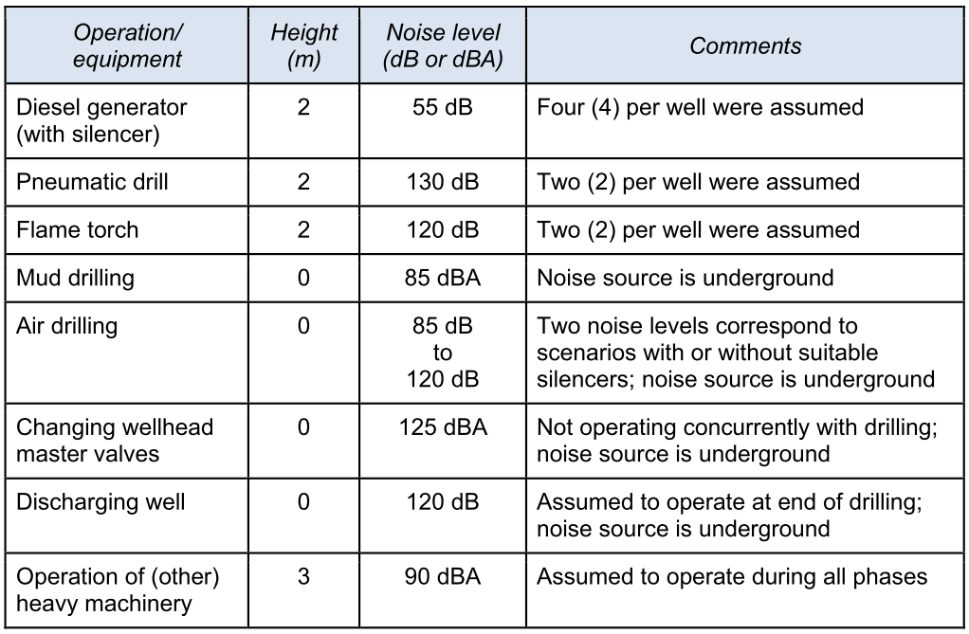

Slide 16
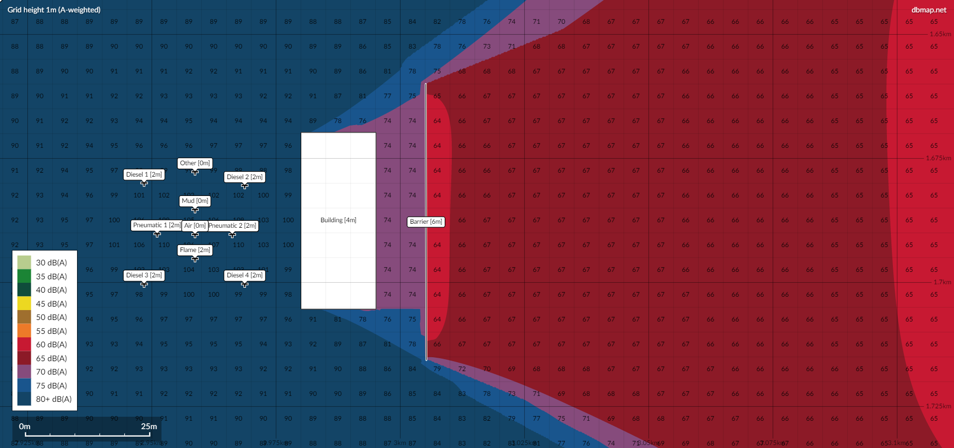

Slide 17
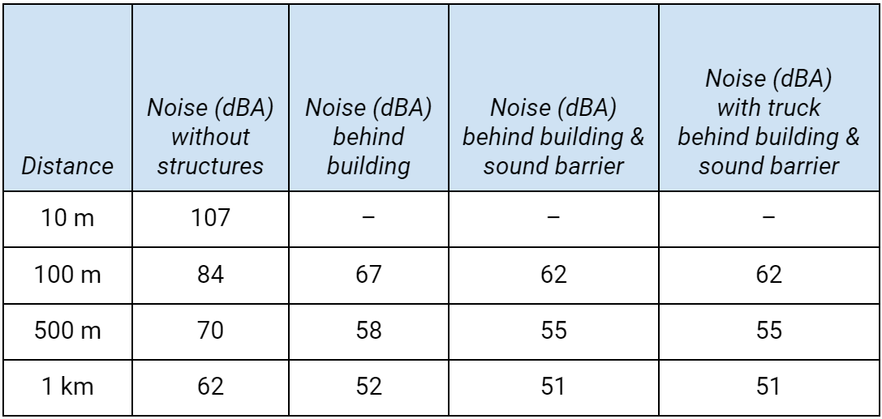
Noise modeling 2/3

Slide 18
Noise modeling 3/3
    The presence of buildings and sound barriers is likely to reduce noise levels by more than 20 dBA at a distance of 100 m (bringing them closer to those experienced during a busy day in a city center).
    At a distance of 1 km, noise barriers are unlikely to contribute significantly to noise reduction as long as buildings are located near the well.

Slide 19
Mitigation measures
    Mitigation measures proposed for
      Soil subsistence
      Induced seismicity
      Groundwater contamination
      Generation and management of liquid and solid wastes
      Land use
      Visual intrusion
      Water consumption
      Water pollution
      Greenhouse gas emissions
      Local air pollution
    (continued)
      Odors and degassing
      Noise
      Ecosystem disturbances
      Biodiversity
      Effects on wildlife
      Health impacts
      Risk from radioactive deposits
      Energy consumption
      Use of materials

Slide 20
Plan for the next 3 to 6 months and input required from partners
    Task 3.2: Social impact assessment, M13 (January 2022) to M22 (October 2022)
    M3.3: Complete online social survey, due by end of M19 (July 2022)
    D3.2: Report on social impacts, due by end of M22 (October 2022)
      Complete literature review (on social impacts and public acceptance), by end of February 2022
      Complete pilot social survey (to be completed by partners, advisory board, and focus group), by end of March 2022
      Complete full-scale social survey (with the aid of partners), by end of May 2022
      Complete statistical analysis of data (M3.3), by end of July 2022
      Have draft of D3.2 ready for review, by end of September 2022
      Have final version of D3.2 ready for upload, by end of October 2022

Slide 21
Another overview of WP3

