Slide 1
The Congress
Marilena Simiti

Slide 2
The Congress
Established by Article I of the Constitution, the Legislative Branch consists of the House of Representatives and the Senate, which together form the United States Congress.

Slide 3
The Congress
The American Congress remains the most influential legislature in the world.

Slide 4
Why is American Congress so powerful?
1)The Constitution: The framers of the Constitution clearly intended that Congress would be the cornerstone of the new republic. A leading role for the legislature was judged an essential defense against executive tyranny; the list of powers which the constitution awards to Congress is longer and more detailed than that given to the President. Madison, an architect of the American constitution, declared that ‘in republican government, the legislative power necessarily predominates’. Thus, Article I of the Constitution grants several key powers to Congress, which include overseeing the budget and all financial matters, the sole power to introduce legislation, confirming or rejecting judicial and executive nominations by the President, reviewing and monitoring other bodies such as the executive branch, and even declaring war

Slide 5
Why is American Congress so powerful
According to the Constitution the Congress has the power to tax and spend. This power is among the most important powers Congress possesses. It gives Congress what is typically referred to as “the power of the purse”. This means Congress controls the money. Thus, Congress has final authority over the budget. However, its proposal is subject to a presidential veto.

Slide 6
Why is American Congress so powerful?
2) Presidential System: Presidentialism is a form of constitutional rule in which the chief executive governs using the authority derived from direct election, with an independent legislature. Because both president and legislature are elected for a fixed term, neither can bring down the other, giving each institution some autonomy. This separation of powers (executive and legislative powers) is the hallmark of the presidential system and is typically reinforced by a separation of personnel. Members of the executive cannot sit in the assembly, creating further distance between the two institutions. Similarly, legislators must resign their seats if they wish to serve in the government. In essence, the presidential system separates the executive and legislative powers.

Slide 7

Presidential System
Presidential government consists of three features:
1. Popular election of the president who directs the government and makes appointments to it
2. Fixed terms of offices for the president and the Congress, neither of which can bring down the other.
3. No overlap in membership between the executive and the legislature.

Slide 8
Parliamentary System
While presidents in the presidential system are separate from the assembly and independently elected, the executive in parliamentary systems is organically linked to the legislature. The government emerges from the assembly and can be brought down by a vote of no confidence. By the same token the government can dissolve parliament and call fresh election.

Slide 9

Parliamentary System
Parliamentary government has three main features:
1. The governing parties emerge from the assembly. Government ministers are usually drawn from, and remain members of, the legislature.
2. The head of the government (called Prime Minister or Chancellor) and the council of ministers (called the Cabinet) can be dismissed from office through a vote of no confidence by parliament. The post of Prime Minister is separate from that of a ceremonial head of state (President or King/Queen)
3. The executive is collective, taking the form of a cabinet. This plural executive contrasts with the focus in presidential government on a single chief executive (the President).

Slide 10
Parliamentary System
In the case of parliamentary systems if a ruling government retains a strong and secure majority in the Parliament and party discipline is enforced, the executive can easily dominate the legislature. In this case government’s survival is not threatened by Parliament and the government can easily pass the legislation it proposes.

Slide 11
American Presidential System
In the American political system President and Congress share power: each seeks to influence the other, but neither is in any position to dictate. This separated system, reflects a successful attempt by the founders to build checks and balances into American government.
★ However, in the American political system the prospect of political stalemate is built into the American legislative-executive process. For example, there might be a Republican in the White House and Democrats controlling the Senate and the House of Representatives. That may lead to policy gridlock.

Slide 12
Divided- Unified Government
Divided government occurs when one or more houses of the legislature are controlled by the party in opposition to the executive.
Unified government occurs when the same party controls the executive and the legislature entirely

Slide 13
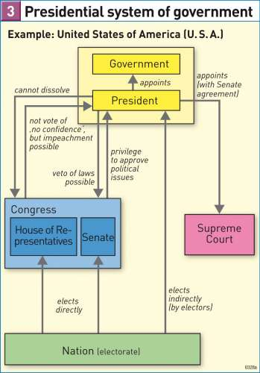

Slide 14
The Legislature
When a legislature has one chamber, we speak of a unicameral legislature (unicameralism)
When a legislature has two chambers we speak of a bicameral legislature (bicameralism). In bicameral legislatures, the first or lower chamber is typically called the National Assembly or House of Representatives. The second or upper chamber is usually known as the Senate.

Slide 15
Federations - Bicameralism
In all federations the federal units (e.g., states, cantons) have a guaranteed voice in national policy-making through an upper chamber of the assembly. In that chamber each state normally receives equal, or nearly equal, representation. The American Senate, with two senators per state, is the prototype. With its constitutional position as representative of the states, the Senate plays a full part in the country’s legislative process. Accordingly, the bicameral American Congress seeks to balance the effects of popular majorities with the interests of the states.

Slide 16
The American Congress
The American Constitution gives the Congress a bicameral but interconnected design. Article 1, section 7 of the Constitution requires them to work together to produce legislation. Both the House and the Senate must pass a bill in the same form for it to become law. There are further provisions that connect the two chambers together. For instance, the House of Representatives is responsible for deciding the impeachment of a President. The Senate is responsible for the trial of the President. In brief, both legislative bodies matter and are co-equal. On the other hand, there are clear differences between the two legislative bodies regarding size, terms of office, size of constituency and constitutional responsibilities. For instance, only the House can originate revenue legislation, and only the Senate confirms presidential nominations and approves treaties. Finally, each branch creates its own rules and organization.

Slide 17
American Congress -Senate (upper chamber)
The Constitution specifies that every state will have two senators who each serve a six-year term. Therefore, with fifty states in the Union, there are currently one hundred seats in the U.S. Senate. Senators were originally appointed by state legislatures, but in 1913, the Seventeenth Amendment was approved, which allowed for senators to be elected by popular vote in each state. Senators’ terms are arranged so that about one-third of the Senate is up for reelection every two years
Senate → Direct popular vote in each of 50 states, Length of term: 6 years, Limit in Reelection: No limits

Slide 18
2024 United States –Senate elections
50 for majority
DEMOCRATS: 47
REPUBLICANS: 53
Republicans won the Senate

Slide 19
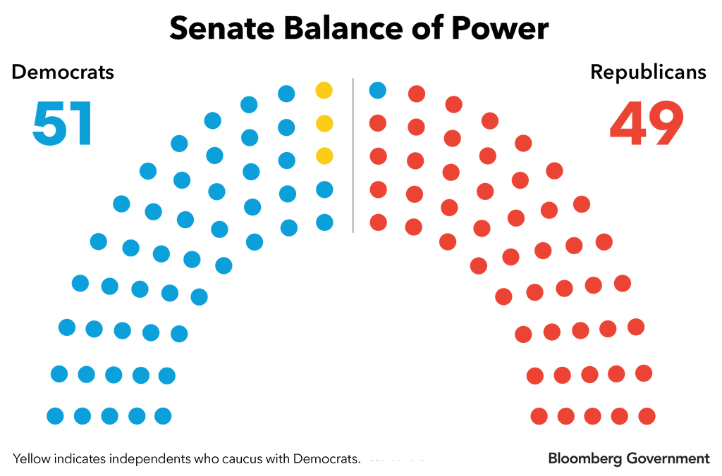
2022 United States Senate elections

Slide 20
American Congress -Senate (upper chamber)
In addition to full legislative authority, the U.S. Constitution provides the Senate with two unique responsibilities: first, the power to confirm certain presidential nominees to the federal judiciary and certain executive branch positions; and second, the power to approve treaties. The Constitution requires that two-thirds of voting Senators agree for a treaty to be ratified. Most presidential nominations are referred to the relevant Senate committee of jurisdiction. Prior to potential committee action to report a nomination, a committee may hold a hearing at which a nominee answers questions from the committee’s members. His or her confirmation requires only a simple majority vote.

Slide 21
American Congress-
House of Representatives
(lower chamber)
The House of Representatives has several powers assigned exclusively to it, including the power to initiate revenue bills, impeach federal officials, and elect the President in the case of an Electoral College tie.

Slide 22
American Congress -House of Representatives (lower chamber)
The House of Representatives is larger than the Senate, with 435 elected members. Seats in the House of Representatives are distributed among the states based on each state’s population. Each state is divided into several single-member districts according to its population. States with larger populations are divided into more numerous single-member districts. Accordingly, more populous states have more representatives in the House. Because of this system, representatives in the House generally have fewer constituents than do senators. Members of the House are elected every two years.
House of Representatives→ Direct popular vote in each of 435 districts, Length of term: 2 years, Limit in Reelection: No limits

Slide 23
2024 United States House of Representatives: Total 435
212 Democrats
Before: 214
Not yet called -5
218 seats for majority
The Republicans won the House of Representatives.
218 Republicans
Before: 221

Slide 24
2022 United States House of Representatives elections
Partisan composition, U.S. House
118th Congress
Party | Members
Democratic | 213
Republican | 221
Vacancies | 1
Total | 435

Slide 25
House of Representatives - Election
Since elections for the members of the House of Representative take place in single-member districts, the candidate who receives the greatest overall number of votes wins. Winner-take-all elections with one representative elected for one district allow voters to develop a personal relationship with “their” representative to the government. But winner-take-all elections also tend to limit the number of people who run for office. Since voters do not like to waste votes, candidates of third parties must convince voters they have a real chance of winning races before voters will take them seriously. Third parties that appeal to only a small percentage of voters will always lose to a party that is more popular. Therefore, analysts argue that the existing winner-take-all elections favor and strengthen the established two-party system.

Slide 26
House of Representatives – Drawing Electoral districts
Federal law requires states with more than one representative to draw numerous individual districts. Federal law requires that these districts must be as equal in population as possible. The federal law also requires the creation of districts where minority groups comprise most of the district population where possible. Electoral district boundaries must be redrawn at least every decade according to the population and demographic changes recorded by the United States Census. However, state legislatures are free to draw the boundaries as they please, keeping in mind the population and minority requirements. “Redistricting” can have a decisive effect on who is elected in the House of Representatives.

Slide 27
House of Representatives - Gerrymandering
The term ‘gerrymandering’ refers to districts deliberately drawn is such a way to disadvantage a certain group of people (e.g., racial, ethnic minorities) or political party and privilege another. Historically, this was one method of disenfranchising African Americans. Concentrations of African Americans were divided between districts to prevent any district majorities (this method is known as “cracking”). Today federal law prohibits racial/ethnic “cracking”. As United States have become more politically polarized, partisan gerrymandering has become increasingly common. States controlled by one party will draw districts to advantage their own party. Some states to overcome the danger of gerrymandering have turned to independent districting commissions (e.g. Arizona, California, Montana)

Slide 28
The incumbency effect
Incumbents are elected officials who currently hold an office. Modern political campaigns in the United States are expensive, and they have been growing more so. For example, in 1986, the costs of running a successful House and Senate campaign were $849,111 and $7,243,782, respectively (in 2020 dollars). By 2020, those values had shot to $2.4 million and $27.2 million. The amount of money that incumbents raise against their challengers demonstrates their advantage. This is one of the many reasons incumbents win a large majority of congressional races each electoral cycle.

Slide 29
The incumbency effect
In the House, the percentage of incumbents winning reelection has been over 85 percent for the last half century. The difficulty of unseating an incumbent in the House or Senate is often referred to as the incumbent advantage or the incumbency effect. The advantage in financing is a huge part of this effect, but it is not the only important part. Incumbents often have a much higher level of name recognition. Voters are far more likely to select the name of the person they recall seeing on television than the name of a person they hardly know. And donors are more likely to want to give to a proven winner.

Slide 30
The incumbency effect
Also, political parties in general prefer to support incumbents in elections, because the general consensus is that incumbents are better candidates. Finally, incumbent members of Congress have paid staff, influence, and access to specialized information that can help their constituents in ways other persons cannot. On the other hand, significant changes in public opinion may affect the incumbency effect. For instance, in the political environment of 2014, when conservative voices turned further to the right, House majority whip Eric Cantor (highest-level Republican representative) failed to be reelected.

Slide 31
The incumbency effect
The incumbency effect refers to the electoral bonus sitting members enjoy, arising from
their visibility in their district, their ability to deliver specific benefits to their home districts and their access to resources for their re-election campaign. The incumbency effect helps to explain the high re-election rate in the American Congress.

Slide 32
Congress
Representation
Lawmaking
Oversight and monitoring the executive branch

Slide 33
Congress - Representation
By definition Senators and House members are representatives. This means they are intended to be drawn from local populations around the country so they can speak for and make decisions for their constituents. Two fundamental questions can be posed regarding representation:
Should Congress share the same demographic characteristics as the public, look like the public? (descriptive representation),
Should the role of representatives be that of a delegate or a trustee?

Slide 34
Descriptive Representation
In the past, there was relatively little concern about descriptive representation in Congress. A major reason was that until well into the twentieth century, White men of European background constituted an overwhelming majority of the voting population. African Americans were routinely deprived of the opportunity to participate in democracy, and Hispanics and other minority groups were fairly insignificant in number. While women in many western states could vote sooner, all women were not able to exercise their right to vote nationwide until passage of the Nineteenth Amendment in 1920, and they began to make up more than 5 percent of either chamber only in the 1990s.

Slide 35
Descriptive Representation
In recent decades, Congress has become much more descriptively representative of the United States. The 117th Congress, which began in January 2021 had a historically large percentage of racial and ethnic minorities. African Americans made up the largest percentage, with fifty-seven members, while Latinos accounted for forty-seven members, up from thirty just a decade before. Still, the diversity of the country is not reflected in the U.S. Congress, whose membership (following the 2020 elections) was approximately 76 percent male, 77 percent White, and 88 percent Christian

Slide 36
Delegate vs Trustee
A second question concerning representation is what the role of the legislator as a “representative” should be.
Representatives who see themselves as delegates believe they are empowered merely to enact the wishes of constituents. They are not permitted the liberty of employing their own reason and judgment while acting as representatives in Congress. This is the delegate model of representation.
In contrast, a representative who understands their role to be that of a trustee believes they are entrusted by the constituents with the power to use good judgment to make decisions on the constituents’ behalf. This is the trustee model of representation.

Slide 37
Delegate vs Trustee
Understandably, few if any representatives adhere strictly to one model or the other. Instead, most find themselves attempting to balance the two models. Usually, representatives remain firm in support of some ideologies and resistant to others. On the political right, an issue that demands support might be gun rights; on the left, it might be a woman’s right to an abortion. For votes related to such issues, representatives will likely pursue a delegate approach. For other issues, especially complex questions, such as subtle economic reforms, representatives will tend to follow a trustee approach.

Slide 38
House of Representatives-Organization
The House has a constitutionally specified presiding officer – the Speaker – who is elected by a majority vote of the entire House. The vote is traditionally a party-line vote, so the Speaker is always a member of the majority party. As a testament to the importance of the Speaker, since 1947, the holder of this position has been second in line to succeed the president in an emergency, after the vice president. The Speaker has the authority to assign bills to committees. The Speaker also chooses the chairperson and the majority-party members of the powerful House Rules Committee, which controls the scheduling of bills. Moreover, the House Rules Committee, which is controlled by the Speaker, has the power to enforce formal limits on floor activity – debating and amending bills.

Slide 39
House of Representatives-Organization
In the House every bill gets a rule from the Rules Committee before it is scheduled for floor action by the entire chamber. The rule may place limits on floor debate and amendments. These abilities make the Rules Committee a very powerful force in the House.

Slide 40
Senate-Organization
In contrast the Senate doesn’t have a Speaker. According to the Constitution, the Senate’s president is the elected Vice President of the United States. The Vice President is empowered to preside over Senate deliberations at any time but may not vote except to cast a tie-breaking vote (in case of an equal number of votes). The Senate majority leader’s position is less powerful than that of the House Speaker. Unlike the House, where the Speaker directs the floor debate, the Senate has a tradition of unlimited debate. Any senator who wishes to speak on a bill can do so and for any length of time. Moreover, the Senate allows its members to propose amendments to any bill, even if these amendments are not closely related to the bill’s content.

Slide 41
Senate
Accordingly, coordination of the Senate’s business emerges from constant negotiations between the party leaders, the majority and minority leaders. They spend every legislative day negotiating temporary interparty contracts.

Slide 42
Party Leadership - Congress
Each party in each chamber has its own leadership that coordinates party policy positions (majority and minority leaders). Below these leaders are the two party’s respective whips. A whip’s primary duty is to enforce voting discipline in the chambers.

Slide 43
Committees
Committees are actually mini-legislatures that divide up the workload of Congress. In both chambers policy expertise resides in the standing committees – consisting of members from both parties that typically take the lead in developing and assessing legislation. At present there are 20 standing committees in the House and 16 in the Senate. Standing committees are permanent. All committees are chaired by a member of the majority party, though chairs often work closely with the committee’s ranking member, the most senior member of the minority party on the committee. In almost all cases, the ratio of majority party to minority party members on a committee roughly reflects the overall partisan ratio in the congressional chamber.

Slide 44
Standing Committees
Each standing committee has legislative authority in that it can draft, and rewrite proposed legislation and can recommend to the full chamber the passage or defeat of the bills it handles. These are substantial sources of power that legislative committees in some democracies don't have. Their role is limited to advising party leaders on policy issues. Most of the standing committees have subcommittees, each of which has a defined jurisdiction.

Slide 45
Committees
(Standing Committees - Examples)
House
Senate
Agriculture
Appropriations
Armed Services
Budget
Education and Labor
Energy and Commerce
Ethics
Financial Services
Foreign Affairs
Homeland Security
House Administration
Judiciary
Natural Resources
Oversight and Reform
Rules
Agriculture, Nutrition, and Forestry
Appropriations
Armed Services
Banking, Housing, and Urban Affairs
Budget
Commerce, Science, and Transportation
Energy and Natural Resources
Environment and Public Works
Finance
Foreign Relations
Health, Education, Labor, and Pensions
Homeland Security and Governmental Affairs
Judiciary
Rules and Administration
Small Business and Entrepreneurship
Veterans' Affairs

Slide 46
Four Types of Committees
Standing: Permanent and focus on legislating. They contain only members of one chamber
Select: They are temporary and generally used to investigate issues that do not fit neatly into any standing committees. They contain only members of one chamber.
Joint: They may be permanent or temporary and are generally advisory. They exist to coordinate policy between the House and Senate. As such, they contain members from both chambers
Conference: They are created, whenever needed, solely to resolve differences between House and Senate versions of a single bill. They contain members from both chambers (usually members from the standing committees that developed the bill).

Slide 47

The Process by which a Bill becomes Law

Slide 48
The process of creating laws is often referred to as labyrinth-having lots of twists and turns where proposals can and do disappear.
Moreover, the process by which a bill (meaning a proposed legislative act) becomes law is rarely predictable and can vary significantly from bill to bill

Slide 49
Introduction and Referral of Bills
In the House, bills are referred by the Speaker, to all committees that have jurisdiction over the provisions in the bill. In the Senate, bills are first submitted to the office of the majority leader who will, in consultation with the minority leader, refer the bill to one or more committees in a similar process.

Slide 50
Committee Consideration
The first formal committee action on a bill or issue might be a hearing, which provides a forum at which committee members and the public can hear about the strengths and weaknesses of a proposal from selected parties – like key executive branch agencies, relevant industries, and groups representing interested citizens. The committee agrees by majority vote if a bill should be reported to the chamber (meaning if it is eligible for floor consideration).

Slide 51
House Floor
In the House, each and every bill gets a rule from the Rules Committee before it is scheduled for floor action by the entire chamber. The rule may place limits on floor debate and amendments. The Rules Committee may enact stricter limits on debate (all the way down to no debate at all),and may place limits on amending (all the way down to no amendments at all) as well. These abilities make the Rules Committee a very powerful force in the House. The final vote requires a simple majority for approval of the bill.

Slide 52
Clarification
Plurality: A plurality vote describes the circumstance when a candidate or proposition polls more votes than any other but does not receive more than half of all votes cast
Simple Majority: A simple majority is a vote where at least 50% + 1 of the members must vote yes to approve a bill before it is accepted.
Supermajority: It is the requirement for a particular measure or legislation to receive significantly more than half of the votes in order for the measure to pass. For example, a supermajority can refer to a three-fifths or two-thirds vote.

Slide 53
Senate floor
With no similar rules in the Senate, there is no similar referral to any rules committee. One way the Senate can take up a bill is by agreeing to a motion to proceed to it. Once a Senator – typically the majority leader – makes such a motion that the Senate proceed to a certain bill, the Senate can then normally debate the motion to proceed. If it eventually agrees to the motion by a majority vote, the Senate can then begin consideration of the bill. Most questions that the Senate considers – from a motion to proceed to a bill, to each amendment, to the bill itself – are not subject to any debate limit. Simply put, Senate rules provide no way for a simple numerical majority to cut off or otherwise impose a debate limit and move to a final vote. This lack of enforcement power of strict rules is often used strategically in the form of a filibuster. Thus, Senators can effectively wage (or threaten to wage) a filibuster. In doing this, a ﬁlibustering senator or set of senators seize control of Senate business, greatly slowing the legislative process. Filibuster is a Senate rule (but not a law).

Slide 54
Filibuster
In earlier times, filibusters were tiresome and physically difficult In the past, senators wishing to filibuster had to talk continuously—hour after hour. In the past, groups of dedicated southern senators used the filibuster to prevent the passage of anti-lynching legislation on multiple occasions during the first half of the twentieth century. Later when faced with the 1964 Civil Rights Act southern senators staged a fifty-seven-day filibuster to try to kill the bill. But the momentum in society was against them. The bill passed over their obstructionism. Some senators began to realize that one way to elongate a filibuster is to work in concert with others. Teams of senators may filibuster for days, weeks, or longer. When one Speaker tires, a sympathizer rises to ask a question—which may take several hours—giving the original Speaker a much-needed break. Thus, a typical filibuster involves several senators taking turns speaking and asking questions.

Slide 55
Filibuster - Cloture
A ﬁlibuster ends only when a supermajority of sixty senators vote to end it (which is known as “cloture”). Since a cloture process requires a supermajority (three-fifths or 60 Senators) to end debate on a bill, this means in practice that the bill must have the support of a three fifths supermajority.
So any bill that has the support of at least 60 senators is, in effect, filibuster-proof, and the Senate can quickly move on to the next steps leading up to a final vote.
If a proposed bill is not threatened by a filibuster then the final vote for approval requires only a simple majority.

Slide 56
Filibuster
A feature of the modern legislative process, exclusively in the Senate, is the application of the modern filibuster. Unlike, the traditional filibuster, in which a senator took the floor and held it for as long as possible, in modern times the senators can request cloture before any bill gets a vote. As a result, most of the time, the actual filibuster action is not needed since floor leaders rarely bring bills to the floor that don’t meet the cloture threshold.

Slide 57
Filibuster
Thus the new ﬁlibuster has transformed the Senate minority leader into a major political player in national American politics. In an important sense, the Senate minority leader and his colleagues exercise a kind of veto in the legislative process. This means that there is a new veto that cannot be found in the Constitution. The Constitution gives the president a qualiﬁed veto, one that can be overridden by a majority of two-thirds in both chambers

Slide 58
Filibuster
The new ﬁlibuster has also another effect. It influences the size of a party’s feasible policy agenda when it happens to control both chambers. When the same party holds a majority in both the House and the Senate, the Senate majority’s policy agenda will be smaller than the House majority’s agenda. This is because the Senate has a veto player that the House does not have. In other words, the House majority can seem to do more than the Senate majority. But bicameralism means that the new limits on what the Senate majority can actually accomplish will also limit what the House can do.

Slide 59
Can the filibuster be eliminated?
To end a filibuster senators may use the “nuclear option” to change the Senate’s standing rules by a simple majority vote. Basically, they create a new precedent. Before 2013, Senate majorities used the nuclear option only rarely. In November 2013, Democrats employed it to abolish the filibuster for all presidential nominations other than Supreme Court justices. In 2017, Republicans used it to abolish the filibuster for Supreme Court nominations.

Slide 60
What Americans think of the filibuster
Source: Pew Research Center poll, 2018

Slide 61
Budget-Reconciliation: Preconditions
Via the process called “budget reconciliation” a bill can be brought up for a vote and pass with a simple majority in the Senate. However, the reconciliation bill must affect federal spending or federal revenue. Raising and lowering taxes, expanding subsidies for health insurance, and spending money on new infrastructure projects are some of the obvious subjects that could be included in a reconciliation bill. The Senate cannot use budget reconciliation for every bill. Historically, the Senate has usually been limited to passing only one budget reconciliation bill in a given fiscal year.

Slide 62
US lawmakers approved $1tn in infrastructure spending – Bipartisan Support
(11/2021)
The Senate gave overwhelming bipartisan approval to a $1 trillion infrastructure bill to upgrade highways, roads and bridges, and to modernize city transit systems and passenger rail networks. It also provides funding for clean drinking water, high speed internet, and a nationwide network of electric vehicle charging points. In the Senate the vote was uncommonly bipartisan (69 to 30).

Slide 63
Resolving Differences
A bill must be agreed to by both chambers in the same form before it can be presented to the President. Once one chamber, passes a bill it is sent to the other chamber. In a majority of cases, the second chamber simply agrees to the exact text passed by the first chamber, in which case Congress has then completed its action on the bill.
In some cases, the second chamber instead decides to amend the first chamber’s bill. It may propose an alternative version of the bill. In this case after the second chamber has agreed to its own version of the bill, this new version of the bill is sent back to the first chamber for consideration and a vote. The receiving chamber may vote the new proposal or respond with a counterproposal, and so on. This back-and-forth trading of proposals by the House and Senate is called amendment exchange, or sometimes simply ping-pong. For the bill to have a chance of becoming law, one chamber must eventually agree to the proposal that the other chamber has sent to it.

Slide 64
Resolving Differences
Sometimes, the resolution of differences between the House and Senate proposals is accomplished through a conference committee (a temporary committee with the task to negotiate a proposal that can be agreed to by both chambers). It is made up of members of the House and members of the Senate who are drawn primarily from the committees with jurisdiction over the bill. Negotiations in the conference committee lead to a conference report. Both chambers must agree to the conference report without changes.

Slide 65
Presidential Actions
Once both chambers of Congress have each agreed to the bill, it is presented to the President. The President has ten days to sign or veto the bill. If the bill is signed in that ten-day period, it becomes law. If the President vetoes the bill, it is returned to the congressional chamber in which it originated; that chamber may attempt to override the president’s veto. However, a presidential veto can be overridden only by a two-thirds majority in each chamber. Only if both chambers vote to override the veto does the bill becomes law. A successful override of a presidential veto is extremely rare. Since the late 18th century until present day, presidents have exercised their veto authority more than 2,500 times. Congress’s rate of override has been a little more than 4 percent. Therefore, Congress typically must accommodate the president’s position on proposed policies.

Slide 66
Congress
Once law is enacted, Congress has the prerogative and responsibility to provide oversight of policy implementation, and its committees take the lead in this effort. Both chambers provide their committees with significant powers for oversight and investigations into questions of public policy and its effects.

Slide 67
Summarizing- Co-equal Bodies
House and Senate are co-equal bodies in nearly all respects (an exception is presidential nominees who are confirmed or rejected by Senate only).
Because they are co-equal bodies, no bill can be enacted by Congress unless passed in identical form by both the House and Senate.
They are similar in organization. The majority party’s leaders head each chamber, and each chamber has standing committees which work on bills before they are submitted to the full chamber. The chair of each standing committee is from the majority party, as are a majority of each committee’s members.

Slide 68
Summarizing-Operationally, however, the House and Senate Differ
The House is a much larger body than the Senate (435 members to 100 members) and therefore requires more centralized organization to function. The Speaker of the House has considerably more power over House members of the same party than does the Senate majority leader and also has more control over the chamber’s legislative agenda. Additionally, the standing committees in the House are somewhat more important than those in the Senate. Often, most of the work on a bill will be done first by a House standing committee and then be picked up its corresponding Senate committee.

Slide 69
The Budgetary Process
The budgetary process—>the process through which annual federal spending and revenue decisions are made
The Constitution assigns Congress the power to tax and spend, but the president, as chief executive, also has a major role in determining the budget. The budgetary process involves give- and-take between Congress and the president as each tries to influence how federal funding will be distributed among various agencies and programs. From beginning to end, the budgetary process lasts a year and a half

Slide 70
The Budgetary Process - The President
The process is relatively simple. Early every year, the president submits a budget proposal to the Congress. It consists of requests from all federal agencies and organizations for operating funds, as well as requests from the president for funding new programs and policies. However, the president does not have any real say over most of the budget, about two- thirds of which involves mandatory spending. This spending is required by law, as in the case of Social Security payments to retirees. The president has no authority to suspend or reduce such payments. Only one-third of the budget that involves discretionary spending, which includes spending in areas such as defense, foreign aid, education, space exploration, highways, etc.

Slide 71
The Budgetary Process – The Congress
In January, the president’s budget is submitted to Congress. Upon reaching Congress, the President’s budget proposal goes to the House and Senate budget committees. Their job is to recommend overall spending and revenue levels. Once approved by the full House and Senate, the levels are a constraint on the rest of Congress’s work on the budget.

Slide 72
The Budgetary Process
Afterwards, the House and Senate appropriations committees take over. After the House and Senate appropriations committees have completed their work, they submit their recommendations to the full chambers for a vote. Approval requires a majority in the House and in the Senate. If there are differences in the Senate and House versions, these differences are reconciled in the conference committee. The reconciled version of the budget is then voted upon in the House and the Senate and, if approved, is sent to the president to sign or veto. The threat of a presidential veto can be enough to persuade Congress to accept many of the president’s recommendations. In the end, the budget inevitably reflects both presidential and congressional priorities. Neither branch gets everything it wants, but each branch always gets some of what it seeks.

Slide 73
The Budgetary Process- Government Shutdown
After the budget has been signed by the president, it takes effect on October 1, the starting date of the federal government’s fiscal year. If agreement on the budget has not been reached by October 1, temporary funding legislation is required in order to maintain government operations. If agreement is not reached, there is a shutdown where all non-essential discretionary functions are discontinued.

Slide 74
Partisan Conflict in Congress
The past thirty years have brought a dramatic change in the relationship between the two parties as fewer conservative Democrats and liberal Republicans have been elected to office. As political moderates, or individuals with ideologies in the middle of the ideological spectrum, leave the political parties at all levels, the parties have grown farther apart ideologically, a result called party polarization. For example, until the 1980s, northern and midwestern Republicans were often fairly progressive, supporting racial equality, workers’ rights, and farm subsidies. Southern Democrats were frequently quite socially and racially conservative and were strong supporters of states’ rights. Cross-party cooperation on these issues was fairly frequent.

Slide 75
Partisan Conflict in Congress
As the partisan divide in Congress has widened, there has been a decline in the number of lawmakers in the political center. At an earlier time, congressional moderates were the key players. Their numbers were large enough for them to force other lawmakers to come to the middle to engage in the negotiation and compromise that can be necessary to get agreement on legislation. Today, there are too few moderates in Congress to force other members to come to the center. A frequent result has been legislative deadlock. Republicans and Democrats have taken opposite positions on a bill, with neither side being willing to make the concessions that would produce the bipartisan support necessary to pass it. In the party-in-government, this means fewer members of Congress have mixed voting records.

Slide 76
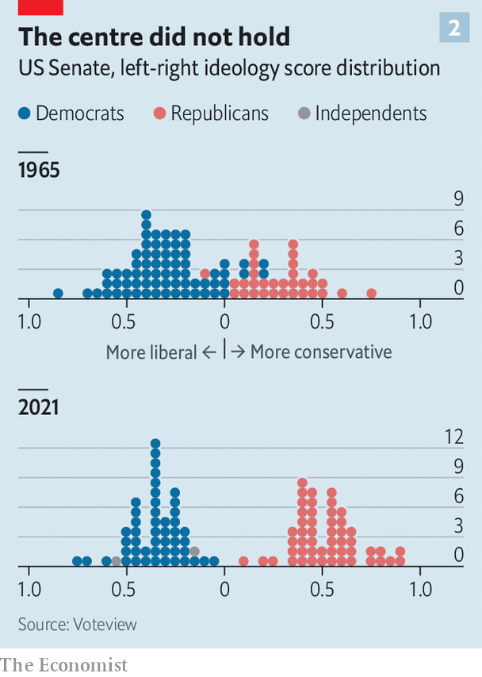

Slide 77
Legislative gridlock
In a parliamentary system, the majority party has full control of legislative and executive power and can enact its agenda. In the American system, by contrast, executive and legislative powers are divided, and legislative power is further divided between the House and the Senate. When the two parties are closely divided in strength, the division of powers enables each party to prevent the other from acting. The result can be policy deadlock and delay.

Slide 78
Legislative gridlock
This tension within the presidential system continues even when one party controls both the White House and the Congress. Partisans in the legislature cannot be expected to simply obey the executive’s orders. First, legislators may serve a constituency that disagrees with the executive on key matters of policy. If the issue is important enough to voters, as in the case of gun control or abortion rights, an office holder may feel their job will be in jeopardy if they too closely follow the party line, even if that means disagreeing with the executive. Second, there are still divisions within parties (e.g., radicals/liberals – moderates/conservatives in the Democratic Party).

