Slide 1

We the People: Between Ideas/IDeals and Reality

Slide 2
“American democracy has never shed an undemocratic assumption
present at its founding:
that some people are inherently entitled
to more power than others.”
Jamelle Bouie

Slide 3
What is democracy …. and what is it not?

Slide 4
Buzz Session: America
America
Democracy

Slide 5
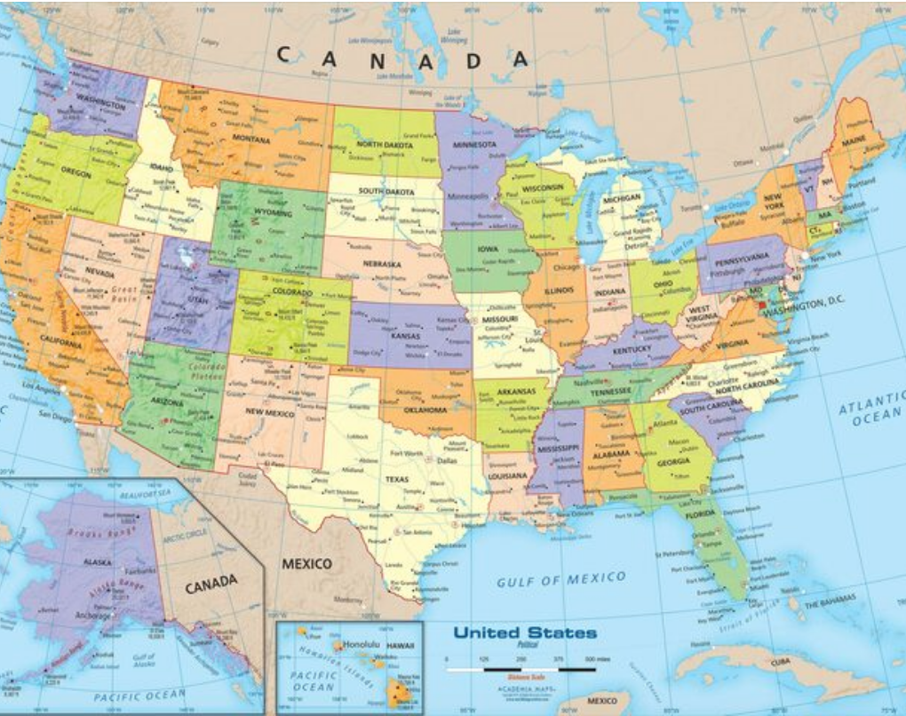
Recap: Snapshot of the United States of America
329.5 mill (EU: 447 mill; China: 1,4 bill)
Foreign born: 47 mill (14.4%)
Capital: Washington, DC
Presidential democracy with a bicameral legislature
Federal system
https://www.worldmapsonline.com/united-states-political-wall-map/

Slide 6
Key Points and Some Takeaways from Today’s Conversation
More holistic understanding of American history, politics and culture
America as the “biggest experiment in human liberty”
American exceptionalism
A history of contradictions – between ideas/ideals and reality
The history of American democracy is the struggle of the dis-empowered to be treated as “citizens,” entitled to and enjoying all rights and protections, and to access power
  27.4% women, 23% people of color
“A Nation by Design” (Zolberg 2008)
Stolen lives, stolen land, stolen labor & the centrality of slavery to American history and economics
  How to reckon with this history? -> BLM, CRT removing statues
  Whose history, whose truth?
What is the proper role of government (in American society and the economy?)
Balancing liberty – equality – order
Balancing federal versus states’ rights
Individual rights and individualism versus societal needs and group rights
Role of religion in public life
Increasing polarization

Slide 7
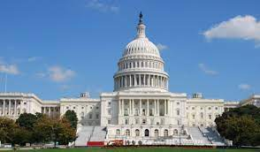
Key Dates, Terms and Ideas in American Democracy
1607 Jamestown
1619 enslaved Africans brought to Continental America
John Locke, Jean Jacques Rousseau, JJ de Montesquieu
natural law
social contract
Declaration of Independence 1776
Constitution 1789
Bill of Rights and Amendments to the Constitution
republic
popular sovereignty
limited government
federalism
separation of powers
checks and balances
representative democracy
1863/1865
1868 14th Amendment
1919 19th Amendment
1964 Civil Rights Act, 1965 Voting Rights Act

Slide 8
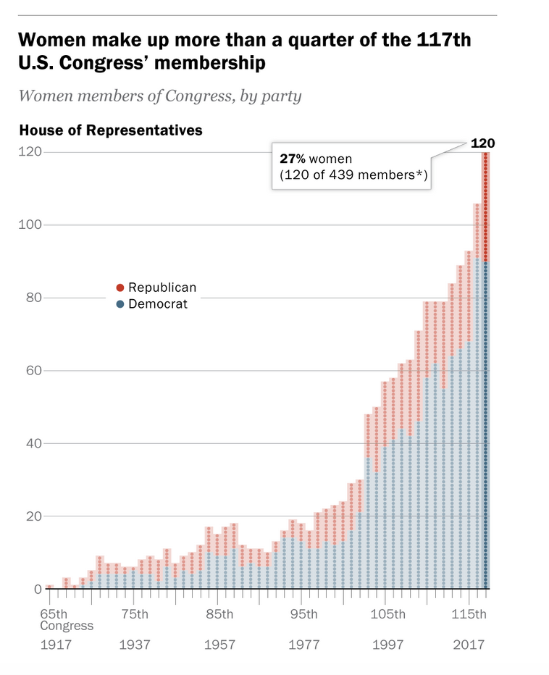
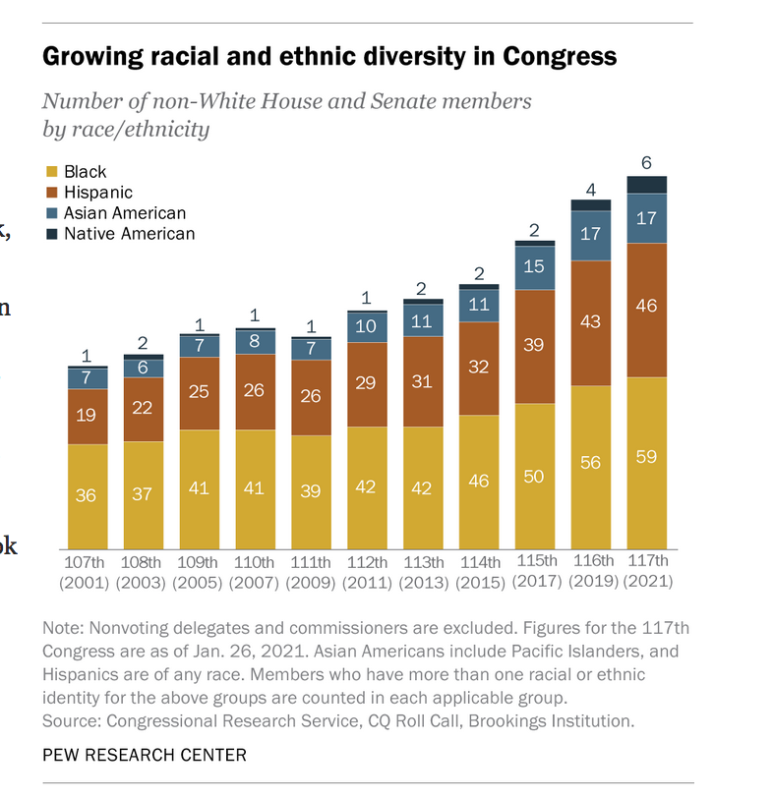
https://www.pewresearch.org/fact-tank/2021/03/10/the-changing-face-of-congress/

Slide 9
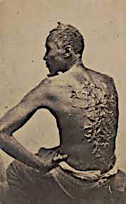
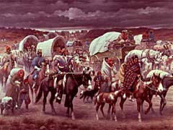
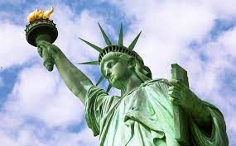

Slide 10
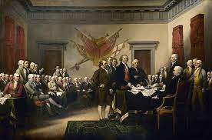
The Founders: Idealistic Heroes or Racist Villains?
George Washington, Thomas Jefferson, James Madison, and Benjamin Franklin owned enslaved people.

Slide 11
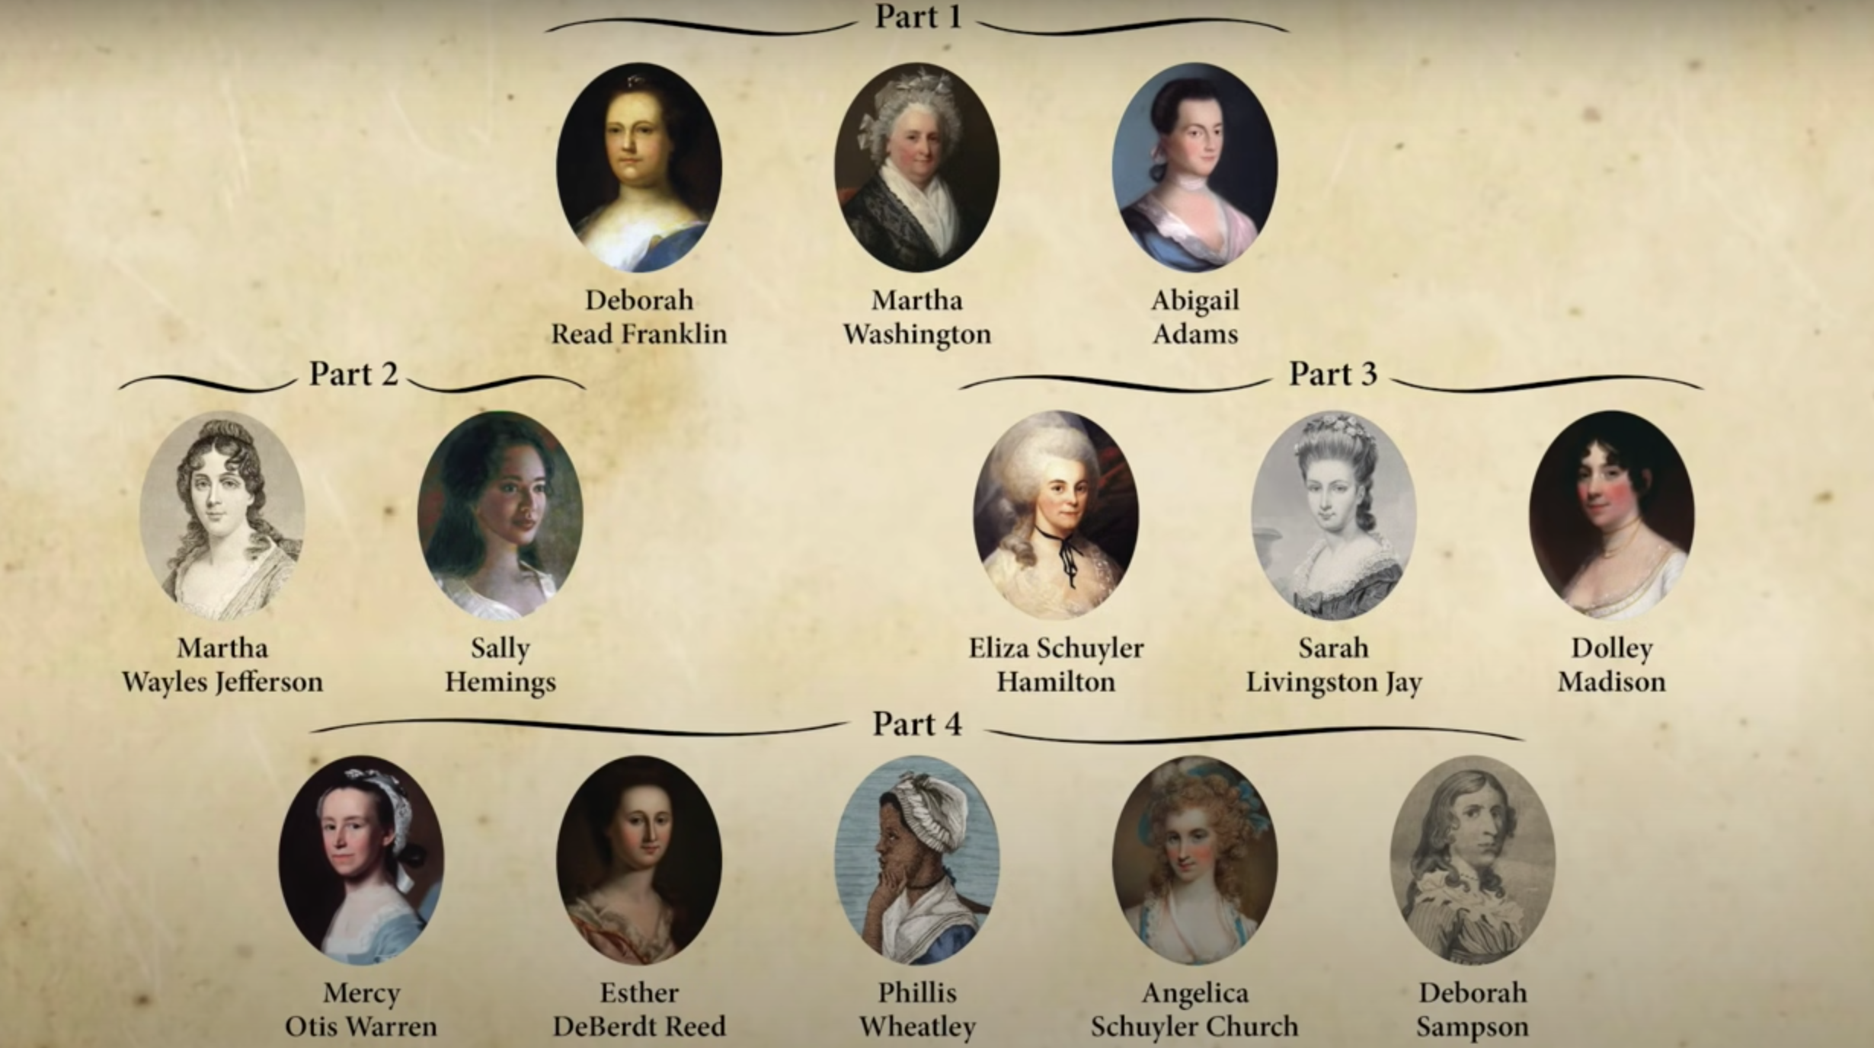
And what about the Founding Mothers?
Check out these short videos on these amazing women: https://www.youtube.com/watch?v=N7kqNR2l704

Slide 12
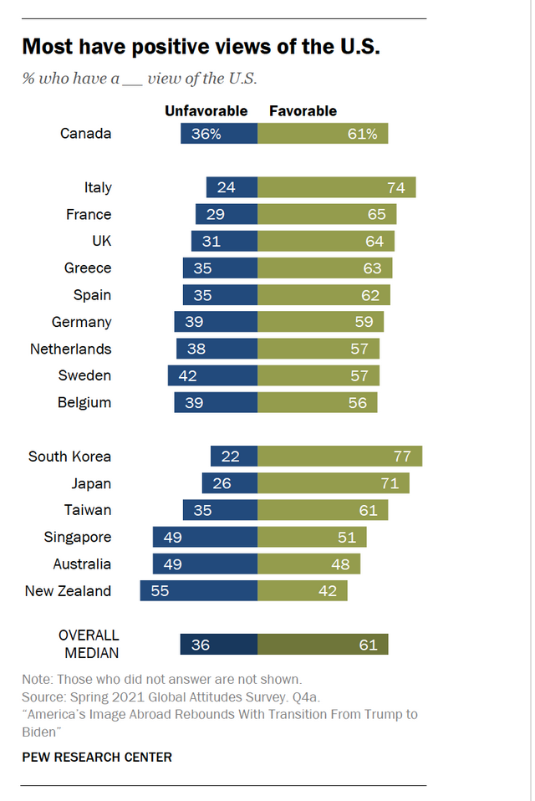
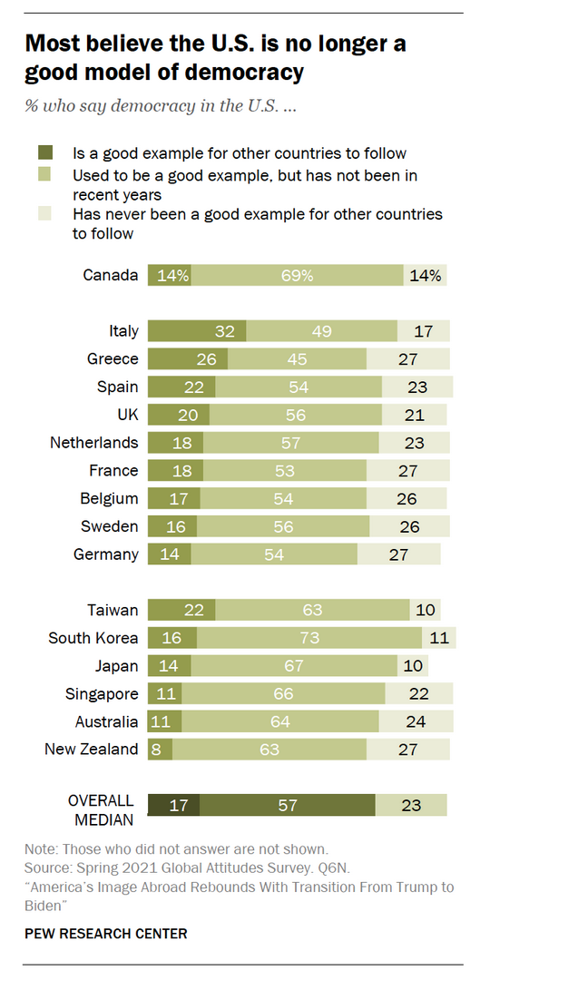
https://www.pewresearch.org/social-trends/2020/01/09/trends-in-income-and-wealth-inequality/

Slide 13
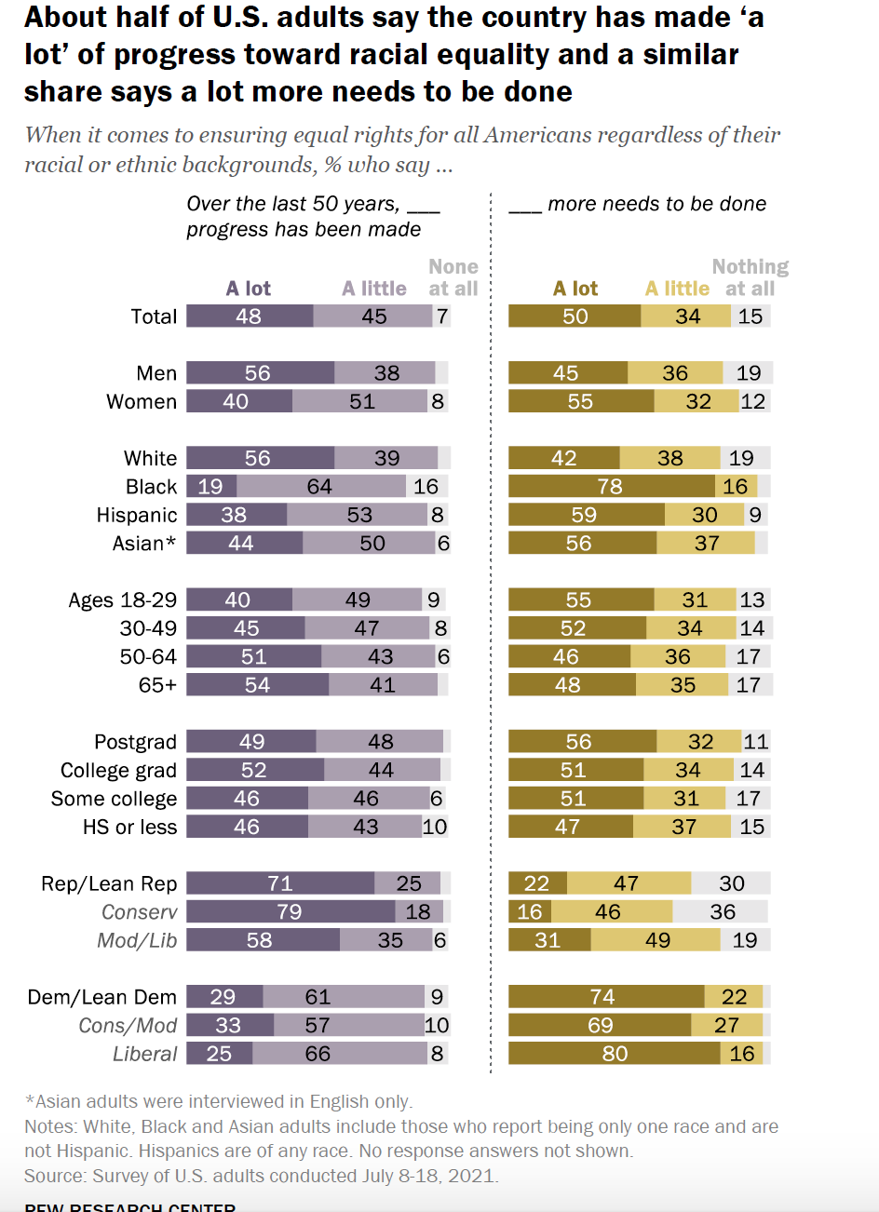
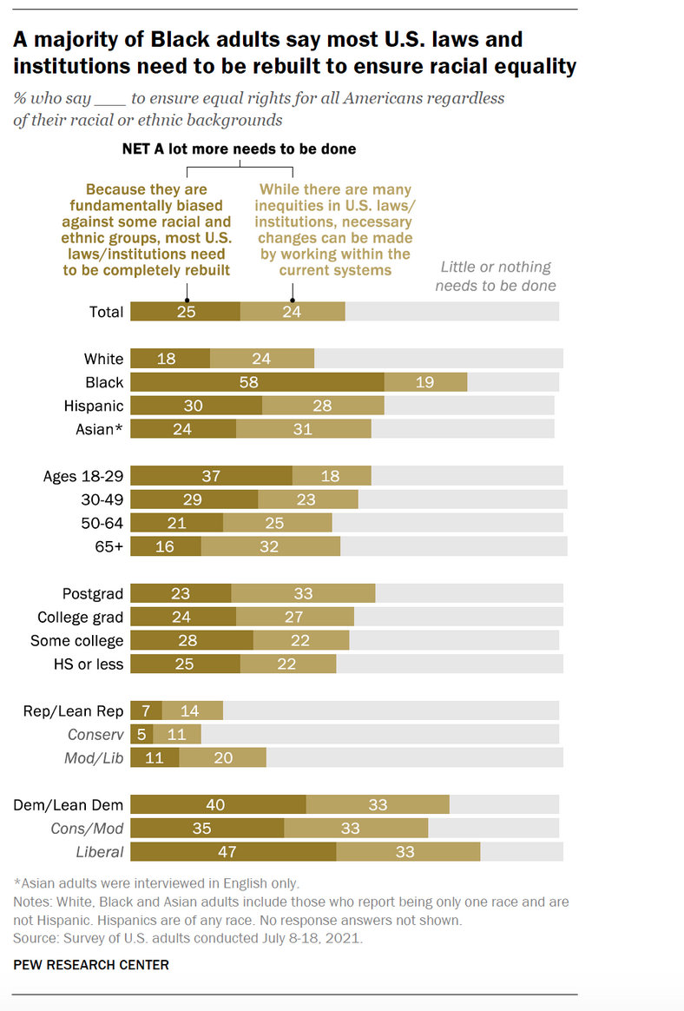
https://www.pewresearch.org/politics/2021/08/12/deep-divisions-in-americans-views-of-nations-racial-history-and-how-to-address-it/

Slide 14
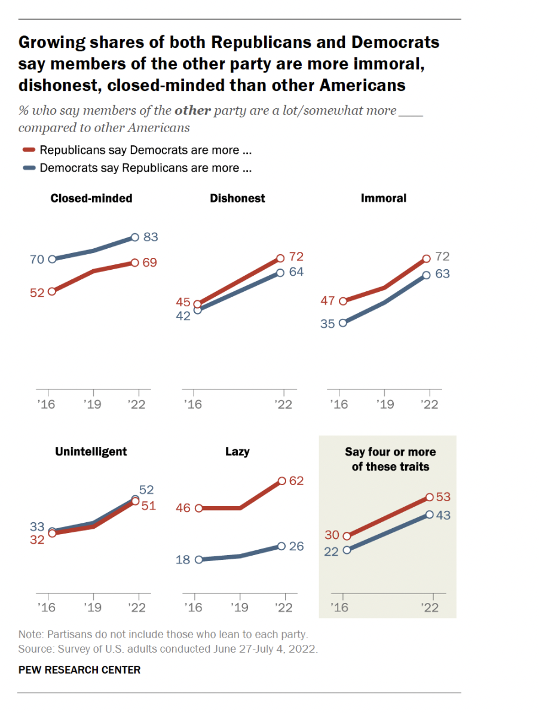
https://www.pewresearch.org/fact-tank/2022/12/08/in-2022-midterms-nearly-all-senate-election-results-again-matched-states-presidential-votes/

Slide 15
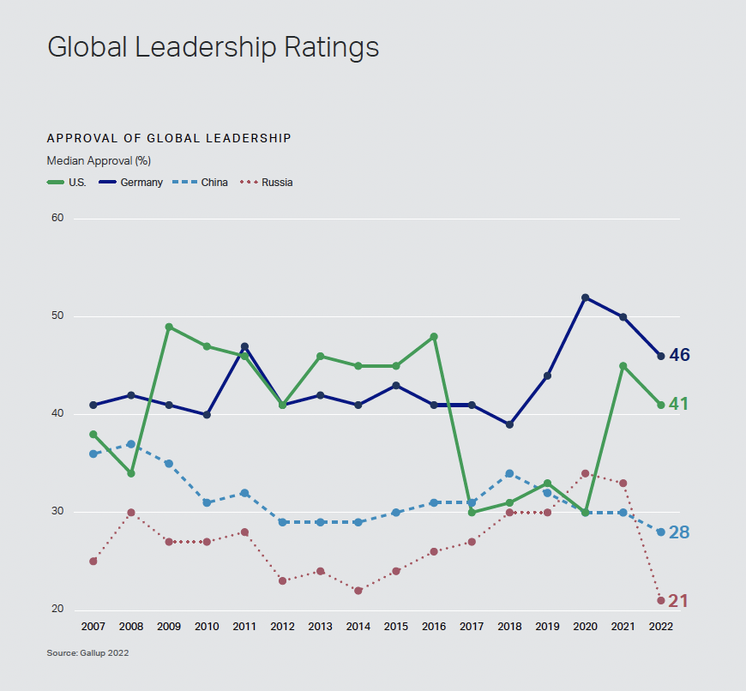
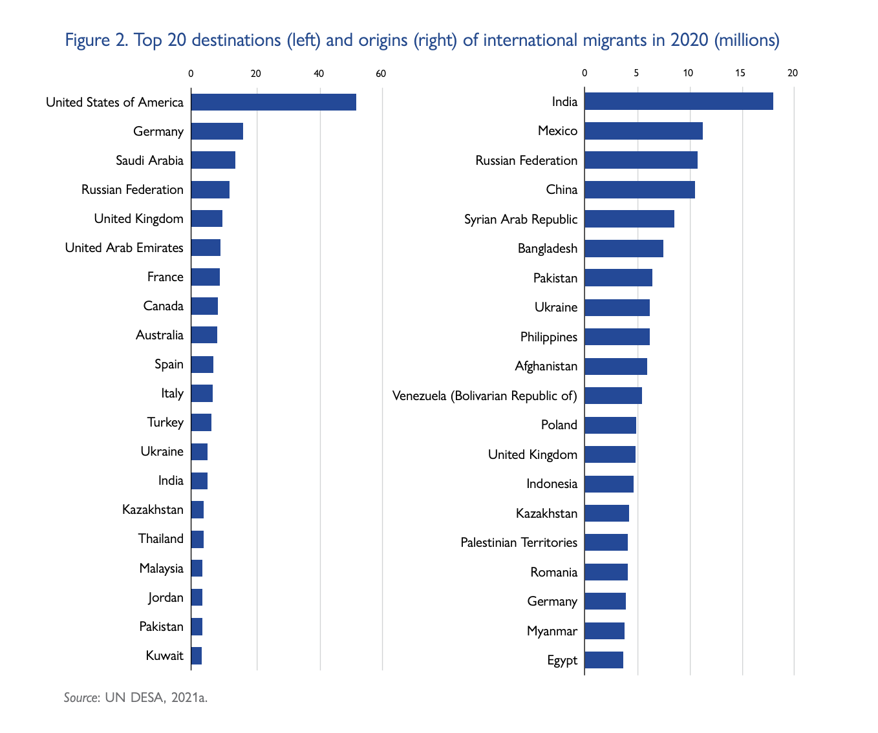
https://www.gallup.com/analytics/355787/gallup-rating-world-leaders-report.aspx
file:///Users/silviamaier/Desktop/WMR-2022-EN-CH-2_1.pdf

Slide 16
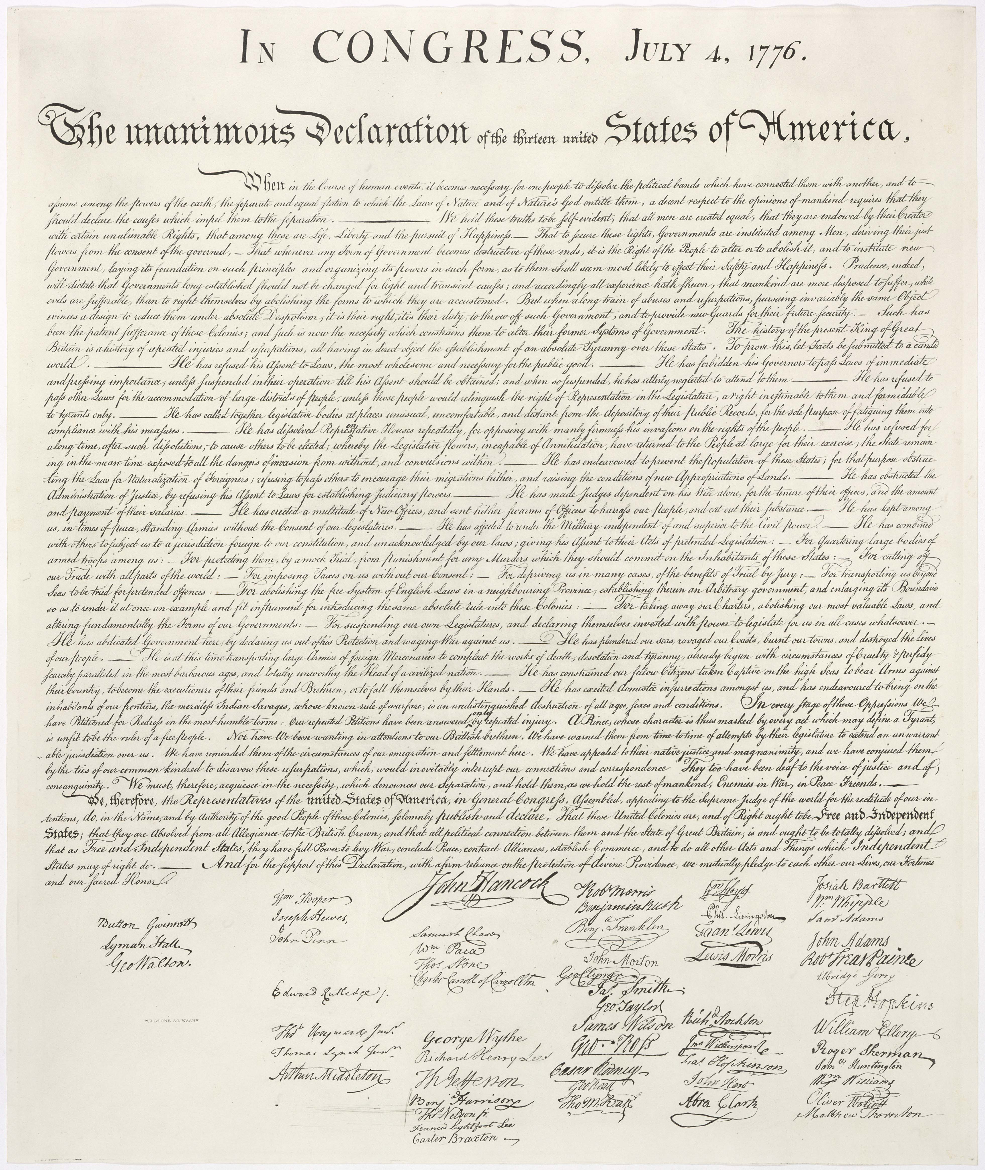

Slide 17
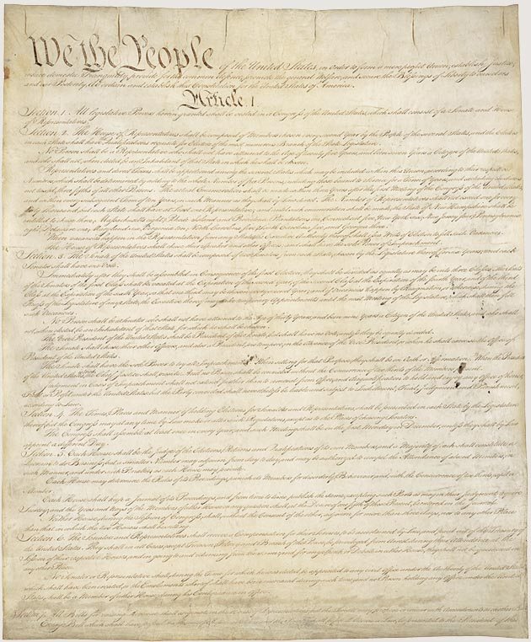
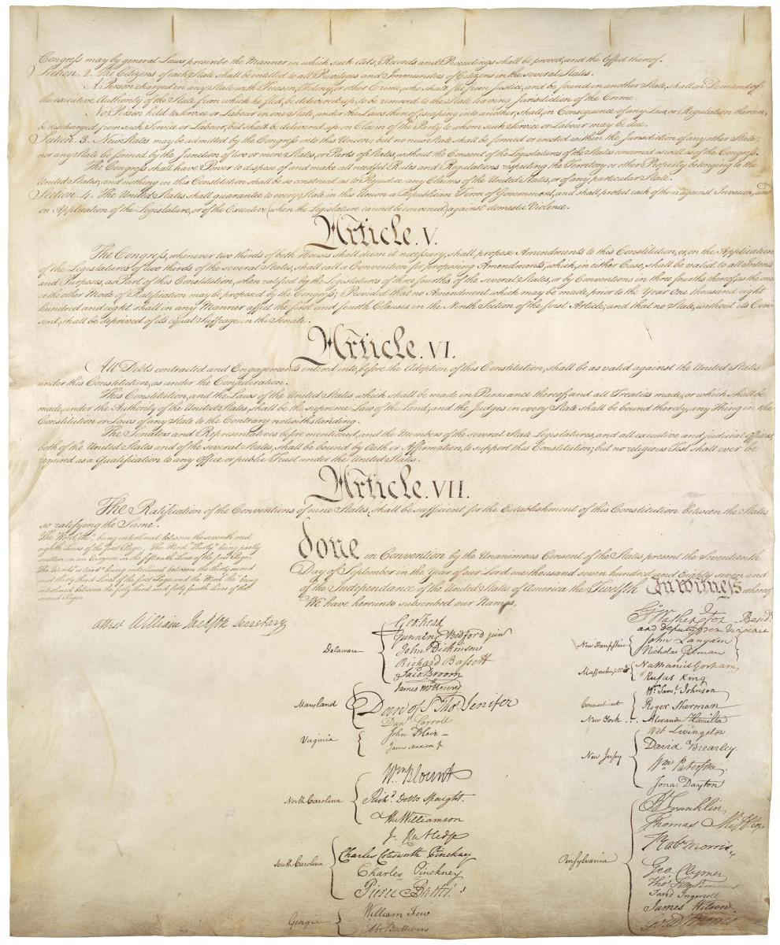

Slide 18
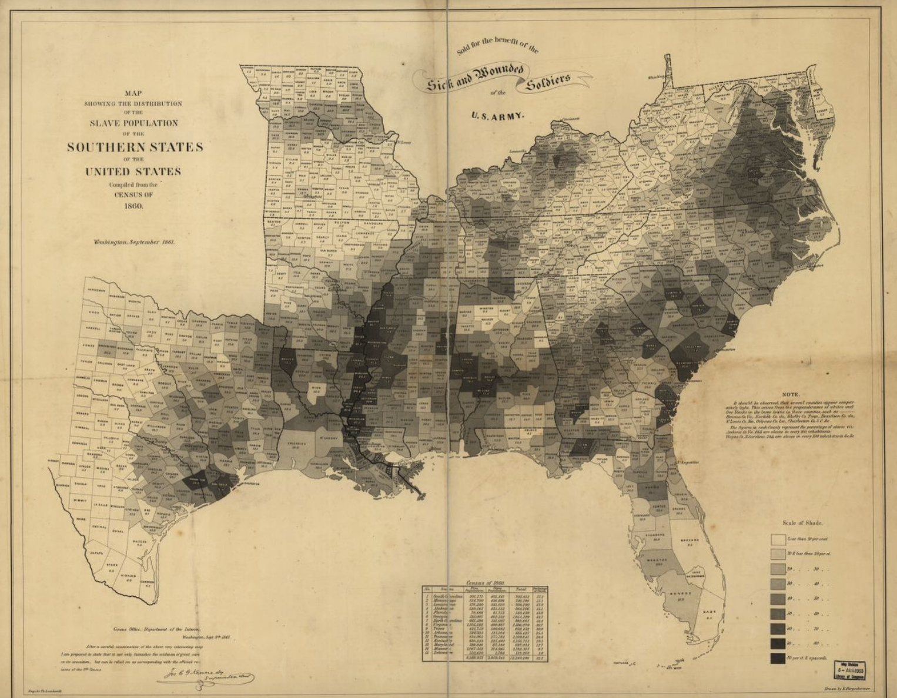
https://www.loc.gov/resource/g3861e.cw0013200/?r=-0.452,-0.007,1.949,0.798,0

Slide 19
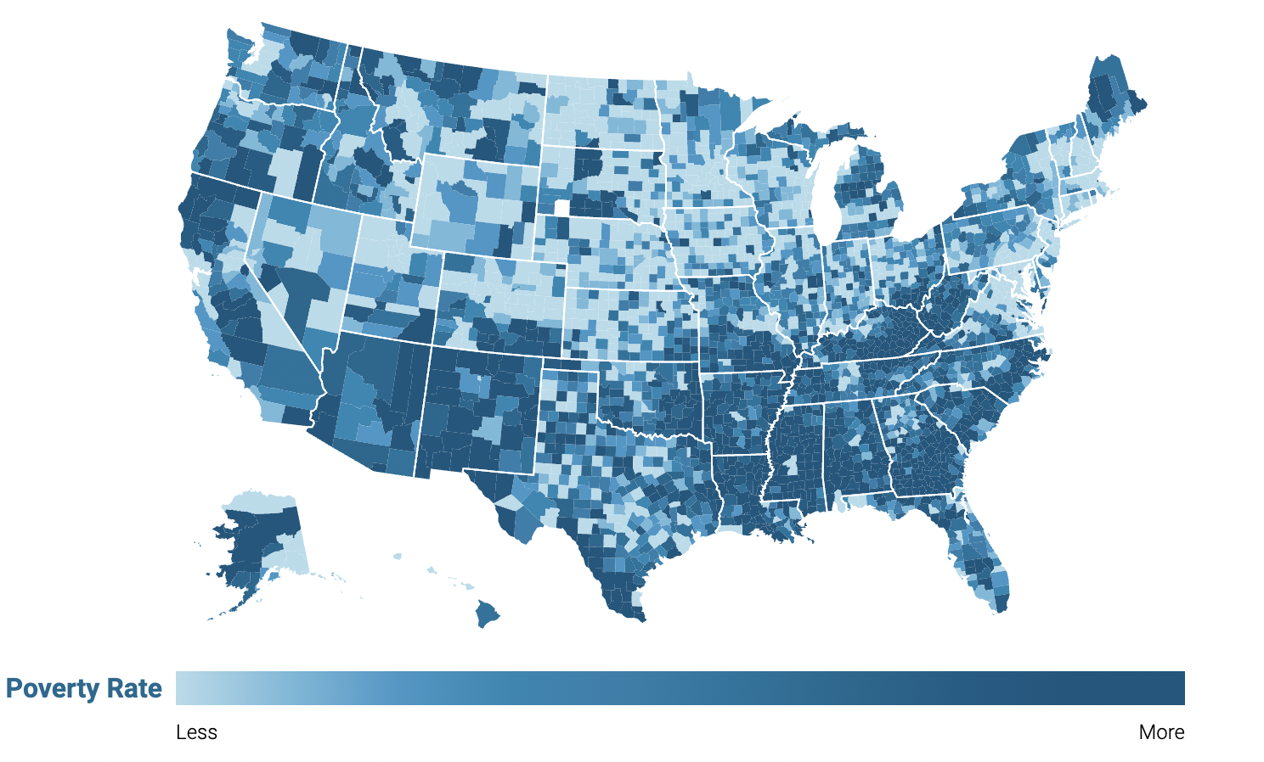
Poverty in the United States: 11.6% (Native Americans: 27%)
https://www.census.gov/library/visualizations/interactive/acs-percentage-poverty-2015-2019.html
How poverty is officially measured: https://www.census.gov/library/visualizations/2021/demo/poverty_measure-how.html
https://www.npr.org/2022/08/20/1117689118/poll-69-of-native-americans-say-inflation-is-severely-affecting-their-lives

Slide 20
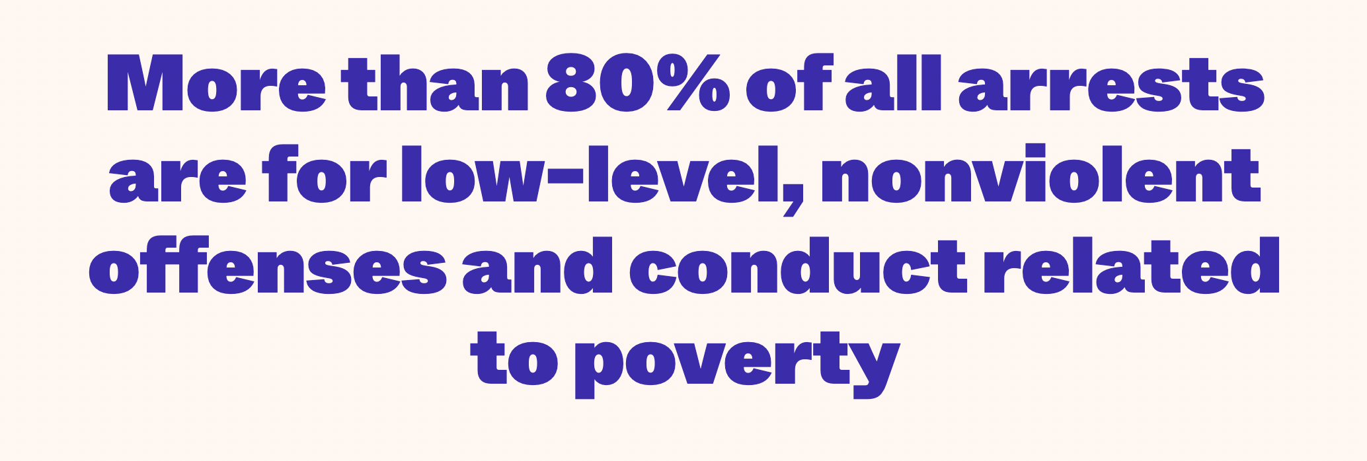
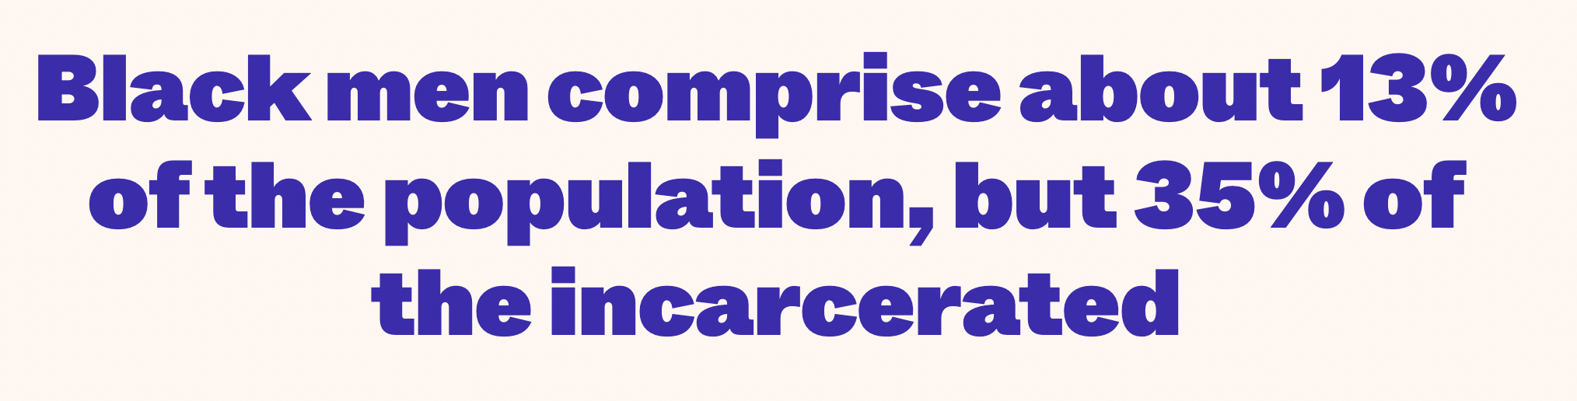
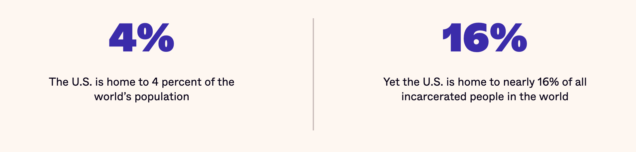
Source: https://www.vera.org/ending-mass-incarceration/criminalization-racial-disparities

Slide 21
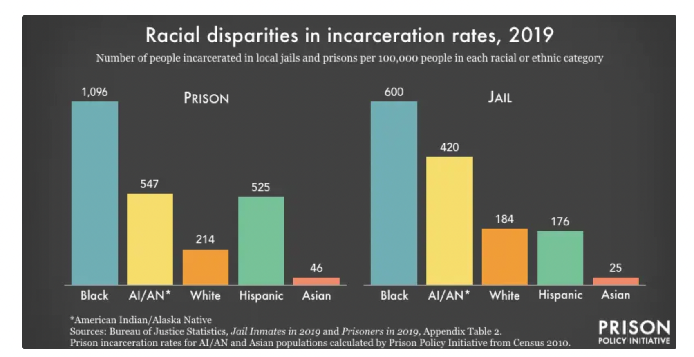
https://www.prisonpolicy.org/graphs/prison_rates_by_race_2019.html

Slide 22
Interactive Map
http://www.slate.com/blogs/the_vault/2014/06/17/interactive_map_loss_of_indian_land.html
https://www.bia.gov/sites/bia.gov/files/assets/bia/ots/webteam/pdf/idc1-028635.pdf

Slide 23
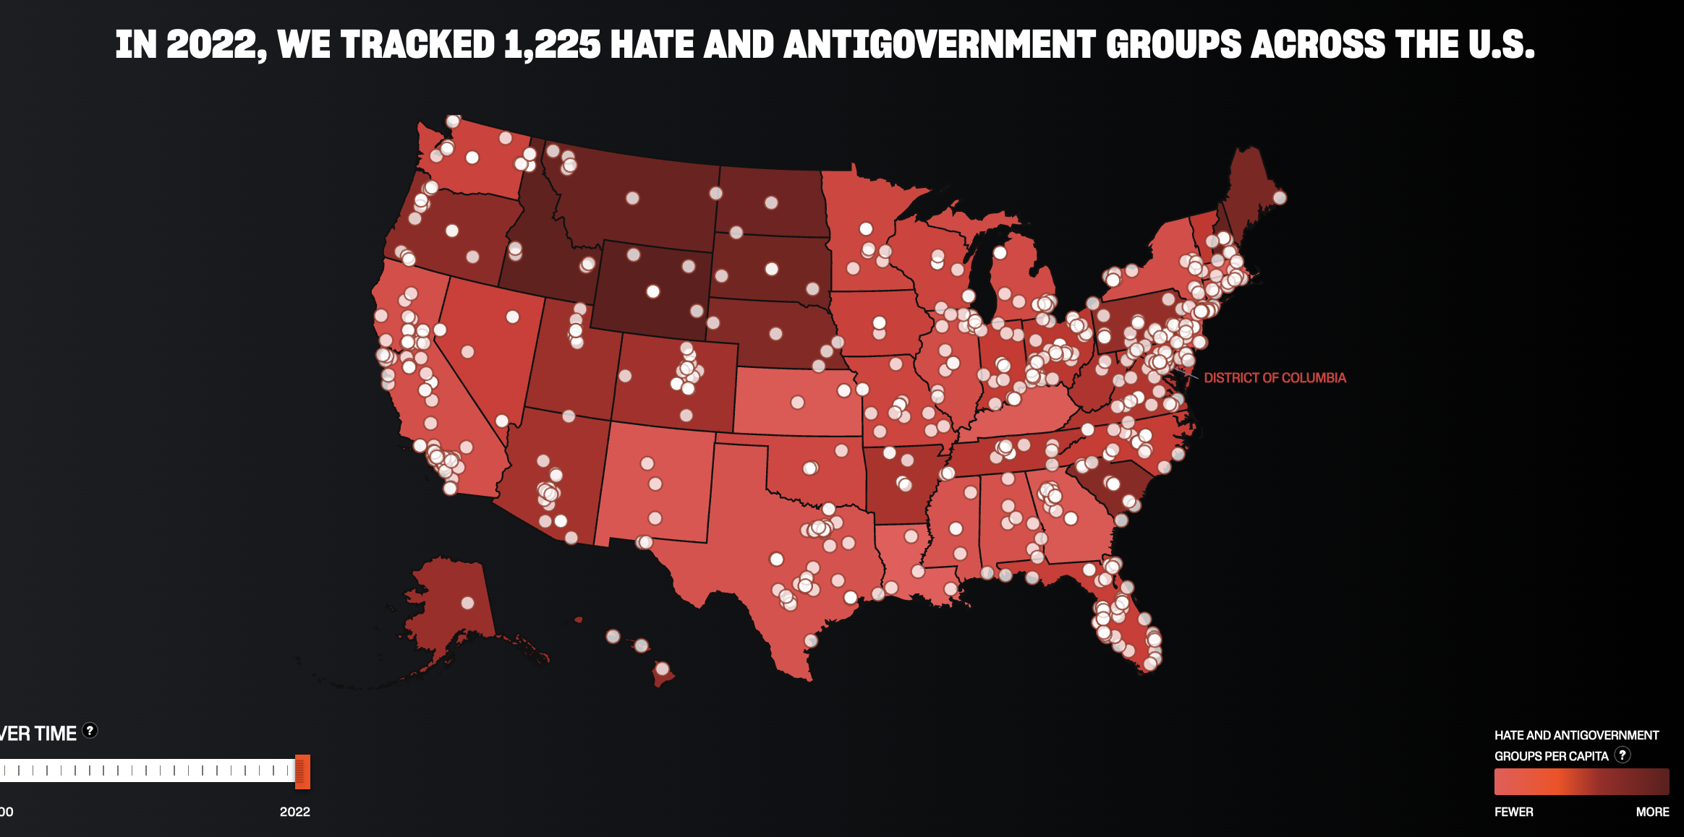
https://www.splcenter.org/hate-map

Slide 24
Concluding Thoughts and Observations
What surprised you the most?
What was the most interesting thing you learned and what shifted your position on a particular topic?
What questions, if any, are emerging for you?

Slide 25
Quiz:
Where do you fit into the US political typology?
https://www.pewresearch.org/politics/quiz/political-typology/

