Slide 1
The Presidency

Slide 2
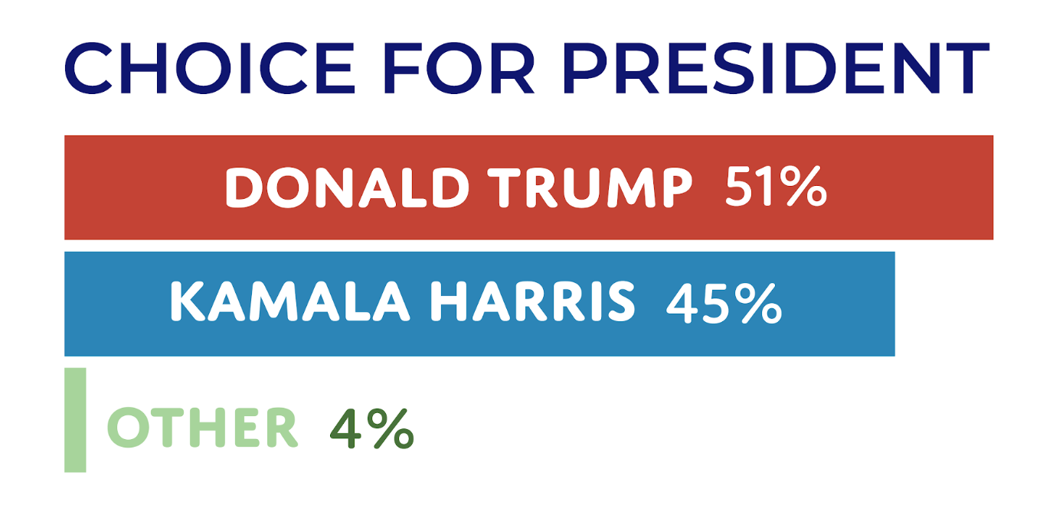
2024 - Elections

Slide 3

Dual Role
Head of State
Head of Government

Slide 4
The Presidency
The framers of the Constitution expected from the presidency: leadership in national affairs, command in time of war, direction in foreign affairs and implementation of the laws. However, they did not have a clear sense of how the office would work in practice. Accordingly, they chose to describe the powers of the president in general terms. By comparison with the precise listing in Article I of Congress’s powers, the provisions in Article II that define the president’s authority are broadly worded

Slide 5
Presidential Powers
The President:
is the Commander in Chief of the armed forces. He or she has the power to call into service the state units of the National Guard, and in times of emergency may be given the power by Congress to manage national security or the economy.
has the power to make treaties with Senate approval. He or she can also receive ambassadors and work with leaders of other nations.
is responsible for nominating the heads of governmental departments, federal judges, and Supreme Court justices. The U.S. Senate is charged with approving these nominations.
can issue executive orders, which have the force of law but do not have to be approved by Congress.
can issue pardons for federal offenses.
can convene Congress for special sessions.
can veto legislation approved by Congress. However, the veto is limited. It is not a line-item veto, meaning that the President must veto the entire bill, rather than parts of it. Further, a presidential veto can be overridden by a two-thirds vote by Congress.
delivers the State of the Union address annually to a joint session of Congress.

Slide 6
The
Presidency
Initially, the presidency was a fairly weak branch of government compared with the legislature. But Presidents have sought to increase their power typically at the expense of Congress.

Slide 7
The Shifting Powers of Congress and Presidency
In the twentieth century, power-struggles between the Congress and the President intensified. There are two primary reasons this struggle emerged. First, as the country grew larger and more complex, the need for the government to assert its regulatory power grew. The executive branch, because of its hierarchical organization with the president at the top, is seen as a more effective governmental machine than Congress.

Slide 8
The Shifting Powers of Congress and Presidency
The second reason has to do with the president’s powers as commander-in-chief in the realm of foreign policy. Historically, the twin disasters of the Great Depression in the 1930s and World War II, provided President Franklin D. Roosevelt with a powerful platform from which to expand presidential power. His popularity and his ability to be elected four times allowed him to greatly overshadow Congress. As a result, Congress attempted to restrain the power of the presidency by proposing the Twenty-Second Amendment to the Constitution, which limited a president to only two full terms in office. Although this limitation is a significant one, it has not held back the tendency for the presidency to assume increased power.

Slide 9
The Shifting Powers of Congress and Presidency
In the decades following World War II, the United States entered the Cold War, a period that allowed the Presidency to assert more authority, especially in foreign affairs. In an exercise of this increased power, in the 1950s, President Harry Truman effectively went around an enumerated power of Congress by sending troops into battle in Korea without a congressional declaration of war. By the time of the Kennedy administration in the 1960s, the presidency had assumed nearly all responsibility for creating foreign policy, effectively shutting Congress out. Following the twin scandals of Vietnam and Watergate in the early 1970s, Congress attempted to assert itself as a coequal branch, even in creating foreign policy, but could not hold back the trend. The war on terrorism after 9/11 has also strengthened the President’s hand.

Slide 10
Summarizing- Key Factors for Increased Presidential Power
Changes in American society and the nation’s economy have served to strengthen the presidency. As the executive branch has grown in response to increased demands on government, the president, as chief executive, has become more powerful.
Also, the emergence of the U.S. as a global superpower has elevated the importance of global affairs, which has enhanced the president’s constitutional power as chief diplomat and commander-in-chief of the Armed Forces.
As power has shifted toward the presidency, Congress has ceded some of its authority to the president – for example, its power to initiate military action and its control over the budget (the president now has a much larger role in developing the federal budget than was once the case),
All of these changes are extra-constitutional – there has been no constitutional amendment that formally expanded the president’s power. The one amendment that has addressed presidential power has limited it – the 22nd Amendment restricts the president to two terms of office.

Slide 11
Examples of expansion of the President’s Powers.
The Constitution provides the president with legislative authority, including use of the veto and the ability to propose legislation to Congress. The framers expected this authority to be used in a limited way. George Washington acted as the framers anticipated: He proposed only three legislative measures and vetoed only two acts of Congress. Modern presidents have assumed a more active legislative role. They regularly submit proposals to Congress and do not hesitate to veto legislation they dislike.

Slide 12
Examples of expansion of the President’s Powers.
The Constitution grants the president command of the nation’s military, but only Congress can declare war. Nevertheless, none of America’s major conflicts since World War II (e.g. Korea, Vietnam, Iraq, Afghanistan) were waged based on a congressional declaration of war.

Slide 13
Vice-President
Despite provisions for the election of a vice president (to serve in case of the president’s death, resignation, or removal through the impeachment process), and apart from the suggestion that the vice president should be responsible for presiding over the Senate, the framers left the vice president’s role undeveloped. As a result, the influence of the vice presidency has varied dramatically, depending on how much of a role the vice president is given by the president. Some vice presidents, such as Dick Cheney under President George W. Bush, were highly influential.
-The nominees for the Presidency and the Vice- Presidency run together on the same ticket (unified ticket).

Slide 14
The President – Domestic Politics

Slide 15
The success of presidential action typically depends on the approval of Congress, the cooperation of the bureaucracy, and the acceptance of the judiciary. Congress in particular—more than the courts or the bureaucracy—holds the key to presidential success. Without congressional authorization and funding, most presidential proposals cannot be materialized. Today, a president’s legislative success in the foreign and domestic policy areas is affected by the partisan makeup of Congress.

Slide 16
Presidential System
The American system is based on the principle of divided power – presidents have the power to present legislative ideas to Congress and can put pressure on Congress, but the power to enact laws rests with Congress.
The presidency is thus different from the office of prime minister in a parliamentary system. In the latter, the prime minister is head of both the executive branch and the legislative branch. With a parliamentary majority, a prime minister has the votes needed to pass laws. In the American system, presidents must convince Congress that what the president wants is also what a majority in Congress should want.
Presidents succeed most often when a majority in the House and in the Senate are of the same party. In that situation, the president and the congressional majority share partisan goals. When one or the other legislative chamber is controlling by the opposing party, the president’s task is much harder.

Slide 17
Presidents and Congress
Presidents’ success with Congress depends on:
Whether the President has just won election by a wide margin (size of electoral victory)
Whether the President is highly popular with the American public (“going public” →when the president bypasses bargaining with Congress and promotes his policies by appealing to the American public for support)
Whether the lobbying groups supporting the Presidents’ proposals are more powerful than opposing groups
Whether Presidents’ parties control Congress.

Slide 18
Presidents and Congress
No source of support is more important to presidential success than whether the president’s party controls Congress. In case of unified government, presidents have usually enjoyed considerable legislative success. When the other party controls one or both houses, presidents have greater difficulty convincing Congress to follow their lead. During Obama’s first two years in office, when Democrats controlled both the House and the Senate, more than 85 percent of the bills that he supported were enacted into law. In 2011, with Republicans holding the House, it dropped to 32 percent and then fell to 20 percent in 2012.

Slide 19
Presidents’ Legislative Success
Source: CQ Voting Studies, 1952-2017

Slide 20
President Trump’s Legislative Success Rate
Source: CQ Vote Studies

Slide 21

Executive Orders
Presidents often rely on executive orders when they cannot pass their policy agenda through Congress.
Executive orders are Presidential directives specifying how a law is to be carried out.

Slide 22
Executive Orders
An executive order is a signed directive of the President of the United States that manages operations of the federal government. An executive order is not the President creating a new law or appropriating new money from the U.S. Treasury (both are the domain of Congress). It is the President instructing the government how it is to work within the parameters that are already set by Congress and the Constitution.

Slide 23
Executive Orders
An executive order has the force of law. Since executive orders are not legislation, they do not require any approval from Congress. Congress can pass a new law to override an executive order, subject to a presidential veto. Congress, usually, passes legislation that makes it difficult, or even impossible, to carry out the order, such as removing funding. A sitting President may overturn an existing executive order by issuing another executive order. In his first month in office Biden revoked 31 of Trump’s 220 executive orders. For instance, he issued executive orders to rejoin the Paris climate accord and a proclamation stopping construction of his predecessor’s border wall.

Slide 24
Executive Orders
Executive orders can be struck down by the courts, if the courts decide that the orders violate constitution or statutory authority. An example, is President Trump’s initial executive order that banned foreign nationals from 7 predominantly Muslim countries from entering the United States. That order was blocked by federal courts on grounds that it violated both statutory law and the Constitution.

Slide 25
Executive Orders
The use of executive orders has often been the subject of controversy with the opposition party arguing that the President is actually changing the law rather than working within it. Despite the frequent use of executive orders, durable political reforms come only through congressional legislation. On the contrary, executive orders can be quickly cancelled by subsequent Presidents. Executive orders are important but limited policy tool.

Slide 26
Veto Powers
The president’s most direct legislative tool is the veto. Once a bill has passed through Congress, the President has ten days to sign or veto the bill. If the President vetoes the bill, it returns to Congress. A presidential veto can be overridden only by a two-thirds majority in each chamber of Congress. Only if both chambers vote to override the veto does the bill becomes law. A successful override of a presidential veto is extremely rare.

Slide 27
Presidential Powers
Presidential Powers include nominations of federal judges, including Supreme Court justices, as well as of other federal officials, as well as making appointments to fill military and diplomatic posts. The number of judicial appointments and nominations of other federal officials is great. In recent decades, two-term presidents have nominated well over three hundred federal judges while in office. Moreover, new presidents nominate close to five hundred top officials to their Executive Office of the President, key agencies (such as the Department of Justice), and regulatory commissions (such as the Federal Reserve Board), whose appointments require Senate majority approval.

Slide 28
The Cabinet and Agency Appointees
The heads of the 15 executive departments, such as the Department of Defense and the Department of Agriculture, constitute the president’s cabinet. They are appointed by the president, subject to confirmation by the Senate. The most important members of the Cabinet—the heads of the Departments of Defense, Justice, State, and the Treasury —receive the most attention from the president, the Congress, and the media. These four departments have been referred to as the inner cabinet, while the others are called the outer cabinet. Although the cabinet once served as the president’s main advisory group, as issues have grown in complexity, presidents have increasingly relied on presidential advisers for advice rather than seeking it from the cabinet as a whole. Nevertheless, cabinet members as individuals who head major departments, are important figures in any administration. The president selects them for their prominence in politics, business, government, or the professions.

Slide 29
Trump- Recess Appointments
Recess appointments can let a president install nominees who normally must be confirmed by the Senate. Both chambers have to pass a resolution to go into recess (meaning pause), which can give the oppositional party in the Senate an opportunity to filibuster the resolution and essentially block its passage. During Trump’s first term, for example, he was blocked by the Senate from using recess appointments to replace then-Attorney General Jeff Sessions.

Slide 30
Recess Appointments
Recess appointments by previous presidents have been a last resort - not their opening move like Trump's, which is why it's so alarming to the Senate
Outgoing Senate Minority Leader Mitch McConnell (R-Kentucky) has been the most forceful and public on the issue so far, insisting that the Senate must maintain its authority and constitutional duty to “advise and consent” on political appointees.
Recess appointments test the separation of powers between the executive and legislative branches.

Slide 31
The President – Foreign Policy

Slide 32

The President – Foreign Policy
Two constitutionally assigned responsibilities:
Chief diplomat: a) The President has the power to make Treaties subject to approval by 2/3 of the Senate, b) The President has the power to receive ambassadors
Military Chief: The President is commander- in –chief (“The President shall be commander in chief of the Army and Navy of the United States, and of the militia of the several states.”)

Slide 33
The President – Chief Diplomat
Presidents have considerable ability in the foreign policy area to act on their own, separate from what Congress might want. Presidents have the power, for example, to make on their own treaty-like formal agreements with other countries (these are called executive agreements). Executive agreements are based on the President’s constitutional authority as Chief Diplomat. Executive agreements have the same legal status as treaties. However, unlike treaties they do not require Senate approval. Finally, a later president can void an executive agreement but not a treaty.

Slide 34
Executive Agreements
In the past eight decades, presidents have negotiated over 17,000 executive agreements—more than 15 times the number of treaties ratified by the Senate during the same period. These agreements span a wide range of policies, everything from military bases to cultural exchanges. However, some executive agreements do require some legislative approval, such as those that commit the United States to make payments and thus are restrained by the congressional power of the purse.

Slide 35
Constitution – War Powers – The President
Commander in chief: Article II, Section 2: “The President shall be commander in chief of the Army and Navy of the United States, and of the militia of the several states.”

Slide 36
Congress – War Powers
Declare War
01
Raise and Support Military
02
Control the Budget
03

Slide 37
War Powers
Article I, Section 8, Clause 11 of the U.S. Constitution grants Congress the power to declare war. The President, meanwhile, derives the power to direct the military after a Congressional declaration of war. These provisions require cooperation between the President and Congress regarding military affairs, with Congress funding or declaring the operation and the President directing it (checks and balances). However, the Constitution is a paradoxical mix of clearly defined war powers for Congress and implied prerogatives for the President, which over the years created an uneasy balance between the two branches.

Slide 38
US Presidents and Congress Have Long Clashed Over War Powers
In the decades following World War II, the United States entered the Cold War, a period that allowed the presidency to assert more authority, especially in foreign affairs. In the 1950s, President Harry Truman sent troops into battle in Korea without a congressional declaration of war. After the Kennedy, Johnson, and Nixon Administrations had spent nearly a decade committing U.S. troops to Southeast Asia without Congressional approval, Congress responded by passing the War Powers Resolution in 1973.

Slide 39
War Powers Resolution
The resolution had broad bipartisan support and the Congress succeeded in overriding President’s Nixon veto. The aim was to ensure that Congress and the President agreed on war actions before committing troops into hostile situations. “It is the purpose of this joint resolution to fulfill the intent of the framers of the Constitution of the United States and ensure that the collective judgement of both the Congress and the President will apply to the introduction of United States Armed Forces into hostilities”

Slide 40
War Powers Resolution
“The President in every possible instance shall consult with Congress before introducing US Armed Forces into hostilities or into situations where imminent involvement in hostilities is clearly indicated by the circumstances, and after every such introduction shall consult regularly with the Congress. In the absence of a declaration of war, when troops are introduced
1) into hostilities or imminent hostilities
2) into the territory of a foreign nation armed for combat
3) In numbers which substantially enlarge the forces in a nation or region
the President shall submit within 48 hours to the Speaker of the House and President of the Senate a report, in writing including
1)The circumstances requiring forces
2)The constitutional and legislative authority under which troops were introduced
3)The estimated duration of the hostilities
Within 60 days after the report is submitted or required to be submitted, the President shall terminate any use of United States armed forces unless the Congress
Declares war
Has extended by law the 60-day period

Slide 41
War Powers Resolution
When passed, Congress intended the War Powers Resolution to halt the erosion of Congress's ability to participate in war-making decisions. This resolution, however, has not been as effective as Congress likely intended. Some legislators have gone to court (unsuccessfully) to seek adjudication of what they believe to have been violations of the act. However, no Presidential military action has been successfully challenged under the War Powers Resolution. Increasingly, Presidents have identified resolutions taken by the United Nations or the North Atlantic Treaty Organization as justification for military intervention.

Slide 42
War Powers – War on Terror
Far more common, in the modern era have been congressional authorizations for the use of military force (AUMF). Just one week after Sept. 11, Congress approved an authorization in 2001 allowing the president to target “those nations, organizations, or persons he determines planned, authorized, committed, and aided” the terrorist attacks, or any countries that harbored those doing the planning. This 2001 congressional authorization for the use of military force (AUMF) is what authorized the war in Afghanistan, and it is the legal basis for many American counterterrorism operations 20 years later. Lawmakers passed a second authorization in October 2002 that authorized the start of military operations in Iraq.

Slide 43

Why the shift from Congressional to presidential preeminence in war powers?
General growth of Presidential prominence
US becomes global power
Presidents’ ability to act on their own in the foreign policy arena is also strengthened by their special relationship with the country’s defense, diplomatic, and intelligence agencies.
Changing nature of war and global threats (e.g. President Barack Obama ordered targeted military strikes in Libya in 2011 and dozens of unmanned drone strikes in Pakistan without congressional approval)

Slide 44
War Powers
Summarizing, the history of war powers has been a history of disputes between the executive and legislative branches about what the meaning of Congress’s authority over war is, what the meaning of ‘war’ is, and what kinds of actions do and don’t count as war.

Slide 45
Summarizing- War Powers
Congress has never fully invoked the War Powers Act. It’s an open question whether, if invoked, the Supreme Court would uphold it on constitutional grounds.
Congress has rarely defunded a war (the risk in such action is that would endanger the troops who are fighting the war)
Control of Congress by the opposing party has rarely altered the course of a military conflict.
The Supreme Court has never declared a president-directed war to be unconstitutional.

Slide 46
Impeachment

Slide 47
Impeachment
Congress’s ultimate sanction is its constitutional authority to impeach and remove the president from office.
Grounds for Impeachment:
“The President, Vice President and all civil Officers of the United States, shall be removed from Office on Impeachment for, and Conviction of, Treason, Bribery, or other high Crimes and Misdemeanors”.
The method the framers designed required two steps and both chambers of the Congress. First, the House of Representatives could impeach the president by a simple majority vote. In the second step, the Senate could remove the president from office by a two-thirds majority, with the chief justice of the Supreme Court presiding over the trial. Upon conviction and removal of the president, if that occurred, the vice president would become president.

Slide 48
Impeachment
Since World war II three presidents have faced impeachment proceedings in the House; none has been both impeached by the House and removed by the Senate:
-President Richard Nixon faced an overwhelming likelihood of being removed for his cover-up of key information relating to the 1972 break-in into the Democratic National Headquarters at the Watergate Hotel and Office Building. The investigations uncovered evidence that President Nixon was involved and that the men arrested for the Watergate break-in had committed burglaries before. Nixon most likely would have been removed by the Senate, since there was strong bipartisan consensus for his impeachment and removal. Instead, he resigned before the House and Senate could exercise their constitutional prerogatives.
-In 1998, the House of Representatives impeached President Clinton on grounds he had lied under oath about a sexual relationship with intern Monica Lewinsky. The Senate acquitted Clinton, partly because polls indicated that most Americans did not think Clinton’s behavior constituted “treason, bribery, or other high crimes and misdemeanors,” which is what the Constitution defines as the grounds for removing a president from office

Slide 49
Impeachment
The most recent impeachments were of President Donald Trump, who was impeached in the House twice. However, support for removal in the Senate did not meet the super-majority requirement, although on the second attempt in 2021 a solid majority favored removal. The first Trump impeachment brought charges of “abuse of power” and “obstruction of Congress” related to allegations that he improperly used his office to pressure the president of Ukraine to investigate political rival Joe Biden and his son, in exchange for military aid. The second Trump impeachment was for “incitement of insurrection” related to the attack on the U.S. Capitol building during the counting of Electoral College votes on January 6, 2021. Although the Senate did not convict him, Trump was the first-ever president in history to be impeached twice and the first to face an impeachment trial as a former President.

Slide 50
Nominating the Candidate for the Presidency

Slide 51
The President
The Constitution specifies that the president must be at least 35 years old, be a natural-born U.S. citizen, and have been a U.S. resident for at least 14 years. Presidents have usually served previously as vice presidents, members of Congress, or state governors. Trump was the first businessman elected to the presidency who had not previously held public office.

Slide 52
The Nominating Campaign: Primaries and Caucuses
The nominating races become a question of which candidates are going to acquire enough delegates in the primaries and caucuses to get the delegate majority at the National Party Convention. Before the general election, candidates for president go through a series of state primaries and caucuses.

Slide 53
The Nominating Campaign: Primaries and Caucuses
State primaries are run by state and local governments. Voting happens through secret ballot.
Caucuses are local meetings run by political parties. In most, participants divide themselves into groups according to the candidate they support. Undecided voters form their own group. Each group gives speeches supporting its candidate and tries to get others to join its group. At the end, the number of voters in each group determines how many delegates each candidate has won.
Both primaries and caucuses can be “open,” “closed,” or some hybrid of the two.
  During an open primary or caucus, people can vote for a candidate of any political party.
  During a closed primary or caucus, only voters registered with that party can take part and vote.

Slide 54
How Delegates are Awarded
A candidate must win at least 15% of the votes cast in the primary or caucuses in order to receive any delegates.
The Democratic and Republican parties use different methods for determining how many delegates are awarded to the various candidates at their national conventions.
Democrats use a proportional method. Each candidate is awarded a number of delegates in proportion to their support in the state caucuses or the number of primary votes they won.
In the Republican Party, each state chooses either the proportional method or a "winner-take-all" method of awarding delegates. Under the winner-take-all method, the candidate getting the most votes from a state's caucus or primary gets all of that state's delegates at the national convention.

Slide 55
The National Party Conventions
The summertime national party conventions mark the end of the nominating campaign. In an earlier era, the delegates from the various states actually bargained and negotiated over the choice of a presidential nominee. In the contemporary era the candidate, who has acquired the majority of delegates through the primaries and caucuses wins the nomination. If no candidate gets the majority of a party’s delegates , convention delegates choose the nominee through additional rounds of voting.

Slide 56
THE FOUR SYSTEMS OF CANDIDATES’ SELECTION
1. Original (1788–1828). Party nominees are chosen in congressional caucuses.
2. Party convention (1832–1900). Party nominees are chosen in national party conventions by delegates selected by state and local party organizations (parties tried to control Presidents)
3. Party convention, primary (1904–1968). Party nominees are chosen in national party conventions by delegates. However, a minority of delegates are chosen through primary elections (the majority still being chosen by party organizations).

Slide 57
THE FOUR SYSTEMS OF CANDIDATES’ SELECTION
4. Party primary, caucuses (1972–present). Today it is the voters in state primaries and caucuses who choose the Democratic and Republican Presidential nominee

Slide 58
Electing the President

Slide 59
Electoral College
The delegates to the constitutional convention of 1787 feared that popular election of the president (direct election by popular vote) would make the office too powerful. Moreover, others argued that a straightforward popular vote would be unfair, as it would give more power to larger, more populous states. They devised, therefore, the so-called Electoral College. Accordingly, the president and vice president are not elected directly by citizens. Instead, they’re chosen by “electors” through the Electoral College. The process of using electors comes from the Constitution, meaning that it would take a constitutional amendment to change the process.

Slide 60
Electors
The Constitution states that electors can’t be a member of Congress, or hold federal office, but left it up to individual states to figure out everything else. Until the mid-1800s, it was common for many state legislatures to simply appoint electors, while other states let their citizens decide on electors. Today, the most common method of choosing electors is by state party convention or by state party committees. Electors can be elected officials or party leaders in the state, or people who have some kind of personal or professional connection with the party’s candidate.

Slide 61
Electoral College
Each state has a number of electors equal to the number of its deputies in the House of Representatives (which number is determined by the state’s population) plus its two senators. California, which is the most populous state, has 54 electors in the Electoral College
-The Electoral College favours the smaller states

Slide 62
Total: 538. Majority needed to elect the president and vice president: 270.
Electoral votes by state
state | number of votes | state | number of votes
*Although not a state, the District of Columbia is allotted electors.
Alabama | 9 | Montana | 4
Alaska | 3 | Nebraska | 5
Arizona | 11 | Nevada | 6
Arkansas | 6 | New Hampshire | 4
California | 54 | New Jersey | 14
Colorado | 10 | New Mexico | 5
Connecticut | 7 | New York | 28
Delaware | 3 | North Carolina | 16
District of Columbia* | 3 | North Dakota | 3
Florida | 30 | Ohio | 17

Slide 63
Total: 538. Majority needed to elect the president and vice president: 270.
Georgia | 16 | Oklahoma | 7
Hawaii | 4 | Oregon | 8
Idaho | 4 | Pennsylvania | 19
Illinois | 19 | Rhode Island | 4
Indiana | 11 | South Carolina | 9
Iowa | 6 | South Dakota | 3
Kansas | 6 | Tennessee | 11
Kentucky | 8 | Texas | 40
Louisiana | 8 | Utah | 6
Maine | 4 | Vermont | 3
Maryland | 10 | Virginia | 13
Massachusetts | 11 | Washington | 12
Michigan | 15 | West Virginia | 4
Minnesota | 10 | Wisconsin | 10
Mississippi | 6 | Wyoming | 3
Missouri | 10

Slide 64
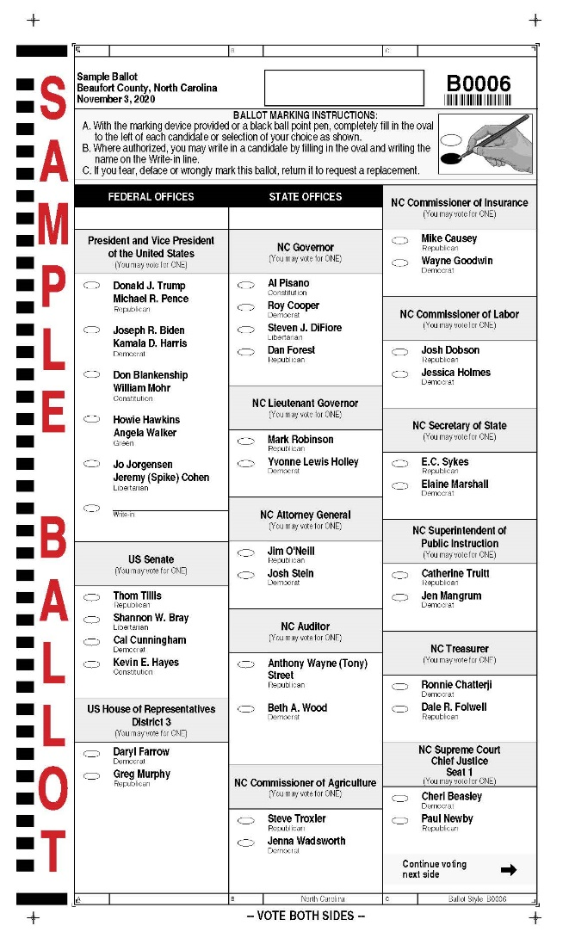
.

Slide 65
Electoral College
Τhe Electoral College consists of a body of 538 electors, each representing one of the fifty states as well as the District of Columbia (Washington D.C.). Electors formally cast votes for the election of the president and vice president. Forty-eight states have a winner-take-all system (“first past the post”), meaning that the candidate who receives a plurality of the vote, wins all that state’s electors. Only in Maine and Nebraska are the electoral votes divided.

Slide 66
Election of the Presidency or Vice Presidency
To win the presidency or vice presidency, a candidate must get 270 electoral votes (a majority). Should no candidate receive a majority of the votes cast, the House of Representatives selects the president, with each state casting a single vote, while the Senate choses the vice president.

Slide 67
Electors
Although it is not unconstitutional for electors to vote for someone other than those to whom they pledged their support, many states “bind” electors to their candidate using oaths and fines. During the nineteenth century, “faithless electors”—those who broke their pledge and voted for someone else—were rare, but not uncommon. In the modern era, faithless electors are rarer still, and have never determined the outcome of a presidential election. In 2016, seven electors broke with their state on the presidential ballot

Slide 68
Can a Candidate lose the Public vote but become President?
It is possible to win the Electoral College but lose the popular vote. It is possible for a candidate to become President by winning a number of tight races in certain states, despite having fewer votes across the country. In 2016 Donald Trump had almost three million fewer votes than Hillary Clinton but won the presidency because the Electoral College gave him majority. The same happened in 2000 when George Bush won with 271 electoral votes, although Democrat candidate Al Gore won the popular vote.

Slide 69
Election Strategy and Electoral College
The Presidential candidates’ strategies in the general election are shaped by the Electoral College. The winner-take-all feature of the electoral vote system leads presidential candidates to focus on the competitive states—those that conceivably could be won by either party. One-sided states—those that are solidly Republican or Democratic—are more or less ignored during the campaign. As a result ‘safe’ states receive no real electioneering. Over half of the country is ignored in the general election.

Slide 70
Battleground states-Swing States
The terms “battleground states” and “swing states” refer to states with closely divided support for Democratic and Republican presidential candidates. A state that had a margin of victory of 5% or less in the most recent presidential race shows a narrow divide among voters. Each battleground state receives ample campaign visits, ad spending, and national attention because the outcomes in most other states are clear months ahead of elections.

Slide 71
Reforming the Electoral College
There were at least 752 known proposals to change the electoral system from 1789 to 2017, according to the Congressional Research Service.
Since 1979, advocates for Electoral College reform have shifted their efforts from Congress to the states. This shift was fueled by the difficulty in getting two-thirds of both congressional chambers and all state legislatures to agree on an amendment. State laws and constitutions present opportunities to reform how electoral votes are allocated without dealing with the U.S. Constitution.

Slide 72
Funding
Money is a critical factor. It takes a large amount of money to buy the televised ads and hire the staff to run a multistate campaign. Moreover, presidential elections are extremely long. They last more than one and a half year.
Major-party candidates have the option of conducting their campaigns with a set amount of federal funds (the amount was roughly $100 million in 2020), provided that they limit their spending to the set amount. Barack Obama recognized that he could raise far more money for his 2008 campaign than the federal limit and opted to do so. He spent three times as much as did his Republican opponent, John McCain, who accepted public funding. Since then, no presidential nominee has financed the general election campaign with federal funds. Minor-party and independent presidential candidates can qualify for federal funding if they receive at least 5 percent of the vote.

Slide 73
Staffing the Presidency

Slide 74
The Executive Office of the President (EOP)
The key staff organization is the Executive Office of the President (EOP), which functions as the command center of the presidency. The EOP includes a number of units, including the White House Office (WHO), which consists of the president’s closest personal advisers; the Office of Management and Budget (OMB), which consists of experts who formulate and administer the federal budget; the National Security Council (NSC), which advises the president on foreign and military affairs; and the National Economic Council (NEC), which assists the president on economic issues.
The White House Office: The WHO consists of the president’s personal assistants, including top political advisers and press agents. These individuals tend to be skilled at developing political strategy and communicating with the public, the media, and other officials. Because of their proximity to the president, they are among the most powerful individuals

Slide 75
Summary
Multiple factors (e.g. the constitutional indeterminacy of Presidential power, the expansion of the federal bureaucracy, presidential access and control of information, the need for government to act quickly in a globalized era) have contributed to the significant increase in President’s military, diplomatic, legislative, and executive powers. This expansion of Presidential powers has significant implications for the constitutional structure of separation of powers.

Slide 76
