Slide 1
nuclear energy & diplomacy
THE CASE OF Russia
Dr Vassilios Sitaras
International Security Analyst
Unipi, 17-4-2021

Slide 2
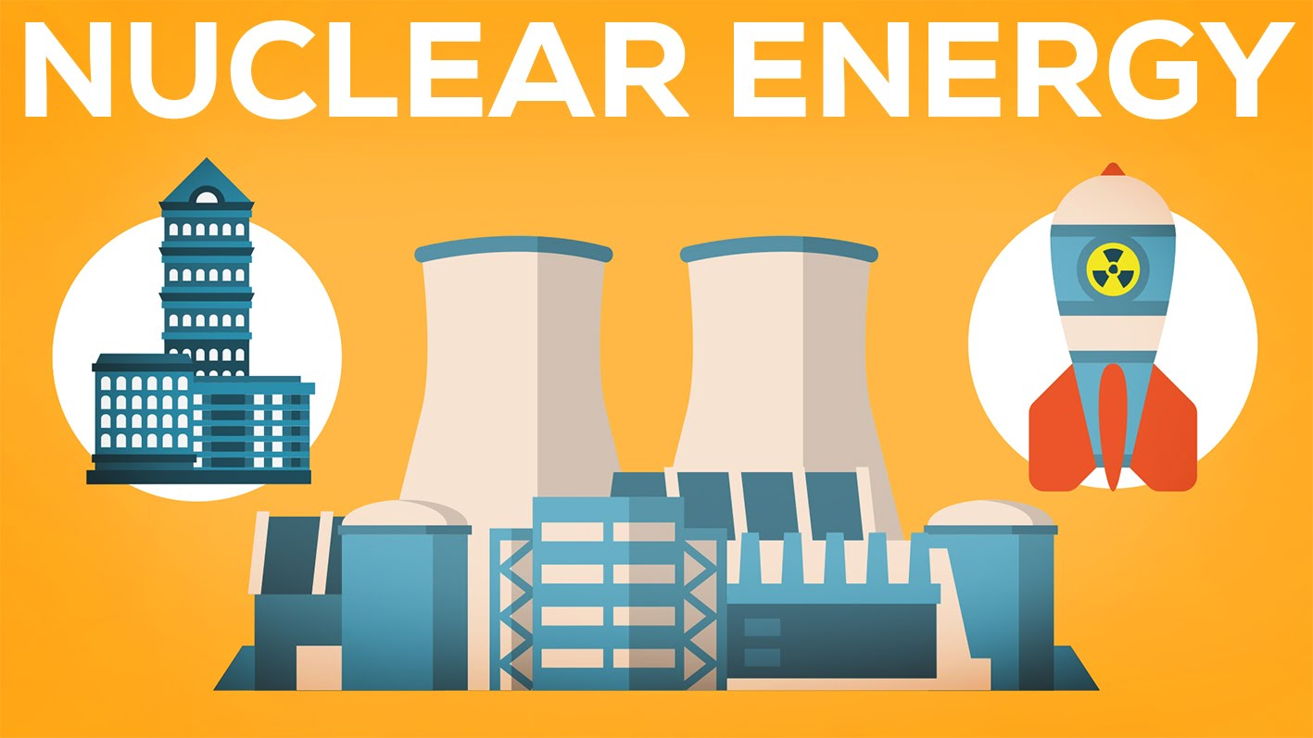
Demonized like no other energy source, nuclear is probably our only hope, together with res, to fight climate change…

Slide 3
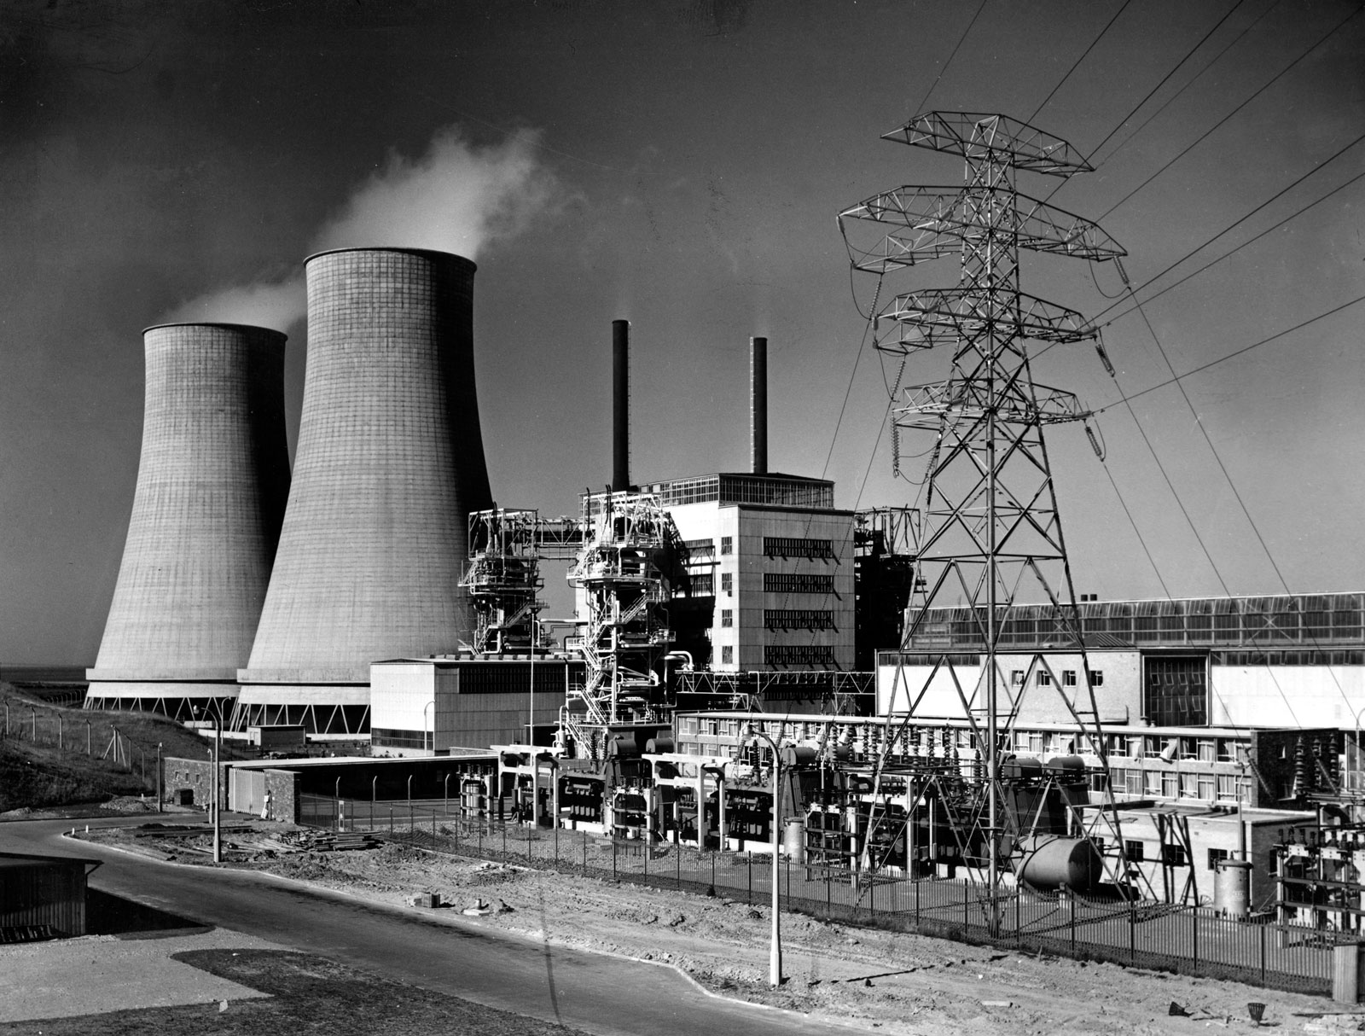
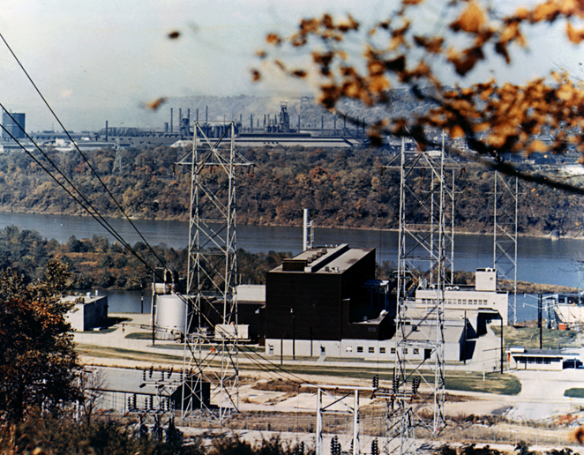
1953 – “ATOMS FOR PEACE”
Calder hAll npp,
uk, 8/1956, 60 MW
Shippingport npp,
USA, 12/1957, 68 mw

Slide 4
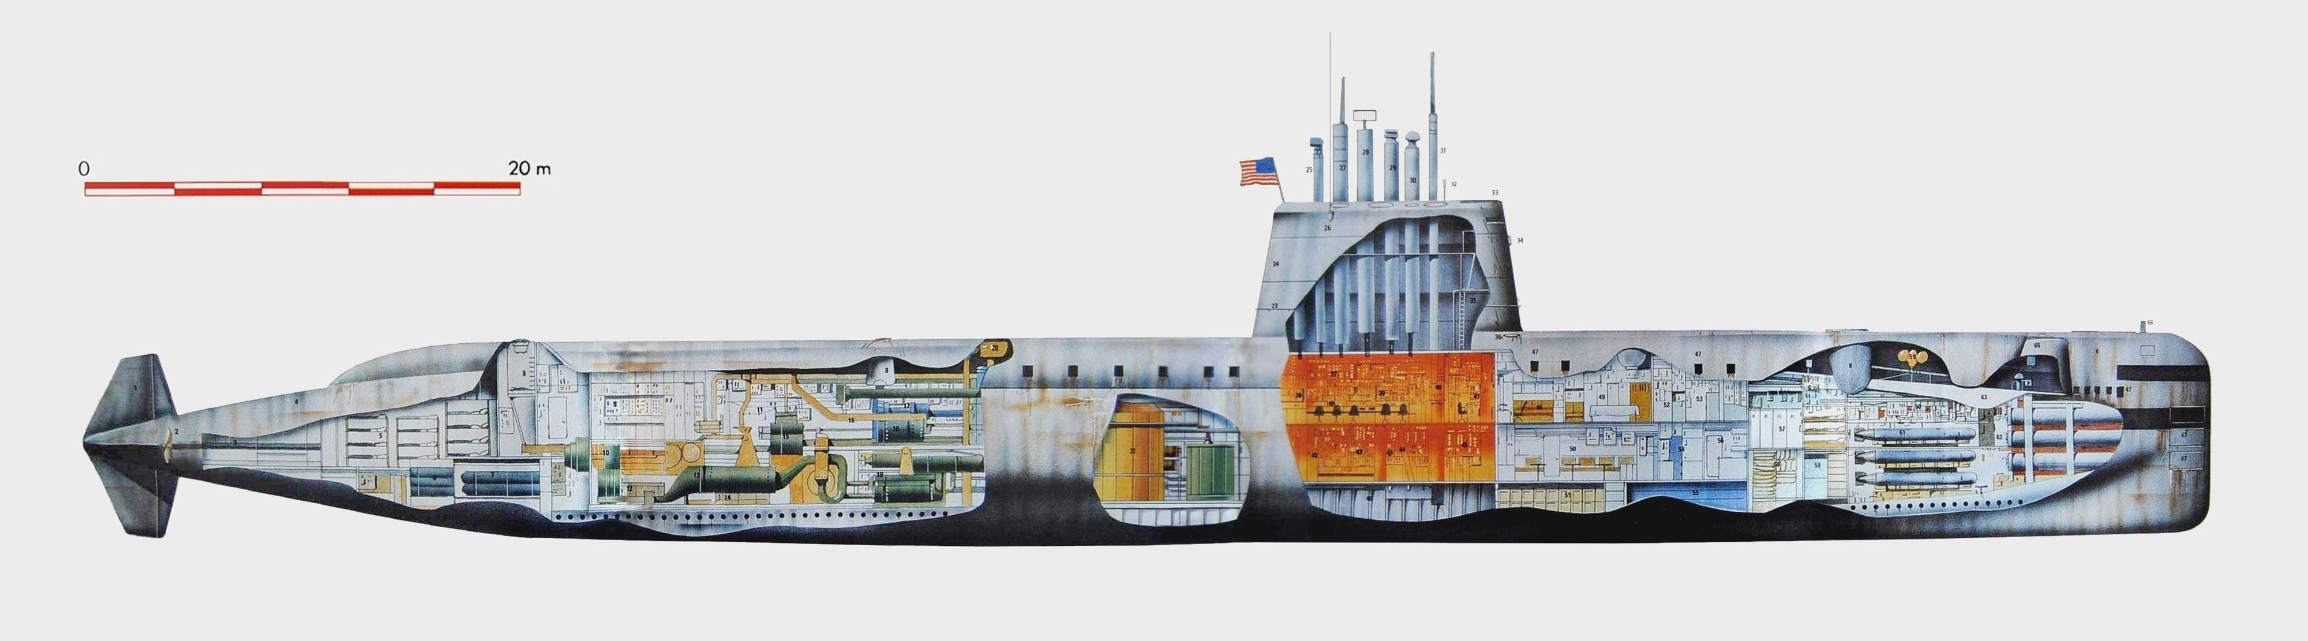
17/1/1955: “UNDERWAY ON NUCLEAR POWER” (ssn-571, nautilus)

Slide 5
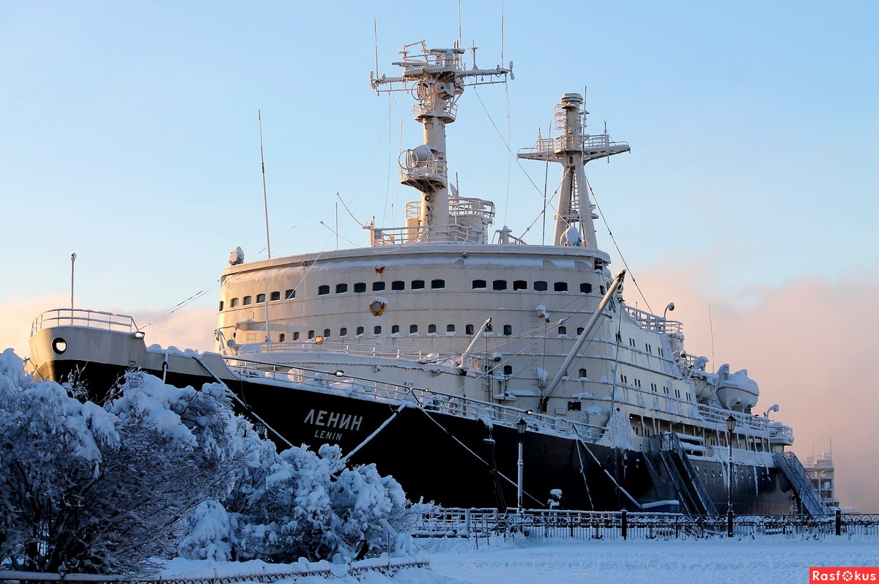
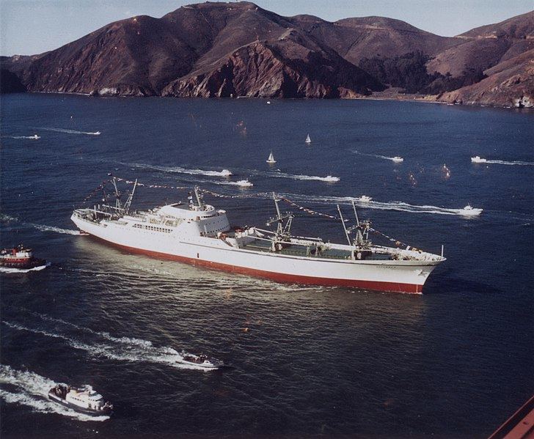
Only submarines and carriers? No!
“LENIN” ICEBREAKER 1959
MERCHANT SHIP SAVANNAH 1962

Slide 6
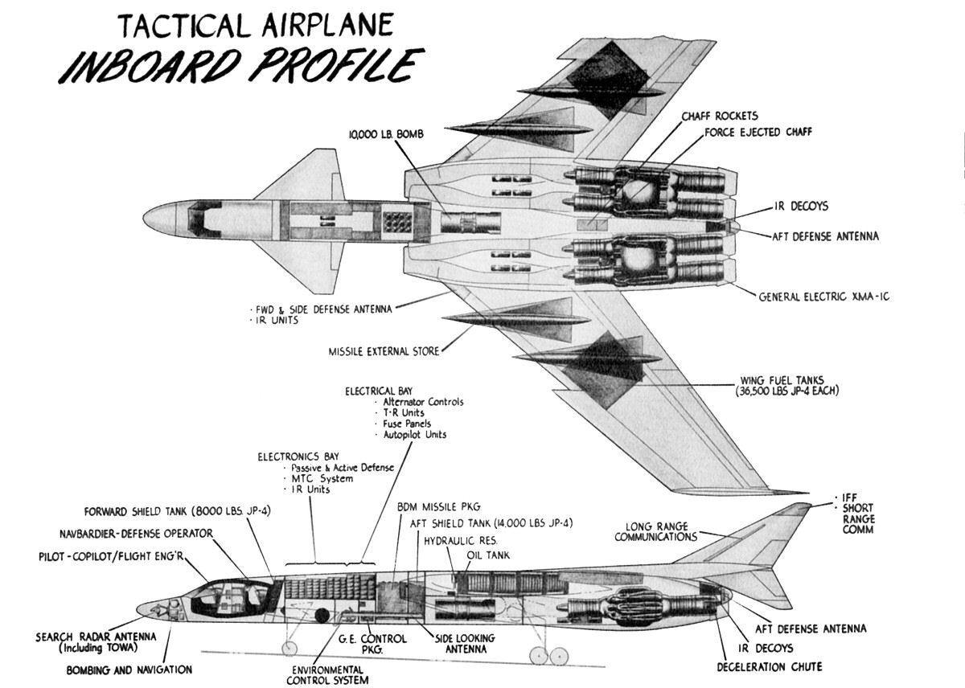
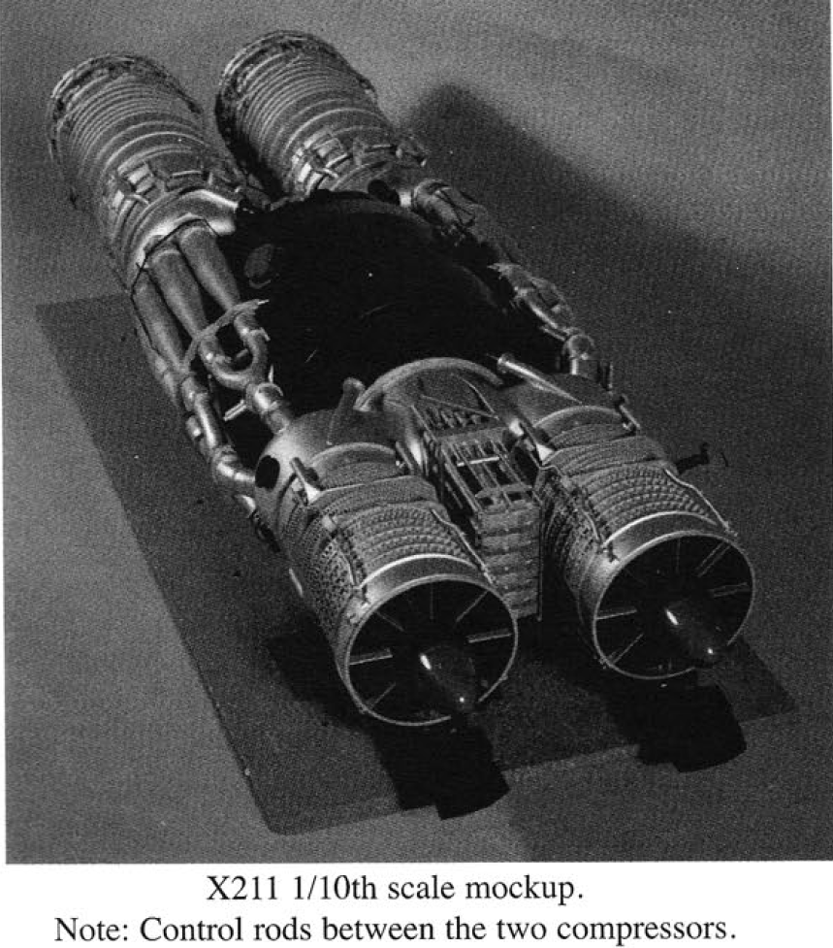
AND MORE…. (weapon system 125)

Slide 7

AND MUCH MORE!!!
April 2021 DARPA awards contracts to Lockheed Martin, Bezos’ Blue Origin and General Atomics for a nuclear-powered spacecraft to orbit Earth by 2025
Mr Putin’s “Kanyon” or “Poseidon” Unmanned Underwater Vehicle (UUV), basically a giant torpedo with nuclear propulsion and practically unlimited range. will be deployed aboard submarines by 2027

Slide 8
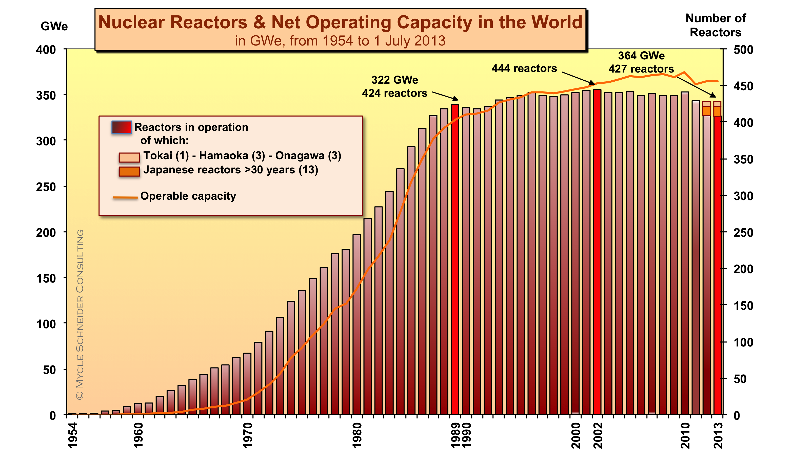
NUCLEAR ENERGY - A Dream too much?
98 LEFT IN THE US OUT OF 133, PLUS121 CANCELLED…

Slide 9
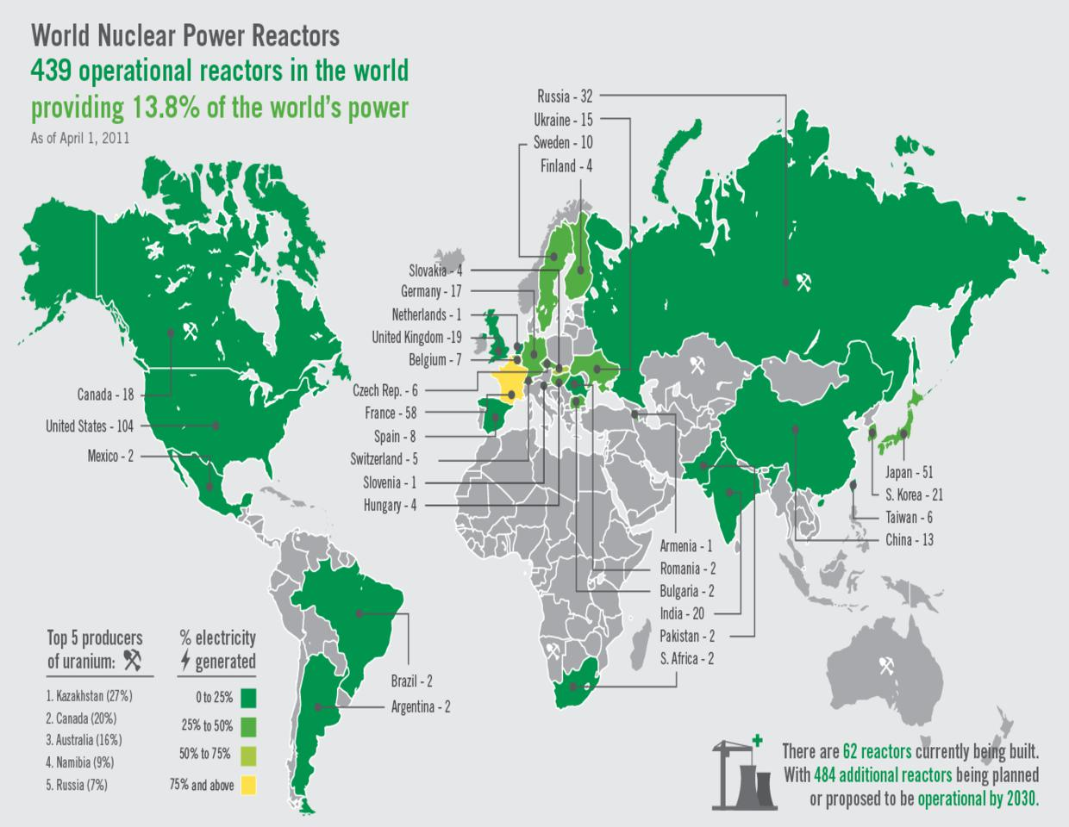
The situation at the fukushima incident

Slide 10
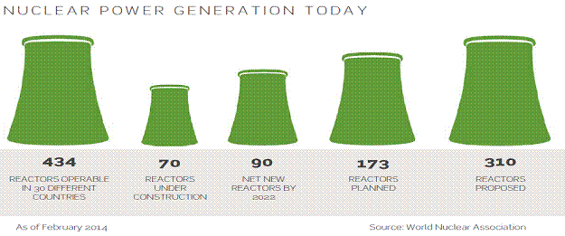
Today: only 10.5% of global electricity / 18% in the 37 oecd countries / 20% in the us
Still, there is huge potential…
443 operational / 54 being built / 100 planned

Slide 11
Challenges and opportunities
challenges
opportunities
Financial (capital-intensive) 70% of the cost of a kWh in 60 years is accounted for by the early/fixed cost from the construction phase…
Geopolitical: NPT “Trojan Horses”, e.g. export limitations for US companies, as Section 123 of the Atomic Energy Act generally requires the conclusion of a nuclear cooperation agreement
Regulatory, for obvious safety reasons/see EURATOM
RAW Management (e.g. Yuka mountain)
Alternative source of electricity
“Too cheap to meter”, once operational
More than 94% installed capacity factor vs just 35% for wind and 25% for solar
600 million tons of oil equivalent annually
2015 Paris Agreement is good news
Promising technological breakthroughs, like fusion and thorium

Slide 12
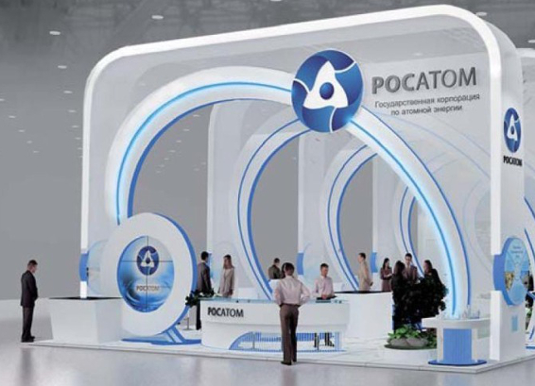
Rosatom State Corporation established December 2007

Slide 13
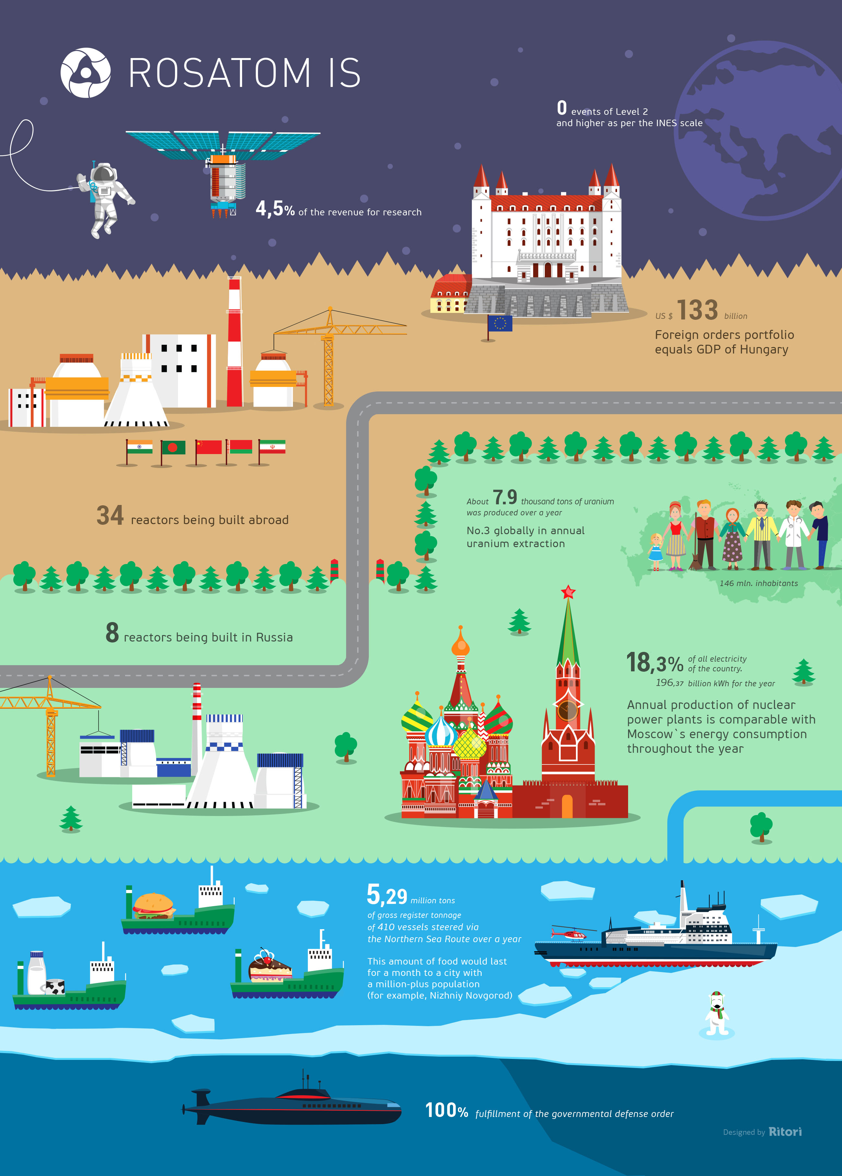
Undisputed World leader in nuclear activities

Slide 14
 | 2011 | 2012 | 2013 | 2014 | 2015 | 2016 | 2017 | 2018 | 2019
Kazakhstan | 19,451 | 21,317 | 22,451 | 23,127 | 23,607 | 24,586 | 23,321 | 21,705 | 22,808
Canada | 9145 | 8999 | 9331 | 9134 | 13,325 | 14,039 | 13,116 | 7001 | 6,938
Australia | 5983 | 6991 | 6350 | 5001 | 5654 | 6315 | 5882 | 6517 | 6,613
Namibia | 3258 | 4495 | 4323 | 3255 | 2993 | 3654 | 4224 | 5525 | 5,476
Uzbekistan | 2500 | 2400 | 2400 | 2400 | 2385 | 2404 | 2404 | 2404 | 3,500
Niger | 4351 | 4667 | 4518 | 4057 | 4116 | 3479 | 3449 | 2911 | 2,983
Russia | 2993 | 2872 | 3135 | 2990 | 3055 | 3004 | 2917 | 2904 | 2,911
China | 885 | 1500 | 1500 | 1500 | 1616 | 1616 | 1885 | 1885 | 1,885

Slide 15
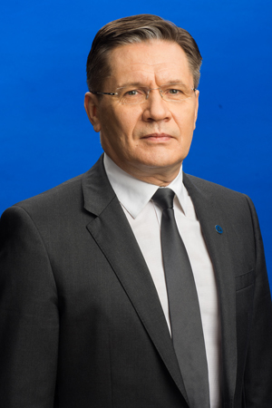
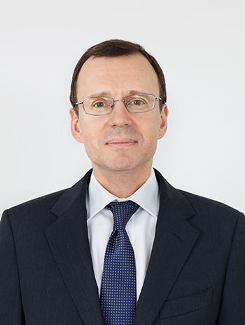
AL. LIKHACHoV & NIK. SPASSKIY

Slide 16


rosatom’S international branch and its main SHAREHOLDER

Slide 17
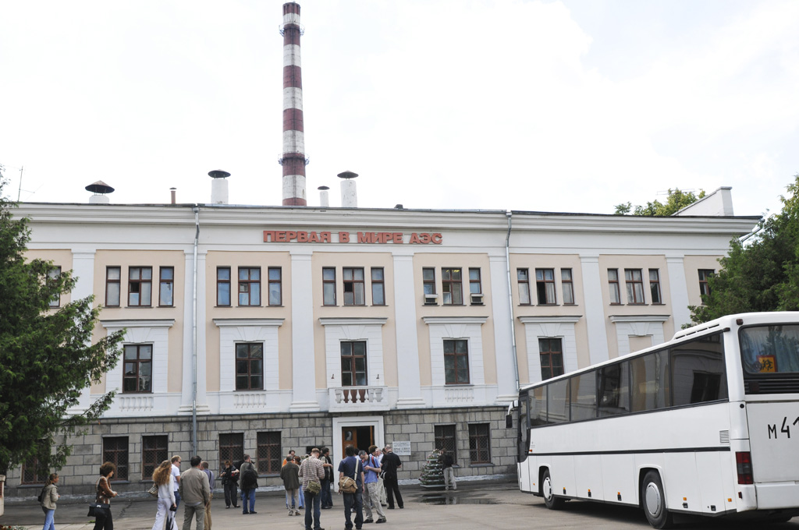
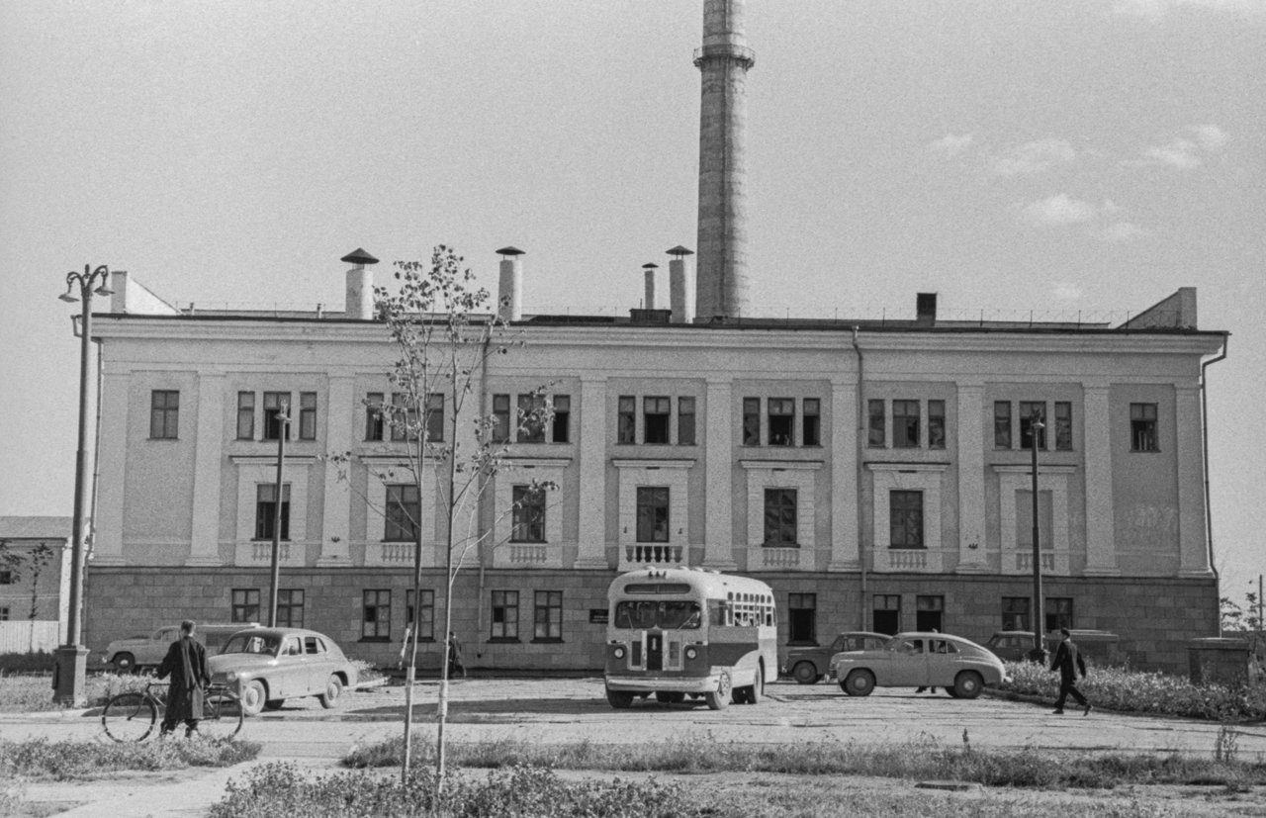
June 1954: OBNINSK NPP CONNECTED TO THE GRID IN KALUGA - 6 mw

Slide 18
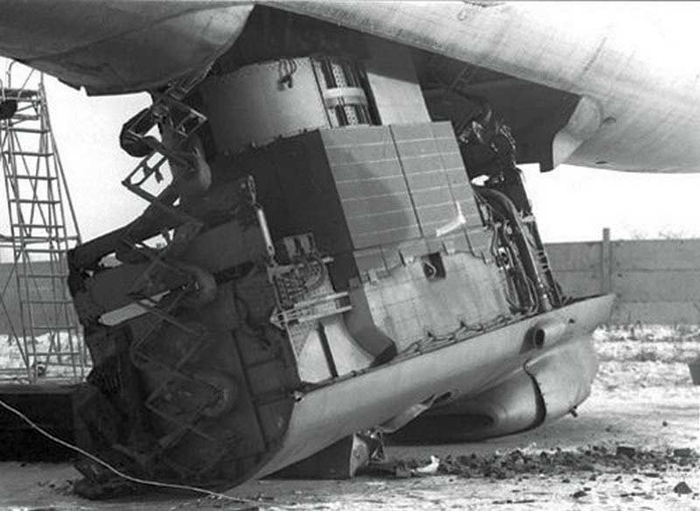
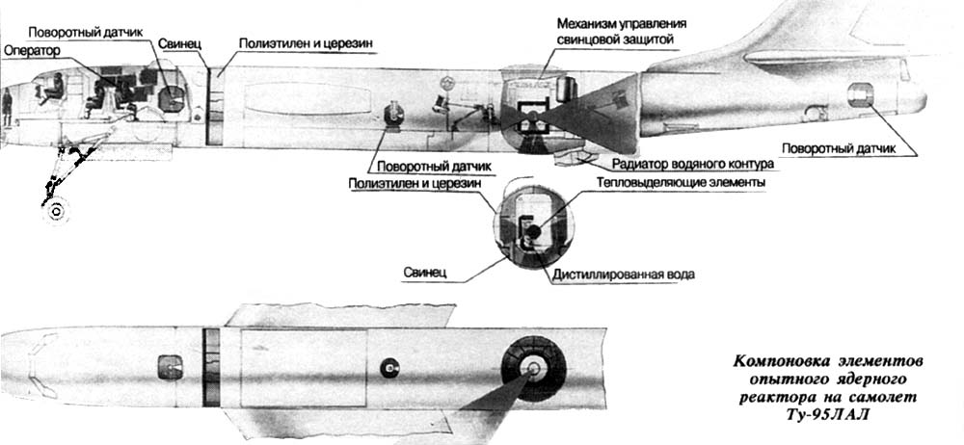
They even tested a reactor inside a modified tupolev bomber in 1961

Slide 19
MAJOR SOVIET MILESTONES
1953 “Ministry of Medium Machine Building” established, the forerunner of ROSATOM
1964 Beloyarsk 1 commissioned at 110 MW. Dominant concept was the minimalist RBMK by OKB Gidropress using natural uranium as fuel, regular water for cooling and solid graphite for neutron moderator
1966 Rheinsberg, the first NPP abroad (D.D.R.) used the WWER (water cooled, water moderated energetic reactor) concept, also by OKB Gidropress. instead of the RBMK. Output 70 MW
1973 BN-350, the world's first “breeder” or “fast neutron” reactor commissioned in Aktau, SSR Kazakhstan, but remained “limited edition”. Designed by OKB Afrikantov. No neutron moderator needed, in contrast with classic thermal reactors plus they use almost all of their waste as fuel. In the meanwhile, in April 1977 Jimmy Carter in the US decided to halt the construction of “breeders” due to proliferation concerns…
By the mid-1980s, the total capacity of Soviet nuclear power plants reached a record of 37 GW

Slide 20
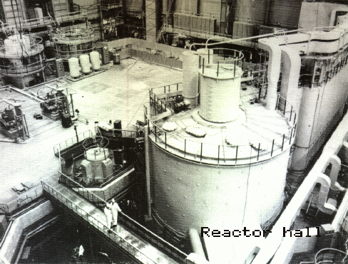
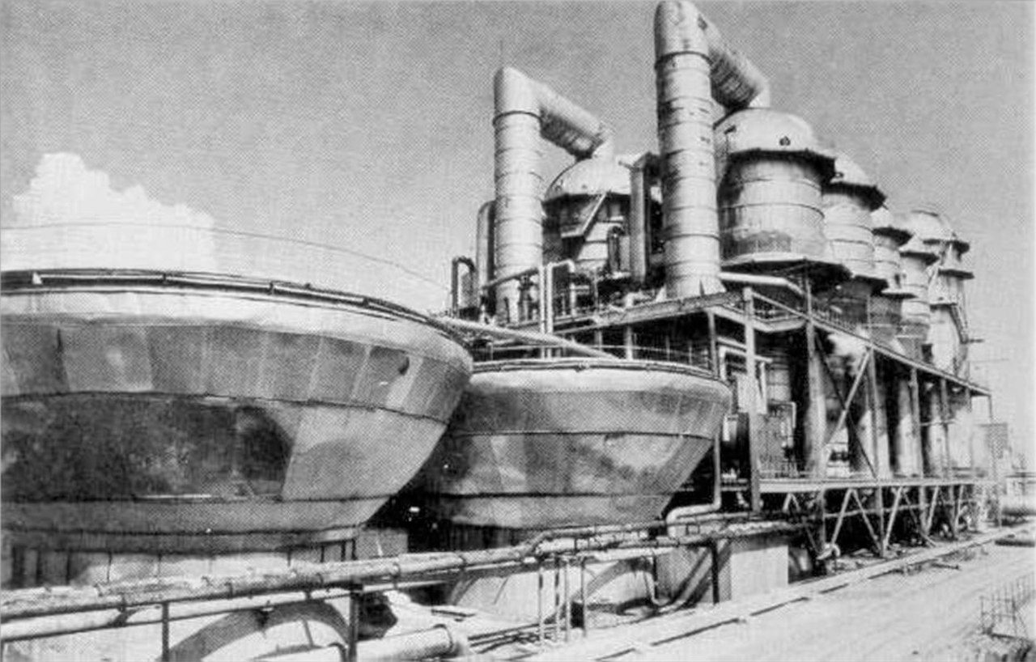
THE BN-350 AKTAU PLANT OF 135 mw

Slide 21
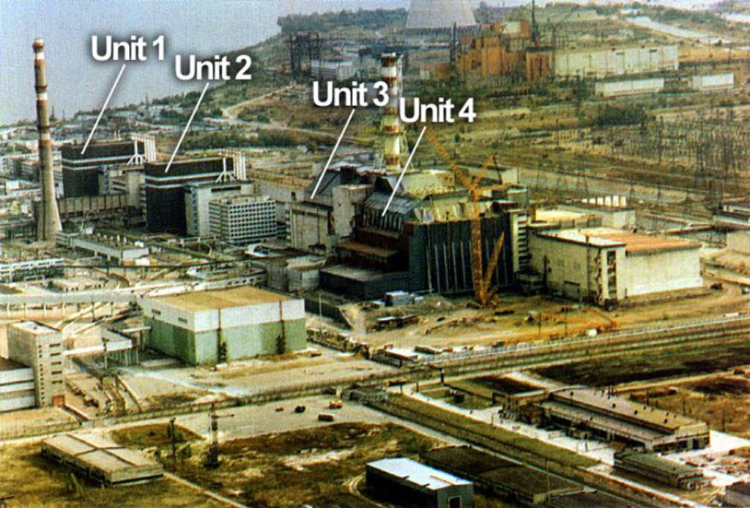
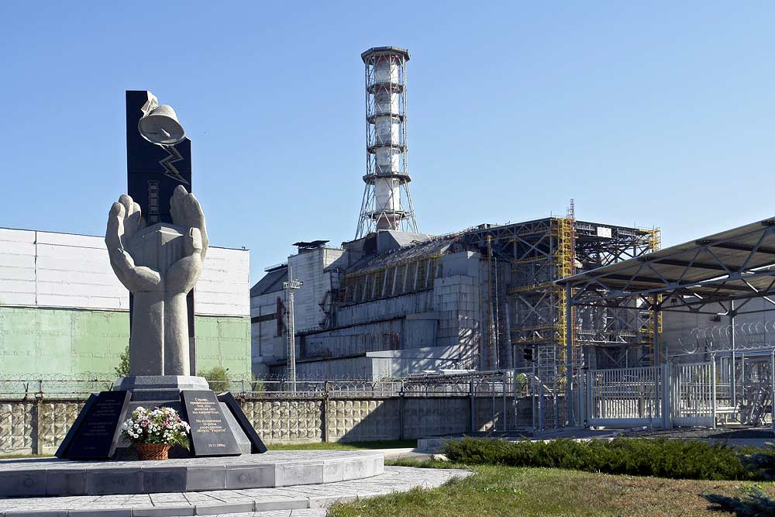
APRIL 1986: chernobyl 4 tragedy RBMK concept is abandoned

Slide 22
RECENT ACHIEVEMENTS
Since 2007, Rosatom has completed 18 new NPP in Russia and abroad, the Akademik Lomonosov floating nuclear power plant in December 2019 and a modern icebreaker, Arktika
2016 Commissioning of the first 3+ generation reactor, WWER-1200 Novovoronezh 6, with a useful life of 60 years at 90% capacity factor. “Technical and economic indicators that ensure absolute safety during operation and fully comply with IAEA's post-Fukushima requirements"
2026 Target for commissioning the first 4th generation or sodium-cooled fast neutron (breeder) reactor, Brest-300 at Seversk

Slide 23
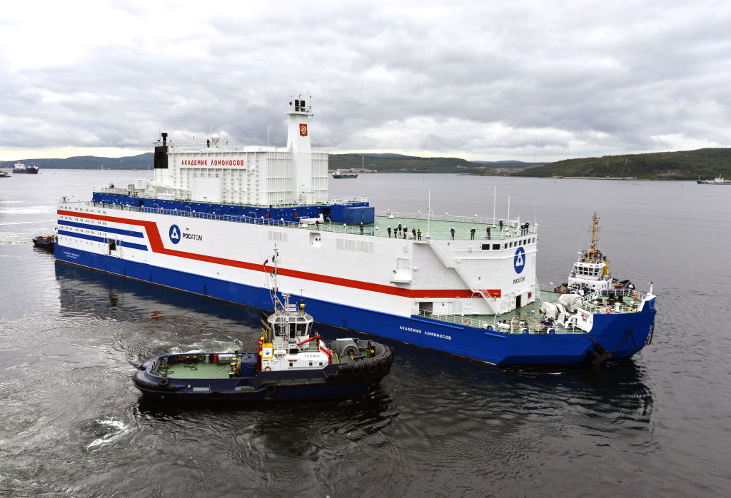
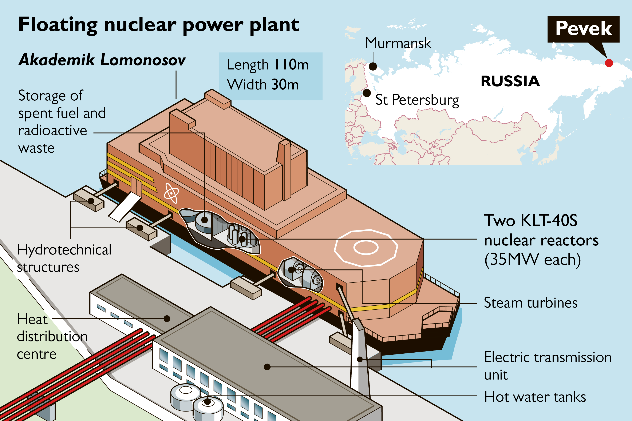
Akademik Lomonosov

Slide 24
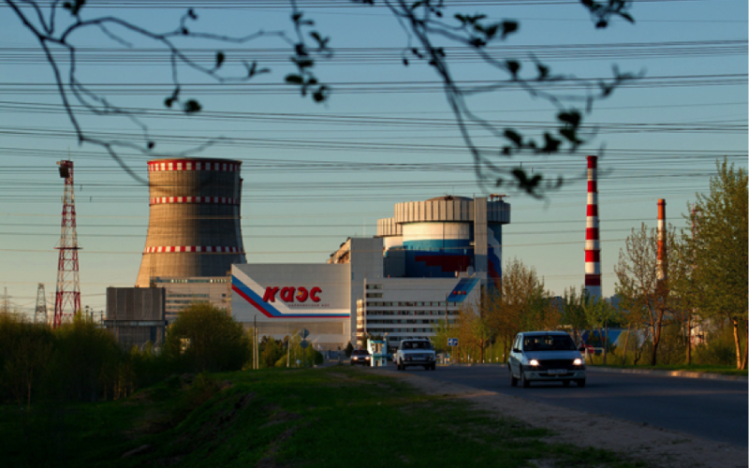
25 units under construction in late 2019, export revenues $ 7.3 bn fuel supply for 75 npp globally market share target 30% 5/16 annually

Slide 25
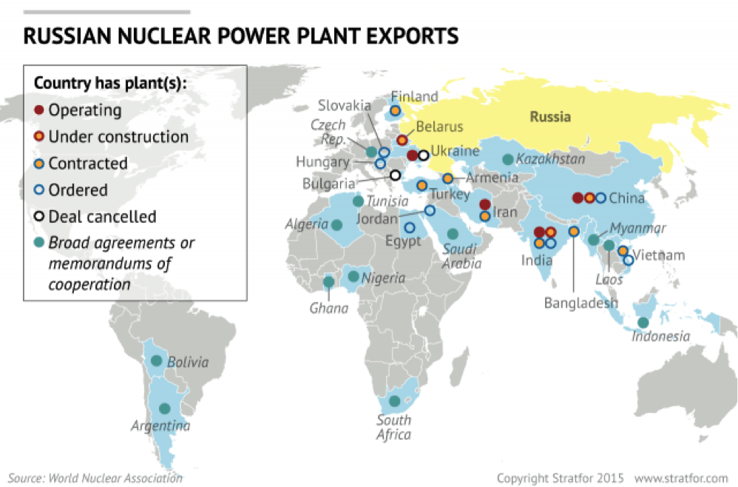
Total orders exceed $ 130 bn

Slide 26
ROSATOM Comparative advantages
Full vertical integration and “full package”, including return of RAW
Enormous political and diplomatic support (diplomatic attaches in at least 15 Russian embassies)
Projects financed up to 90% by export credits. Hungary $ 11 Bn
BOO (Build-Own-Operate) model for the first time in Turkey, following the 2010 IGA. A kind of “Bastion” in a NATO country!
Global reach, in contrast with the pipeline gas of OAO Gazprom
Each deal forges a “strategic” cooperation of long-term nature

Slide 27
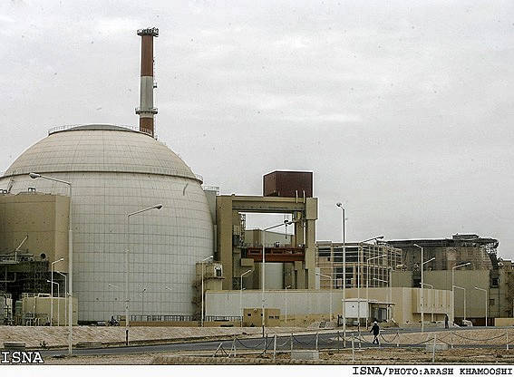
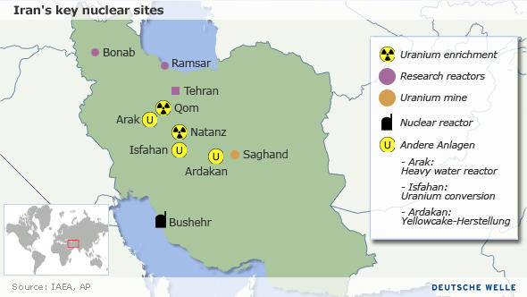
September 2011: «BUSHEHR 1», IRAN
«BUSHEHR 2» operational in 2024

Slide 28
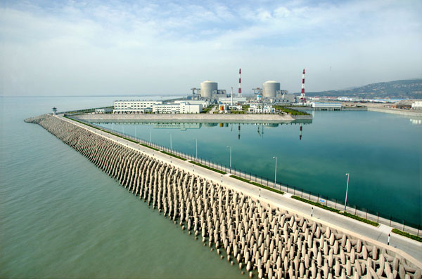
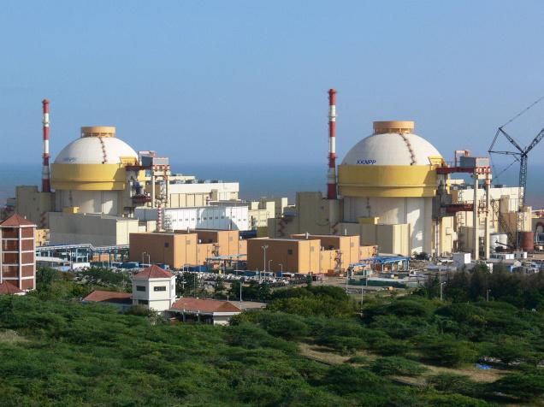
INDIA AND CHINA also BUY RUSSIAN…

Slide 29
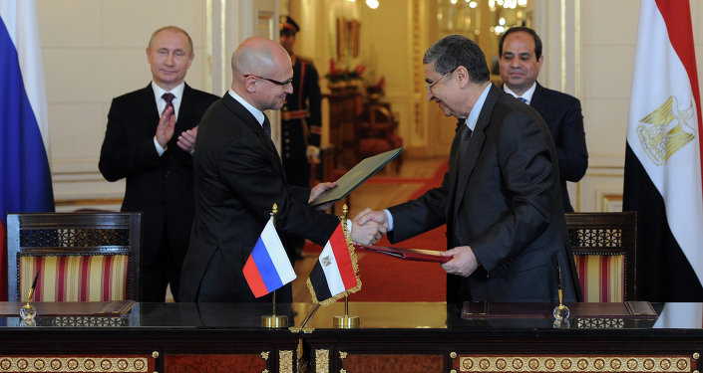
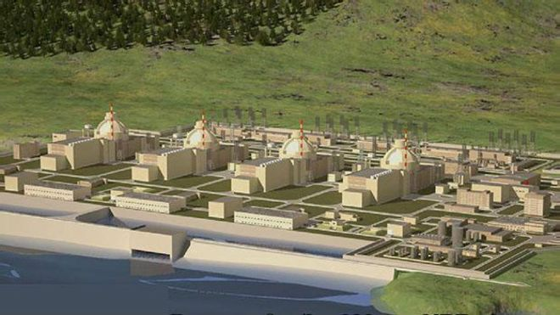
EASTERN MEDITERRANEAN: STRONG PRESENCE, “AKKUYU 1” READY 10/2023 at 22 bN, the top russian fdi ever

Slide 30
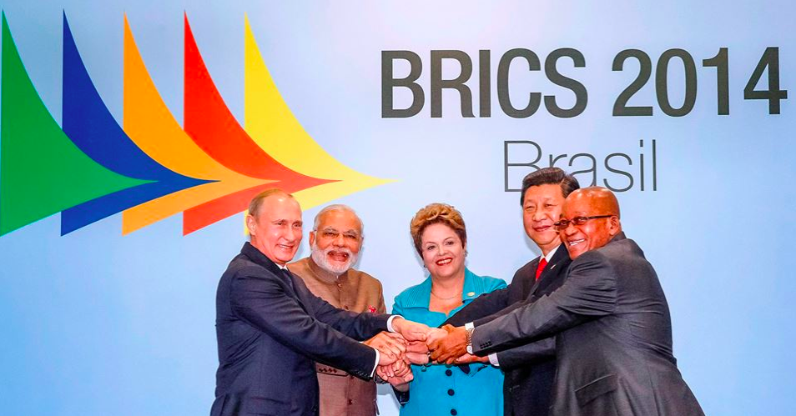
BRICS: UNITED BY NUCLEAR COOPERATION

