Slide 1
CASPIAN RESOURCES AND EUROPEAN EN. SECURITY
Dr Vassilios Sitaras
Unipi, 17-4-2021

Slide 2
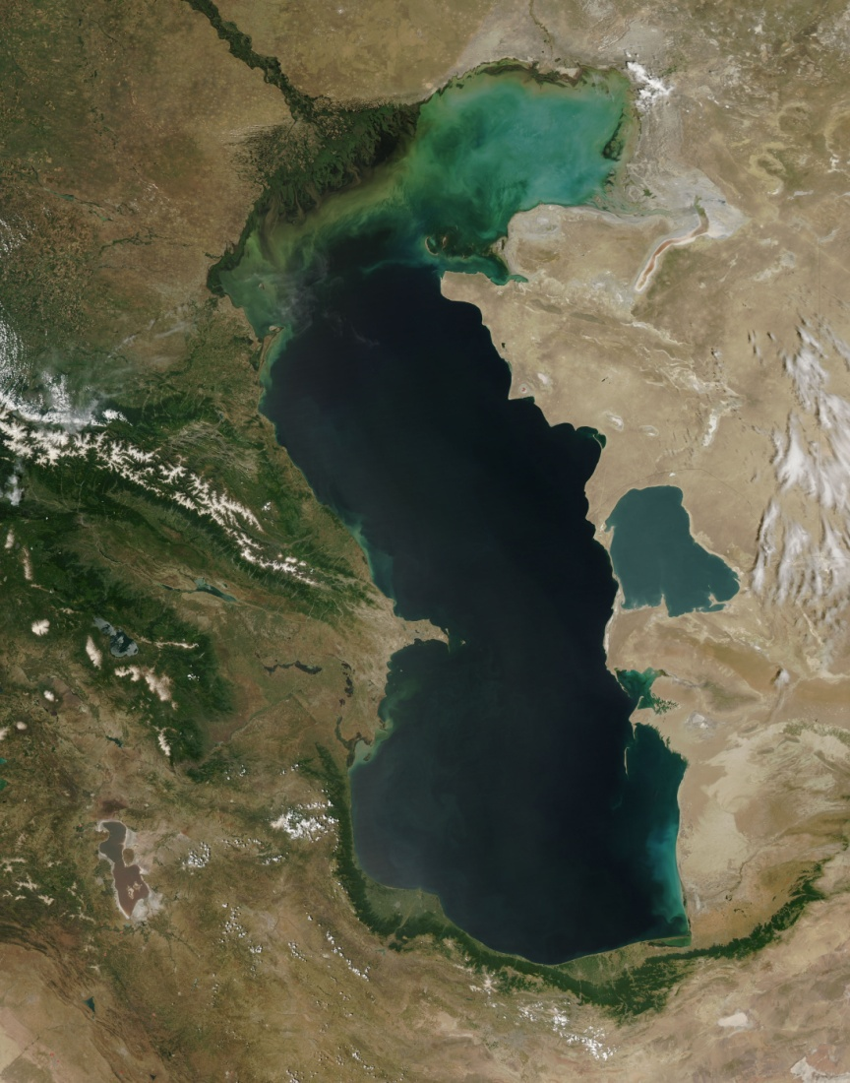
THE CASPIAN SEA

Slide 3
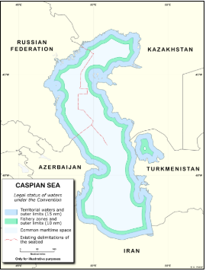
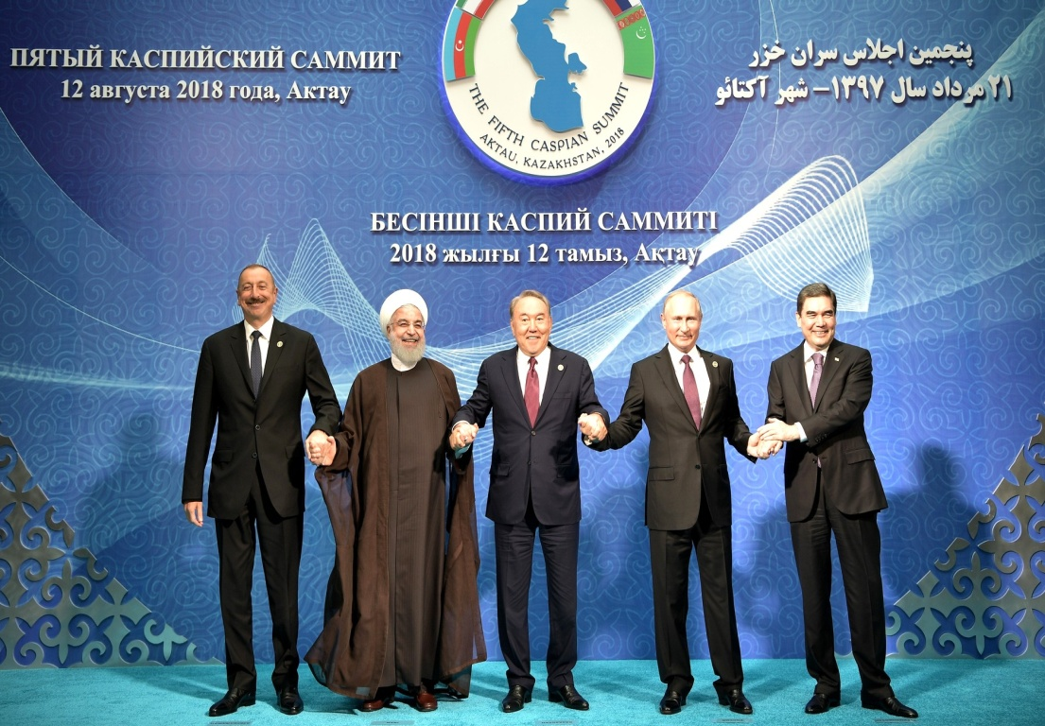
RENTIER-STATES WITH POST-SOVIET LEADERSHIP AND NOC/PSA
Alternative source to Russian Oil and Gas

Slide 4
FIELDS AND PIPELINES
TOP FIELDS
PIPELINES TO EUROPE
ACG
Shah Deniz
Absheron (2021)
Tengiz
Karashaganak
Kashagan
Galkunys
CPC or Tengiz-Novorosirk oil
BTC oil
Southern Gas Corridor combo SC/TANAP/TAP
Trans Caspian (proposed) gas

Slide 5
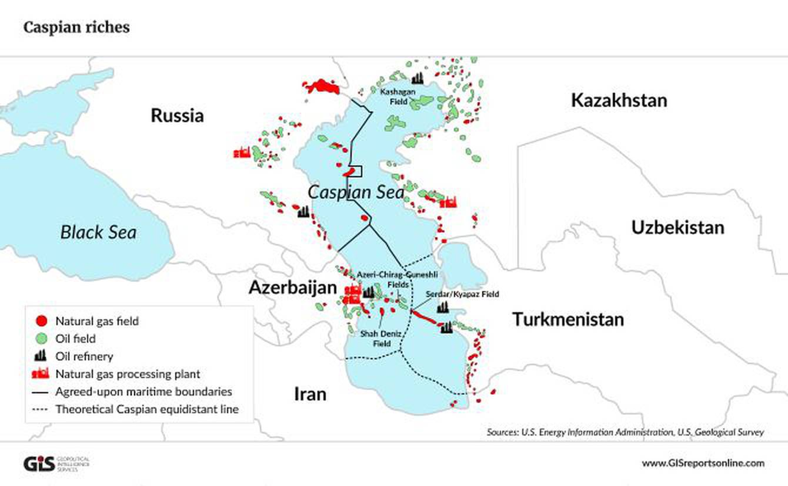
THE RESOURCES

Slide 6
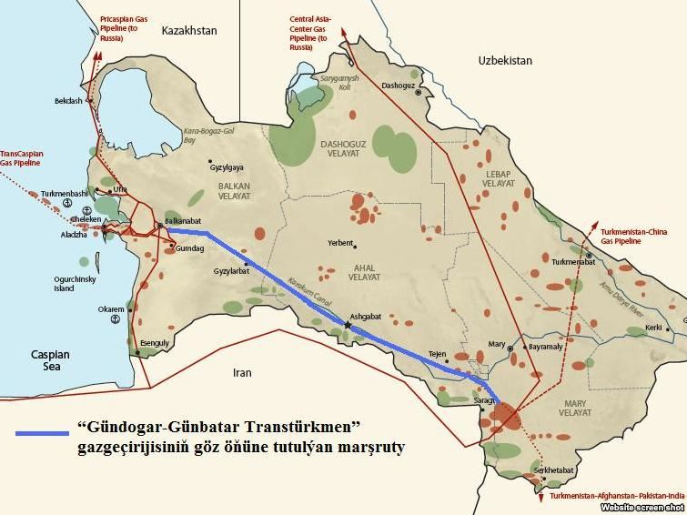
TURKMENISTAN

Slide 7
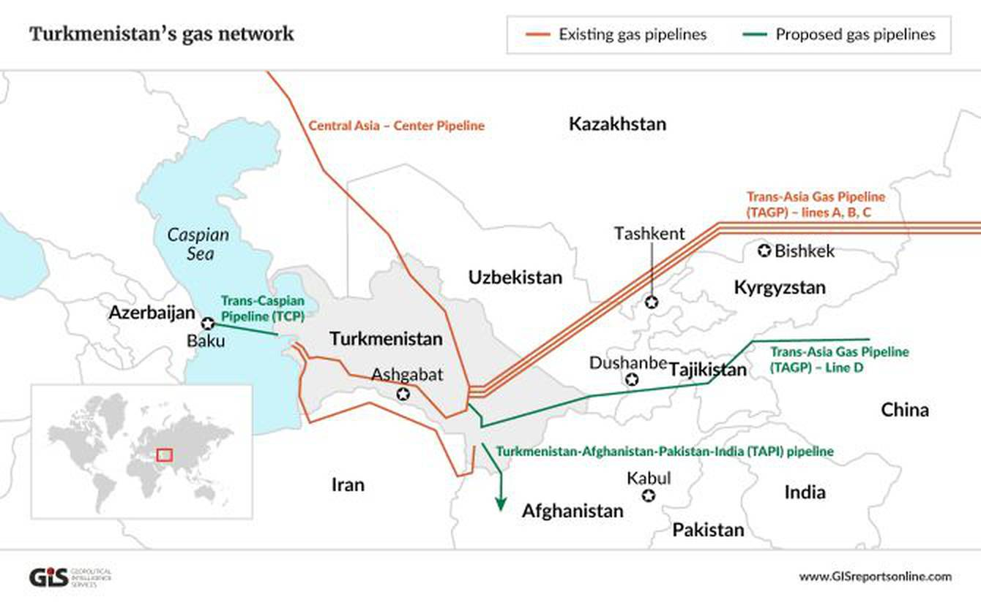
EXPORT STRATEGY

Slide 8
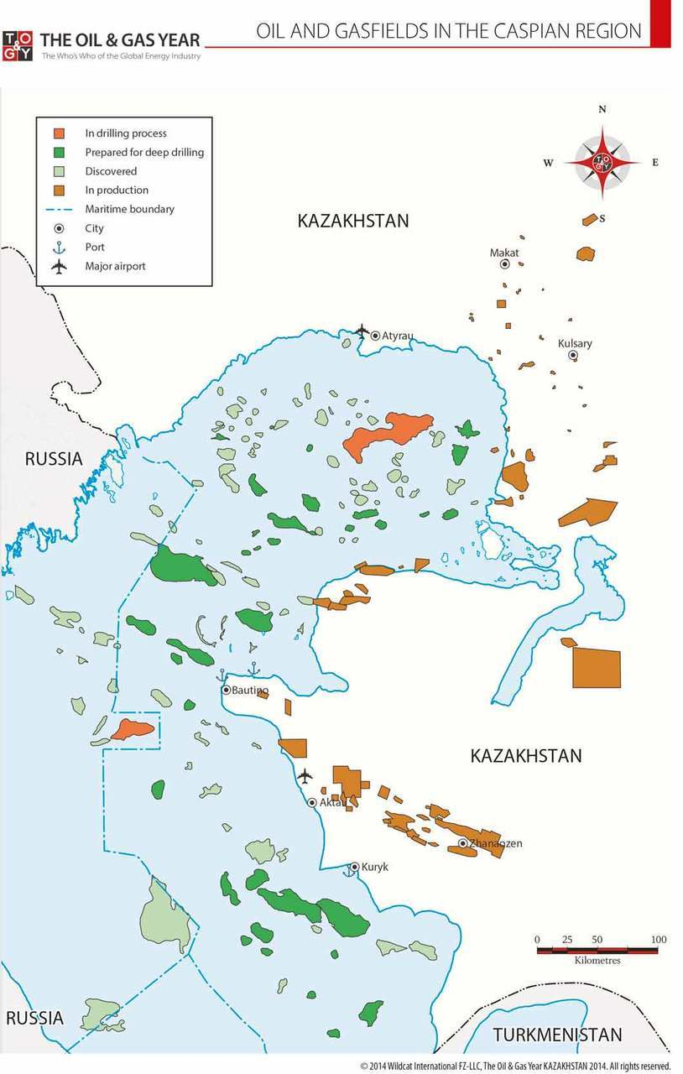
KAZAKHSTAN

Slide 9
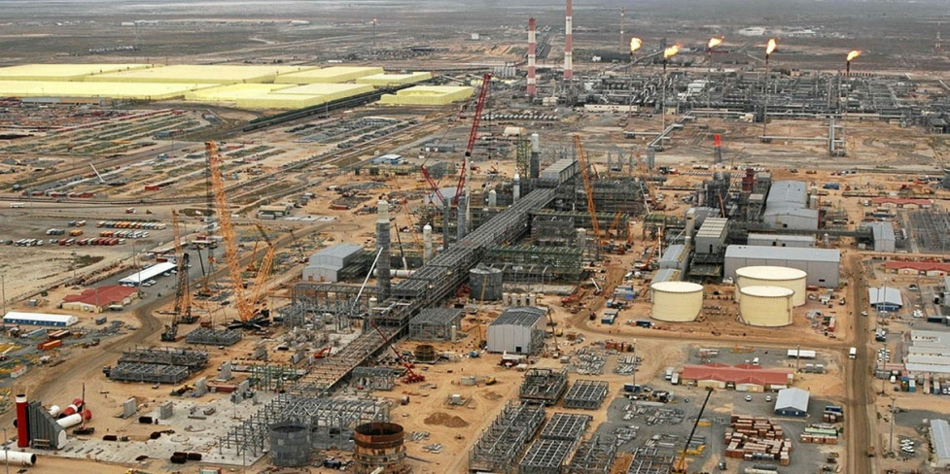
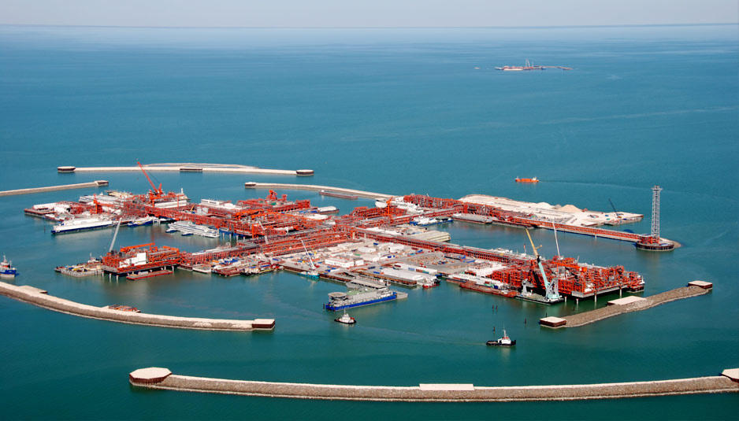
TWO HOLY GRAILS
Tengiz 1979, Terrific accident 1985, Tengizchevroil 1993,
50% Chevron, 25% Exxon Mobil, 5% Lukoil
Kashagan 2000 Biggest since 1968 and biggest outside Middle East 16,8% each Total, ENI, Shell, Exxon Mobil, around 8% CNPC, Ipex

Slide 10
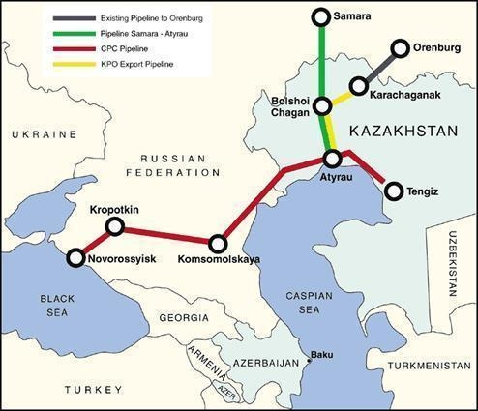
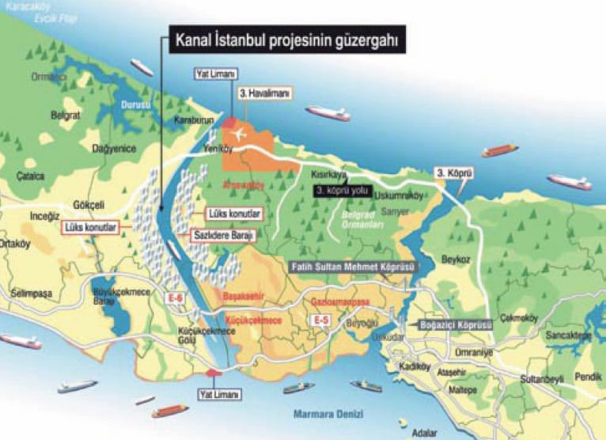
An iconic pipeline and its extension No, it will not be the BAP or any other “bypass “pipeline…

Slide 11
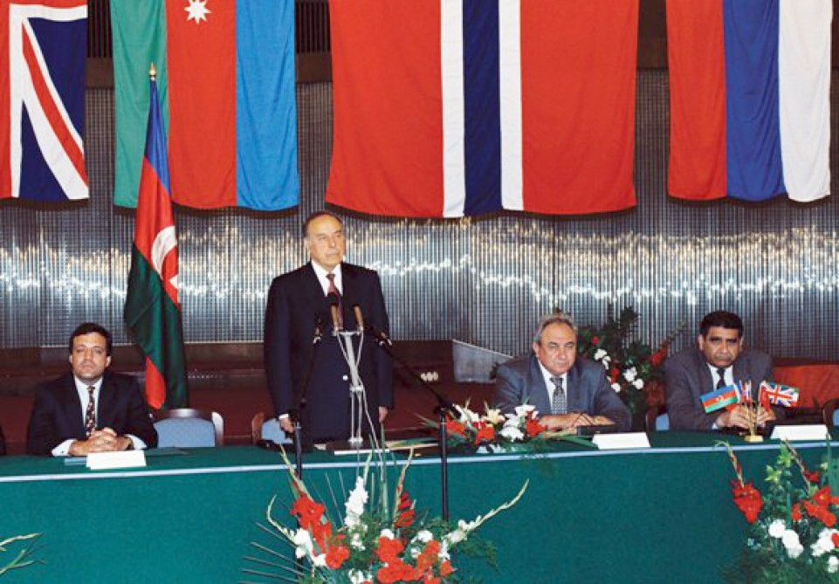
AZERBAIJAN
20.9.1994 The day the country entered the world map

Slide 12
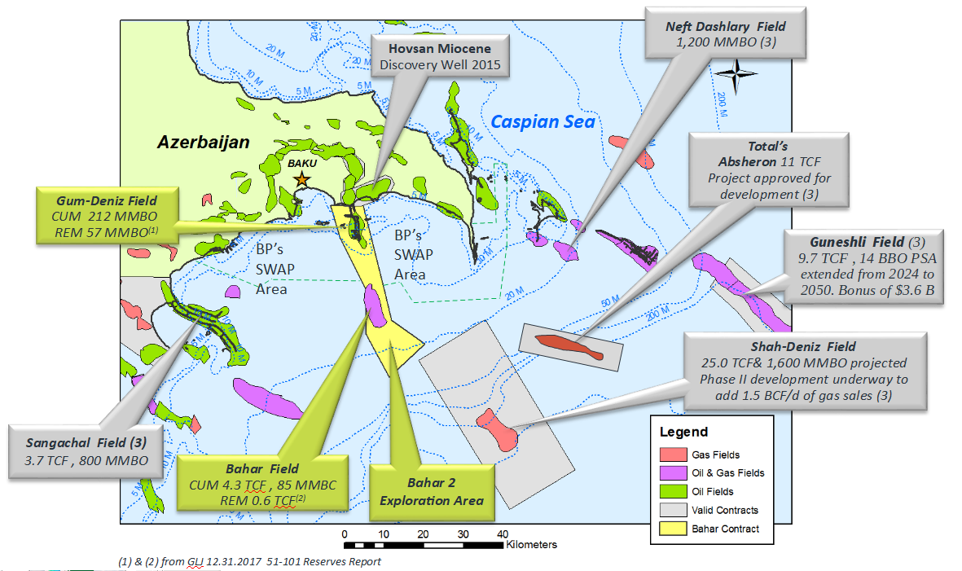
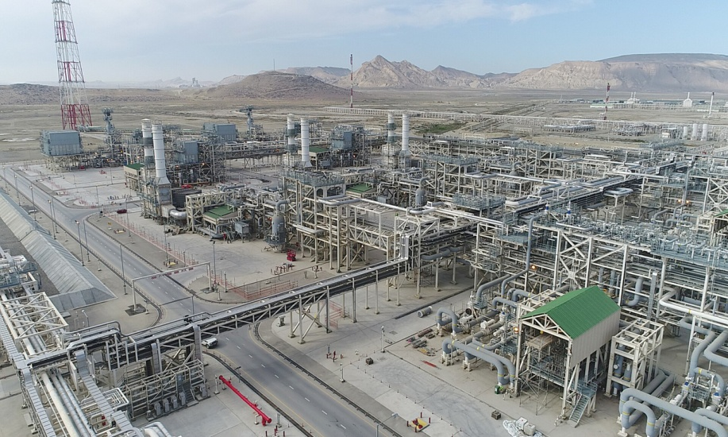
OFFSHORE FIELDS AND A GIANT TERMINAL

Slide 13
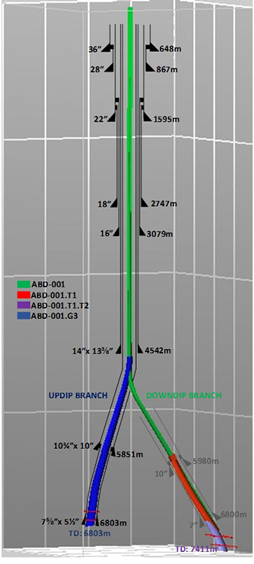
Absheron will probably make it in 2021, but challenges are big due to the depth

Slide 14
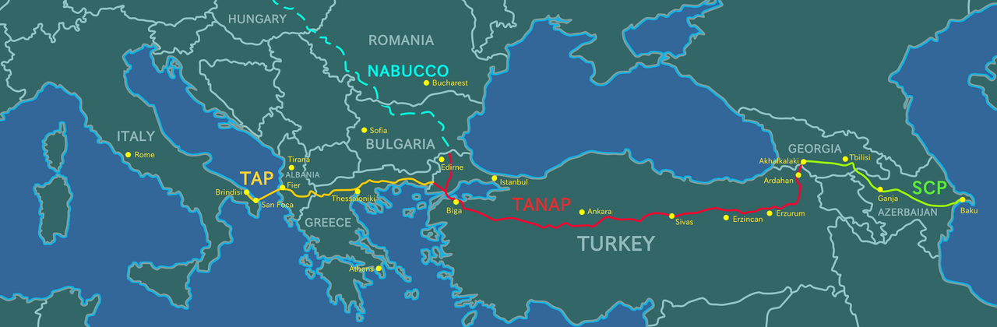
THE SOUTHERN GAS CORRIDOR
At $ 45 bn a rather expensive project to deliver just 16 bcm of gas anually, 10 EU and 6 Turkey. Big questions on phase 2 on Azeri gas only…
BP after making huge money on oil was probably persuaded by the host government to invest on a gas mega-project of perhaps marginable profitability. Total sold 10% in TPAO for 1.5 bn and Statoil 15.5% to PETRONAS for 2.2 bn . This leaves BP with 4NOC and Lukoil…

