Slide 1
nuclear energy & diplomacy THE CASE OF Russia, especially since 2007
Dr Vassilios Sitaras
Unipi, 27-5-2023

Slide 2
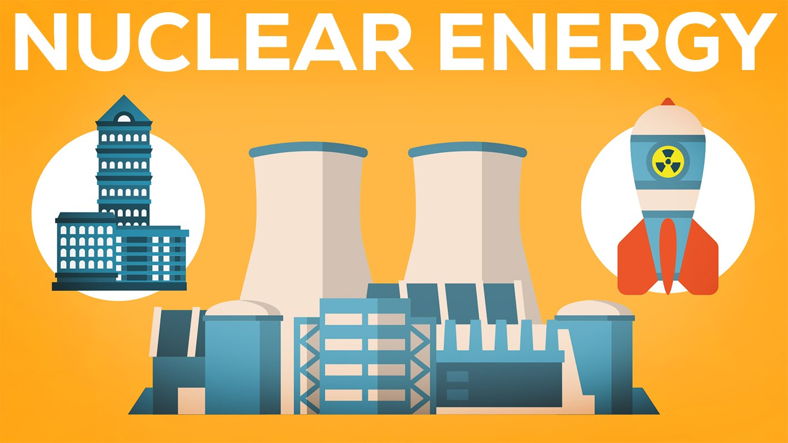
Demonized like no other energy source, nuclear is probably our only hope, together with res, to fight climate change…

Slide 3
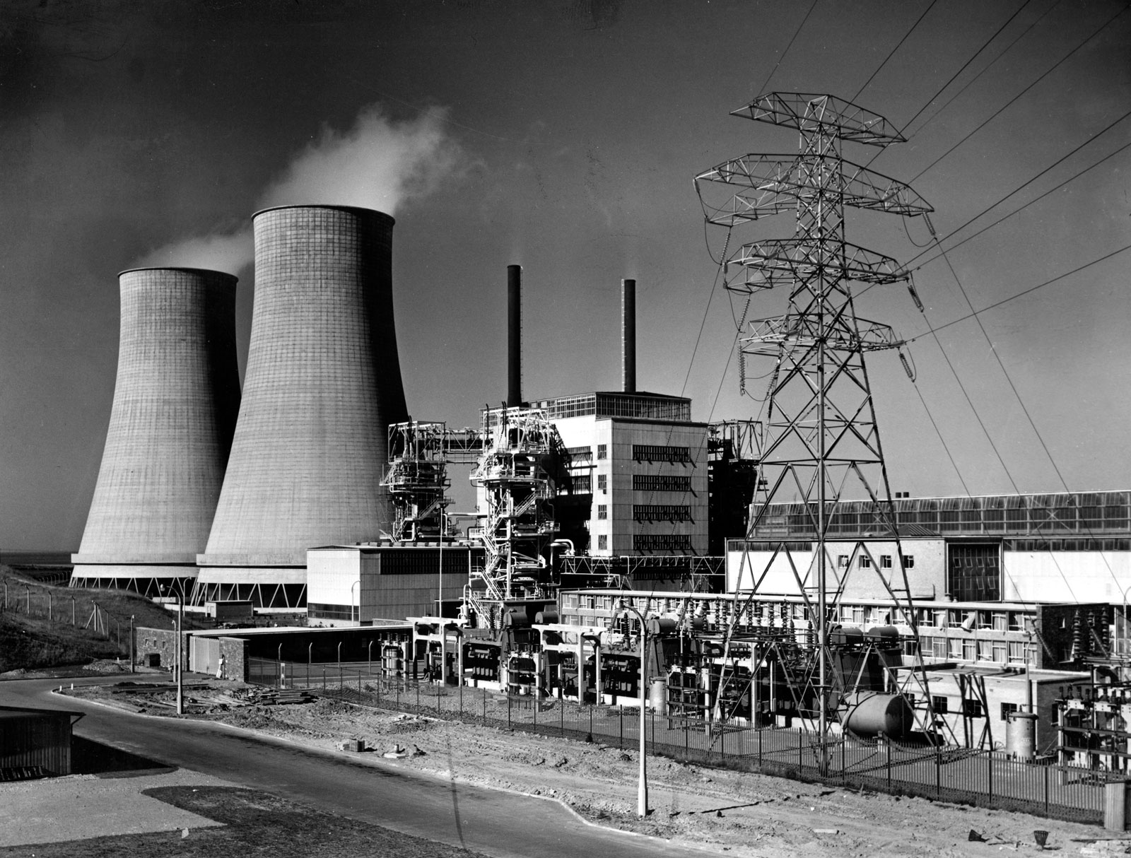
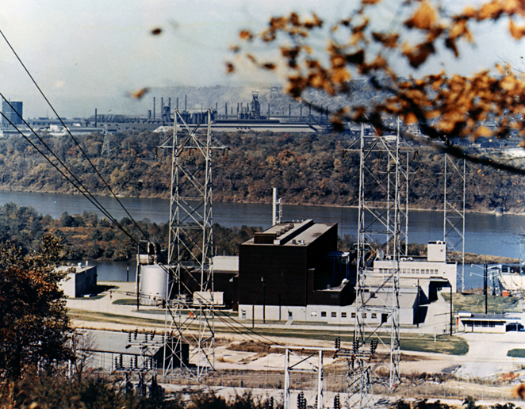
1953 – “ATOMS FOR PEACE”
Calder hAll npp,
uk, 8/1956, 60 MW
Shippingport npp,
USA, 12/1957, 68 mw

Slide 4
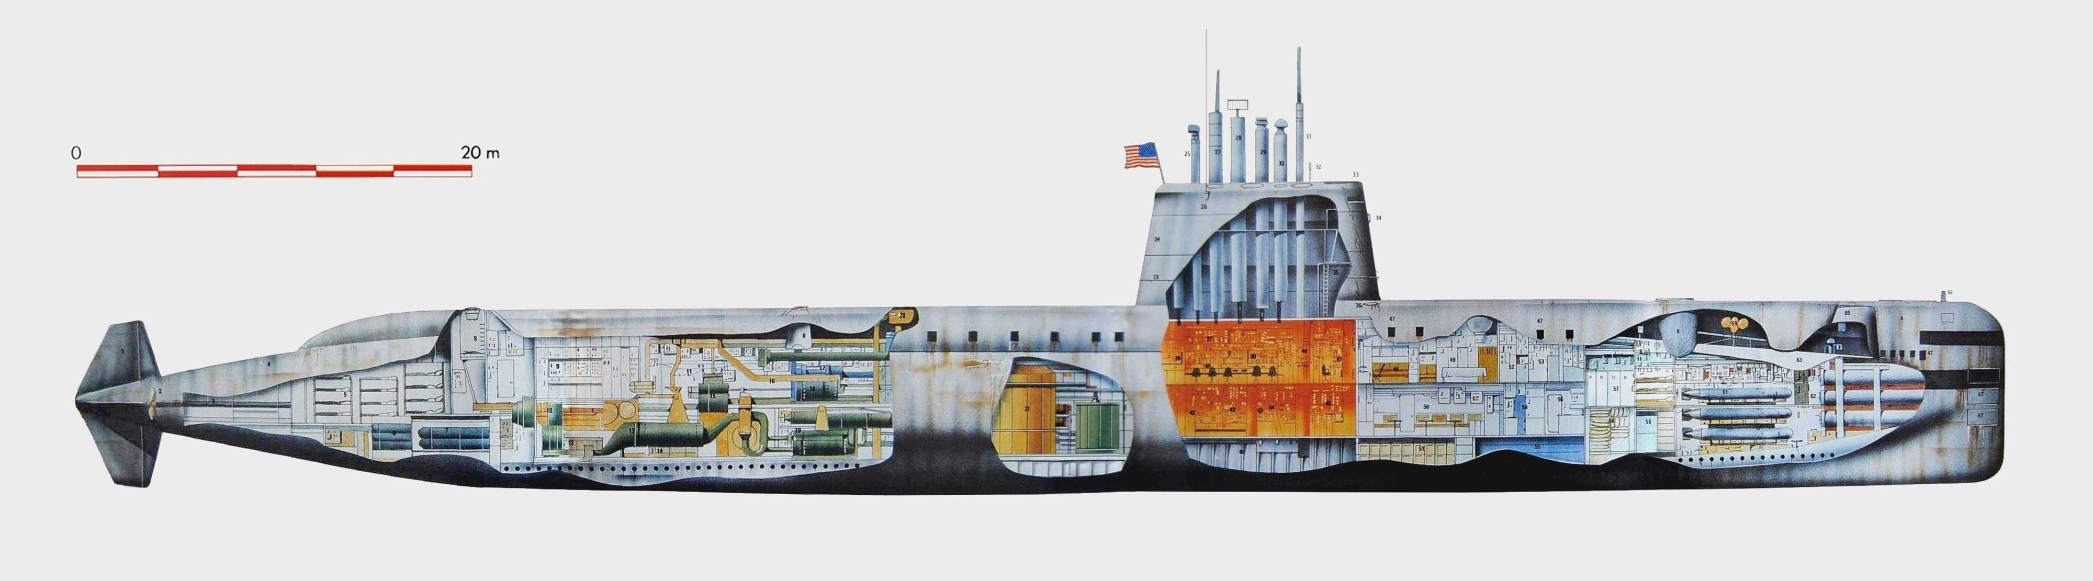
17/1/1955: “UNDERWAY ON NUCLEAR POWER” (ssn-571, nautilus)

Slide 5
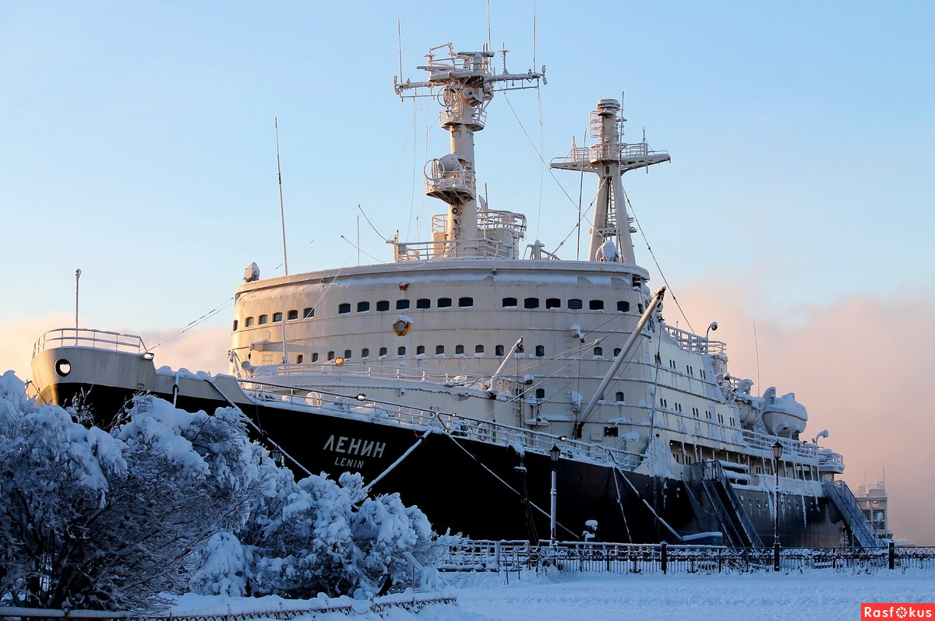
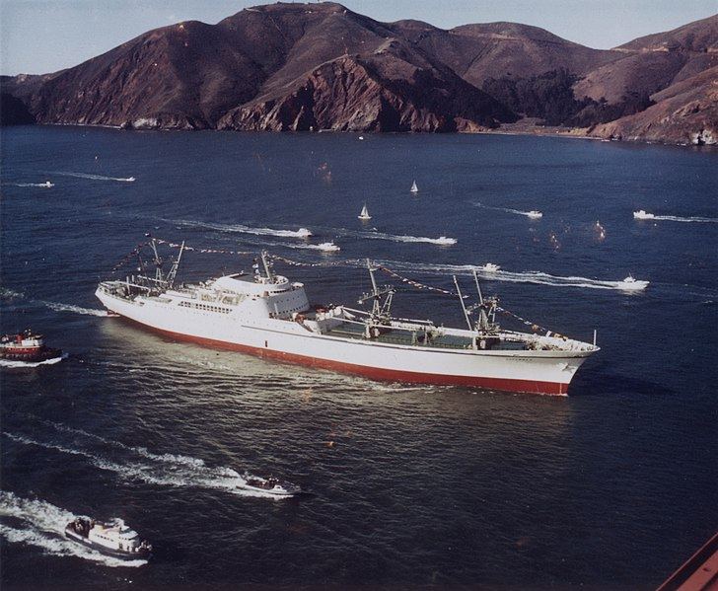
Only submarines and carriers? No!
“LENIN” ICEBREAKER 1959
MERCHANT SHIP SAVANNAH 1962

Slide 6
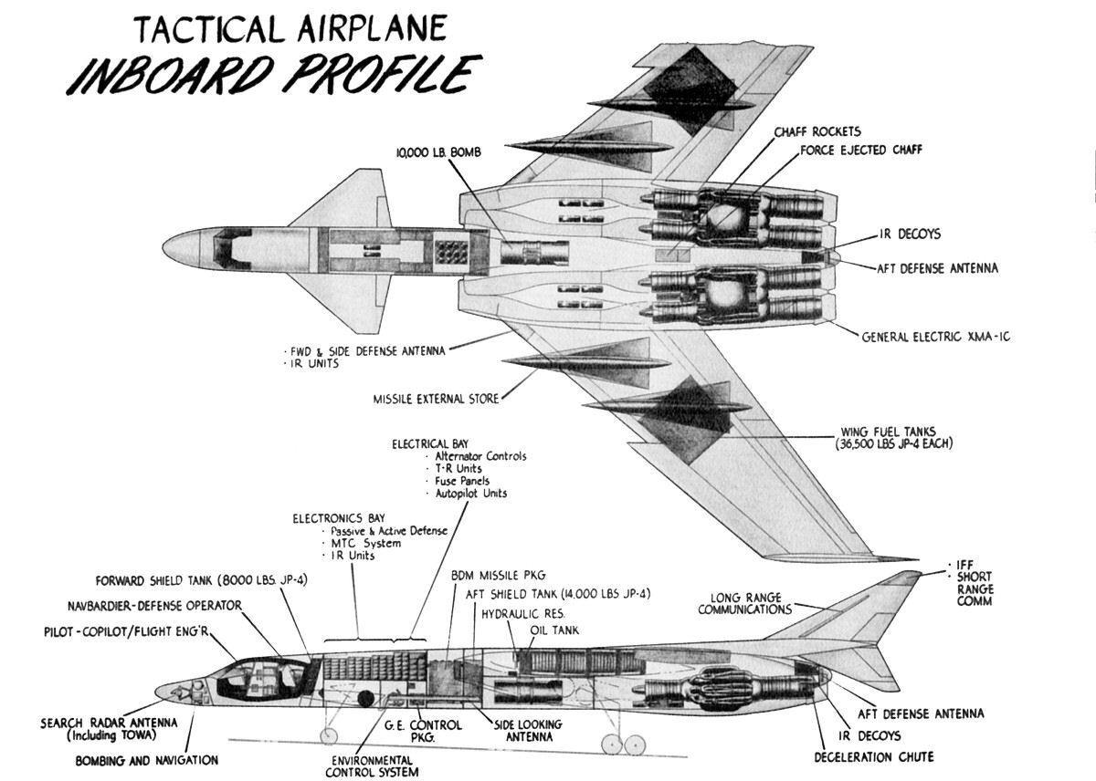
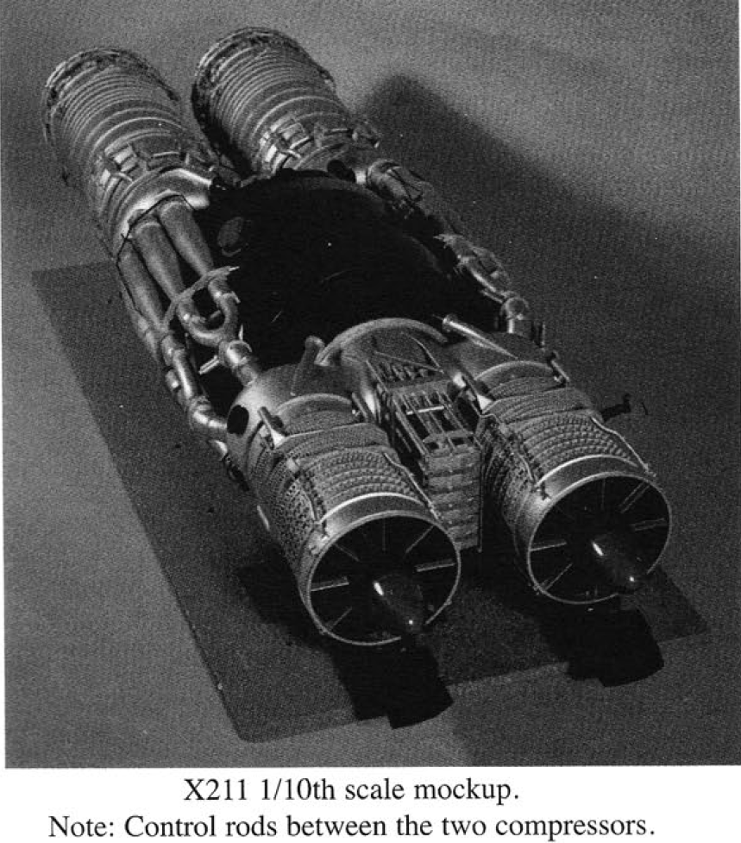
AND MORE…. (weapon system 125)

Slide 7
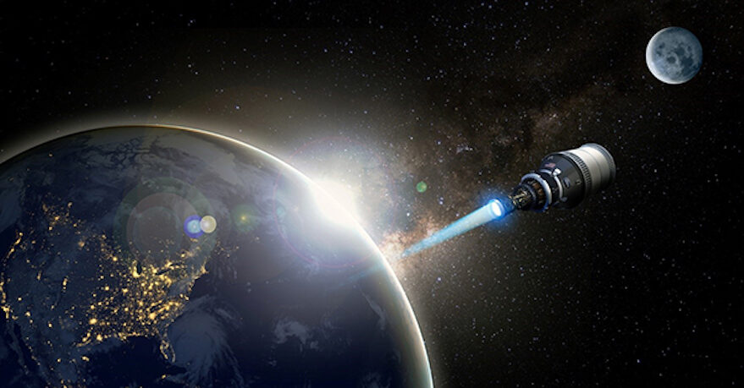
AND MUCH MORE!!!
April 2021 DARPA awards contracts to Lockheed Martin, Bezos’ Blue Origin and General Atomics for a nuclear-powered spacecraft to orbit Earth by 2025
“Kanyon” or “Poseidon” Unmanned Underwater Vehicle (UUV), basically a giant torpedo with nuclear propulsion and practically unlimited range. Said to be deployed on Russian submarines by 2027

Slide 8
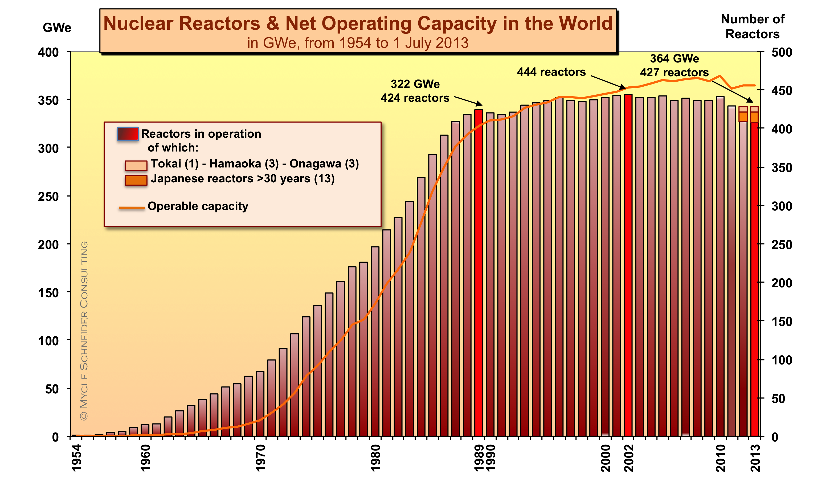
NUCLEAR ENERGY - A Dream too much? 93 LEFT IN THE US OUT OF 133, PLUS121 CANCELLED…

Slide 9
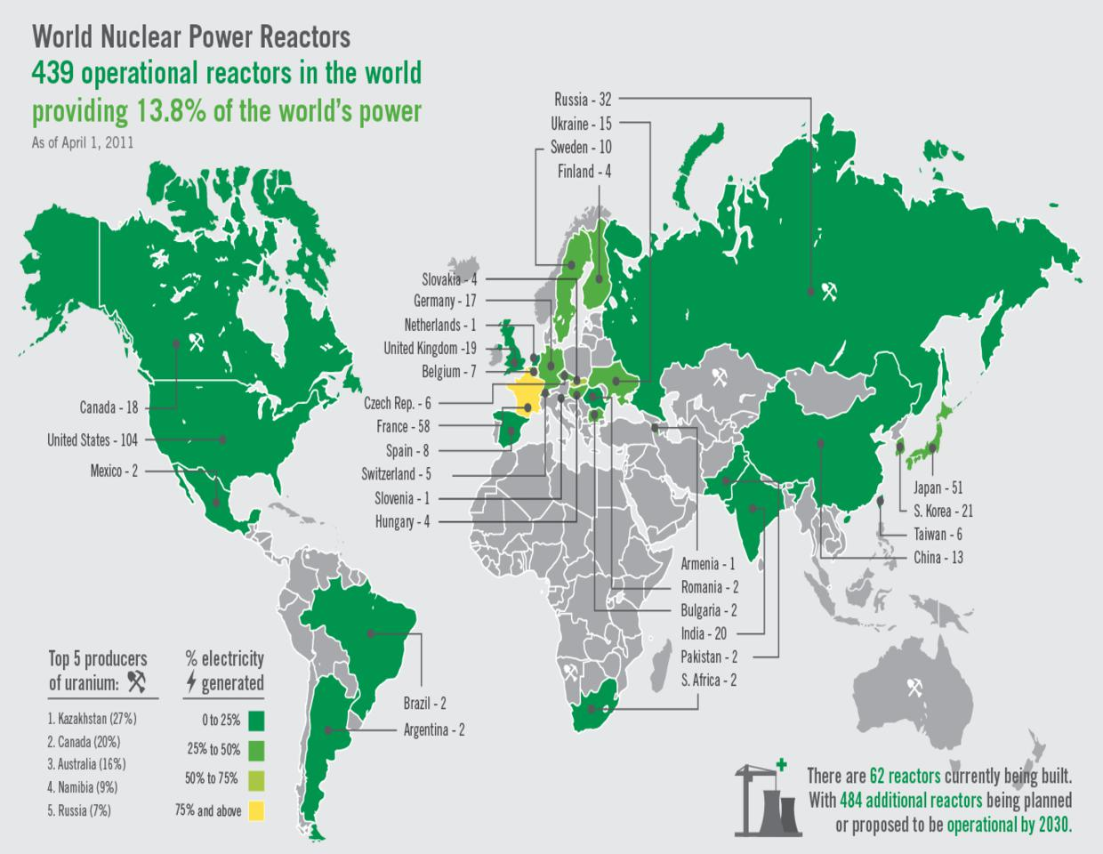
The situation at the fukushima incident

Slide 10
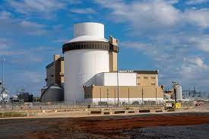
Today: only 10.5% of global electricity / 18% in the 37 oecd countries / 20% in the us (93) Still, there is huge potential… 443 operational / 54 being built / 100 planned

Slide 11
Challenges and opportunities
challenges
opportunities
Financial (capital-intensive) 70% of the cost of a kWh in 60 years life span is accounted for by the early/fixed cost during the construction phase…
Inherent Each NPP is unique
Geopolitical: NPT “Trojan Horses”, e.g. export limitations for US companies, as Section 123 of the Atomic Energy Act generally requires the conclusion of a nuclear cooperation agreement
Regulatory, for safety reasons/see EURATOM
RAW Management (e.g. Yuka mountain)
Alternative source of electricity
“Too cheap to meter”, once operational
More than 94% installed capacity factor vs just 35% for wind and 25% for solar
600 million tons of oil equivalent annually
2015 Paris Agreement is good news
Promising technological breakthroughs, like fusion and thorium

Slide 12
NOBODY CAN DOUBT THAT:
Unlike RES, which offer an intermittent energy supply, nuclear energy has already demonstrated that it can provide reliable and flexible power 24/7, while using far less land than most RES
A proven and safe technology, it has evolved dramatically since the first reactors of the 1950s.
It is the only zero-carbon option that works for high-temperature industrial processes, such as steel or cement production.
Jobs in the industry (130,000 Direct and 470,000 Indirect in NA alone) are very well paid…

Slide 13
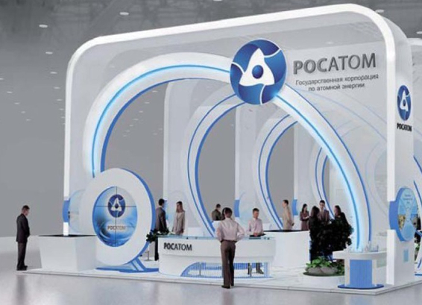
Rosatom State Corporation established December 2007

Slide 14
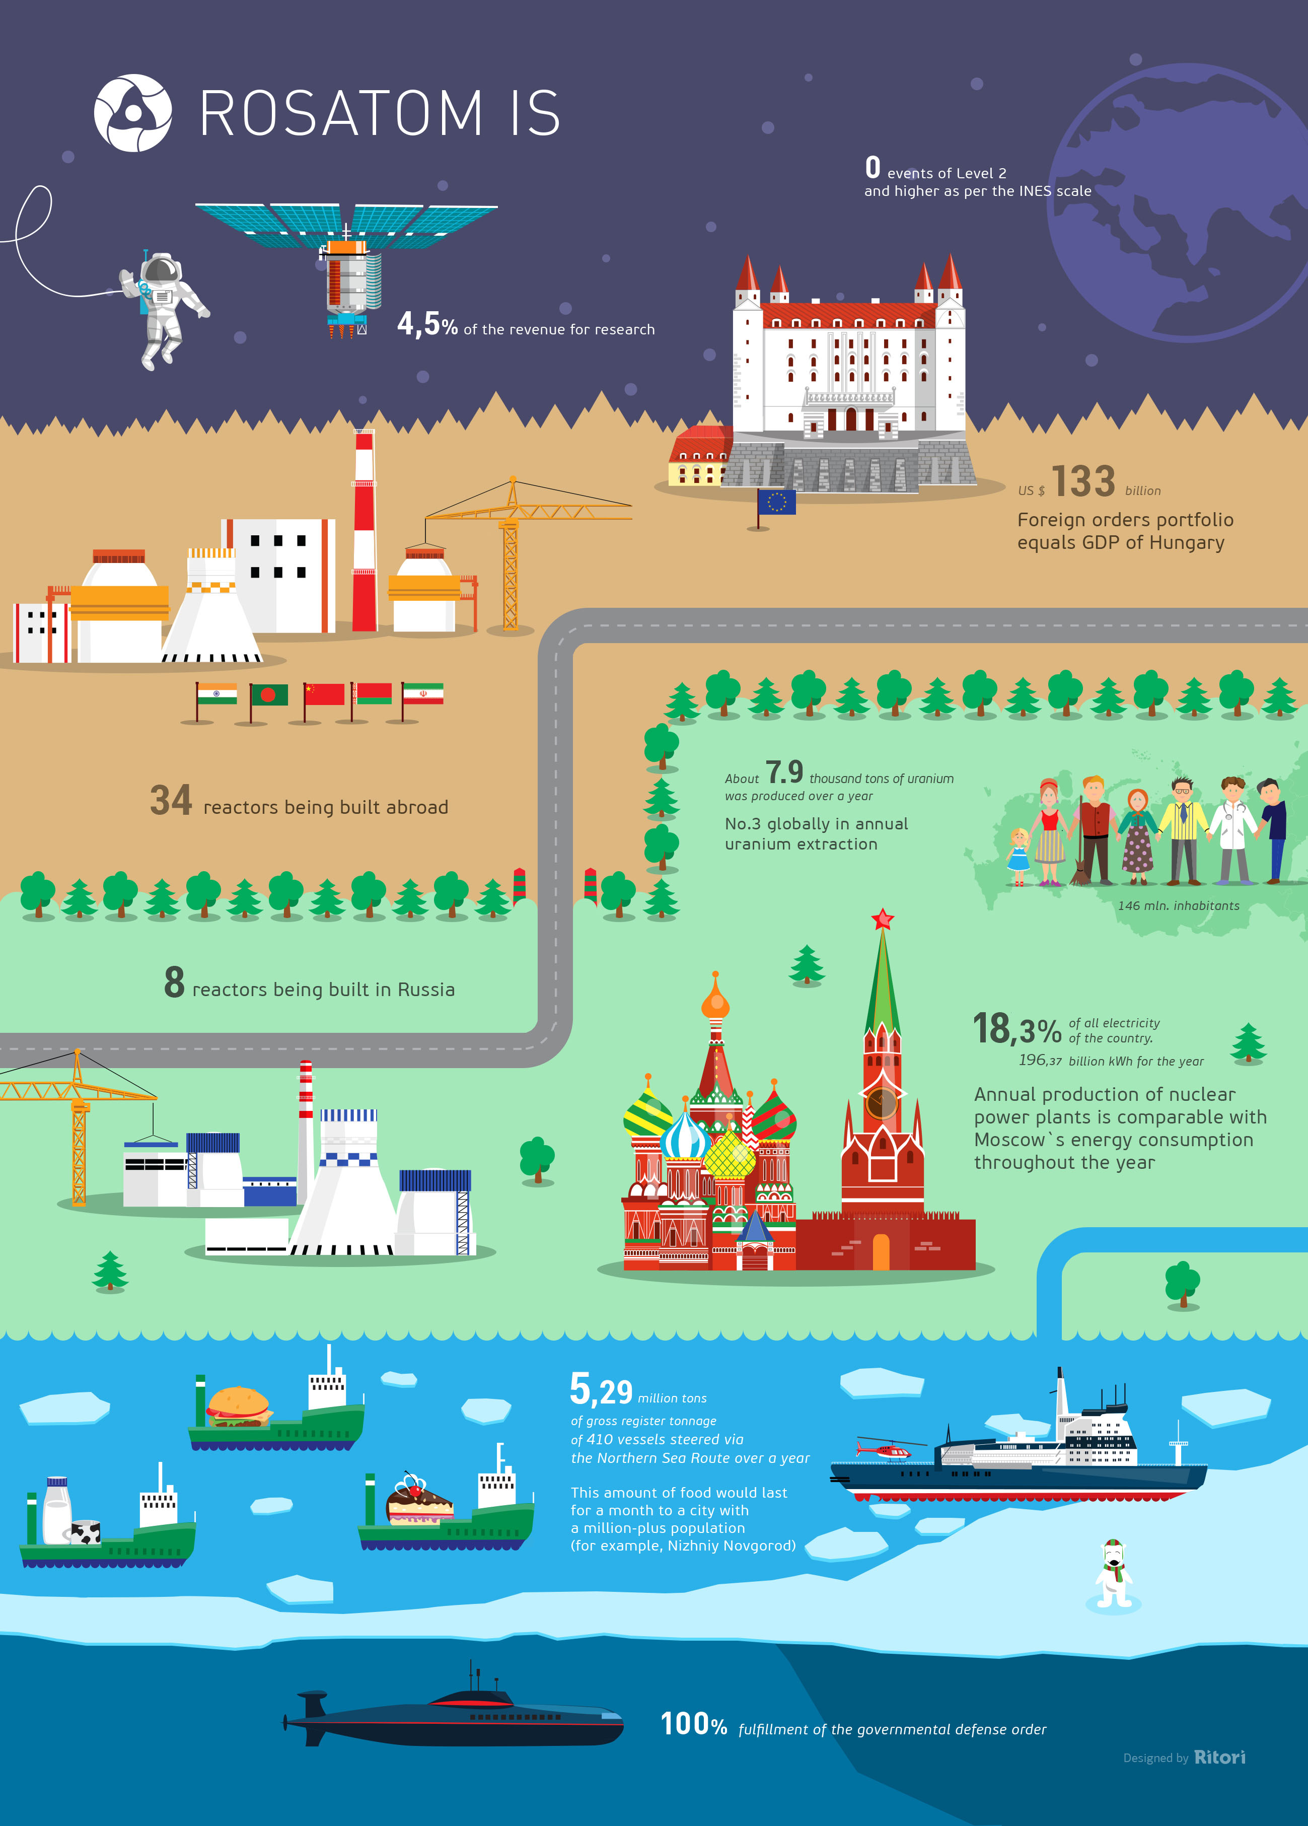
Undisputed World leader in nuclear activities

Slide 15
 | 2011 | 2012 | 2013 | 2014 | 2015 | 2016 | 2017 | 2018 | 2019
Kazakhstan | 19,451 | 21,317 | 22,451 | 23,127 | 23,607 | 24,586 | 23,321 | 21,705 | 22,808
Canada | 9145 | 8999 | 9331 | 9134 | 13,325 | 14,039 | 13,116 | 7001 | 6,938
Australia | 5983 | 6991 | 6350 | 5001 | 5654 | 6315 | 5882 | 6517 | 6,613
Namibia | 3258 | 4495 | 4323 | 3255 | 2993 | 3654 | 4224 | 5525 | 5,476
Uzbekistan | 2500 | 2400 | 2400 | 2400 | 2385 | 2404 | 2404 | 2404 | 3,500
Niger | 4351 | 4667 | 4518 | 4057 | 4116 | 3479 | 3449 | 2911 | 2,983
Russia | 2993 | 2872 | 3135 | 2990 | 3055 | 3004 | 2917 | 2904 | 2,911
China | 885 | 1500 | 1500 | 1500 | 1616 | 1616 | 1885 | 1885 | 1,885

Slide 16
THE LEADER IN ENRICHMENT
Uranium found in nature consists largely of two isotopes, U-235 and U-238. The production of energy in nuclear reactors comes from the 'fission' / splitting of the U-235 atoms
Natural uranium in nature contains just 0.7% of the U-235 isotope. Isotope separation is a physical process to concentrate or ‘enrich’ one isotope relative to others. Most reactors today are light water reactors and require uranium to be enriched from 0.7% to around 3 - 5% U-235 in their fuel. This is called low-enriched uranium (LEU). Nuclear weapons need much higher degree of enrichment.
ROSATOM has the largest, by far, enrichment capacity in the World

Slide 17
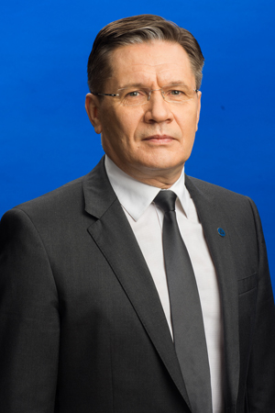
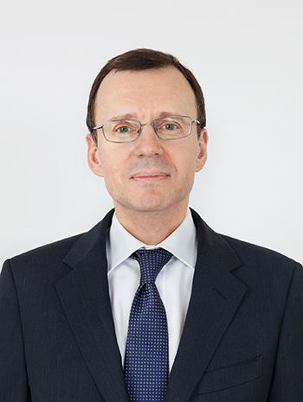
AL. LIKHACHoV & NIK. SPASSKIY

Slide 18
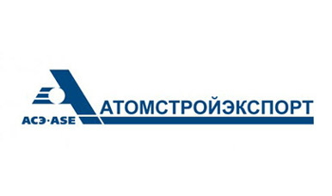

rosatom’S international branch and its main SHAREHOLDER

Slide 19
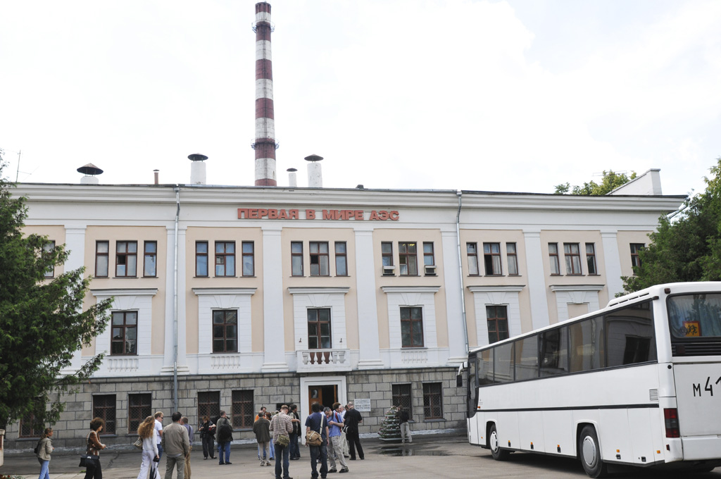
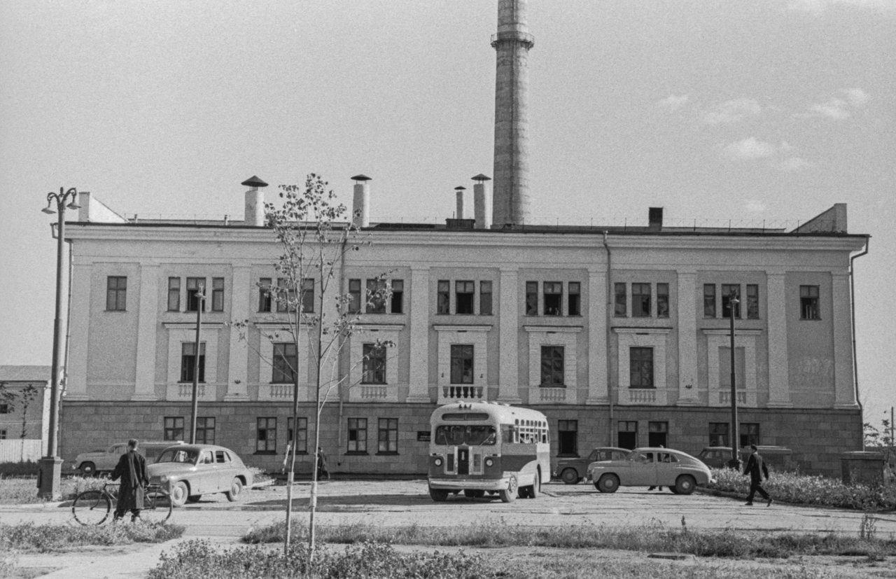
June 1954: OBNINSK NPP CONNECTED TO THE GRID IN KALUGA - 6 mw

Slide 20
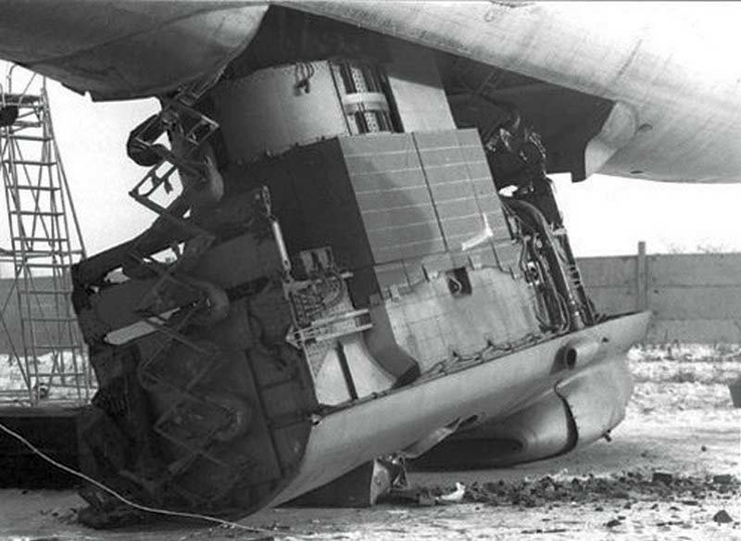
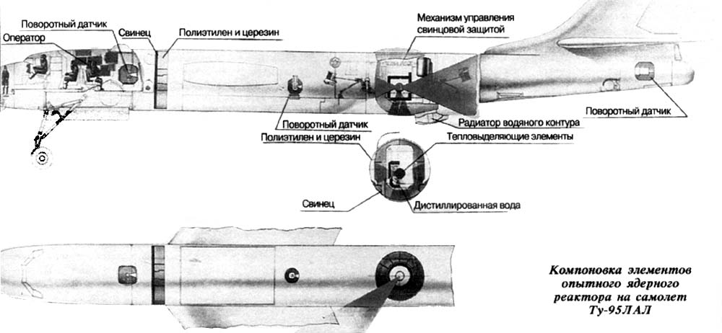
They even tested a reactor inside a modified tupolev bomber in 1961

Slide 21
MAJOR SOVIET MILESTONES
1953 “Ministry of Medium Machine Building” established, the forerunner of ROSATOM
1964 Beloyarsk 1 commissioned at 110 MW. Dominant concept was the minimalist RBMK by OKB Gidropress using natural uranium as fuel, regular water for cooling and solid graphite for neutron moderator
1966 Rheinsberg, the first NPP abroad (D.D.R.) used the WWER (water cooled, water moderated energetic reactor) concept, also by OKB Gidropress. instead of the RBMK. Output 70 MW
1973 BN-350, the world's first “breeder” or “fast neutron” reactor commissioned in Aktau, SSR Kazakhstan, albeit limited edition. OKB Afrikantov. No neutron moderator needed like classic thermal reactors plus they use almost all of their waste as fuel. In the meanwhile, in April 1977 Jimmy Carter decided to halt the construction of “breeders” due to proliferation concerns…
By the mid-1980s, the total capacity of Soviet nuclear power plants reached a record of 37 GW

Slide 22
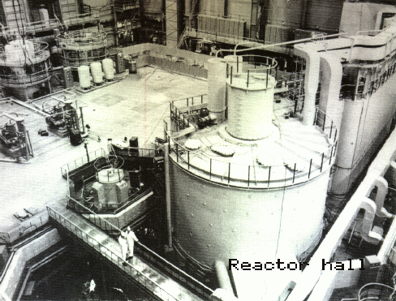
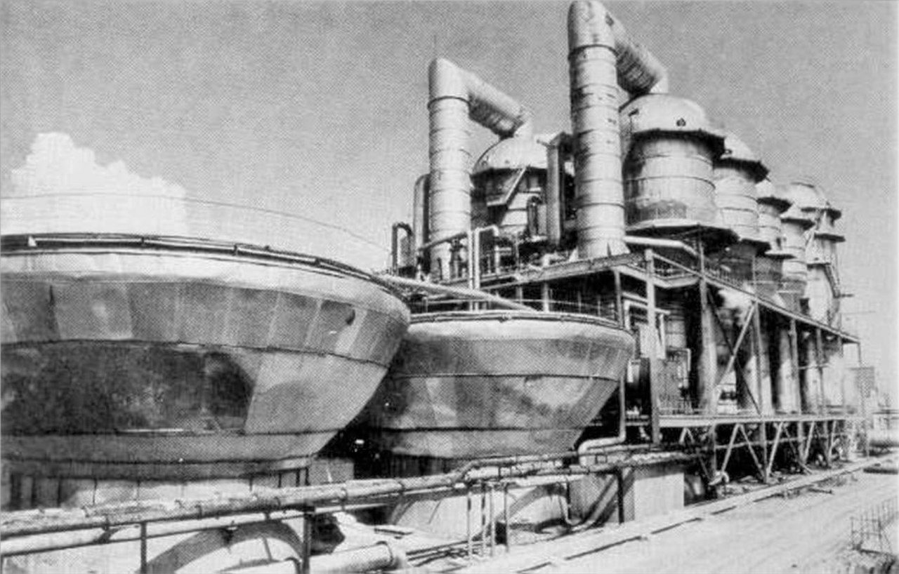
THE BN-350 AKTAU PLANT OF 135 mw

Slide 23
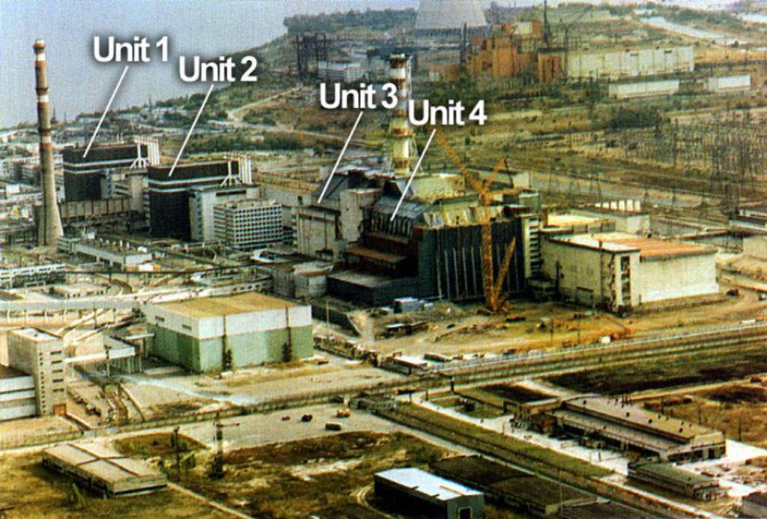
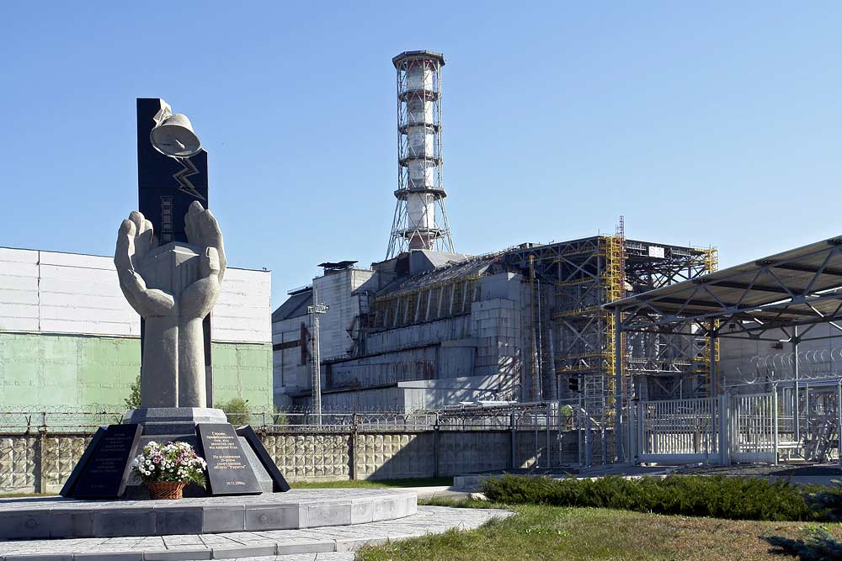
APRIL 1986: chernobyl 4 tragedy RBMK concept is abandoned

Slide 24
RECENT ACHIEVEMENTS
Since its establishment in 2007, Rosatom has completed 20 new NPP in Russia and abroad, the Akademik Lomonosov floating nuclear power plant in December 2019 and the most modern icebreaker, Arktika
2016 Commissioning of the first 3+ generation reactor, WWER-1200 Novovoronezh 6, with a useful life of 60 years at 90% capacity factor. “absolute safety and compliance with post-Fukushima requirements"
2026 Target for commissioning the first 4th generation or sodium-cooled fast neutron (i.e. breeder) reactor, BREST-300 at Seversk/Tomsk. The industry’s resource base will practically become inexhaustible, thanks to the infinite reprocessing of nuclear fuel, Likhachev said in 2021.

Slide 25
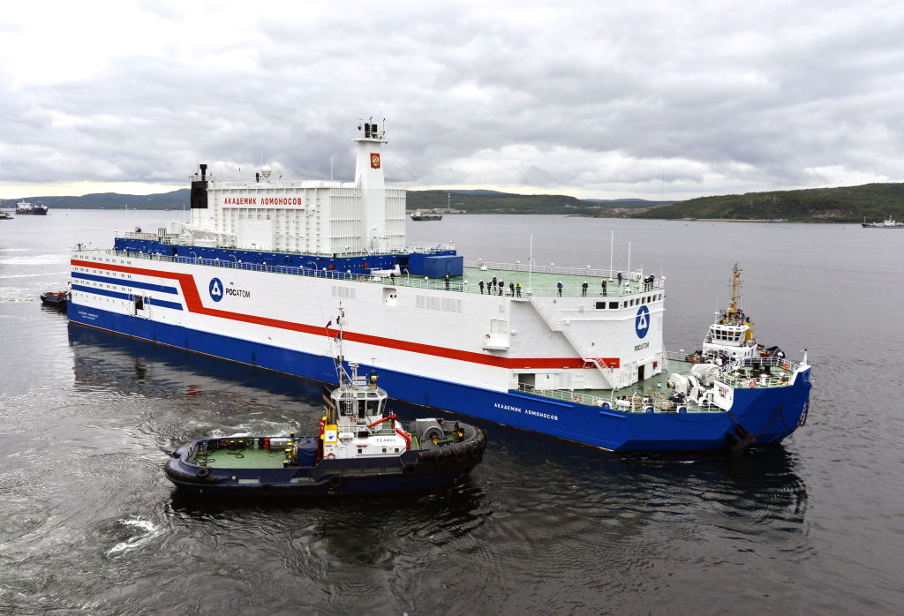
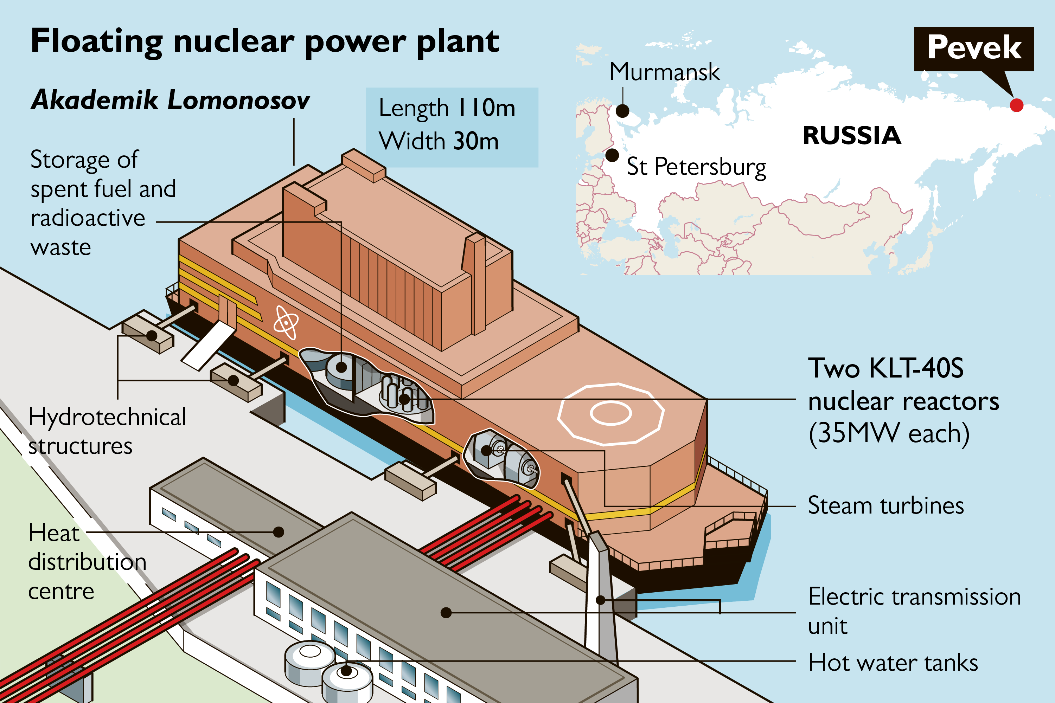
Akademik Lomonosov

Slide 26
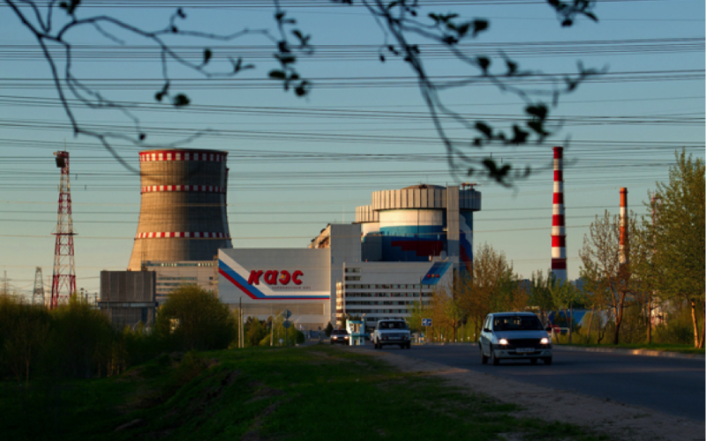
25 units under construction in 2020, export revenues $ 7.3 bn fuel supply for 75 npp globally market share target 30% 5/16 annually

Slide 27
The EU is also dependent…
20% of EU natural uranium imports come from Russia at a worth of €200 million/year (third place after Niger and Kazakhstan, where ROSATOM presence is also strong)
Namely, this uranium, processed as nuclear fuel, powers all 6 Czech reactors, 4 Slovak, 4 Hungarian, 2 Bulgarian and 2 Finnish (total 18)
ROSATOM is exempt from any kind of sanctions, but….

Slide 28
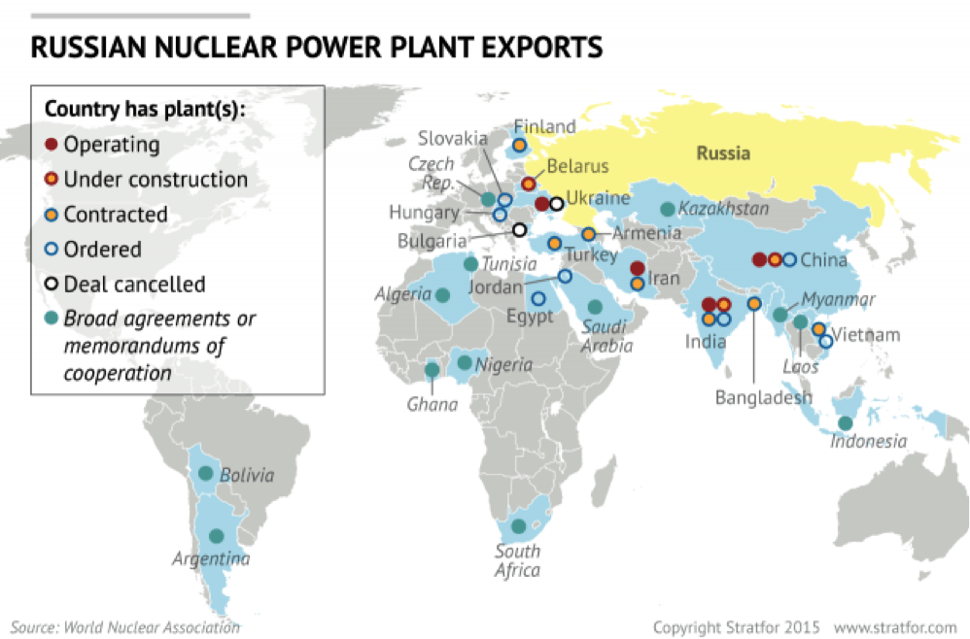
Total orders exceed $ 130 bn

Slide 29
ROSATOM Comparative advantages
Full vertical integration and “full package”, including return of RAW
Enormous political and diplomatic support (diplomatic attaches in at least 15 Russian embassies)
Projects financed up to 90% by export credits. Hungary $ 11 Bn
BOO (Build-Own-Operate) model for the first time in Turkey, following the 2010 IGA. A kind of “Bastion” in a NATO country!
Global reach, in contrast with the pipeline gas of OAO Gazprom
Each deal forges a “strategic” cooperation of long-term nature

Slide 30
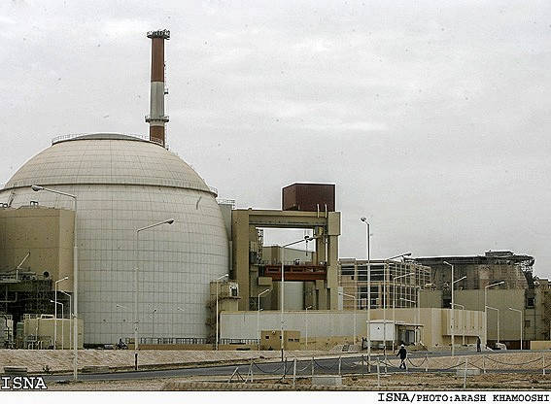
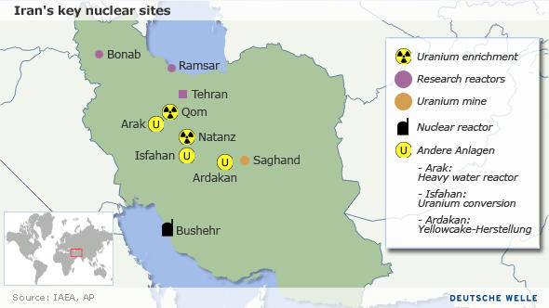
September 2011: «BUSHEHR 1», IRAN «BUSHEHR 2» operational LATE 2024

Slide 31
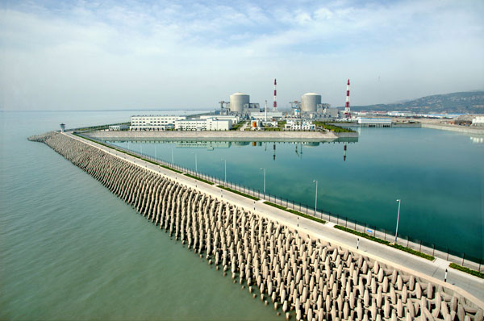
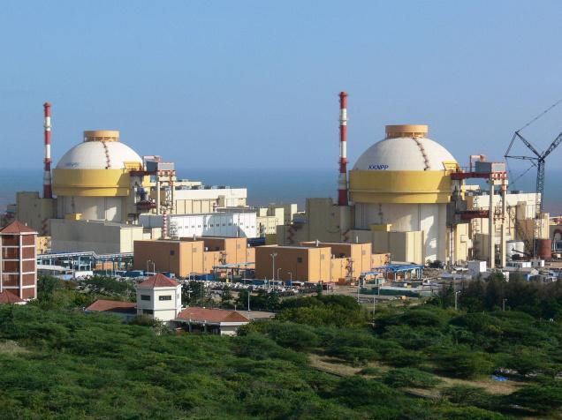
INDIA AND CHINA also BUY RUSSIAN…

Slide 32
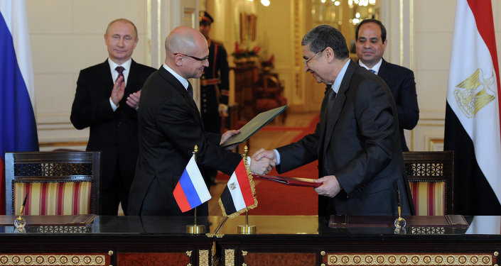
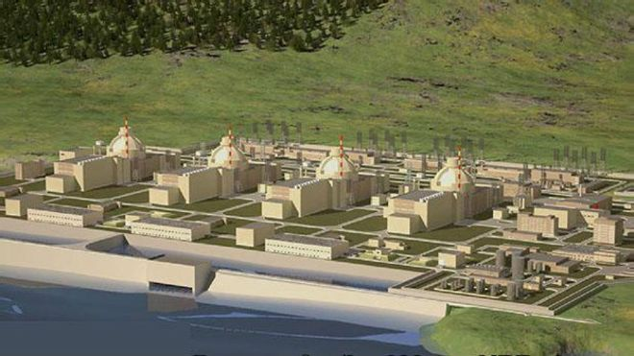
EASTERN MEDITERRANEAN: STRONG PRESENCE, “AKKUYU 1” READY BY 2023 at 22 bN, the top russian fdi ever

Slide 33
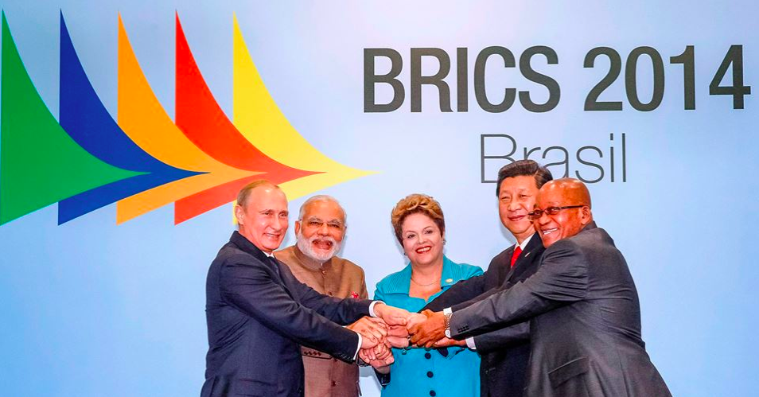
BRICS: UNITED BY NUCLEAR COOPERATION

