Slide 1
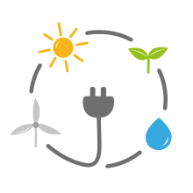

The Renewable Energy Dimension of Energy Security
Renewable Energy Sources in Global
Nikoletta Kontoulis
nicole.kontoulis@gmail.com
PhD Candidate
November 2020

Slide 2
Scope of the lecture
Demonstrate the importance role of energy security
Emphasize its timeless value
Highlight its multidimensional and complex nature
Connect energy security with the transition to Renewable Energy Sources (RES)
🔑Keywords: energy security, renewable energy sources, energy mix, energy transition

Slide 3
Scope of the lecture (cont.)
Analyse the role and the impact of RES on energy security by examining:
The geopolitical consequences of the spread of renewable energy worldwide
The way in which RES enter the dimensions & components of energy security
Case studies of three types of countries (producers, consumers, and transit countries)
🔑Keywords: energy security, renewable energy sources, energy mix, energy transition

Slide 4
Scope of the lecture (cont.)
To answer two questions:
Do renewable energies improve energy security in the long run?
Will energy security in these three groups of countries change in the future with the use of RES in their energy mix?
🔑Keywords: energy security, renewable energy sources, energy mix, energy transition

Slide 5
The traditional role of energy
Non-renewable energy
“Energy is the precondition of all commodities, a basic factor equal with air, water, and earth”
E. F. Schumacher, Nobel laureate economist, 1977
Energy is of the essence of any production process and it must be secured !
Non-renewable energy:
Non-renewable energy comes from sources that will run out or will not be replenished in our lifetimes
Fossil fuels are a valuable source of energy. They are relatively inexpensive to extract. They can also be stored, piped, or shipped anywhere in the world

Slide 6
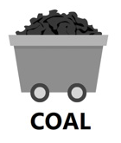
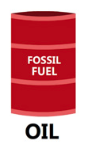
The traditional role of energy
Non-renewable energy
Coal
Coal is a reliable source of energy
But, when coal is burned, it releases many toxic gases and pollutants into the atmosphere
Oil
Oil is a reliable and dependable source of energy and money for the local community. It provides us with thousands of conveniences
But, burning oil is harmful to the environment. It releases hazardous gases and fumes into the air that we breathe

Slide 7


The traditional role of energy
Non-renewable energy
Natural gas
Natural gas is relatively inexpensive to extract
Natural gas is a “cleaner” fossil fuel than oil or coal
But, extracting natural gas can cause environmental issues
Nuclear energy
Nuclear energy is a popular way of generating electricity around the world
Although nuclear energy itself is a renewable energy source, the material used in nuclear power plants is not
But, many countries do not have the scientists and engineers to develop a safe and reliable nuclear energy program and their waste remain radioactive for many years

Slide 8
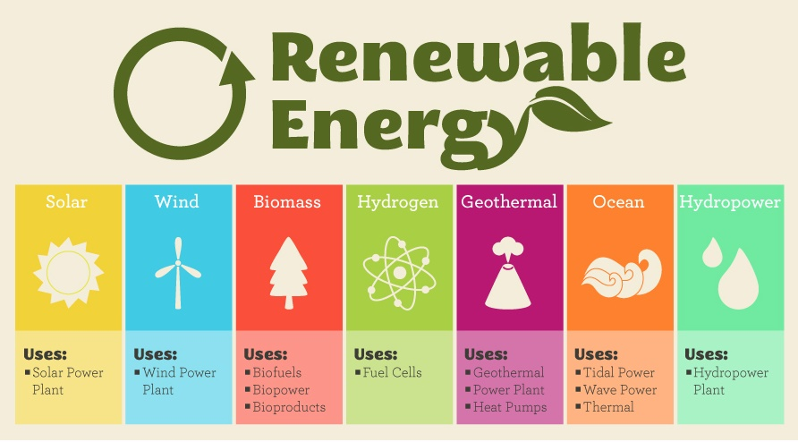
The traditional role of energy
Renewable Energy
Types of Renewable Energy Sources (RES)
Solar
Wind
Other Alternative Energy Sources
Hydroelectric Power
Biomass
Geothermal
Tidal & wave power

Slide 9


Renewables
Solar power
Is the energy from the sun that is converted into thermal or electrical energy
Is the cleanest and the most abundant renewable energy source available
Wind power
Wind energy refers to the process of creating electricity using the wind, or air flows that occur naturally in the earth’s atmosphere
Modern wind turbines are used to capture kinetic energy from the wind and generate electricity

Slide 10


Renewables
Hydropower (hydroelectricity)
Is a form of energy that harnesses the power of water in motion - such as water flowing over a waterfall - to generate electricity
Over two thousand years ago, people in Greece used flowing water to turn the wheel of their mill to ground wheat into flour
Biomass
Is renewable organic material that comes from plants and animals
The use of biomass fuels for transportation and for electricity generation is increasing in many developed countries as a means of avoiding carbon dioxide emissions from fossil fuel use

Slide 11


Renewables
Geothermal energy
Is heat derived within the sub-surface of the earth. Water and/or steam carry the geothermal energy to the Earth’s surface
Geothermal can provide renewable base load and flexible electricity. As the resource is not dependent on climate conditions, geothermal power plants usually operate more than 70% of the time (up to 95% for newer plants)
Ocean energy
Ocean energy refers to all forms of renewable energy derived from the sea. There are three main types of ocean technology: wave, tidal and ocean thermal

Slide 12
Geographical & Technical Characteristics of Renewable Energy
The environmental sustainability is the primary driver behind the deployment of renewable energy sources
Every country has access to at least some form and amount of renewable energy. Thereby all countries have the potential to become energy producers !
Renewable energy can be more efficiently harvested at certain locations than others, some countries can generate energy cheaper than others
Electricity is the energy carrier for most renewables and especially those with the most potential (solar and wind)

Slide 13
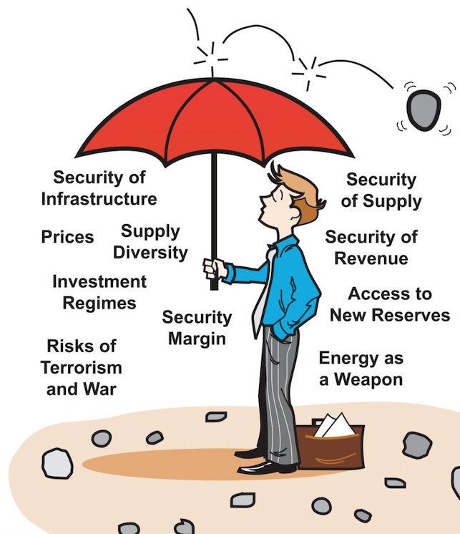
Energy security: an umbrella term
Energy security is the “reliable and affordable access to all fuels and energy sources”
Energy security has many aspects:
long-term energy security mainly deals with timely investments to supply energy in line with economic developments and environmental needs
short-term energy security focuses on the ability of the energy system to react promptly to sudden changes in the supply-demand balance

Slide 14
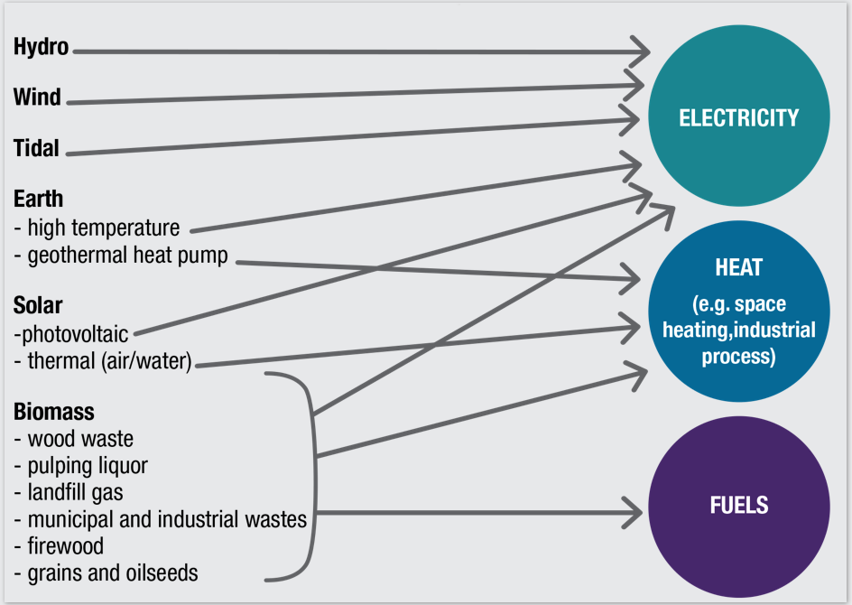
Energy security & Renewable energy
The integration of renewable energy in the energy mix:
Can enhance energy security in
Electricity generation
Water heating/cooling
Transportation
Can help us meet three goals
1. Reduce greenhouse emissions
2. Ensure reliability
3. Ensure cost-efficient delivery of energy

Slide 15
Energy Security Dimensions & Components
The 4A’s of energy security
Availability
the physical existence of energy (energy supply and reserves)
Affordability
refers to the costs
Acceptability
associated with environmental concerns (CO₂ emissions)
Accessibility
the ability to access the energy resources (geopolitical factors)
In the long term, these dimensions need to be persistent for energy to contribute to the sustainable economic development
APERC, 2007

Slide 16
Energy Security
Dimensions & Components
The geographical discrepancy between the major energy production and cosnumption centers results in an intensified vulnerability of both exporting and importing countries to the risks in the reliability of energy markets.
The energy markets are increasingly prone to the threat of major supply disturbances through:
war or political tension
extreme weather conditions
accidents or technical faults
sabotage
financial crises

Slide 17
Energy Security
Dimensions & Components
Renewable energy:
lies at the heart of energy security policies
reduces the need of the countries for energy imports
reduces the dependency to exporter countries
is environmental friendly
This makes renewable energy available, accessible, and acceptable worldwide
The global research and development budgets continuously push down the cost of production making renewable energy affordable

Slide 18
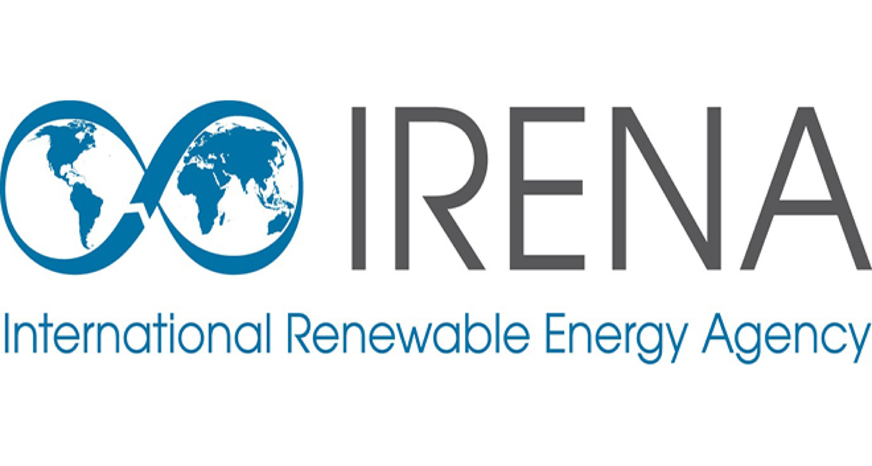
Irena - international renewable energy agency
IRENA is an intergovernmental organisation that supports countries in their transition to a sustainable energy future
IRENA promotes the widespread adoption and sustainable use of all forms of renewable energy in the pursuit of sustainable development, energy access, energy security and low-carbon economic growth and prosperity
With more than 180 countries actively engaged, IRENA promotes renewable resources and technologies as the key to a sustainable future and helps countries achieve their renewable energy potential
https://www.irena.org

Slide 19
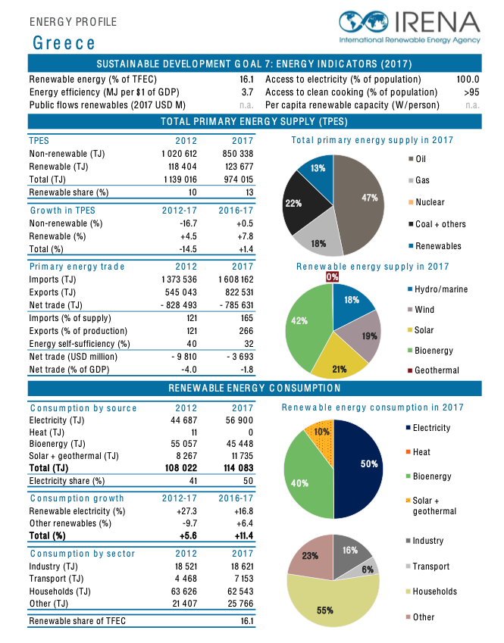
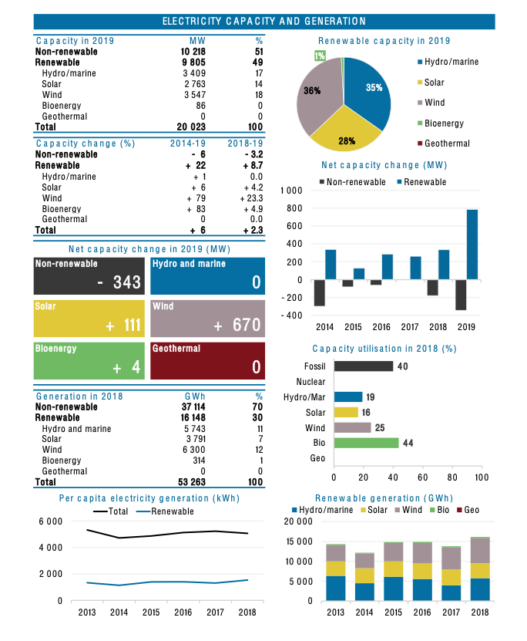

Slide 20
energy transition
Energy transition is a radical shift in the energy system from an existing model to a new paradigm
Humanity has known numerous energy transitions, including the use of fire, the manufacturing of tools and handles, wind and water domestication, and eventually the discovery of fossil fuels
Each of these transitions has progressively transformed the global economic, geopolitical and energy environment

Slide 21
energy transition
According to Sovacool and Geels (2016), energy transition involves changes in three interrelated dimensions:
the tangible elements of the energy system, which include technology, infrastructure, market, production equipment, consumption patterns and distribution chains
actors and their conduct, which comprise new strategies and investment patterns, as well as changing coalitions and capabilities of actors
socio-technical regimes that contain formal regulations and policies, institutions as well as mindset and belief systems, discourse and views about normality and social practices

Slide 22
A new energy transition
IRENA defines the energy transition as “a pathway toward transformation of the global energy sector from fossil-based to zero-carbon by the second half of this century”
IRENA’s energy transition work is built around three pillars:
Power sector transformation knowledge: products & methodologies
Energy system models & data: techno-economic & electrical models with associated data
Energy planning support: application of knowledge & modelling tools to support member countries
IRENA’s REmap programme determines the potential for countries, regions and the world to scale up renewable
https://www.irena.org/energytransition

Slide 23
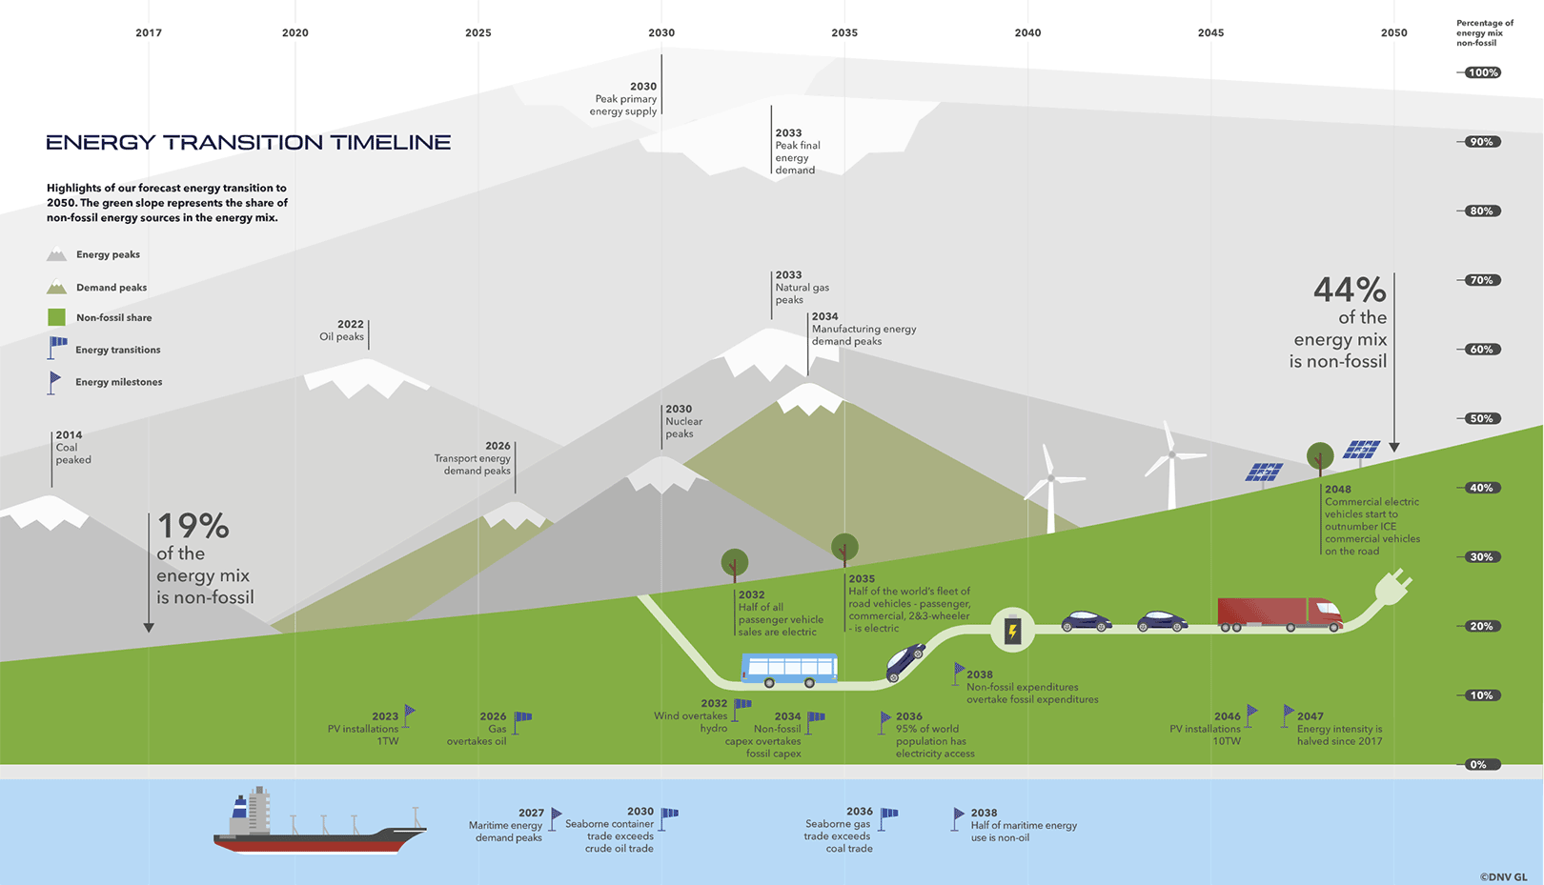

Slide 24
Energy mix
Estimated Renewable Share of Total Final Energy Consumption, 2017
For each region/country, the composition of the energy mix depends on:
The availability of usable resources domestically or the possibility of importing them
The extent and type of energy needs to be met
Policy choices determined by historical, economic, social, demographic, environmental and geopolitical factors
https://www.ren21.net/wp-content/uploads/2019/05/gsr_2019_full_report_en.pdf

Slide 25
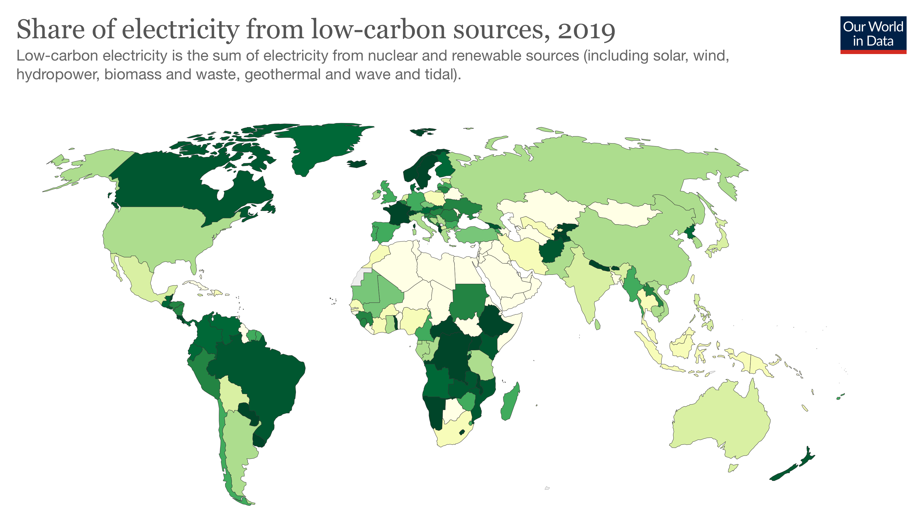
BP Statistical Review of World Energy: https://www.bp.com/en/global/corporate/energy-economics/statistical-review-of-world-energy.html

Slide 26
A new energy transition
The entrance of renewables in the energy mix drives to another phase of traditional geopolitics:
Focus on changes in the positions of countries in the international system
New energy standards for three types of countries
Consumers ➔ Security of supply
Producers (“prosumers”) ➔ Security of demand
Transit countries ➔ Security of energy transition
The massive diffusion of renewable energies forces one to rethink the relationships between producers, consumers, and transit countries
Why?

Slide 27
The complex relationship with energy security
Renewable energies, unlike fossil fuels, are not finite and their geographic concentration is rather low
They bring an important degree of diversification to energy systems
Their use generates other dependencies:
Dependence on energy flows (wind, sunshine)
The development of efficient storage technologies
The exacerbated rivarly with terrestrial resources (for their installation)

Slide 28
Perspective of the consumers & transit states
Why it is crucial to use renewable energy?
Renewable energy reduces the need for energy imports
Renewable energy is produced from the local natural resources
Renewable energy is environmentally friendly
Renewable energy mitigates the risk in the reliability of energy markets
The research & the technology development push down the cost

Slide 29
Perspective of the producer
Oil companies and oil-exporting countries cannot afford to ignore the transition of the energy sector, which can disrupt their business model and erode their revenue base
There are two important differences between major oil companies and oil-exporting countries in relation to energy transition. While the key issue for oil companies is disruption of existing business models, the main challenge for oil-exporting countries is the ability to monetize their large reserve base
For oil-producing economies, policy should promote renewables investment, particularly where it liberates domestic oil and gas consumption for international export
By being proactive in renewable energy development they will undoubtedly have an advantage in the future among other producers

Slide 30
iN a few words…
The 21st century will be characterized by a rising share of cost-competitive renewable technologies, and a move away from carbon-intensive fuels
The entrance of renewables in the energy mix:
will strongly affect security of demand
will have large macroeconomic implications for the producing countries
will change the traditional energy supply balance
The decrease in oil and gas revenues will have significant consequences on transit countries, especially those which benefit fron the pipeline network

Slide 31
Conclusions
We are in the midst of a transition from a fossil fuel-dominated energy regime to a more sustainable lower-carbon one in which natural gas is a bridge fuel
Possible ways of decarbonisation:
By increasing the share of low-carbon intensity fossil fues such as gas
By increasing the share of renewables
Gas seems unlikely to become dominant under present energy geopolitical circumstances
Different countries will follow different paths for adopting gas and other energy sources
It is expected a multi-energy transition in which different countries choose different energy regimes

Slide 32
Conclusions
The transition to RES will gradually and today’s geopolitics of fossil fuels based on historical relationships between energy producers and consumers
Local and decentralized relations could add an new geopolitical layer to current traditional actors
A massive diffusion of renewables in the energy mix could lead to new, unexpected interdependencies such as dependencies to critical materials, a new geopolitics of patents and the implemantation of a renewable diplomacy
A geopolitical appreciation of renewable energy diffusion requires studying the risks and sensitivity of substituting an actor producing a fossil resource by another producing a tranformed resource

Slide 33

Thank you for your attention
STAY HOME AND
WEAR YOUR
MASKS

Slide 34
References
Asia Pacific Energy Research Center (APERC), 2019. A Quest for Energy Security in the 21st Century: Resources and Constraints. Asia Pacific Energy Research Center, Japan, available at: http://aperc.ieej.or.jp/file/2010/9/26/APERC_2007_A_Quest_for_Energy_Security.pdf
Augutis J., Martišauskas L., Krikštolaitis R., Augutiene E., 2014. “Impact of the Renewable Energy Sources on the Energy Security”. Energy Procedia. Volume 61. pp. 945-948. DOI: 10.1016/j.egypro.2014.11.1001
British Petroleum, 2019. BP Statistical Review of World Energy. 68th ed.; June 2019, available at: https://www.bp.com/content/dam/bp/business-sites/en/global/corporate/pdfs/energy-economics/statistical-review/bp-stats-review-2019-full-report.pdf
Cherp A., Jewell, J., 2014. “The Concept of Energy Security: Beyond the Four As”. Energy Policy. Volume 75. pp. 415-421. DOI: 10.1016/j.enpol.2014.09.005
Ediger V.Ş., 2019. “An integrated review and analysis of multi-energy transition from fossil fuels to renewables”. Energy Procedia. Volume 156. pp. 2-6. DOI: 10.1016/j.egypro.2018.11.073
Gielen D., Boshell F., Saygin D., Basilian M.D., Wagner N., 2019. “The role of renewable energy in the global energy transformation”. Energy Strategy Reviews. Volume 24. pp. 38-50. DOI: 10.1016/j.esr.2019.01.006
Hache E., 2018. “Do renewable energies improve energy security in the long run”? International Economics. Volume 156. pp. 127-135. DOI: 10.1016/j.inteco.2018.01.005

Slide 35
References
Harjanne A., Korhonen J.M., 2019. “Abandoning the concept of renewable energy”. Energy Policy. Volume 127. pp. 330-340. DOI: 10.1016/j.enpol.2018.12.029
International Renewable Energy Agency (IRENA), 2019. “Renewable Energy Statistics 2018”, available at: https://www.irena.org/-/media/Files/IRENA/Agency/Publication/2018/Jul/IRENA_Renewable_Energy_Statistics_2018.pdf
International Renewable Energy Agency (IRENA), 2019. “A New World. The Geopolitics of the Energy Transformation. Global Commission on the Geopolitics of Energy Transformation”, available at: https://geopoliticsofrenewables.org/assets/geopolitics/Reports/wp-content/uploads/2019/01/Global_commission_renewable_energy_2019.pdf
Ölz S., Sims R., Kirchner N., 2007. “Contribution of renewables to energy security”. Paris: OECD/IEA, available at: https://www.iea.org/publications/freepublications/publication/so_contribution.pdf
REN21, 2019. “Renewables 2019 Global Status Report”. Paris: REN21 Secretariat, available at: https://www.ren21.net/wpcontent/uploads/2019/05/gsr_2019_full_report_en.pdf
Scholten D., Bosman R., 2016. “The geopolitics of renewables; exploring the political implications of renewable energy systems”. Technological Forecasting & Social Change. Volume 103. pp. 273-283. DOI: 10.1016/j.techfore.2015.10.014
Stigka E., Paravantis J.A., Mihalakakou G.K., 2014. “Social Acceptance of Renewable Energy Sources: A Review of Contingent Valuation Applications”. Renewable and Sustainable Energy Reviews. Volume 32. pp. 100-106. DOI: 10.1016/j.rser.2013.12.026

