Slide 1
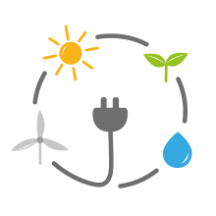

The Renewable Energy Dimension of Energy Security Case studies
Renewable Energy Sources in Global
Nikoletta Kontoulis (PhD Candidate)
nicole.kontoulis@gmail.com
December 2020

Slide 2
Scope of the lecture
Examine the role of renewable energy in shaping energy security against the backdrop of global geopolitical, socioeconomic and technological uncertainties
Analyse the role and the impact of RES on energy security by examining:
The geopolitical consequences of the spread of renewable energy worldwide
The way in which RES enter the dimensions & components of energy security
Case studies of three types of countries (producers, consumers, & transit countries)
🔑Keywords: energy security, renewable energy sources, energy mix, case studies

Slide 3
Defining energy security
Energy security means different things to different countries, depending on their:
Geographical location
Natural resource endowment
Economic disposition
Status as producer / exporter, consumer / importer or transit
Vulnerability to energy supply disruptions
Political system
Ideological views and perceptions
International relations
Luft & Korin, 2009; Johansson, 2013; Marquina, 2008; Leonard & Popescu, 2007

Slide 4
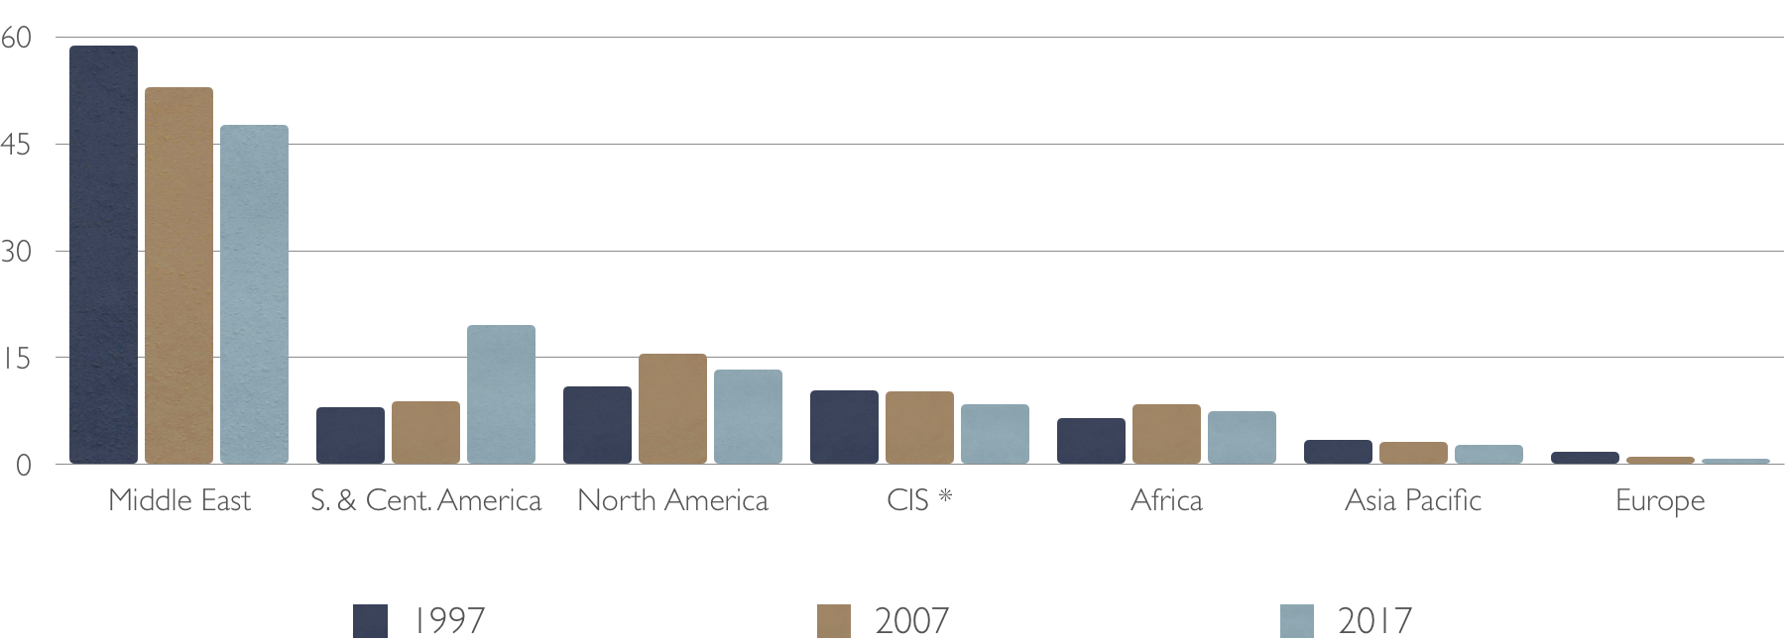
Global distribution of oil stocks

Slide 5
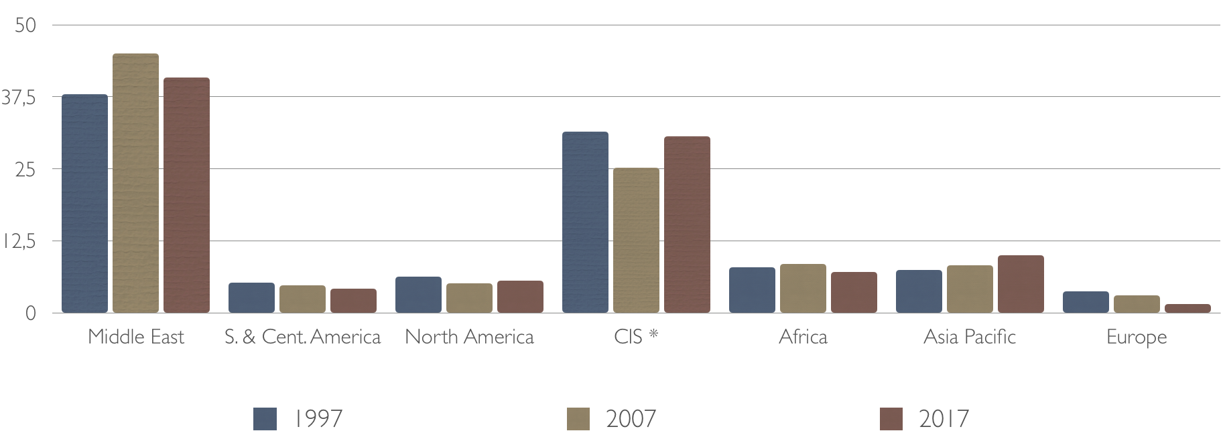
Global distribution of natural gas stocks

Slide 6
Defining energy security
Over different historical time frames, the concept of energy security is dynamic and fluid, with evolving energy policy challenges
The oil crises of 1973 and 1979 transformed oil supply from a military to a socio-political and economic issue for importing countries
The gas crises of 2006 and 2009 between Russia and Ukraine raised concerns about transit countries and brought back the use of energy as a geopolitical weapon
Winzer, 2012; Månsson et al., 2014; Overland, 2019

Slide 7
Defining energy security
Different energy security objectives:
Producers: aim to ensure reliable demand for their commodities
Consumers: aim towards diversity of energy supply, so as to minimize their dependence and maximize their security
Transit states: try to make the best of their role as bridges connecting producers/exporters with their markets
Consumer & transit countries security of supply
Producer/exporter countries security of demand
Luft & Korin, 2009; Johansson, 2013

Slide 8
Defining energy security dimensions
How are the dimensions of energy security covered by the research literature?
In a paper examining 40 years of energy security trends, Brown et al. (2014) found that 91 peer-reviewed academic articles covered the dimensions of energy security differently
In particular:
Αvailability: 82%
Αffordability: 51%
Εnergy & economic efficiency: 34%
Εnvironmental stewardship: 26%
Brown et al., 2014

Slide 9
energy security dimensions
The conceptualization and formulation of the dimensions of energy security is a necessary step for analysing the role of renewable energy in it
Energy security is composed of a small number of dimensions, e.g. technical, social, environmental, political, geological, and economic
Εach dimension contains components; and each component may be measured by metrics, i.e. quantitative or qualitative indicators
Sovacool, 2016

Slide 10
energy security dimensions & components Availability
Availability refers to diversifying the fuels used to provide energy services as well as the location of facilities using those fuels, promoting energy systems that can recover quickly from attack or disruption, and minimizing dependence on foreign suppliers.
Components:
Availability of energy resources (oil or gas)
The demand perspective (security of demand)
Access to energy sources

Slide 11
energy security dimensions & components Affordability
Affordability refers to:
the correlation between energy and economy
providing energy services that are affordable for consumers and minimize price volatility
Components:
The relation between energy price and energy security
Cost of energy security in terms of supply disruption
How much it costs to make an energy system more secure

Slide 12
energy security dimensions & components Diversity
The concept of diversity is portrayed by the expression: “Don’t put all your eggs in one basket”
In principle, more diverse systems are more secure
Components:
Energy carriers
Diversity of sources
Diversity of technology
The consumers’ proﬁle

Slide 13
energy security dimensions & components technology
Since technology is required for utilizing energy, energy security has a strong relationship to the technology advancement, directly and indirectly.
New technological solutions for production, transportation, conversion, storage, and distribution affect energy security.
Components:
Technology advancement
Enhance the efﬁciency of the energy system
Energy intensity
Energy conservation
Grid reliability
Capacity factor

Slide 14
energy security dimensions & components location
Location deals with the spatial features of the energy system and its relation to energy security.
Components:
Εnergy system boundaries
Location of energy source
Density factor
Land use [The concept ‘NIMBY’ (Not In My Back Yard)]
Globalization Location’s geography
Industrial intensity

Slide 15
energy security dimensions & components resilience
Resilience means the ability to withstand diverse disruptions without experiencing a change in the energy security baseline, an adaptive capacity, or the capacity to tolerate disturbance and continue delivering services with the same function, structure, identity, and feedbacks
A resilient system can switch between different:
Energy suppliers
Energy transition pathways and energy carriers
Consumers

Slide 16
energy security dimensions & components environment
When energy systems are to be considered, the environment is regarded as an important dimension
Αn environmental view of energy security needs to be considered internationally
Components:
The ﬁrst parameter consists of energy resources, rate of exploitation, and location shape after exploitation
Τhe extraction methods
Τhe outcome of the energy usage
The effect from climate conditions and climate change on the energy security

Slide 17
energy security dimensions & components governance & Innovation
Governance and innovation regards political factors related to energy security
Components:
Market potential
Innovation and research
Energy & environment management

Slide 18
energy security dimensions & components Unconventional threats
A threat is deﬁned as any potential danger that exists within or outside the energy system and that has a potential to result in some kind of disruption of that system
Threats depend on the country where the energy system exists, its geographic and political region/context
Cyber security:
All energy infrastructures depend on the digital support with future prediction of more digital devices, the digital dimension is important for energy security

Slide 19
The role of res in es dimensions
Many components of energy security that emerge from the dimensions in the bunk of literature are affected by the increased penetration of renewable energy
Renewable energy probably provides the best opportunity for a country to become more independent of the vulnerabilities of global energy markets and approach the goal of energy self-sufficiency irrespective of its endowment in fossil fuel resources or its access to expensive nuclear energy technology
Zhao, 2019

Slide 20
Energy security & renewable energy
Climate change and its link to fossil fuels have moved to the forefront of the political discourse, engaging political and industrial actors, academic researchers, and the society
This has happened against a backdrop of geopolitical turmoil caused by a series of events of energy significance
These events led to the realization that global geopolitics may threaten energy security
Renewable energy is considered a potential game changer in energy security

Slide 21
Energy security & renewable energy (cont.)
The world has entered a prolonged era of peak oil
Global warming and its effects will intensify during the rest of the 21st century
Geopolitical tensions:
China: territorial claims in southeast Asia
India: territorial issues with neighbouring countries
Indonesia: expanding population
Brazil: the world’s most important ecosystem
countries with the highest nominal Gross Domestic Product (GDP) per capita by 2050
Moe E., 2015

Slide 22
Energy security & renewable energy (cont.)
Energy policy & diplomacy: a field of paramount importance in international relations
Energy security: the most important aspect of energy policy
Renewable energy:
Moves to centre stage, as new energy alternatives need to be less polluting
Conceptual alternative to centralized energy sources (coal & nuclear power) which are perceived as environmentally destructive and dehumanizing
Reduces the need of countries for energy imports & their dependence on exporter countries
Harjanne & Korhonen, 2019; Matsumoto & Andriosopoulos, 2016; Scholten & Bosman, 2016; Gökgöz & Güvercin, 2018

Slide 23
barriers to renewable energy projects
Availability
Location
Dependency on weather conditions
Technical and planning factors (e.g. local geography and geomorphology)
Issues with the process of selecting an available site
Affordability
Economic and factors (e.g. economic conditions in a region)
Lack of financial incentives
High investment costs (compared to fossil fuel alternatives)

Slide 24
barriers to renewable energy projects
Accessibility
Institutional defects
Issues with public or private ownership
Complex licensing procedures and bureaucratic problems
Inefficiencies in the existing legal framework
Acceptability
Impacts on the quality of life in the area
Environmental and quality of life issues (e.g. landscape deterioration, visual instruction, noise pollution and vibrations)
Disruption of nearby ecosystems
Factors related to public perceptions (e.g. lack of information or knowledge of renewable energy technologies, Suspicion towards investors, Mistrust)

Slide 25
barriers to renewable energy projects
Political and regulatory
Technical
Social-cultural (the misconceptions regarding their reliability)
Financial and economic
Market-related
Geographical and ecological

Slide 26
Case studies
The renewable energy situation of:
Denmark
Germany
China
Russia
US
These countries include producer, consumer and transit countries, with different approaches to energy security and different usage of renewable energy sources

Slide 27
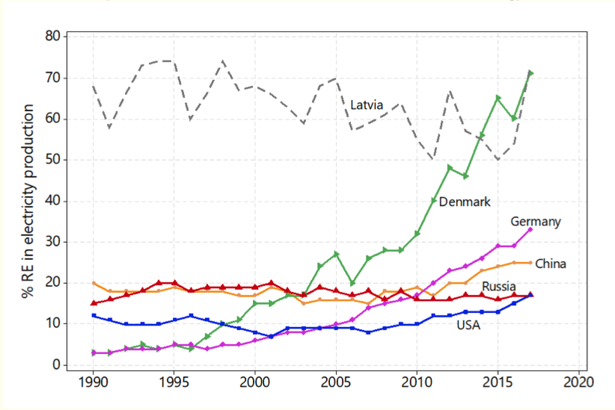

Slide 28
Case studies: Denmark

Slide 29
Case studies: Denmark
Denmark is one of the most
environmentally friendly energy producers in Europe
energy secure and sustainable countries among the OECD and the EU27 countries
Denmark has achieved a swift decrease of its dependence on foreign energy sources from above 90% in the 1970s to practically zero, and has become a net exporter of fuels and electricity
Core of Denmark’s successful approach: the commitment to energy efficiency, prolonged taxes on energy fuels, electricity, and carbon dioxide, and incentives and subsidies for Combined Heat and Power (CHP) and wind turbines
Denmark aims to go 100% renewable by 2050
Danish Government, 2011; Sovacool & Tambo, 2016

Slide 30
Case studies: germany

Slide 31
Case studies: Germany
Germany started from 3% of renewable energy το 33% in electricity production
Wind, 32.1%
Biomass, 28.8%
Hydro, 19.6%
Solar, 19.5%
Geothermal, <1%
The most successful country in the promotion of renewable energy
The best energy security performance among EU countries
Energiewende: the best-known renewable-based national energy policy.
Aims to:
Reduce greenhouse gas emissions by 80–95% in 2050 (compared to 1990)
Increase the renewable share of final energy to at least 60%
Increase the renewable share of electricity demands to 80%
Kopp, 2014; Hansen et al., 2019;
Agora Energiewende, 2019

Slide 32
Case studies china

Slide 33
Case studies: china
China has been producing more electricity from renewable energy than both Russia and the US, and it has increased its corresponding share of renewables since 2011
Hydro 86.7%
Wind 12.4%
Solar 0.6%
Biomass 0.3%
Geothermal 0.02%
China is the:
World’s largest energy consumer
Biggest emitter of greenhouse gases
Fifth largest producer of oil
Seventh largest producer of natural gas
Largest producer of coal
Liu, 2019; Yang et al., 2016; Zhang et al., 2017

Slide 34
Case studies: china
Aims to cut the share of coal in its power mix, but coal consumption is growing, and more coal-fired power projects are under development
Possesses the biggest amount of hydro resources globally, with a total theoretical hydropower potential of 694 GW
Studies:
“Role of renewable energy in China’s energy security and climate change mitigation: An index decomposition analysis” (Wang et al. 2018)
“China's renewable energy law and policy: A critical review” (Liu, 2019)

Slide 35
Cases studies: russia

Slide 36
Case studies: russia
Russia’s share of renewable energy in electricity production comes
Hydro 99.6%
Geothermal 0.3%
Biomass 0.03%
Wind 0.02%
Russia owns one of the largest fossil fuel resource stocks in the world and is the world’s fourth largest emitter (after China, the US and India)
Ηas the second largest natural gas reserves and production in the world (after the US)
Capacity-Based Renewable Energy Support Scheme (CRESS)
The energy security of Russia will remain linked to its natural gas deposits, while its ability to continue to supply it to the European and other markets will determine its position as an energy hegemon
Lanshina et al., 2018; Smeets, 2017

Slide 37
Case studies: USA

Slide 38
Case studies: usa
The US has been lingering around the 10% share of renewable energy in electricity production since 1990, and appears to have achieved a small increase since 2015
Hydro 55.5%
Wind 26.2%
Biomass 11.8%
Geothermal 3.7%
Solar 2.8%
In 2018, almost half of the global raise in natural gas (5.2%) came from the US, which (as with oil production) recorded the largest annual growth seen by any country in history
The US plans to achieve 80% renewable electricity by 2050
Αctions of the states rather than at a federal level
Bang, 2010; Greene, 2010; U.S. Chamber of Commerce, 2013

Slide 39
conclusions
Contrary to China and Russia, the EU and the US are expected to develop a diversified energy mix with the aid of scientific and technological developments
The EU will continue to improve renewables to limit its dependence on fossil fuel imports especially from Russia
The introduction of more renewable energy sources into the energy mix of countries will influence their energy security favourably
The global distribution of renewable energy sources is more evenly spread compared to fossil fuel
Renewable energy is more amenable to distributed production, which is inherently more secure than the fossil fuel paradigm
Renewable energy will help enter an era of energy democracy

Slide 40

Thank you for your attention
STAY HOME AND
WEAR YOUR
MASKS

Slide 41
References
Agora Energiewende, 2019. European Energy Transition 2030: The Big Picture. Ten Priorities for the next European Commission to meet the EU’s 2030 targets and accelerate towards 2050, available at: https://www.agora-energiewende.de/fileadmin2/Projekte/2019/EU_Big_Picture/153_EU-Big-Pic_WEB.pdf
Asia Pacific Energy Research Center (APERC), 2019. A Quest for Energy Security in the 21st Century: Resources and Constraints. Asia Pacific Energy Research Center, Japan, available at: http://aperc.ieej.or.jp/file/2010/9/26/APERC_2007_A_Quest_for_Energy_Security.pdf
Augutis J., Martišauskas L., Krikštolaitis R., Augutiene E., 2014. “Impact of the Renewable Energy Sources on the Energy Security”. Energy Procedia. Volume 61. pp. 945-948. DOI: 10.1016/j.egypro.2014.11.1001
British Petroleum, 2019. BP Statistical Review of World Energy. 68th ed.; June 2019, available at: https://www.bp.com/content/dam/bp/business-sites/en/global/corporate/pdfs/energy-economics/statistical-review/bp-stats-review-2019-full-report.pdf
Danish Government, 2011. “Energy Strategy 2011–From Coal, Oil and Gas to Green Energy”. Ministery of Climate and Energy, Copenhagen, available at: http://www.danishwaterforum.dk/activities/Climate%20change/Dansk_Energistrategi_2050_febr.2011.pdf
European Commission (EC), 2000. “Towards a European Strategy for the Security of Energy Supply”. Green Paper, Luxembourg: Office for Official Publications of the European Communities, available at: http://aei.pitt.edu/1184/1/enegy_supply_security_gp_COM_2000_769.pdf
Eurostat, 2013. “EU27 Energy Dependence Rate at 54% in 2011”. February 2013, available at: https://ec.europa.eu/eurostat/web/products-press-releases/-/8-13022013-BP
Hache E., 2018. “Do renewable energies improve energy security in the long run”? International Economics. Volume 156. pp. 127-135. DOI:
Harjanne A., Korhonen J.M., 2019. “Abandoning the concept of renewable energy”. Energy Policy. Volume 127. pp. 330-340. DOI: 10.1016/j.enpol.2018.12.029
Hazboun S.O., Briscoe M., Givens J., Krannich R., 2019. “Keep quiet on climate: Assessing public response to seven renewable energy frames in the Western United States”. Energy Research & Social Science. Volume 57. pp.101243. DOI: 10.1016/j.erss.2019.101243

Slide 42
References
International Energy Agency (IEA), 2003. “Renewables in Russia: From Opportunity to Reality”. Paris: IEA/OECD, available at: https://www.iea.org/publications/freepublications/publication/RenewRus_2003.pdf
International Energy Agency (IEA), 2007. “Energy Security and Climate Policy: Assessing Interactions”. Paris: IEA/OECD, available at: https://www.iea.org/publications/freepublications/publication/energy_security_climate_policy.pdf
International Energy Agency (IEA), 2011. “Measuring short-term energy security”. Paris: OECD/IEA, available at: https://www.iea.org/publications/freepublications/publication/Moses.pdf
International Renewable Energy Agency (IRENA), 2019. “Renewable Energy Statistics 2018”, available at: https://www.irena.org/-/media/Files/IRENA/Agency/Publication/2018/Jul/IRENA_Renewable_Energy_Statistics_2018.pdf
Liu J., 2019. “China's renewable energy law and policy: A critical review”. Renewable and Sustainable Energy Reviews. Volume 99. pp. 212-219. DOI: 10.1016/j.rser.2018.10.007
Marquina A., 2008. “The Southeast–Southwest European Energy Corridor”. In Energy Security: Visions from Asia and Europe, Marguina A. (ed.). Palgrave Macmillan, UK. ISBN: 978-0230595002
Overland I., 2019. “The geopolitics of renewable energy: Debunking four emerging myths”. Energy Research and Social Science. Volume 49. pp. 36-40. DOI: 10.1016/j.erss.2018.10.018
Proskuryakova L., 2018. “Updating energy security and environmental policy: Energy security theories revisited”. Journal of Environmental Management. Volume 223. pp. 203-214. DOI: 10.1016/j.jenvman.2018.06.016
Sovacool B.K., 2013. “An International Assessment of Energy Security Performance”. Ecological Economics. Volume 88. pp. 148-158. DOI: 10.1016/j.ecolecon.2013.01.019
Sovacool B.K., Tambo T., 2016. “Comparing Consumer Perceptions of Energy Security, Policy, and Low-Carbon Technology: Insights from Denmark”. Energy Research and Social Science. Volume 11. pp. 79-91. DOI: 10.1016/j.erss.2015.08.010

Slide 43
References
Sovacool B.K., Brown M.A., 2009. “Competing Dimensions of energy Security: An International Perspective”. Working Paper #45, Working Paper Series, Ivan Allen College, School of Public Policy, Georgia Tech, Atlanta: GA, available at: https://people.iac.gatech.edu/files/publication/394_wp45.pdf
Wang B., Wang Q., Wei Y-M., Li, Z-P., 2018. “Role of renewable energy in China’s energy security and climate change mitigation: An index decomposition analysis”. Renewable and Sustainable Energy Reviews. Volume 90. pp. 187-194. DOI: 10.1016/j.rser.2018.03.012
Yang X.J., Hu H., Tan T., Li J., 2016. “China’s renewable energy goals by 2050”. Environmental Development. Volume 20. pp. 83-90. DOI: 10.1016/j.envdev.2016.10.001
Yergin D., 1988. “Energy Security in the 1990s”. Foreign Affairs. Volume 67. No 1, pp. 110-132. DOI: 10.2307/20031912
Yergin D., 2006. “Ensuring Energy Security”. Foreign Affairs. Volume 85. No 2, pp. 69-82. DOI: 10.2307/20043677
Zhang L., Sovacool B.K., Ren J., & Ely A., 2017. “The Dragon awakens: Innovation, competition, and transition in the energy strategy of the People’s Republic of China, 1949–2017”. Energy Policy. Volume 108. pp. 634-644. DOI: 10.1016/j.enpol.2017.06.027

