Slide 1

A game theoretic analysis of energy security in the Eastern Mediterranean
Vasileios D. Papakostas
University of Piraeus
Elissavet E. Bekou
University of Piraeus
John A. Paravantis
University of Piraeus
September 2019

Slide 2
Introduction
Recent hydrocarbon discoveries in the Eastern Mediterranean have elevated energy to a major geopolitical concern and have heated up the relationship of Turkey with Cyprus and Greece.
Turkey conducts exploration and drilling operations violating the claimed Cypriot EEZ.
As Greece is expected to start exploration activities soon, Turkey’s reaction in possible scenarios of exclusion from the hydrocarbons game, may seriously affect the energy security of the region.

Slide 3
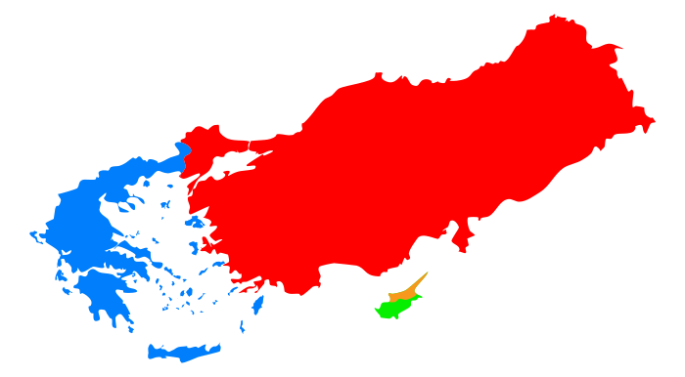
Aim
This paper investigates the energy security of the Eastern Mediterranean, analyzing the opposing interests of Turkey with Cyprus and Greece with game-theoretic tools.

Slide 4
Issues that Turkey faces in the Energy arena of Eastern Mediterranean
Escalation of tension with Greece
Violation of Cypriot EEZ
Tension towards Israel
Invasion of Syria
Aggravation with NATO
Approach with Russia – Iran
Kurdish Liberation War
Egypt’s continuous rise in the energy arena
Immigration/Refugee crisis
Libyan Civil War

Slide 5
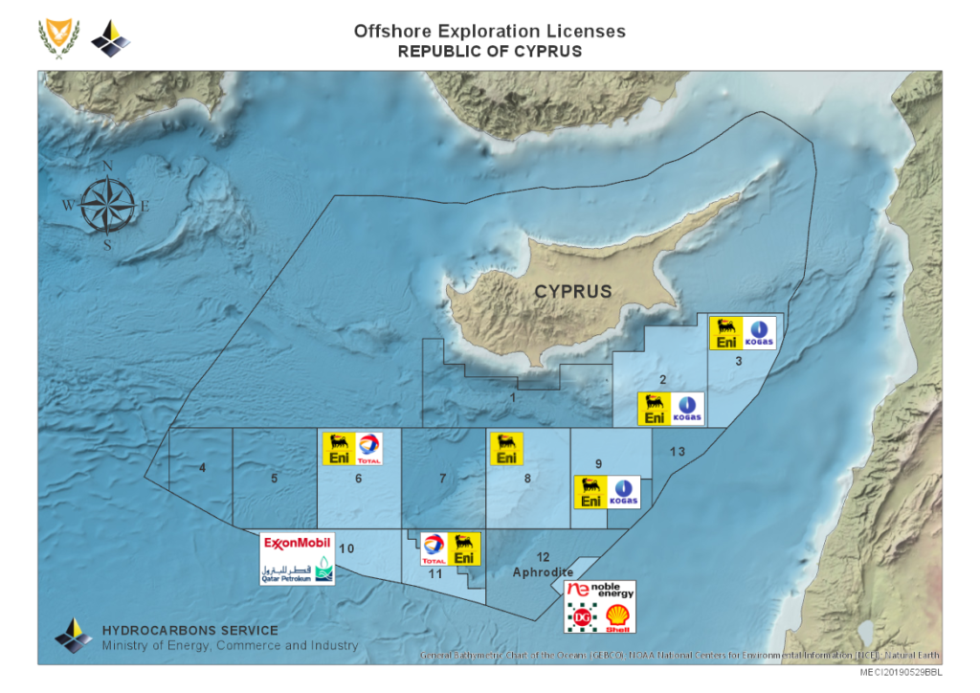
Current situation in Cyprus
Delimitation agreements with Egypt (2003), Lebanon (2007) and Israel (2010) based on the median line method
Cyprus has completed successfully three offshore licensing rounds

Slide 6
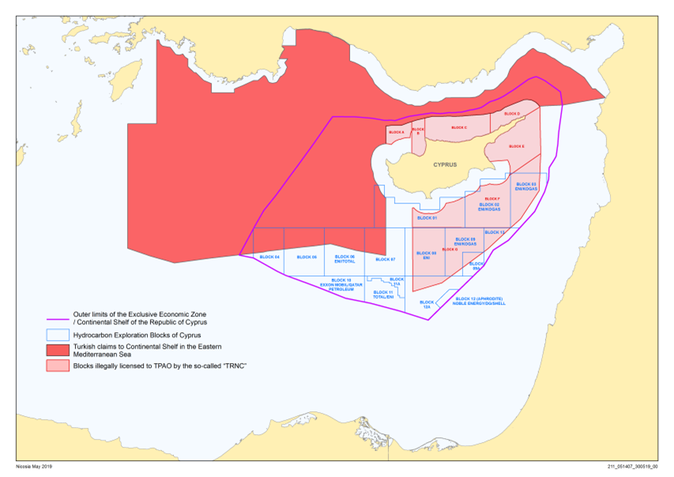
Current situation in Cyprus
Delimitation agreement between Turkey and TRNC
Attempts to sign agreements with Egypt failed
2011: issuance of exploration licenses to TPAO
2019: drilling ships and warships violate Cypriot claimed EEZ

Slide 7
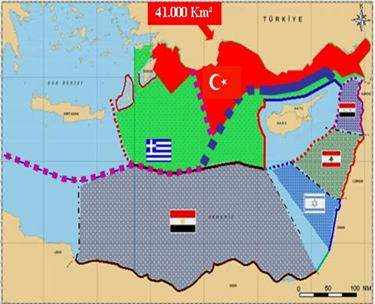
Description of the link between Cyprus and Aegean conflicts
Greece has not signed any delimitation agreement with littoral states in Aegean
Supposing that Greece signs delimitation agreements, Turkish naval routes to Mediterranean will be blocked and Turkey will be excluded from the hydrocarbon game in the area

Slide 8
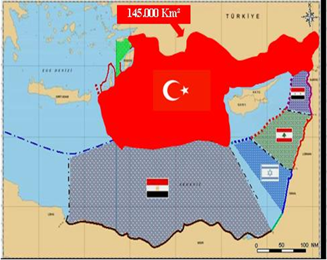
Description of the link between Cyprus and Aegean conflicts
Turkish main targets are to maintain open sea transport corridors and thwart exploration or exploitation of hydrocarbons by Greece and Cyprus
Turkey has not signed UNCLOS

Slide 9
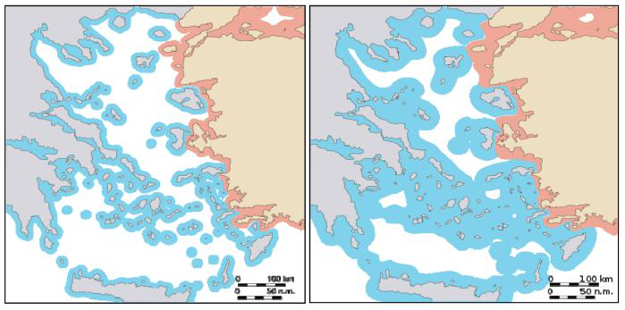
Description of the current and potential situation in Aegean Sea
Continental shelf concept was not foreseen in 1923 Lausanne Treaty
Invoking the International Law of the Sea, Greece claims the right to extend its territorial waters to 12 n.m. at any time

Slide 10
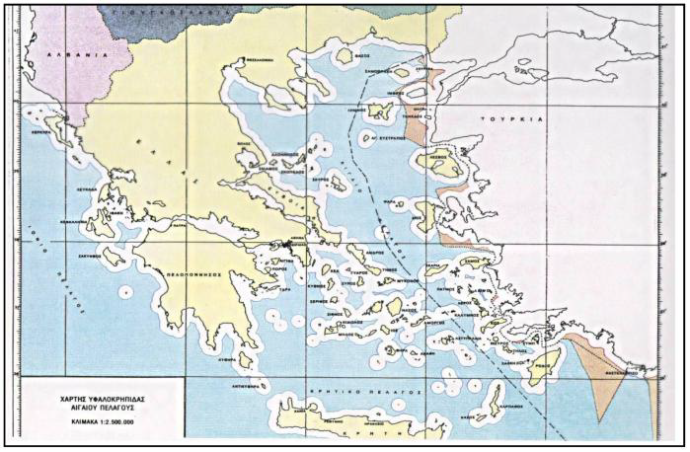
Description of the current and potential situation in Aegean Sea
Turkey contests Greece’s right on a casus belli issued by Turkish National Assembly on 1995
According to Turkey, Greek islands do not have rights to exert jurisdiction on the continental shelf, because they are located on the Turkish continental shelf

Slide 11
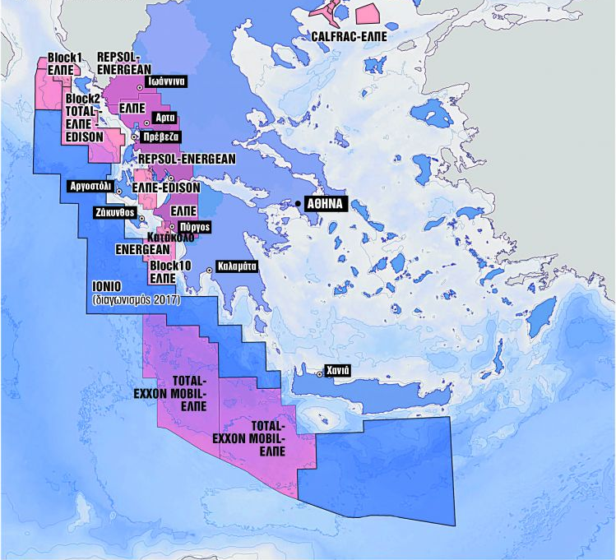
Description of the current and potential situation in Aegean Sea
2019: A joint venture of Exxon Mobil, Total and HELPE acquired licenses for oil and gas exploration and exploitation South of Crete
Turkey was alarmed

Slide 12
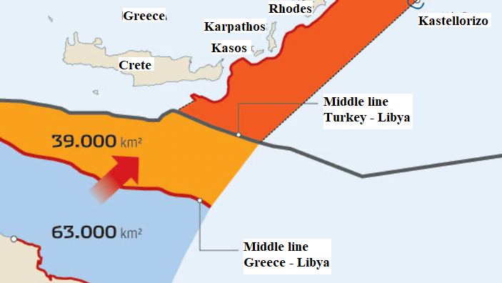
Description of the current and potential situation in Aegean Sea – Turkish Strategy
Turkey involved in the civil war in Libya trying to secure a delimitation agreement which will ignore Greek EEZ claims

Slide 13
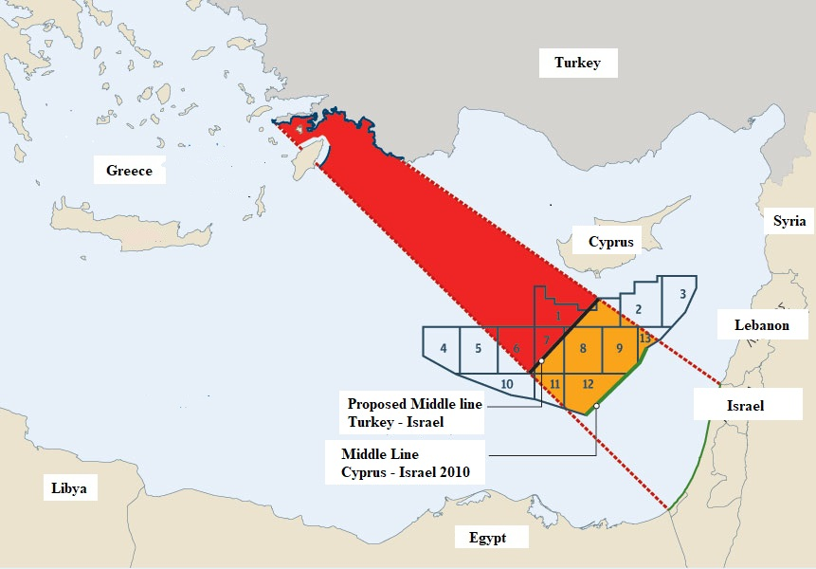
Turkish strategy

Slide 14
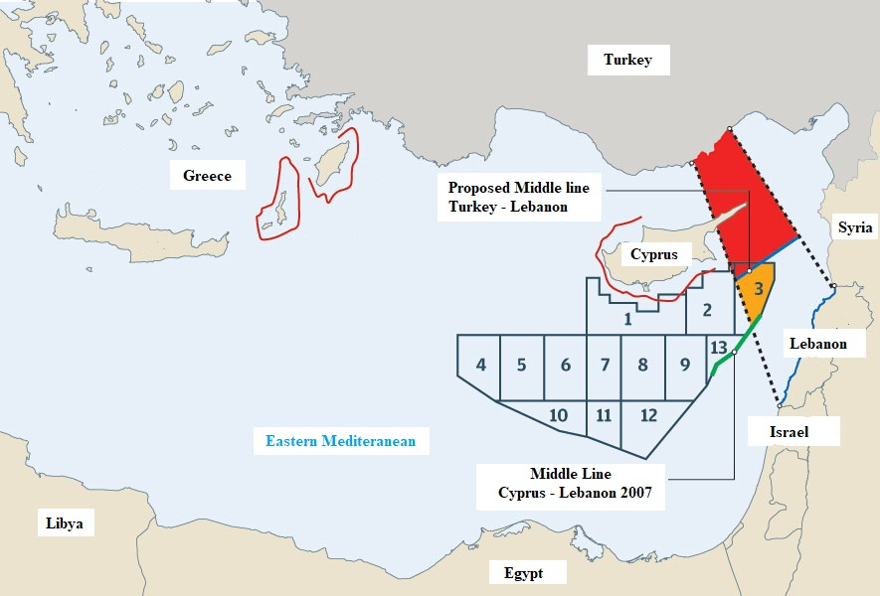
Turkish strategy

Slide 15
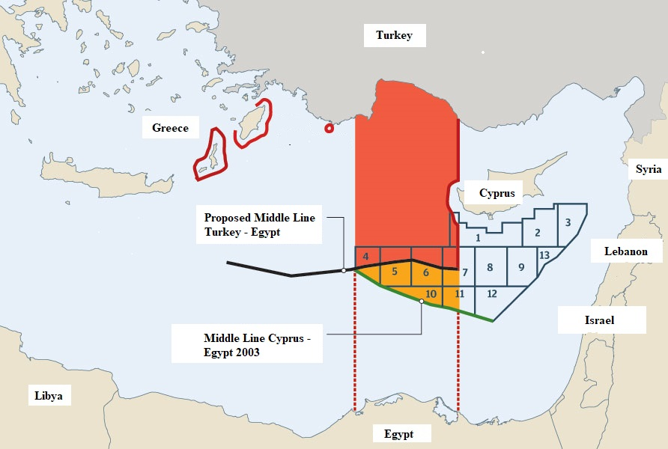
Turkish strategy

Slide 16
Background, Methodology and Strategies
Aggressive strategy
Submissive strategy
Optimum strategy of the weak player
Cyprus
A game of sequential moves between Cyprus, Turkey and Greece was set up.
A range of payoffs was investigated using sensitivity analysis.
Concerns related to the influence of other states were studied at a qualitative level.
Aggressive strategy
Pacifist strategy
Neutral strategy
Turkey
Aggressive strategy
Submissive strategy
Dispassionate strategy
Greece

Slide 17
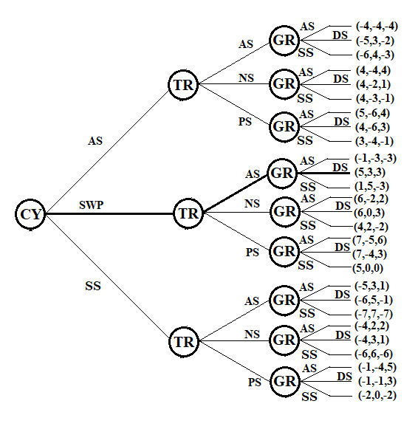
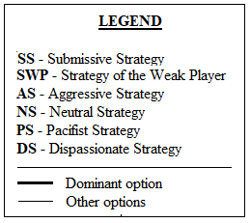
Game structure illustration

Slide 18
Results
It is confirmed that Cyprus is likely to follow the policy of a weak player in the absence of military might. Sealing agreements on a diplomatic and economic level with hydrocarbon companies backed by their corresponding states, will safeguard its national rights
Turkey is expected to follow an aggressive policy aiming at the disruption of oil and gas operations in Cyprus and the Aegean and bypassing Greek claims to help secure a share of the areas’ hydrocarbon resources
Greece is expected to follow a dispassionate strategy of both diplomacy and military deterrence
A full-scale war is unlikely

Slide 19
Conclusions
Turkey, Cyprus and Greece will continue to be entangled in an unusual sort of a chicken game where everyone understands that blinking is ultimately unavoidable
Turkey will likely manage to secure a part of the resource pie
Greece will likely maintain a dispassionate stance
Cyprus will strengthen its positions by diplomatic means bringing more countries into the game
War will be avoided

Slide 20
Limitations - Suggestions
Game theoretic models become exponentially unwieldy as more players and strategies are added, so external actors are treated qualitatively
Influence of players like NATO, EU, Russia, Iran and China should be taken into consideration
Situation regarding Syria, Libya, Kurds and Israel should be taken into consideration
The alliance between Greece – Cyprus and Israel should be taken into consideration

Slide 21

THANK YOU FOR YOUR ATTENTION
Vasileios D. Papakostas
va.papakostas@gmail.com
Elissavet E. Bekou
elisavet13bekou@gmail.com
Dr. John A. Paravantis
paravantis@gmail.com

