Slide 1

Inventory Management (II)
12
PowerPoint presentation to accompany
Heizer, Render, Munson
Operations Management, Twelfth Edition, Global Edition
Principles of Operations Management, Tenth Edition, Global Edition
PowerPoint slides by Jeff Heyl
Modified by Dr. N.P. Rachaniotis
Assistant Professor in Supply Chain Management
Department of Industrial Management & Technology, University of Piraeus

Slide 2
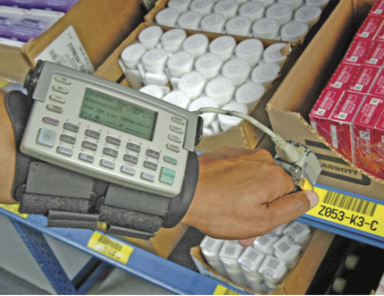
Record Accuracy
Accurate records are a
critical ingredient in
production and inventory
systems
  Periodic systems require
  regular checks of inventory
    Two-bin system
  Perpetual inventory tracks receipts and subtractions on a continuing basis
    May be semi-automated

Slide 3
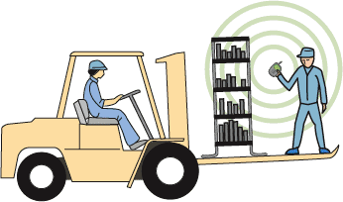
Record Accuracy
Incoming and outgoing
record keeping must be
accurate
Stockrooms should be secure
Necessary to make precise decisions about ordering, scheduling, and shipping

Slide 4
Control of Service Inventories
Can be a critical component of profitability
Losses may come from shrinkage or pilferage
Applicable techniques include
  Proper personnel selection, training and discipline
  Tight control of incoming shipments
  Effective control of all goods leaving facility

Slide 5
Holding Costs
TABLE 12.1 | Determining Inventory Holding Costs
CATEGORY |  | COST (AND RANGE) AS A PERCENT OF INVENTORY VALUE
Housing costs (building rent or depreciation, operating costs, taxes, insurance) |  |  | 6% (3 - 10%)
Material handling costs (equipment lease or depreciation, power, operating cost) |  |  | 3% (1 - 3.5%)
Labor cost (receiving, warehousing, security) |  |  | 3% (3 - 5%)
Investment costs (borrowing costs, taxes, and insurance on inventory) |  |  | 11% (6 - 24%)
Pilferage, space, and obsolescence (much higher in industries undergoing rapid change like tablets and smart phones) |  |  | 3% (2 - 5%)
Overall carrying cost |  |  | 26%

Slide 6
Holding Costs
TABLE 12.1 | Determining Inventory Holding Costs
CATEGORY |  | COST (AND RANGE) AS A PERCENT OF INVENTORY VALUE
Housing costs (building rent or depreciation, operating costs, taxes, insurance) |  |  | 6% (3 - 10%)
Material handling costs (equipment lease or depreciation, power, operating cost) |  |  | 3% (1 - 3.5%)
Labor cost (receiving, warehousing, security) |  |  | 3% (3 - 5%)
Investment costs (borrowing costs, taxes, and insurance on inventory) |  |  | 11% (6 - 24%)
Pilferage, space, and obsolescence (much higher in industries undergoing rapid change like PCs and cell phones) |  |  | 3% (2 - 5%)
Overall carrying cost |  |  | 26%
Holding costs vary considerably depending on the business, location, and interest rates. Generally greater than 15%, some high tech and fashion items have holding costs greater than 40%.

Slide 7
Inventory Models for Independent Demand
Need to determine when and how much to order
Basic economic order quantity (EOQ) model
Quantity discount model
Production order quantity model

Slide 8
EOQ is a Robust Model
The EOQ model is robust
It works even if all parameters and assumptions are not met
The total cost curve is relatively flat in the area of the EOQ

Slide 9
An EOQ Example
Determine optimal number of needles to order
D = 1,000 units Q*_{1,000} = 200 units
S = $10 per order T = 50 days
H = $.50 per unit per year
N = 5 orders/year
1,500 units
Q*_{1,500} = 244.9 units
Ordering previous Q*
Ordering new Q*

Slide 10
An EOQ Example
Determine optimal number of needles to order
D = 1,000 units Q*_{1,000} = 200 units
S = $10 per order T = 50 days
H = $.50 per unit per year
N = 5 orders/year
Only 2% less than the total cost of $125 when the order quantity was 200
1,500 units
Q*_{1,500} = 244.9 units
Ordering old Q*
Ordering new Q*

Slide 11
Quantity Discount Models
Reduced prices are often available when larger quantities are purchased
Trade-off is between reduced purchasing (product) cost and increased holding cost
Example: Chris Beehner Electronics stocks toy remote control flying drones. Recently, the store has been offered a quantity discount schedule for these drones. This quantity schedule was shown in Table 12.2 . Furthermore, setup cost is $200 per order, annual demand is 5,200 units, and annual inventory carrying charge as a percent of cost, I , is 28%. What order quantity will minimize the total inventory cost?
TABLE 12.2 | A Quantity Discount Schedule
PRICE RANGE |  | QUANTITY ORDERED | PRICE PER UNIT P
Initial price |  | 0 to 119 | $ 100
Discount price 1 |  | 200 to 1,499 | $ 98
Discount price 2 |  | 1,500 and over | $ 96

Slide 12
Quantity Discount Models
Total annual cost = Setup cost + Holding cost + Product cost
where Q = Quantity ordered P = Price per unit
D = Annual demand in units I = Holding cost per unit per year
S = Ordering or setup cost per order expressed as a percent of price P
Because unit price varies, holding cost is expressed as a percent (I) of unit price (P)

Slide 13
Quantity Discount Models
Steps in analyzing a quantity discount
Starting with the lowest possible purchase price, calculate Q* until the first feasible EOQ is found. This is a possible best order quantity, along with all price-break quantities for all lower prices.
Calculate the total annual cost for each possible order quantity determined in Step 1. Select the quantity that gives the lowest total cost.

Slide 14
Quantity Discount Models
Recall that in the basic EOQ model, the determination of the optimal order size does not involve the purchasing cost, since under the assumption of no quantity discounts, price per unit is the same for all order quantities.
When quantity discounts are offered, there is a separate U-shaped total-cost curve for each unit price.
Because the unit prices are different, each curve is raised by a different amount: a smaller unit price will raise the total cost curve less than a larger unit price.
No single curve applies to the entire range of quantities.
Each total cost curve has its local minimum.

Slide 15
Quantity Discount Models
Figure 12.7
Initial Price
Discount Price 1
Discount Price 2
550,000 –
TC for No Discount
540,000 –
TC for Discount 1
530,000 –
Annual Total Cost
Not Feasible
TC for Discount 2
520,053 –
517,155 –
Feasible
510,000 –
Not Feasible
Possible Order Quantities
500,000 –
120
Order Quantity
1,500

Slide 16
Quantity Discount Example
Calculate Q* for every discount starting with the lowest price
2(5,200)($200)
(.28)($96)
Q_{$96}* = = 278 drones/order
Infeasible – calculate Q* for next-higher price
2(5,200)($200)
(.28)($98)
Q_{$98}* = = 275 drones/order
Feasible

Slide 17
Quantity Discount Example
TABLE 12.3 |  | Total Cost Computations for Chris Beehner Electronics
ORDER QUANTITY | UNIT PRICE |  | ANNUAL ORDERING COST | ANNUAL HOLDING COST | ANNUAL PRODUCT COST | TOTAL ANNUAL COST
275 | $98 |  | $3,782 | $3,773 | $509,600 | $517,155
1,500 | $96 |  | $693 | $20,160 | $499,200 | $520,053
Choose the price and quantity that gives the lowest total cost
Buy 275 drones at $98 per unit

Slide 18
Quantity Discount Variations
All-units discount is the most popular form
Incremental quantity discounts apply only to those units purchased beyond the price break quantity
Fixed fees may encourage larger purchases
Aggregation over items or time
Truckload discounts, buy-one-get-one-free offers, one-time-only sales.

Slide 19
EOQ with Planned Shortages
Here the assumption that changes - in relation to the assumptions of the EOQ model - is that shortages are permissible to a certain extent. Demand is manifested when there is no stock and is met with delay when the new inventory batch (backordering) arrives. For each unit of product requested and not delivered directly due to shortage a cost of shortage B per unit of product and time unit is implied.
The system’s decision variables are the order quantity Q and the maximum allowable level of K (Stock out). The time evolution of the stock is illustrated in the next figure (negative inventory means pending demand).

Slide 20
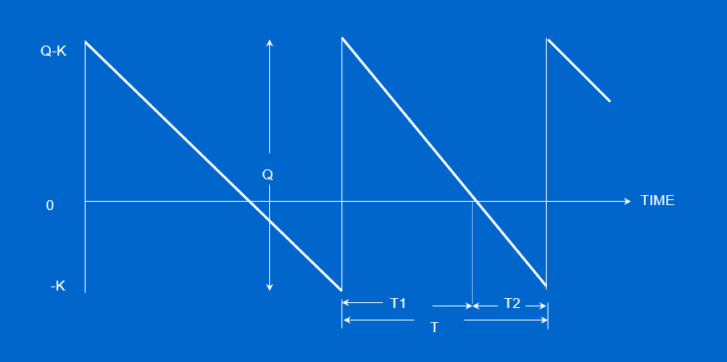
EOQ with Planned Shortages

Slide 21
EOQ For Planned Shortages
When the inventory level reaches – K then quantity Q arrives covering the demanded units and the inventory level reaches Q-K. The cycle time between two consecutive arrivals T is divided into two intervals: T1 (immediate demand coverage) and T2 (pending demand)
The total cost function that must be minimized is:

Slide 22
EOQ for Planned Shortages
The optimal order quantity that minimizes the total cost is:
The maximum level of unsatisfied demand is:

Slide 23
EOQ For Planned Shortages
The time interval that the inventory is positive is:
where d is daily demand
The time interval that the inventory is negative is:

Slide 24
Production Order Quantity Model
Used when inventory builds up over a period of time after an order is placed
Used when units are produced and sold simultaneously
Figure 12.6
Part of inventory cycle during which production (and usage) is taking place
Demand part of cycle with no production (only usage takes place)
Inventory level
Maximum inventory
t
Time

Slide 25
Assumptions
Only one item is involved
Annual demand is known
Usage rate is constant
Usage occurs continually, but production occurs periodically
Production rate is constant and Q is always the same
Lead time is not zero but does not vary (including elements that correspond to the idle production times for machine calibration, tool placement, study of the data for the production of the new batch, removal of the previous production batch parts, cleaning of the production area, etc.)
No quantity discounts

Slide 26
Production Order Quantity Model
Q = Number of units per order p = Daily production rate
H = Holding cost per unit per year d = Daily demand/usage rate
t = Length of the production run in days
Annual inventory holding cost
= (Average inventory level) x
Holding cost
per unit per year
Annual inventory level
= (Maximum inventory level)/2
Maximum inventory level
Total produced during the production run
Total used during the production run
= –
= pt – dt

Slide 27
Production Order Quantity Model
Q = Number of units per order p = Daily production rate
H = Holding cost per unit per year d = Daily demand/usage rate
t = Length of the production run in days
Maximum inventory level
Total produced during the production run
Total used during the production run
= –
= pt – dt
However, Q = total produced = pt ; thus t = Q/p
Maximum inventory level
Q
p
Q
p
d
p
= p – d = Q 1 –
Maximum inventory level
2
Q
2
d
p
Holding cost = (H) = 1 – H

Slide 28
Production Order Quantity Model
Q = Number of units per order p = Daily production rate
H = Holding cost per unit per year d = Daily demand/usage rate
t = Length of the production run in days

Slide 29
Production Order Quantity Example
D = 1,000 units p = 8 units per day
S = $10 d = 4 units per day
H = $0.50 per unit per year

Slide 30
Production Order Quantity Example
Note:
D
Number of days the plant is in operation
1,000
250
d = 4 = =
When annual data are used the equation becomes:

Slide 31
Production Order Quantity Example II
A toy manufacturer uses 48,000 rubber wheels per year for its popular dump truck series. The firm makes its own wheels, which can produce at a rate of 800 per day. The toy trucks are assembled uniformly over the entire year. Carrying cost is $1 per wheel a year. Setup cost for a production run of wheels is $45. The firm operates 240 days per year. Determine the
Optimal run size
Minimum total annual cost for carrying and setup
Run time

Slide 32
Solution
D = 48000 wheels per year
S = $45
H = $1 per wheel per year
P = 800 wheels per day
U = 48000 wheels per 240 days, or 200 wheels per day

Slide 33
Solution

Slide 34
Άσκηση 3 (Παππής, 2006, σελ. 140)
Μία μικρή εταιρεία παράγει μία ηλεκτρονική συσκευή που χρησιμοποιείται σε συστήματα πλοήγησης αεροσκαφών. Η ζήτηση βασίζεται σε παραγγελίες μέσω συμβολαίων για αεροσκάφη και είναι γνωστό ότι είναι ομοιόμορφη και με ρυθμό 6,400 μονάδες ετησίως. Ένα βολτόμετρο που χρησιμοποιείται σε αυτήν την συσκευή μπορεί να παραχθεί από την εταιρεία με ρυθμό 128 μονάδες ημερησίως. Το έτος έχει 250 εργάσιμες ημέρες. Το κόστος ετοιμασίας κάθε παρτίδας παραγωγής είναι 24 ευρώ, και το κόστος αποθήκευσης είναι 3 ευρώ ανά μονάδα προϊόντος ετησίως. Ζητείται η βέλτιστη πολιτική αποθεματοποίησης για αυτό το προϊόν.

Slide 35
Άσκηση 3
Λύση: Το βέλτιστο μέγεθος της παρτίδας παραγωγής είναι
Q*= [2DS/H(1-d/p)]^{1/2}=[2x24x6,400/3x(1-6,400/(128x250))]^{1/2}=358 μονάδες.
Ο χρόνος τοποθέτησης κάθε παρτίδας παραγωγής είναι
Cycle=Q*/d=358/6,400=0.056 χρόνια=0.056x250=14 εργάσιμες ημέρες.
Ο χρόνος που απαιτείται για την παραγωγή μίας παρτίδας είναι
Run= Q*/p=358/128=2.8 εργάσιμες ημέρες.
To ελάχιστο κόστος που αντιστοιχεί σε αυτό το μέγεθος παρτίδας είναι
C_{total}^{min}=[2SHD(1-d/p)]^{1/2}=[2x24x3x6,400(1-6400/(128x250))]^{1/2}=858.65 ευρώ/χρόνο.

Slide 36
Άσκηση 4 (Παππής 2006, σελ. 141)
Υποθέστε ότι η εταιρεία στην προηγούμενη άσκηση διακόπτει την παραγωγή βολτομέτρων και τα παραγγέλλει από έναν εξωτερικό προμηθευτή με κόστος 20 ευρώ ανά μονάδα προϊόντος. Το κόστος έλλειψης είναι 40 ευρώ ανά μονάδα προϊόντος ετησίως εξαιτίας της επιπρόσθετης εργασίας που απαιτείται για την αποσυναρμολόγηση των μερικώς ολοκληρωμένων συσκευών. Το κόστος παραγγελίας είναι 27 ευρώ, και το κόστος αποθήκευσης υπολογίζεται στο 30% του επενδυμένου κεφαλαίου. Η διοίκηση επιθυμεί να γνωρίζει τις προκύπτουσες αλλαγές στην πολιτική αναπλήρωσης του αποθέματος των βολτομέτρων.

Slide 37
Άσκηση 4
Λύση: Η βέλτιστη ποσότητα παραγγελίας είναι η
Q*=(2SD/H)^{1/2}[(B+H)/B]^{1/2}=(2x27x6,400/0.3x20)^{1/2}((40+0.3x20)/(40))^{1/2}=258 μονάδες
Το μέγιστο επίπεδο αποθέματος είναι
Ι_{max}=Q*-K*=(2SD/H)^{1/2}[B/(B+H)]^{1/2}=(2x27x6,400/0.3x20)^{1/2}(40/(40+0.3x20))^{1/2}= 224 μονάδες.
Ο χρόνος τοποθέτησης αναπαραγγελίας είναι
T=Q*/d=258/6,400=0.04 χρόνια=0.04x250=10 εργάσιμες ημέρες.
Η ποσότητα της ζήτησης που δεν καλύπτεται σε κάθε κύκλο ισούται με
K*=Q*-I_{max}=258-224=34 μονάδες.

